Slide 1




Modern Web Application Development in Angular
History in brief

Slide 2
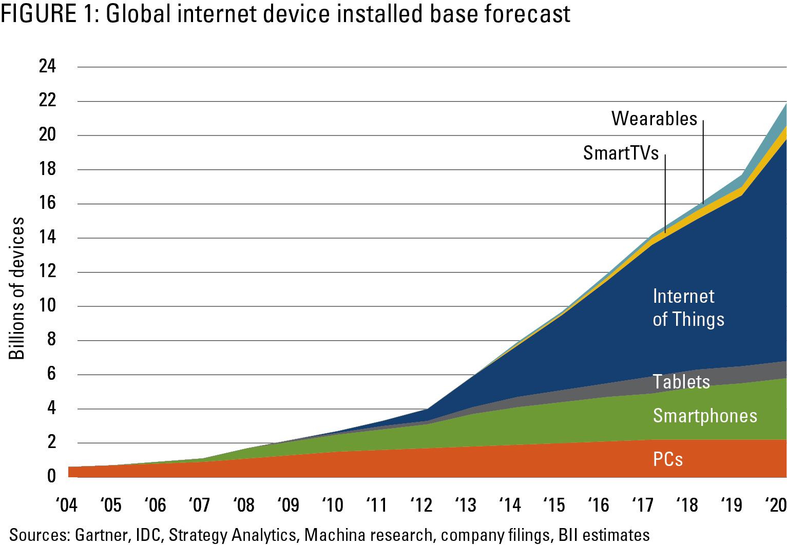

From PC to Device

Slide 3
Client-Server Application History
Client-Server architecture
Server Side Rendering (SSR)
Ajax (Asynchronous JavaScript and XML) / RIA (Rich Internet Application)
Web Services / Web API
Single Page Application
Progressive Web App
SSR / PC
CSR / Device

Slide 4
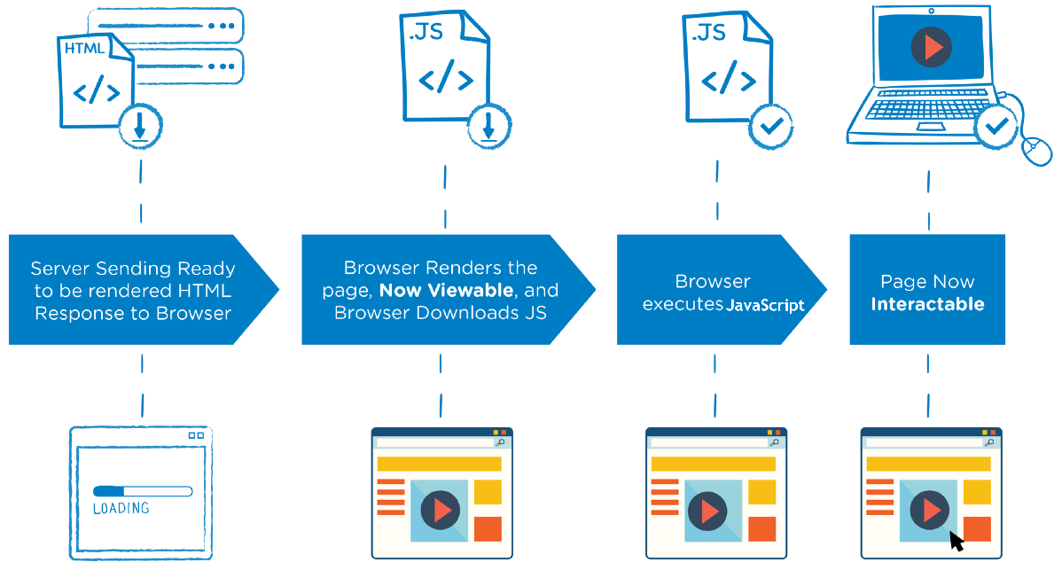
Server Side Rendering

Slide 5
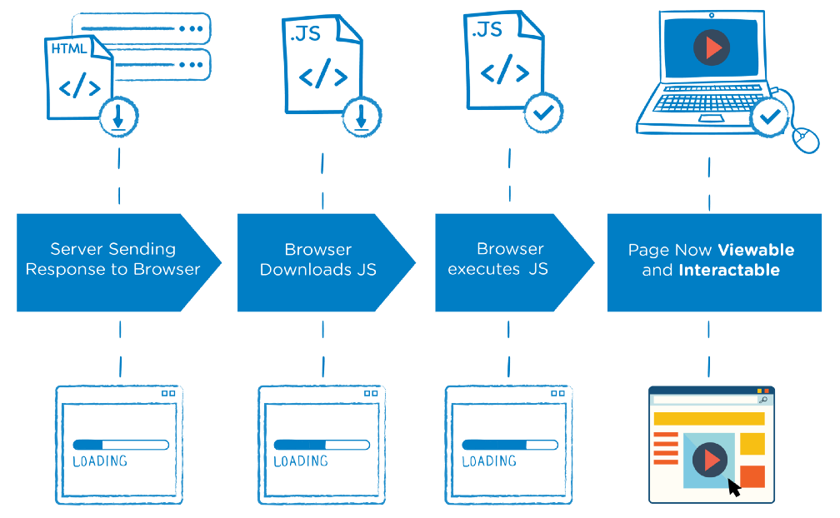
Client Side Rendering

Slide 6
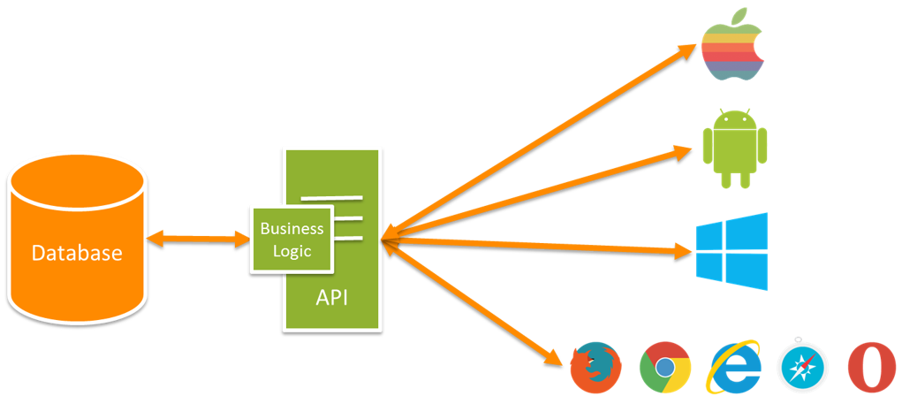
One API for multiple devices

