Slide 1




Modern Web Application Development in Angular
Repository

Slide 2
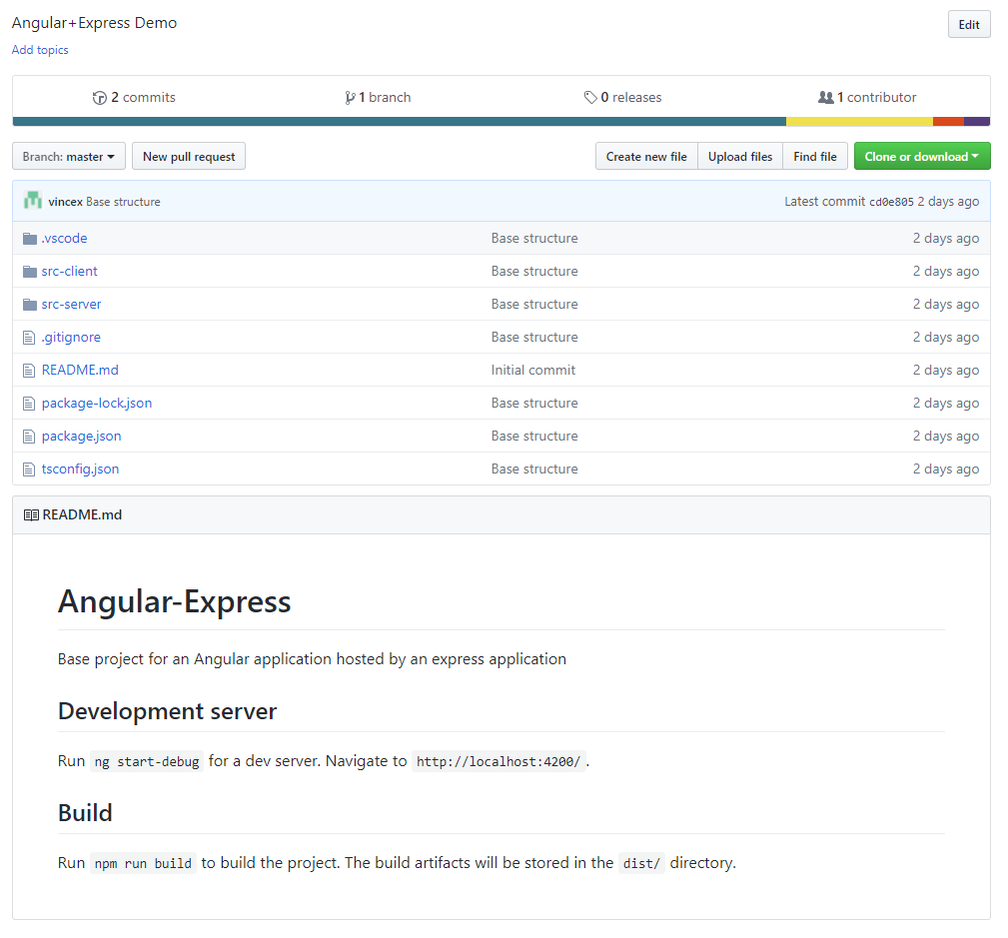

GITHUB
https://github.com/vincex/angular-express

Slide 3
Repository checkout in vscode
Ctrl + shift + P
>Git: clone
https://github.com/vincex/angular-express.git
Path to local folder

