Slide 1
Decision Tree Classifier with GA-based Feature Selection
Samir Sheriff and Satvik N
Under the guidance of
Mrs. Shantha Rangaswamy

Slide 2
Abstract
Machine Learning techniques have been applied to the field of classification for more than a decade.
The input data to classifiers is an extremely large set of features, but not all of features are relevant to the classes to be classified. Hence, the learner must generalize from the given examples in order to produce a useful output in new cases.
In this mini-project, We wish to solve the classification problem using a Decision Tree based Classifier and optimize it using a Genetic Algorithm for feature selection.

Slide 3
Introduction – Classification Problem
Classification is the task of assigning objects/samples to one of the predefined classes. In this mini-project we wish to solve/automate the problem of classifying the water samples as portable or non-portable considering the various features of the water.
It is a pervasive problem that encompases many diverse applications.
Examples:
Classifying emails as spam or not.
Classifying the cancerous cells as malignant or benign.
Classification of water samples as potable or not.
Classification of Blood samples into various blood groups.

Slide 4
Decision Tree Classifiers
Decision tree learning/classification is a method commonly used in data mining. The goal is to create a model that predicts the value of a target variable (classificaiton class) based on several input variables(Feature Values).
C4.5 is an algorithm used to generate a decision tree developed by Ross Quinlan.
A decision tree is made of decision nodes and leaf nodes. Each decision node corresponds to a test X over a single attribute of the input data and has a number of branches, each of which handles an outcome of the test X. Each leaf node represents a class that is the result of decision for a case.

Slide 5
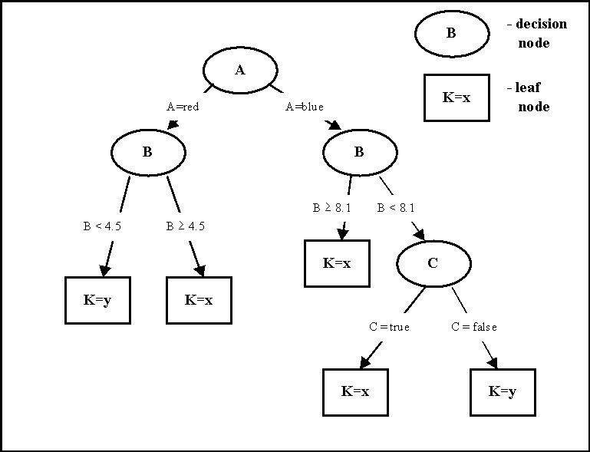
Example of a Decision Tree Classifier

Slide 6
Introduction Genetic Algorithms
Genetic Algorithms (GAs) have been successfully applied to solve search and optimization problems. The basic idea of a GA is to search a population of solutions to find the best solution. A pool of initial solutions called a population is randomly generated and each solution is evaluated with a fitness function.
A GA generally has four components.
Population
Fitness function
Selection function
Genetic operators such as mutation and crossover.

Slide 7
The following is a typical GA procedure:
Procedure GA Begin
Initialize population;
Evaluate population members;
While termination condition not satisfied do
Begin Select fittest parents from current population;
selected parents crossover to produce offspring;
Evaluate offspring;
Add offspring to current population;
End
End

Slide 8
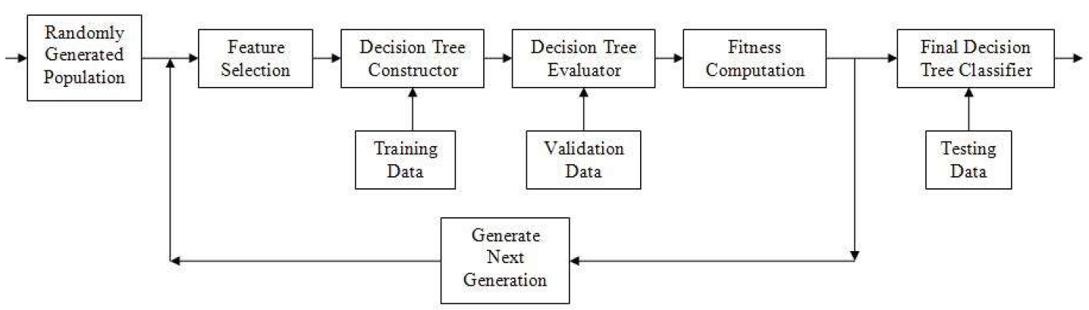
DTs with GA based Feature Selection
A randomly selected population of genomes indicating the features to be used for DTs is taken and using the selected features , the DT is constructed (using training data).
The Decision Tree constructed is evaluated using the validation data sets.
The accuracy of the DT constructed gives the fitness for the selected genome.
Accuracy of the DT is (1-miss_classification)/(total_no_of_classification).

Slide 9

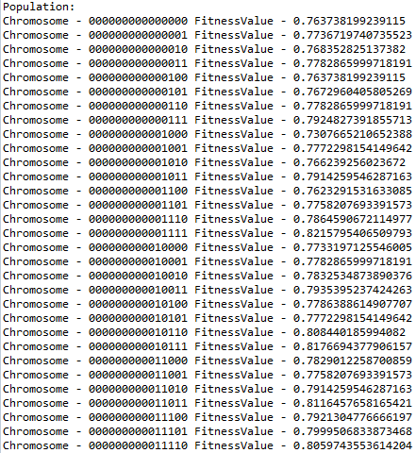
Step by Step execution of the DT-GA based Algorithm
Step 1
Initial Selection of the Population – A collection of bit strings (genomes) are selected indicating the features to be selected while building the DT.
This indicates that the features corresponding the bit value 1 are used while building the decision tree.
The fitness value of the chromosome is indicated by the accuracy of the corresponding DT built.

Slide 10
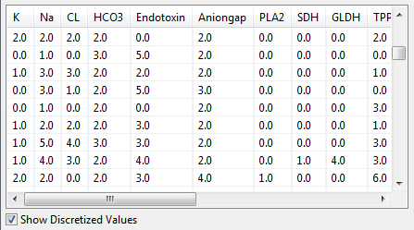
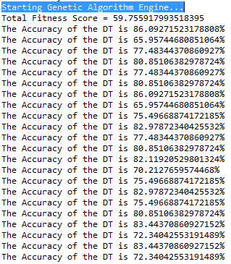
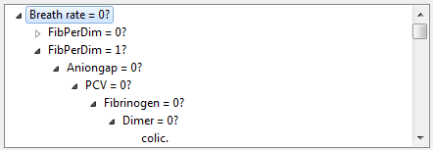
Step 2 Building the Decision Tree
The decision Tree is constructed recursively using the given training samples and the list of features to be used.
Since most of the feature values are continuous, the values are discretized first using one of the following two algorithms:
Equal Binning
Discretization based on the Median.
A decision tree built for the Horse Dataset after discretization

Slide 11
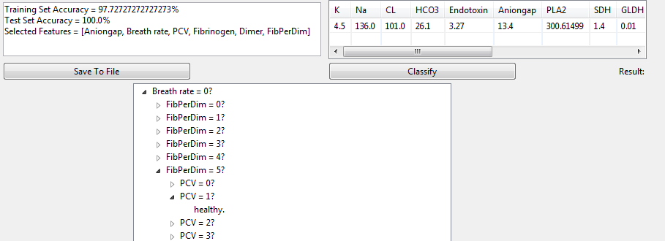
Step 3 Evaluation of the Decision Tree
The Classification is found out for each of the sample in the validation/test set by traversing the decision tree.
The class obtained by the Decision Tree and the actual classification of the validation set are compared.
The accuracy of the decision tree is computed as follows:
Efficiency =
(1-miss _ classification)/(total_no_of_samples)
The fitness values of the chromosome is set as the efficiency of the DT.

Slide 12
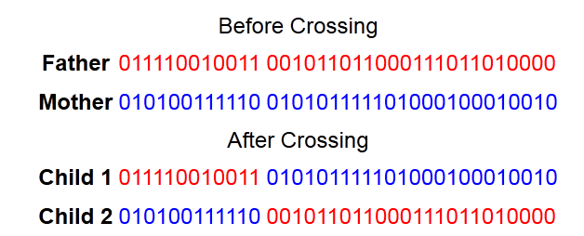
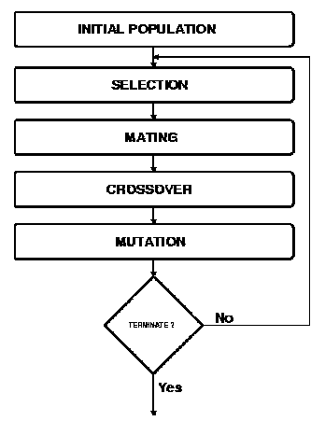
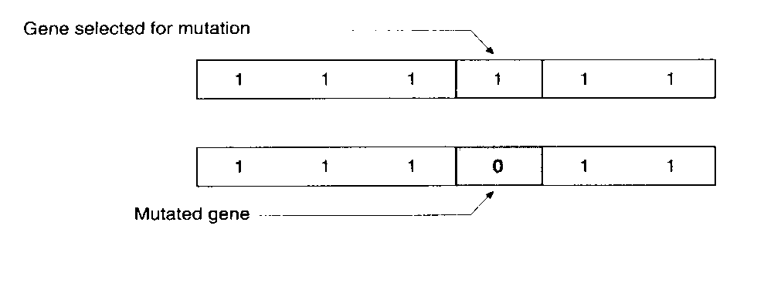
Step 4 Going to the next Generation
Depending on the fitness values of the chromosomes, two chromosomes are chosen based on roulette selection and the genetic algorithm operation crossover is applied.
Crossover
Mutation of the offspring after crossover.
The offspring Is added to the population of the next generation
The genetic algorithm is run for multiple generations and till the DT of required accuracy is found.

Slide 13
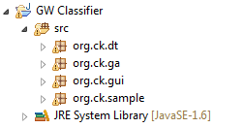
Implementation
This project has been implemented in Java.
Java SWT was used to develop the GUI.
Package – There are four main packages in this project.
Decision Trees – org.ck.dt
Genetic Algorithms – org.ck.ga
GUI – org.ck.gui
Samples – org.ck.sample

Slide 14

Decision Tree Package org.ck.dt
This package contains all the java files necessary to build a Decision Tree classifier.
Important Java Classes are :
Decision Tree Classifier – An object of this class contains an object of DTConstructor class.
Decision Tree Constructor- This class contains methods needed to construct a decision tree for a given samples.
Decision Tree Node – The object of this class represents a decision tree node either an internal or external (leaf) node.
Discretizer – This class is used to convert the real feature values of the samples to discrete values. It is very difficult to construct a DT with continuous or real feature values.

Slide 15

Genetic Algorithm Package org.ck.ga
This package contains all the necessary files required for the operation of the genetic algorithm.
Important Java Files are
Decision Tree Optimizer – This class acts as a middle man between the DTs and GA. It contains methods to maintain the flow of execution of the DT with GAs.
Genome – Represents a binary string of all the features for the current sample. A 1 in the string corresponds to the feature being used while constructing the decision tree or vice versa. It also contains a fitness value for the genome (the accuracy of the DT) used in the GA.
Population – It represents an array of genomes used in the GA. It contains methods to crossover, mutate and others required for the operation of the GA.
Optimal Score Exception – This exception is thrown when a DT of required accuracy has been found.

Slide 16
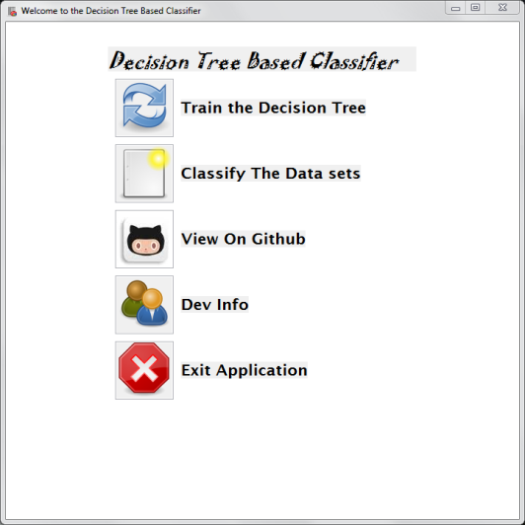
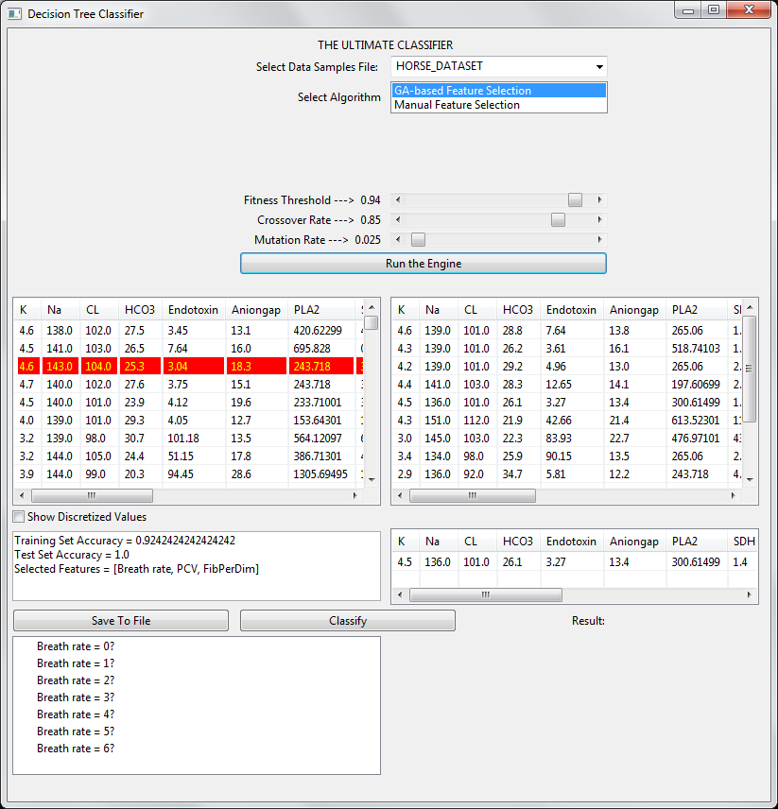
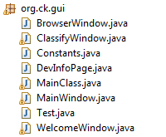
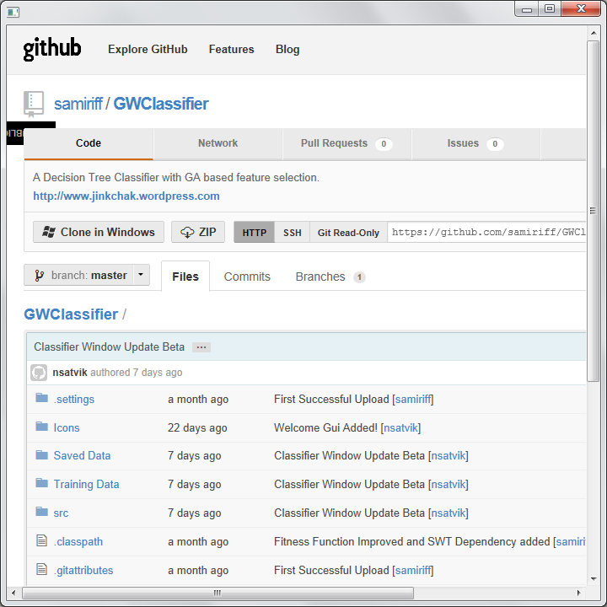
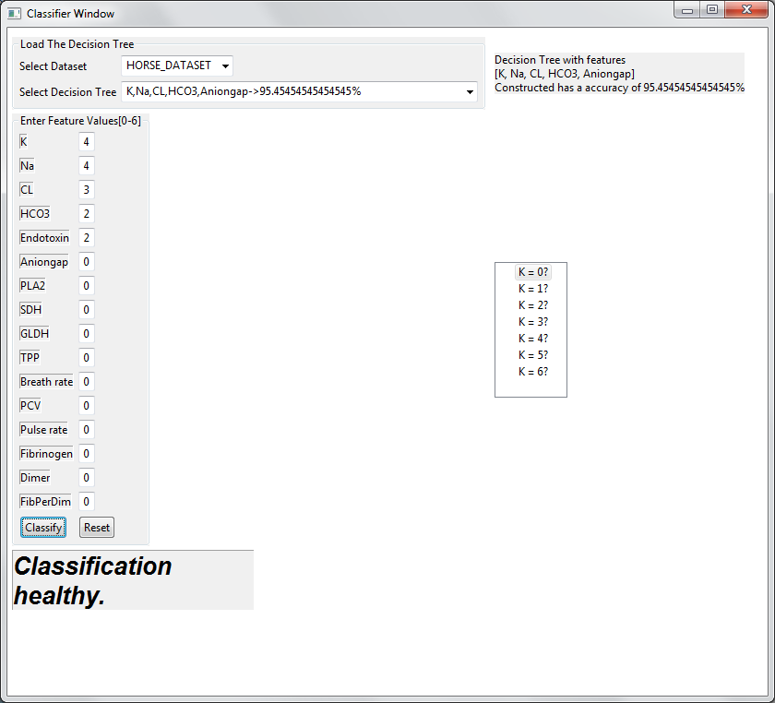
GUI package org.ck.gui
This package contains the definitions of all the classes required for the GUI.

Slide 17
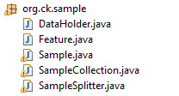
Sample Package org.ck.sample
This package contains java classes required for managing the sample files.
Important Java classes are :
Data Holder – This class keeps track of names of les that contain training and testing samples; lists of features; their corresponding classification values; and Probability values.
Feature – This class stores a mapping between a feature name and a feature value.
Sample – This class stores all the features and the corresponding classification value for one training/test sample only.
Sample Collection – A collection of objects of Sample class
Sample Splitter - This class contains methods that operate on a given SampleCollection, in order to split it into two new SampleCollections, based on a given Feature.

Slide 18

Demo

Slide 19
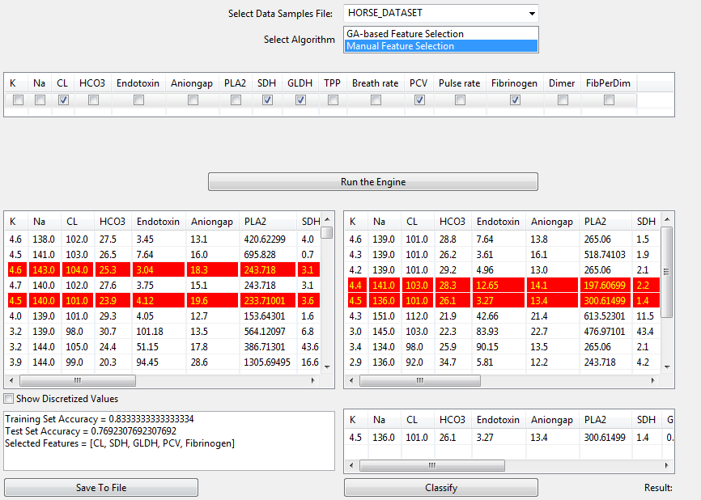
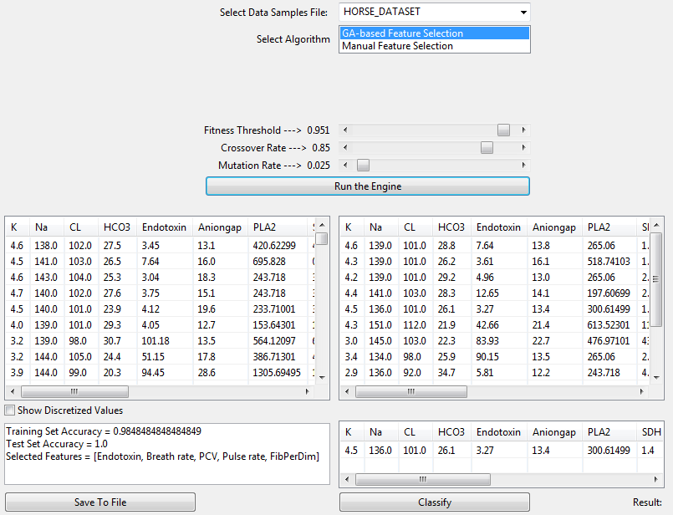
Results
In this mini project, we were able to successfully implement and test the performance of Decision Tree-based classifiers.
GA-based Feature Selection
Manual Feature Selection

Slide 20
Conclusion
This mini-project mainly concentrated on classifying the ground-water samples as potable or not.
With the generic Object Oriented Class design, two other classification problems were addressed:
Classifying/Determining the quality of whine
Classifying the Horse as healthy or colic.
The test results show that the Decision Trees constructed using the Genetic algorithm-based feature selector, were more efficient and accurate in classifying the data than the Decision Trees constructed by selecting features manually.

Slide 21
Future Work
The application could be made more responsive by using Threads.
Genetic Algorithms can be applied by representing a DT as a genome instead of the features.
The Decision Tree Classier built in this application could be optimized using Neural Networks which are more efficient than Genetic Algorithms.
An interesting extension to be explored is the possibility of additional feedback from ID3 concerning the evaluation of a feature set.

Slide 22
References
Genetic Algorithms - http://en.wikipedia.org/wiki/Genetic_algorithm
Genetic Algorithm for constructing DT http://www.jprr.org/index.php/jprr/article/viewFile/44/25
Decision Trees - http://web.cecs.pdx.edu/~mm/MachineLearningWinter2010/pdfslides/DecisionTrees.pdf
Project brief for the DT using Horse data sets - -https://cs.uwaterloo.ca/~ppoupart/teaching/cs486-spring06/assignments/asst4/asst4.pdf
Supervised and Unsupervised Discretization of Continous Features - http://robotics.stanford.edu/users/sahami/papers-dir/disc.pdf
Hybrid learning using Genetic Algorithms and Decision Trees for pattern classification - http://cs.gmu.edu/~eclab/papers/ijcai95.pdf
Kardi Tutorials on DTs- http://people.revoledu.com/kardi/tutorial/DecisionTree/index.html

Slide 23
Questions?

Slide 24
Thank You ☺
Source code available at https://www.github.com/samiriff/GWClassifier
© Samir and Satvik of Code Kshetra Inc.
All Rights Reserved.

