Slide 1
Decision Tree Classifier with GA-based Feature Selection
Samir Sheriff and Satvik N,
under the guidance of
Mrs. Shantha Rangaswamy

Slide 2
Abstract
In this mini-project, we wish to solve the classification problem using a Decision Tree based Classifier and optimize it using a Genetic Algorithm for feature selection.
Machine Learning techniques have been applied to the field of classification for more than a decade.
Input = Large Data set with large feature set
DT/GA Classifier
Generalized Classifier based on a subset of features

Slide 3
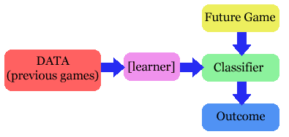
Introduction – Classification Problem
Future Sample
Past Data Samples
Classification - the task of assigning objects/samples to one of many predefined classes.
In this mini-project we wish to solve/automate the problem of classifying the water samples as portable or non-portable considering the various features of the water.
Examples:
Classifying emails as spam or not.
Classifying cancerous cells as malignant or benign.
Classification of water samples as potable or not.
Classification of Blood samples into various blood groups.

Slide 4
Decision Tree Classifiers
ID3 is an algorithm used to generate a decision tree developed by Ross Quinlan.
Decision tree learning/classification is a method commonly used in data mining.
A decision tree is made of decision nodes and leaf nodes. Each decision node corresponds to a test X over a single attribute of the input data and has a number of branches, each of which handles an outcome of the test X. Each leaf node represents a class that is the result of decision for a case.
The goal is to create a model that predicts the value of a target variable (classificaiton class) based on several input variables(Feature Values).

Slide 5
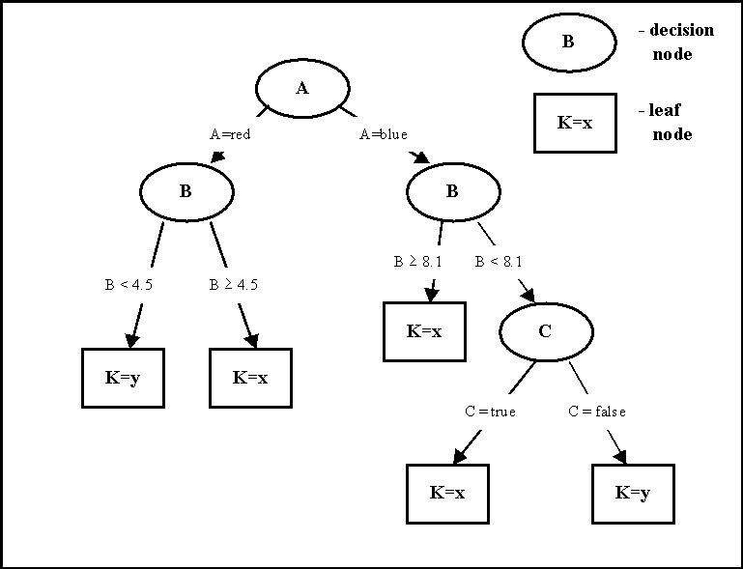
Example of a Decision Tree Classifier

Slide 6
Decision Tree Construction
F = 7
(1) Which to start? (root)
No
Yes
Potable
pH = 7
(2) Which node to proceed?
No
Yes
Not Potable
Potable
(3) When to stop/ come to conclusion?

Slide 7
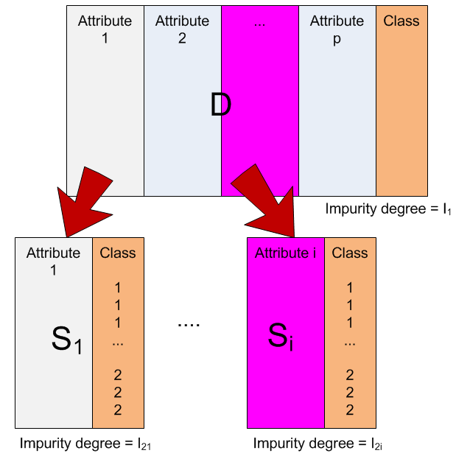
Selection of an attribute to test at each node
Choosing the most useful attribute for classifying examples.
Information gain
measures how well a given attribute separates the training examples according to their target classification
This measure is used to select among the candidate attributes at each step while growing the tree

Slide 8
Entropy
A measure of homogeneity of the set of examples.
Given a set S of positive and negative examples of some target concept (a 2-class problem), the entropy of set S relative to this binary classification is E(S) = - p(P)log₂ p(P) – p(N)log₂ p(N)
Suppose S has 25 examples, 15 positive and 10 negatives [15+, 10-]. Then the entropy of S relative to this classification is E(S)=-(15/25) log2(15/25) - (10/25) log2 (10/25)
The entropy is 0 if the outcome is ``certain’’.
The entropy is maximum if we have no knowledge of the system (or any outcome is equally possible).
Entropy of a 2-class problem with regard to the portion of one of the two groups

Slide 9
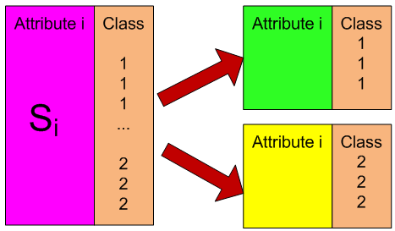
Information Gain
Information gain measures the expected reduction in entropy, or uncertainty, i.e., the difference of impurity degrees before the table is split and the impurity degree after the table is split.
Values(A) is the set of all possible values for attribute A, and Sv the subset of S for which attribute A has value v Sv = {s in S | A(s) = v}.
the first term in the equation for Gain is just the entropy of the original collection S
the second term is the expected value of the entropy after S is partitioned using attribute A

Slide 10
An Example for Information Gain Calculation
Using the ``when’’ attribute, divide into 3 subsets
Entropy of the first set H(5pm) = - 1/4 log(1/4) - 3/4 log(3/4);
Entropy of the second set H(7pm) = - 9/12 log(9/12) - 3/12 log(3/12);
Entropy of the second set H(9pm) = - 0/4 log(0/4) - 4/4 log(4/4) = 0
Expected entropy after partitioning
4/20 * H(1/4, 3/4) + 12/20 * H(9/12, 3/12) + 4/20 * H(0/4, 4/4) = 0.65
Information gain 1-0.65 = 0.35

Slide 11
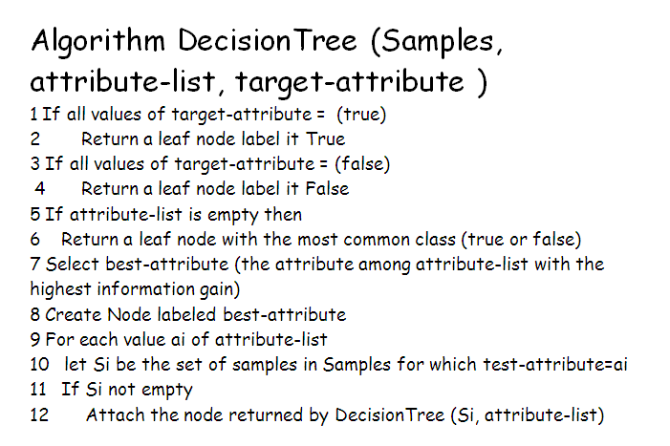
The Decision Tree Algorithm

Slide 12
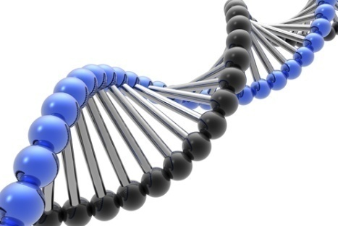
Introduction Genetic Algorithms
Genetic Algorithms (GAs) have been successfully applied to solve search and optimization problems.
A GA generally has four components.
The basic idea of a GA is to search a population of solutions to find the best solution.
A pool of initial solutions called a population is randomly generated and each solution is evaluated with a fitness function.
Population
Fitness function
Selection function
Genetic operators such as mutation and crossover.

Slide 13
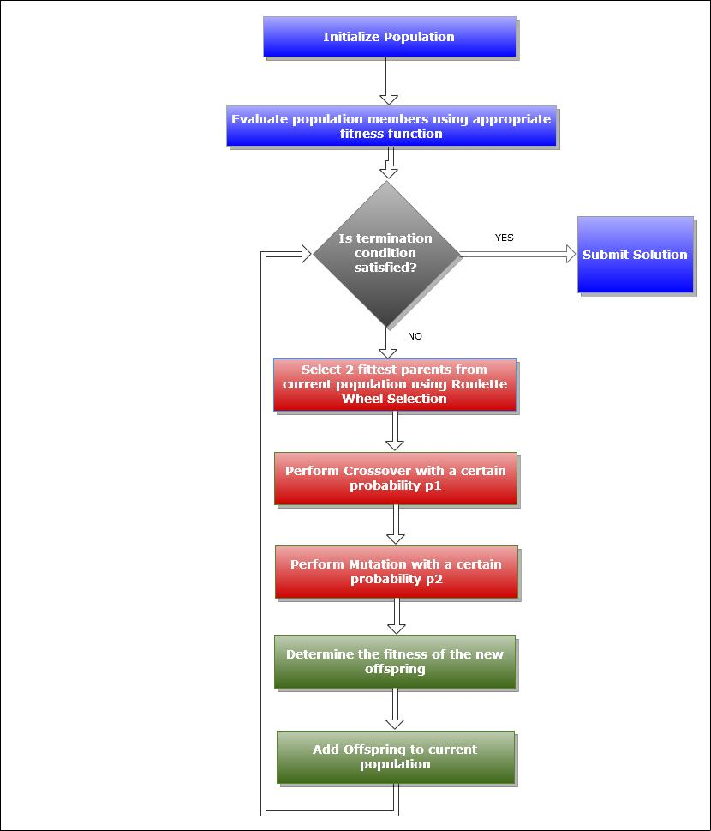
A typical GA procedure:

Slide 14
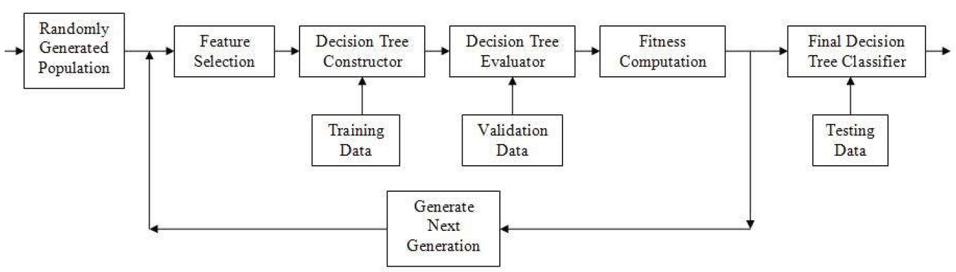
Decision Trees with Genetic Algorithm-based Feature Selection
A randomly selected population of genomes indicating the features to be used for DTs is taken and using the selected features , the DT is constructed (using training data).
The Decision Tree constructed is evaluated using the validation data sets.
The accuracy of the DT constructed gives the fitness for the selected genome.
Accuracy of the DT is
(1-miss_classification)/(total_no_of_classification).

Slide 15
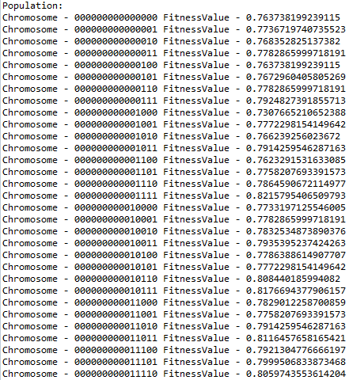
Step by Step execution of the DT-GA based Algorithm
Step 1
Initial Selection of the Population – A collection of bit strings (genomes) are selected indicating the features to be selected while building the DT.
This indicates that the features corresponding the bit value 1 are used while building the decision tree.
The fitness value of the chromosome is indicated by the accuracy of the corresponding DT built.

Slide 16
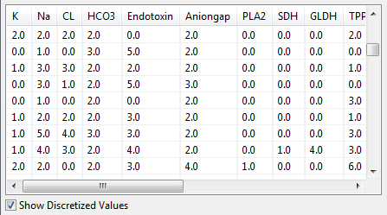
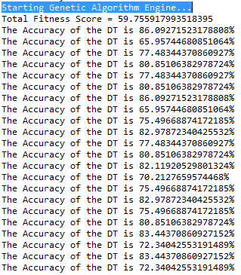
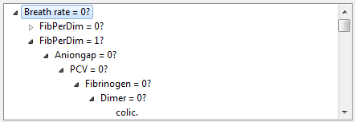
Step 2 Building the Decision Tree
The decision Tree is constructed recursively using the given training samples and the list of features to be used.
Since most of the feature values are continuous, the values are discretized first using one of the following two algorithms:
A decision tree built for the Horse Dataset after discretization
Equal Binning
Discretization based on the Median.

Slide 17
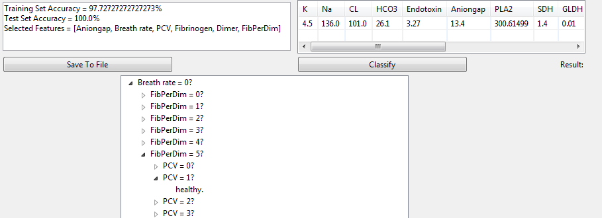
Step 3 Evaluation of the Decision Tree
The Classification is found out for each of the sample in the validation/test set by traversing the decision tree.
The class obtained by the Decision Tree and the actual classification of the validation set are compared.
The accuracy of the decision tree is computed as follows:
Efficiency = (1 - miss _ classification) / (total_no_of_samples)
The fitness values of each chromosome is computed using the weighted average of the training and test set classification accuracies.

Slide 18
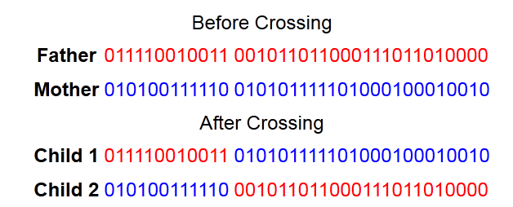
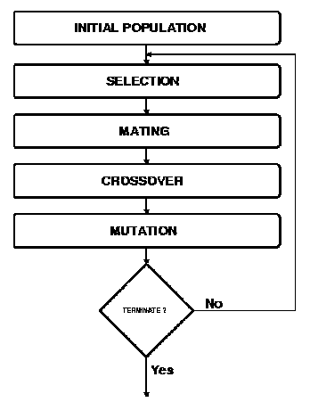
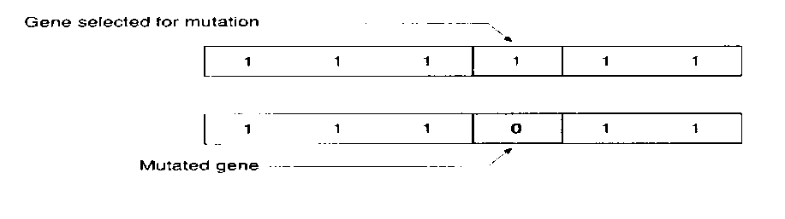
Step 4 Going to the next Generation
Depending on the fitness values of the chromosomes, two chromosomes are chosen based on roulette selection and the genetic algorithm operation crossover is applied.
Crossover
Mutation of the offspring after crossover.
The offspring Is added to the population of the next generation
The genetic algorithm is run for multiple generations and till the DT of required accuracy is found.

Slide 19

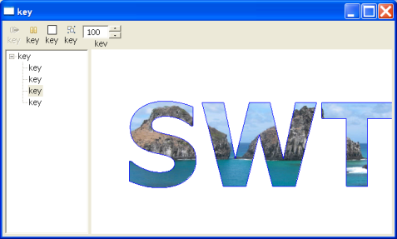
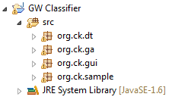
Implementation
This project has been implemented in Java.
Java SWT was used to develop the GUI.
Decision Trees – org.ck.dt
Genetic Algorithms – org.ck.ga
GUI – org.ck.gui
Samples – org.ck.sample
Package – There are four main packages in this project.

Slide 20
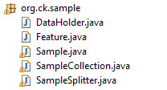
Sample Package org.ck.sample
This package contains java classes required for managing the set of samples provided.
Important Java classes are :
Feature
This class stores a mapping between a feature name and a feature value.
Sample
This class stores all the features and the corresponding classification value for one training/test sample only.
Data Holder
This class keeps track of names of les that contain training and testing samples; lists of features; their corresponding classification values; and Probability values.
Sample Collection
A collection of objects of Sample class
Sample Splitter
This class contains methods that operate on a given SampleCollection, in order to split it into two new SampleCollections, based on a given Feature.

Slide 21

Decision Tree Package org.ck.dt
This package contains all the java files necessary to build a Decision Tree classifier.
Important Java Classes are :
Decision Tree Constructor
This class contains methods needed to construct a decision tree for a given SampleCollection
Discretizer
This class is used to convert the real-valued features of samples to discrete values. It is very difficult to construct a DT with continuous or real-valued features.
Decision Tree Classifier
Keeps track of the measurements (accuracy) of the DecisionTree constructed by a DecisionTreeConstructor object.
Decision Tree Node
An object of this class represents a decision tree node, which may be either an internal or external (leaf) node.

Slide 22

Genetic Algorithm Package org.ck.ga
This package contains all the necessary files required for the operation of the genetic algorithm.
Important Java Files are
Population
It represents an array of genomes used in the GA. It contains methods to crossover, mutate and to perform roulette selection required for the operation of the GA.
Optimal Score Exception
This exception is thrown when a DT of required accuracy has been found.
Genome
Represents a binary string of all the features for the current sample. A ‘1’ in the string corresponds to the feature being used while constructing the decision tree, and vice versa. It also tracks the fitness value for the genome (the accuracy of the DT) used in the GA.

Slide 23
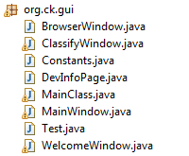
GUI package org.ck.gui
This package contains the definitions of all the classes required for the GUI.
WelcomeWindow
MainWindow
BrowserWindow
ClassifyWindow

Slide 24
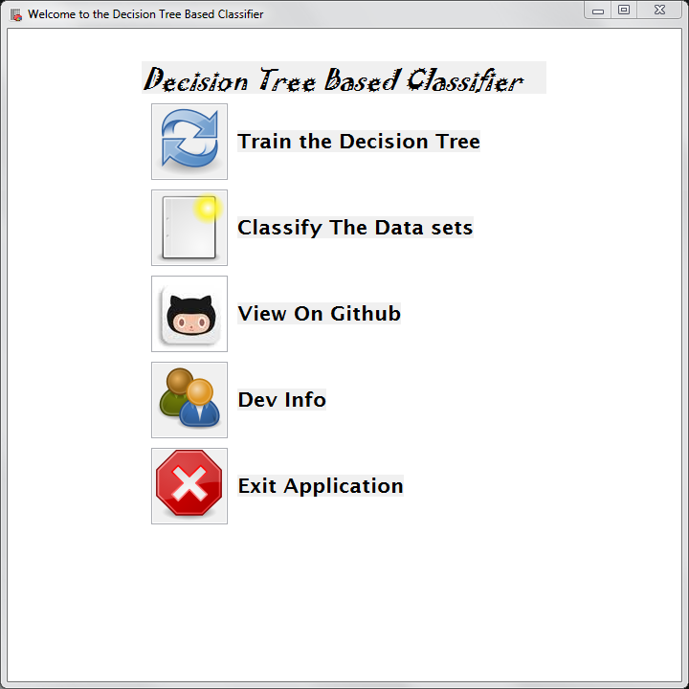
Demo

Slide 25
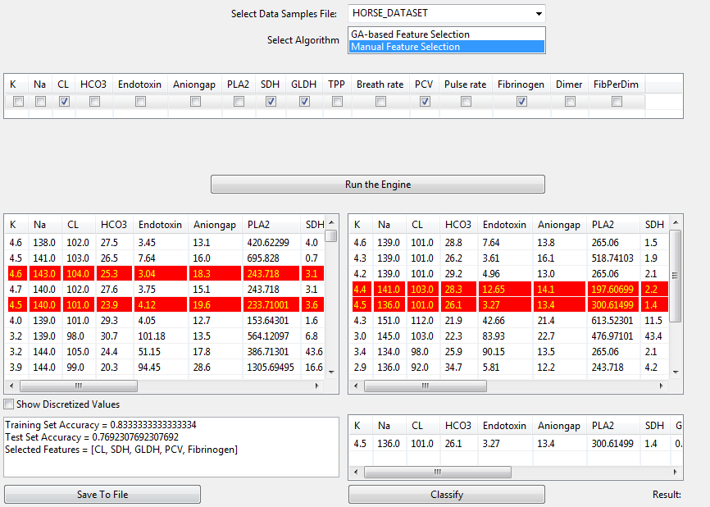
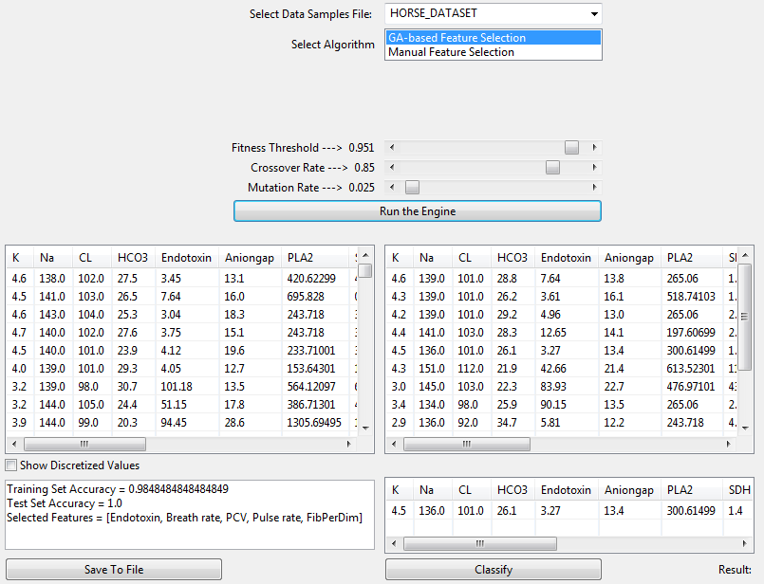
Results
In this mini project, we were able to successfully implement and test the performance of Decision Tree-based classifiers.
GA-based Feature Selection
Manual Feature Selection

Slide 26
Conclusion
This mini-project mainly concentrated on classifying ground-water samples as potable or not.
With the generic Object Oriented Class design, two other classification problems were addressed:
Classifying/Determining the quality of wine
Classifying Horses as healthy or colic.
The test results show that the Decision Trees constructed using the Genetic algorithm-based feature selector, were more efficient and accurate in classifying the data than the Decision Trees constructed by selecting features manually.

Slide 27
Future Work
The application could be made more responsive by using Threads.
Genetic Algorithms can be applied by representing a DT as a genome instead of the features.
The Decision Tree Classier built in this application could be optimized using Neural Networks which are more efficient than Genetic Algorithms.
An interesting extension to be explored is the possibility of additional feedback from ID3 concerning the evaluation of a feature set.

Slide 28
References
Genetic Algorithms - http://en.wikipedia.org/wiki/Genetic_algorithm
Genetic Algorithm for constructing DT http://www.jprr.org/index.php/jprr/article/viewFile/44/25
Decision Trees - http://web.cecs.pdx.edu/~mm/MachineLearningWinter2010/pdfslides/DecisionTrees.pdf
Project brief for the DT using Horse data sets - -https://cs.uwaterloo.ca/~ppoupart/teaching/cs486-spring06/assignments/asst4/asst4.pdf
Supervised and Unsupervised Discretization of Continous Features - http://robotics.stanford.edu/users/sahami/papers-dir/disc.pdf
Hybrid learning using Genetic Algorithms and Decision Trees for pattern classification - http://cs.gmu.edu/~eclab/papers/ijcai95.pdf
Kardi Tutorials on DTs- http://people.revoledu.com/kardi/tutorial/DecisionTree/index.html

Slide 29
Questions?

Slide 30
Thank You ☺
Source code available at https://www.github.com/samiriff/GWClassifier
© Samir and Satvik of Code Kshetra Inc.
All Rights Reserved.

