Slide 1
HelioCloud
Infrastructure for big and open science
Peter Shumate
Software Engineer
Space Research Analysis (SRN) Space Exploration Sector (SES)
Johns Hopkins Applied Physics Lab
peter.shumate@jhuapl.edu

Slide 2
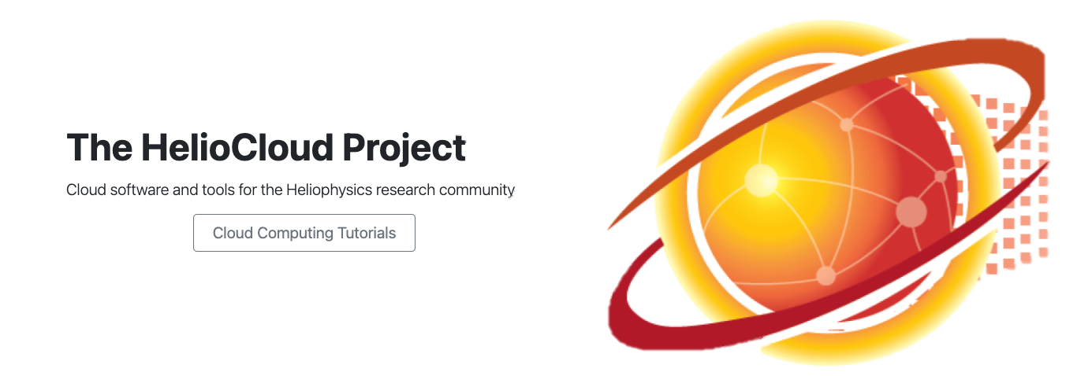
Introduction
Today we will present an overview of HelioCloud – a platform designed to offer an easy on-ramp for heliophysics researchers with interest in cloud computing - Amazon Web Services (AWS) specifically.
The mission of the HelioCloud project is simple: Setup a scientist-friendly AWS environment supportive of Heliophysics research to enable:
Increased exploration of “big” data sets and/or advanced computing capabilities in Heliophysics research. This is research that might otherwise be challenging or impossible in more confined environments (e.g. a laptop) where storage, cpu and memory are limited.
Simplifying data sharing and collaboration across the Heliophysics research community to foster the growth of open science.

Slide 3
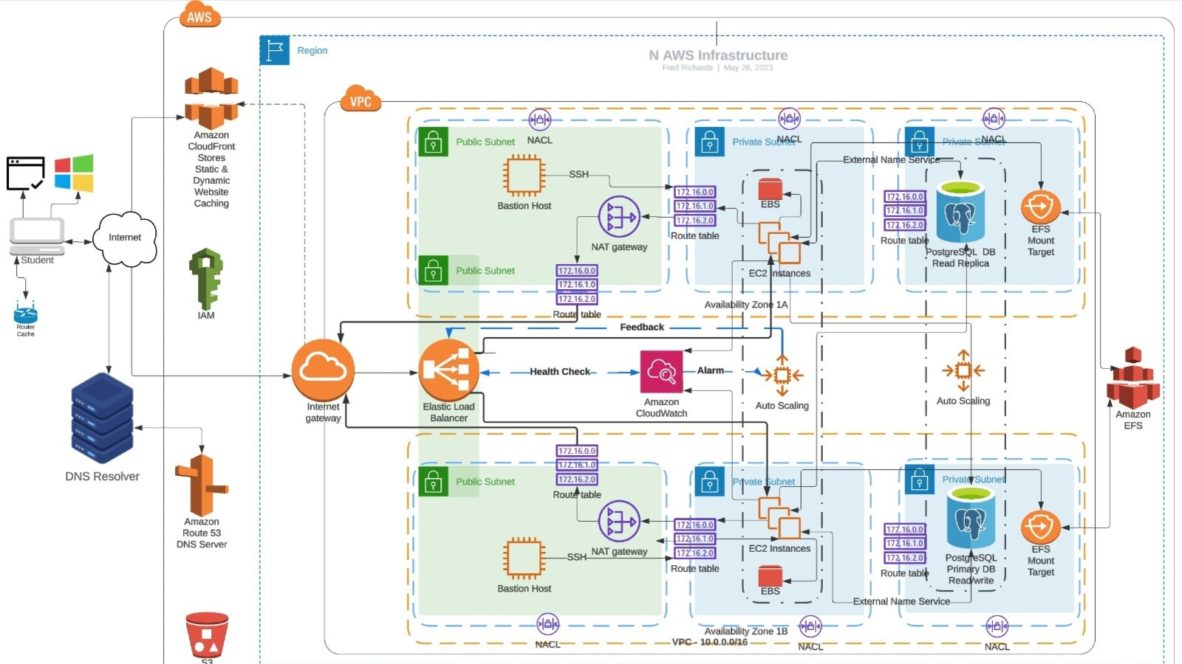
Science Problem
Research may come at a high computational cost... why not make use of commercially available cloud resources?
Remote compute and storage for a pretty penny!
The computing capabilities offered by cloud computing service providers – AWS, Azure, Google, etc – are vast and powerful, but with a substantial learning curve.
A complicated AWS architecture ?!

Slide 4
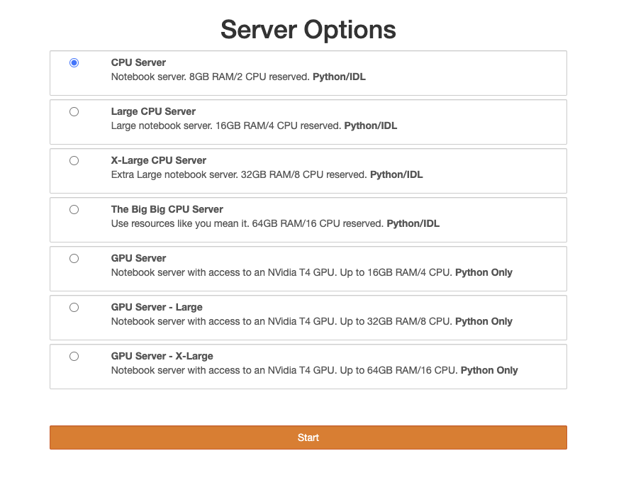
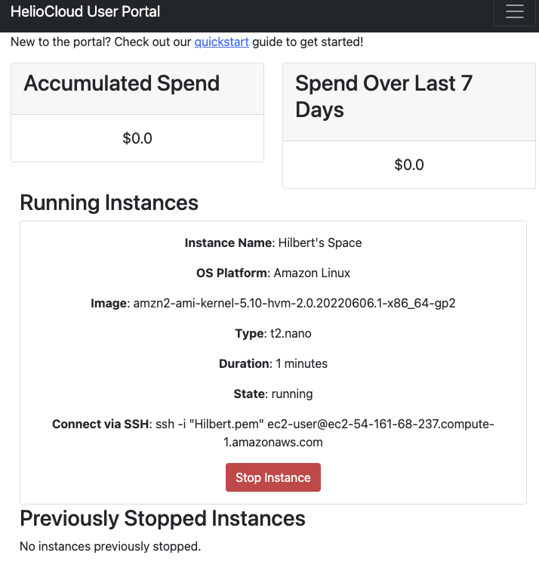
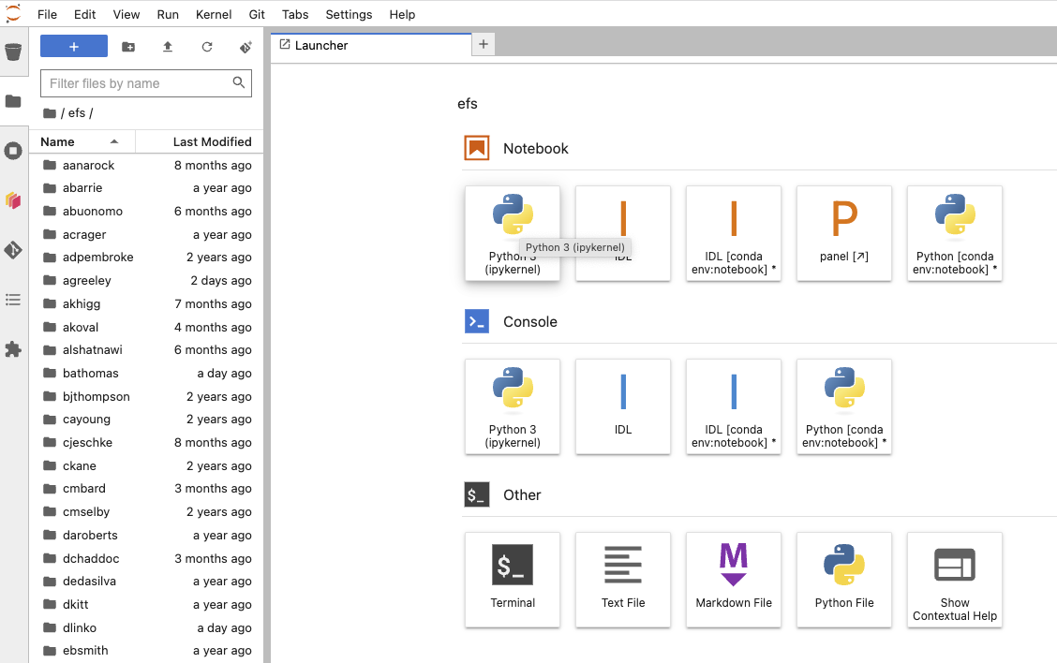
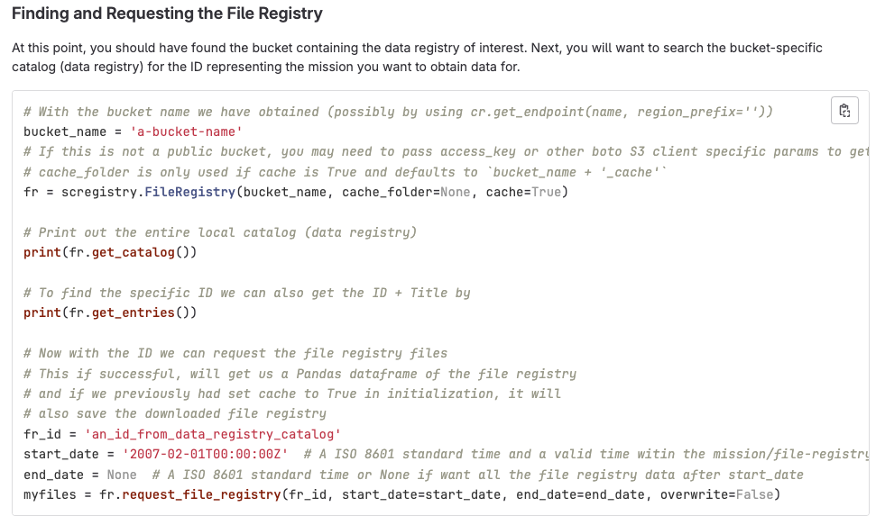

HelioCloud
HelioCloud is our answer to this problem: a heliophysics workbench for AWS, containing capabilities every researcher can make use of. You have the option to get up and going fast (Daskhub), create a customized research compute environment (Dashboard) and/or store and share your heliophysics data sets (Registry).
Datasets
HelioCloud
Daskhub
Jupyterhub on Kubernetes with w/ multiple Heliophysics ready server images available (Python libs from PyHC & Dask , IDL, Matlab, Fortran) along with multi-user shared storage.
Drops a researcher right into a familiar Python notebook environment. Great option for getting up and going on research, while also scalable to larger analysis using Dask for parallelism.
Dashboard
Start your own EC2 instance by selecting from a curated set of heliophysics ready Amazon Machine Images.
Simplifies EC2 host creation with appropriate cost guardrails. Researcher can then remote into the instance and customize it to their liking.
Registry
Store, catalog, share and retrieve heliophysics research datasets within your own Heliocloud and across Heliocloud instances.

Slide 5
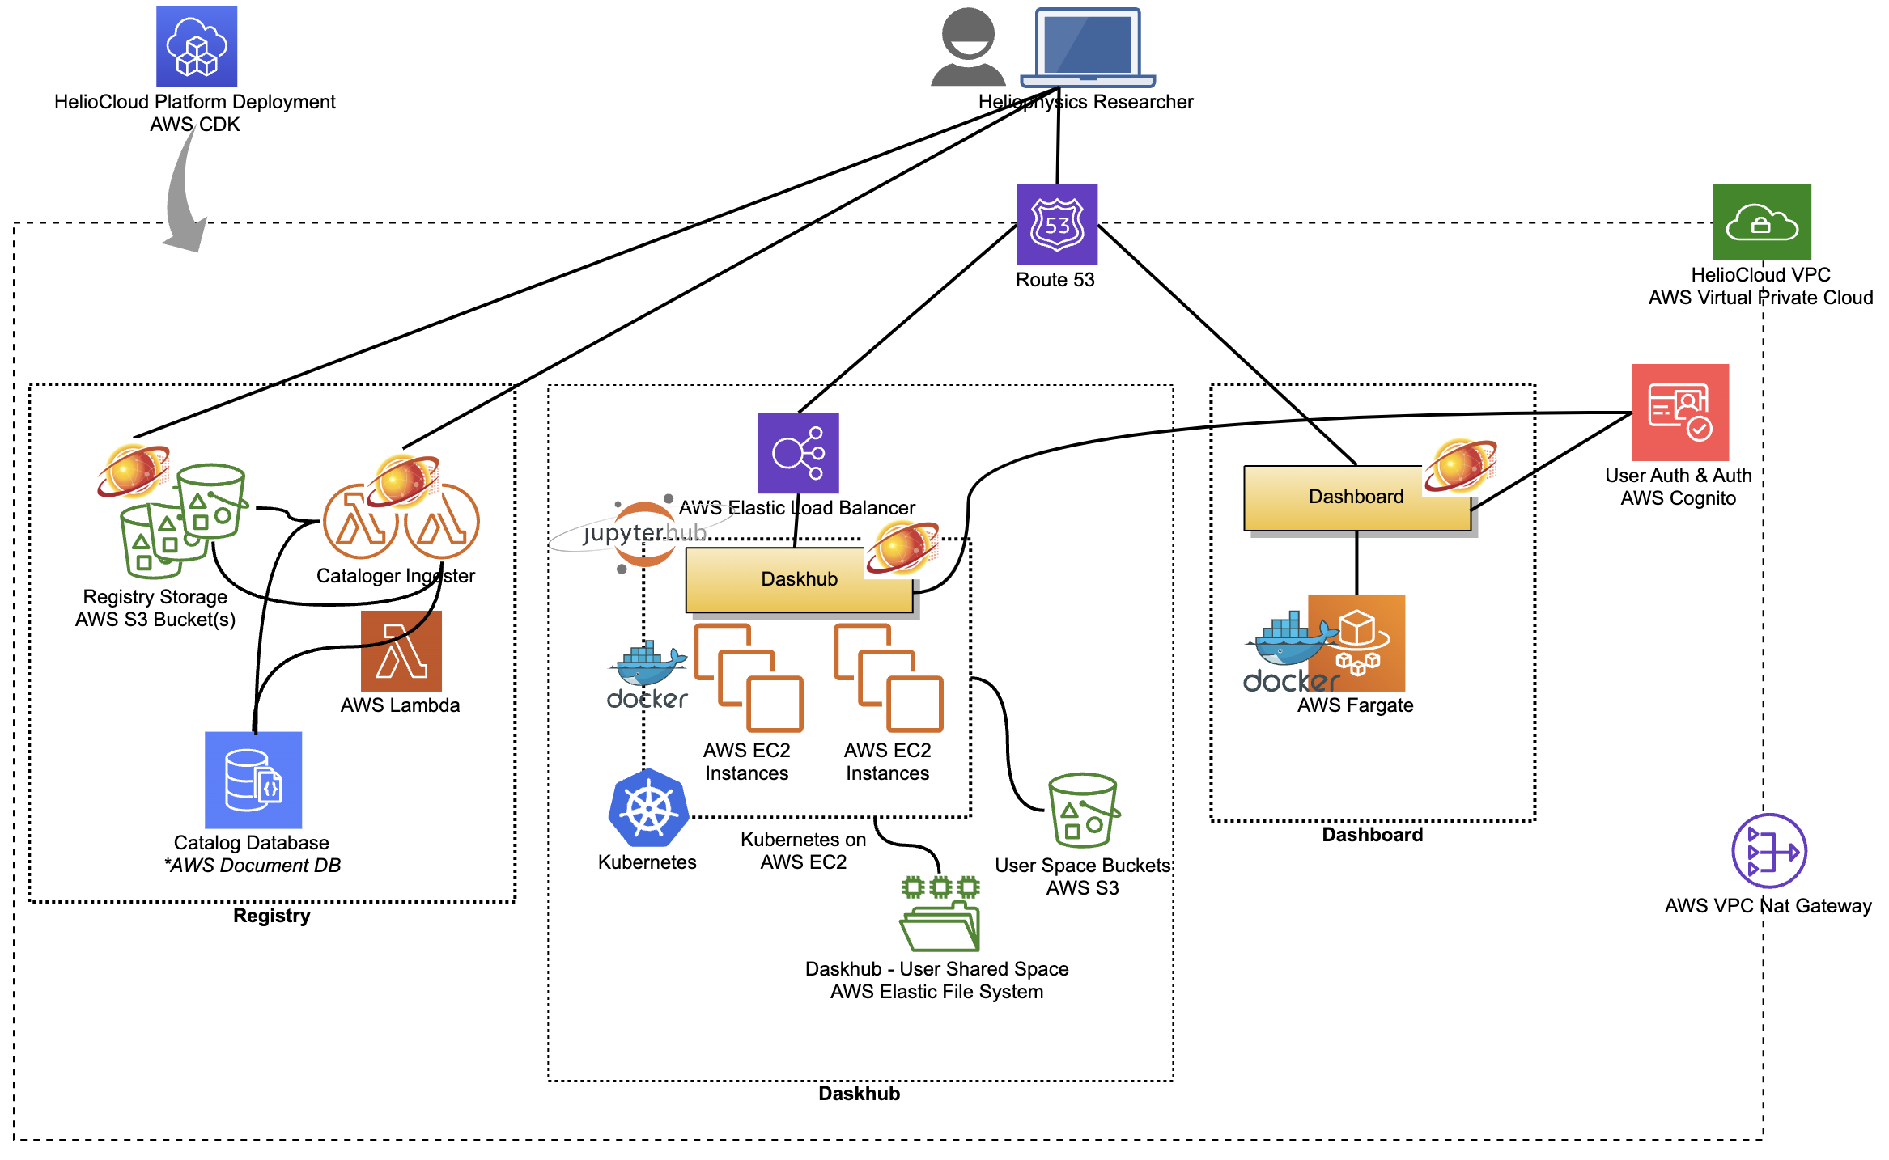

HelioCloud: Architecture
HelioCloud is deployed into a single region within your AWS Account. It is comprised of a number of AWS services & Python apps:
A Virtual Private Cloud (VPC) is created as the networking ‘container’ for the HelioCloud instance.
The Dashboard is a Python Flask app deployed in a Docker container to AWS Fargate.
The Daskhub is composed of a Kubernetes cluster deployed atop AWS EC2, with Docker images containing Jupyterhub, PyHC libraries, etc. An AWS EFS share is created for user data storage.
AWS Route 53 is configured to provide the external DNS entries needed to reach Daskhub & Dashboard (e.g. daskhub.myheliocloud.org).
A combination of AWS Lambda functions, S3 buckets and DocumentDB comprise the Registry implementation.
All of these are provisioned and configured via a single AWS Cloud Development Kit “app” we have written, simply called “HelioCloud Platform”. It does the magic of building a HelioCloud instance.

Slide 6
PyHC Setup
Daskhub/JupyterHub interface
https://pyhcschool.heliocloud.org
Clone Science Tutorials Repo
https://github.com/heliophysicsPy/summer-school-24.git

Slide 7
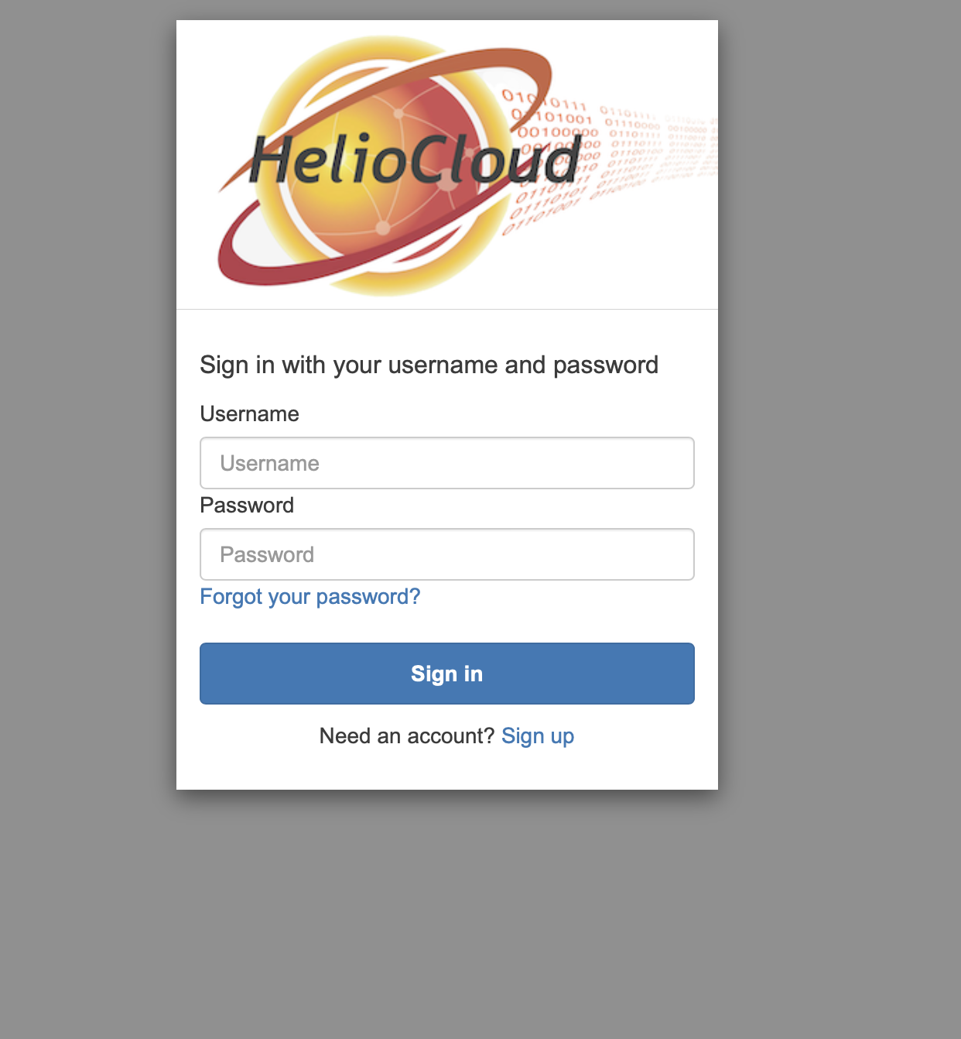
PyHC Setup
Sign up
Use any email you can access here
Enter MFA sent to email

Slide 8
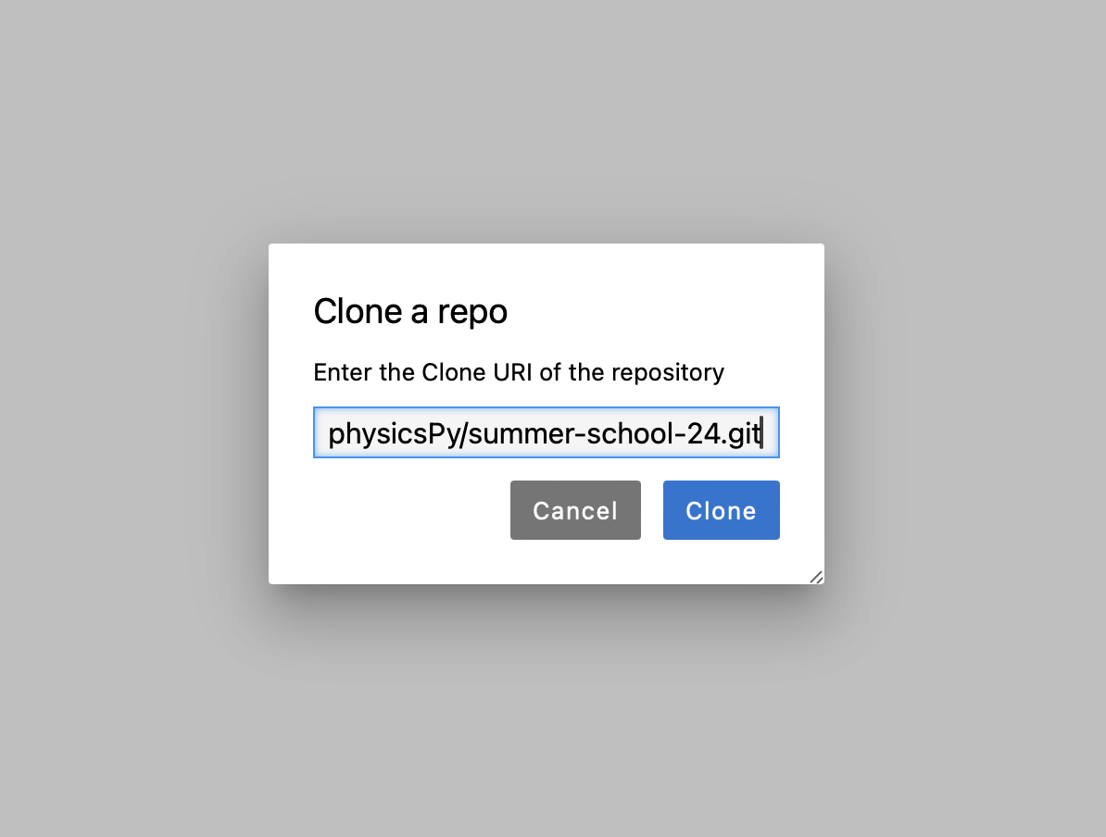
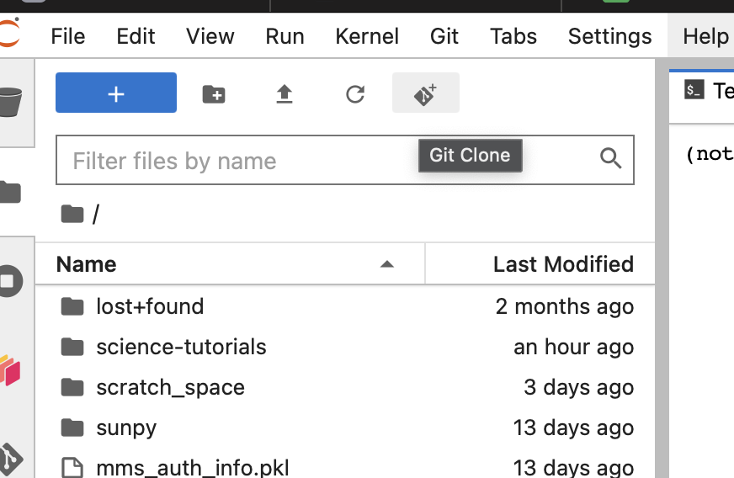
PyHC Setup

Slide 9
Contact Info
Project homepage: Heliocloud.org
GitHub: https://github.com/heliocloud-data/
Contact the team: heliocloud@groups.io
Today’s Presenter: Peter Shumate (peter.shumate@jhuapl.edu)
HelioCloud Development Team:
Name | Organization
Dr. Brian A. Thomas, PhD | NASA GSFC
Dr. Jon Vandegriff | Johns Hopkins APL
Dr. Sandy Antunes | Johns Hopkins APL
Dr. Wenli Mo | Johns Hopkins APL
Dr. Vicki Toy-Edens | Johns Hopkins APL
Mr. Jeffrey Bradford | ADNET Systems Inc
Mr. Christopher Jeschke | Johns Hopkins APL
Mr. Nicholas Lenzi | Johns Hopkins APL
Ms. Sarah Rourke | NASA GSFC
Mr. Peter Shumate | Johns Hopkins APL

