Slide 1

Maximising Flexibility: a Plug-in-based LabVIEW Software for
Laser-scanning Microscopes
Dominik Langer
Brain Research Institute
University of Zurich

Slide 2
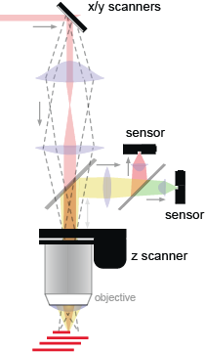
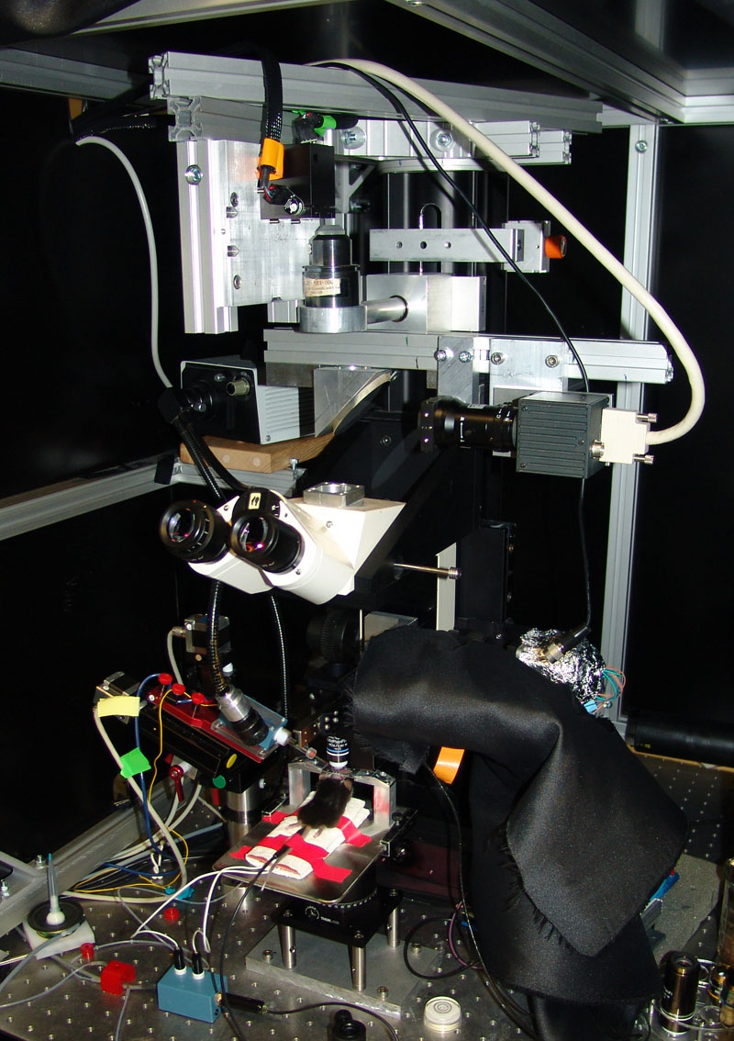
Laser scanning microscopes

Slide 3
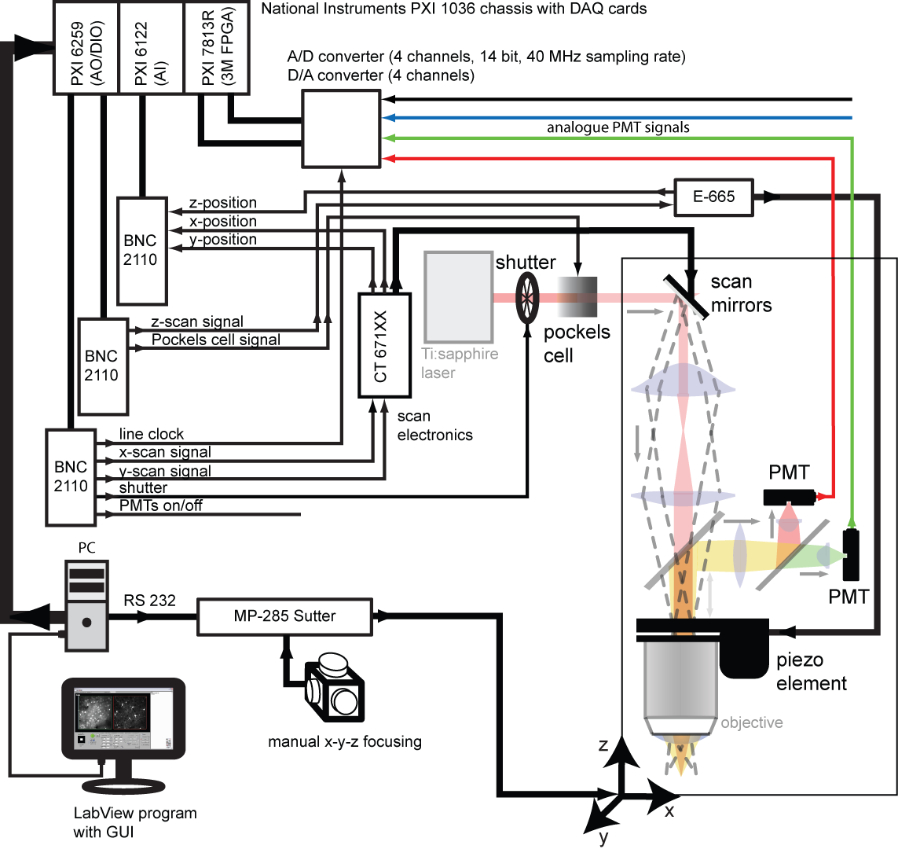
Microscope: example wiring diagram

Slide 4
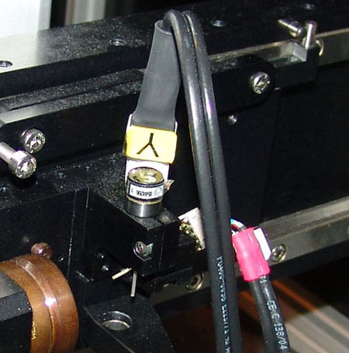
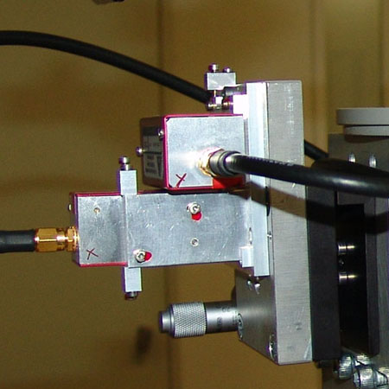
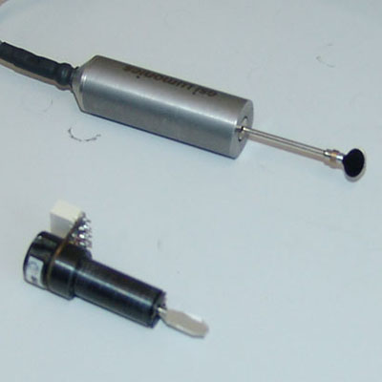
Problem 1: hardware diversity
Each setup is a home-made unique combination of parts
Example: different types of scanners
galvonometric mirrors
acousto-optic deflectors
resonance scanner
galvonometric mirrors
acousto-optic deflectors
resonance scanner

Slide 5
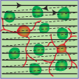

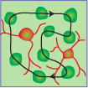

Problem 2: diversity of functionality
Each researcher uses a different set of functionality tailored to his experiments
Example: different scanning modes
horizontal frame scan
arbitrary-plane imaging
horizontal frame scan
arbitrary-plane imaging
2D line scan
2D line scan
3D line scan
3D line scan

Slide 6




Problem 3: multiple developers
avoiding excessive version branching
avoiding versioning conflicts with Subversion
avoiding delays due to locking
goal: loosely interacting developers, independently working on different parts of the software
HelioScan

Slide 7
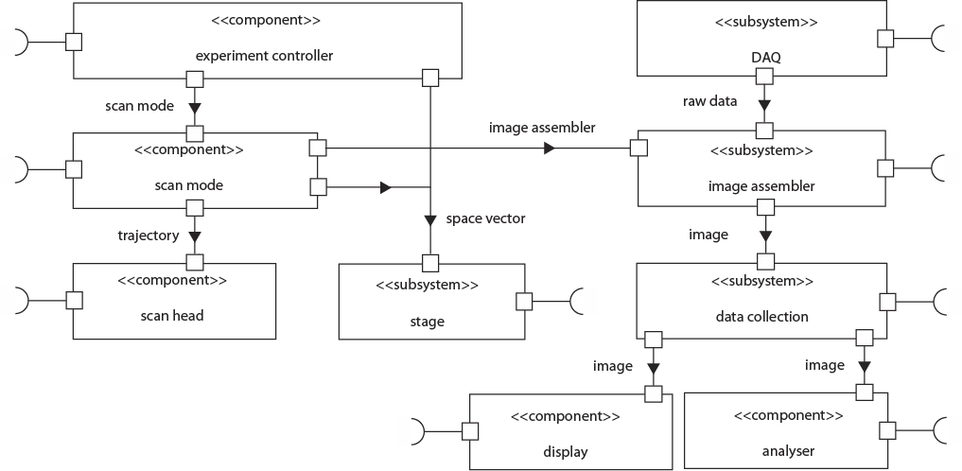
Solution: component-based design
Units of hardware and functionality are implemented as exchangeable components

Slide 8
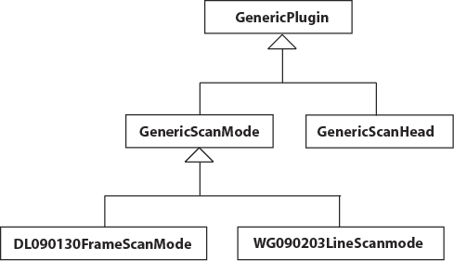
Components as LabVIEW classes
Components of the same type are exchangeable: common parent class, common interface
Example: scan mode components
provide interface and common functionality
actual components

Slide 9
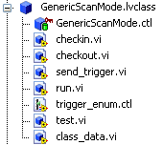
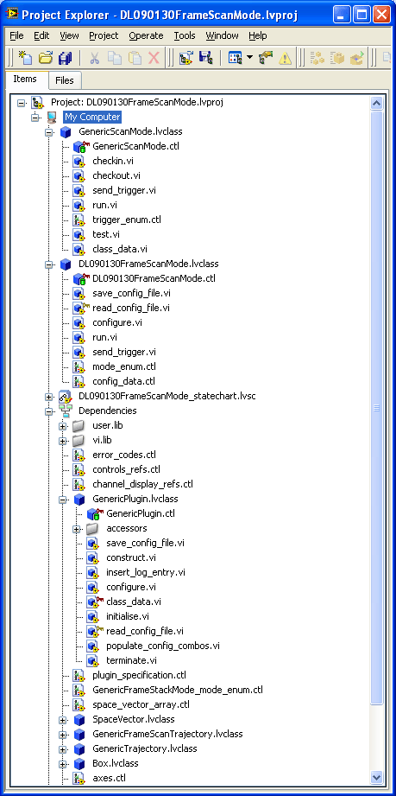
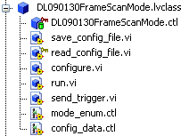
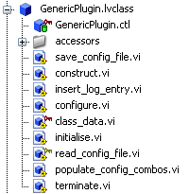
Components as LabVIEW classes

Slide 10
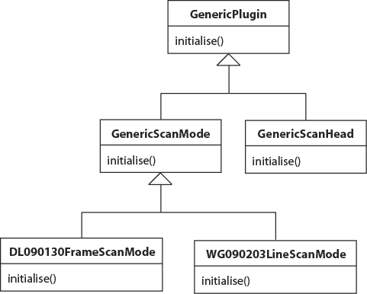
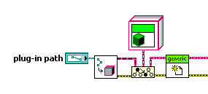
Class instantiation at run-time
LabVIEW object
GenericScanMode
type cast
member VI

Slide 11
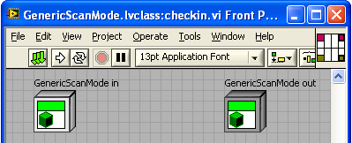
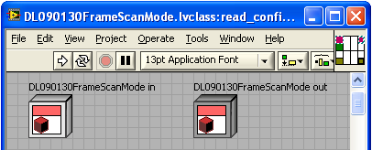
Static vs. dynamic dispatch, overloading
static dispatch:
  only one VI of that name allowed along class inheritance line
dynamic dispatch:
  multiple VIs of the same name along class inheritance line are possible (overloading)
  actual VI to be executed is determined at run-time

Slide 12
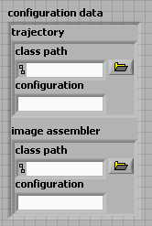
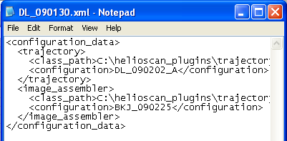
XML-based configuration of components
multiple config files possible per class → differently configured instances of the same class can exist simultaneously
JKI easyXML
each component can have different config files
each component can have its own config cluster

Slide 13
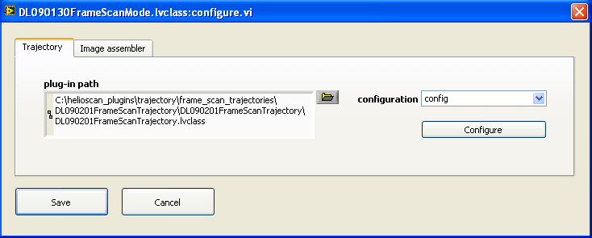
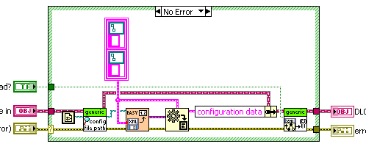
XML-based configuration of components
component-specific configuration dialog (a member VI)
component-specific member VI „read_config_file.vi“ loads configuration into private data of an component object

Slide 14
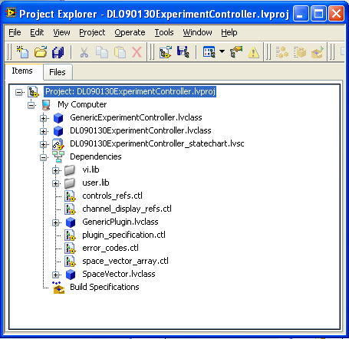
Problem & work-around
Problem: LabVIEW gets very unstable and slow for large projects / class dependency networks
Solution: Uncouple components as much as possible: Split software up in one project per component. Use queues for interaction.
parent class has to be added explicitely to project to allow inheritance
main class of this component project
other dependencies are managed automatically by LabVIEW

Slide 15
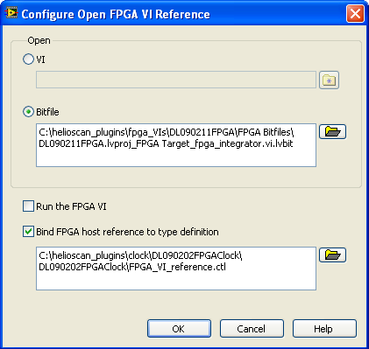
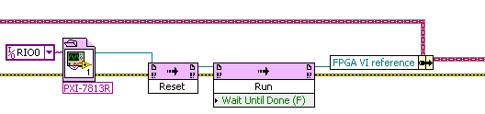
Problems & work-around
Problem: several components make use of the same FPGA VI.
Solution: open FPGA reference via bit file

Slide 16
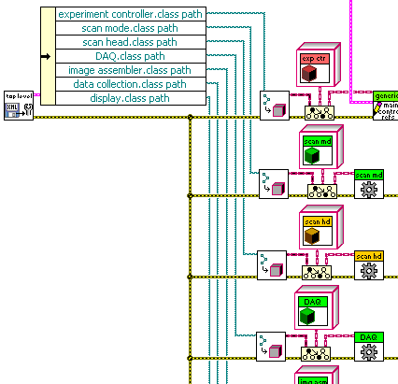
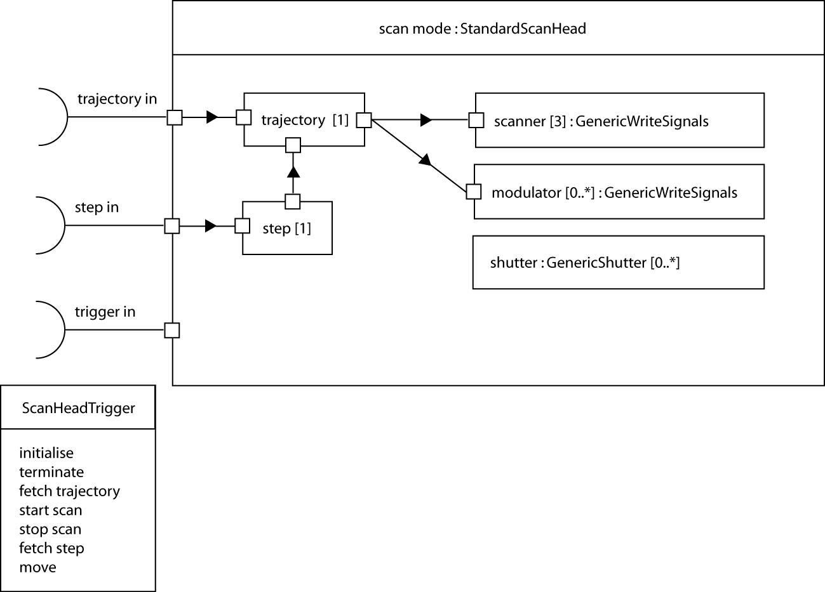
Top-level components & subcomponents
top-level components are continuously running and receive triggers to which they respond
subcomponents are attributes
of top-level components

Slide 17
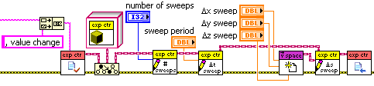
Problems encountered and work-arounds
Problem: avoiding race conditions in a multi-loop parallel loops frame-work
Solution: each top-level component has a check-out and a check-in method on the GenericXY level. Use queues for communication between components.
check-out with locking
check-in with unlocking

Slide 18
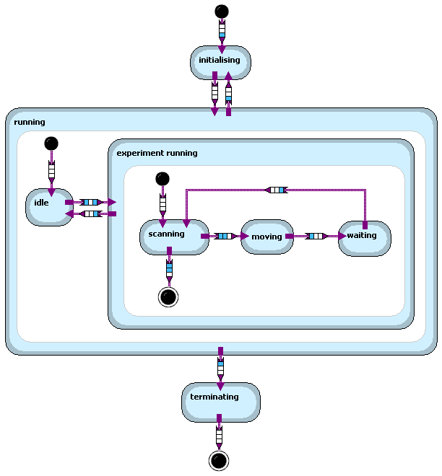
LabVIEW Statechart module is used to model the behaviour of top-level components
transitions are triggered by „triggers“ that are received via trigger queues
both transitions and states can contain LabVIEW code

Slide 19
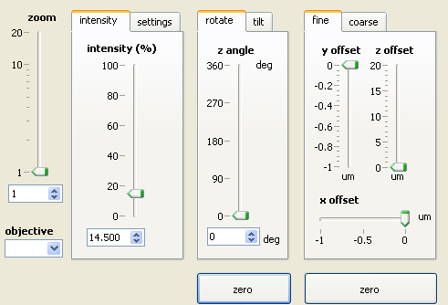
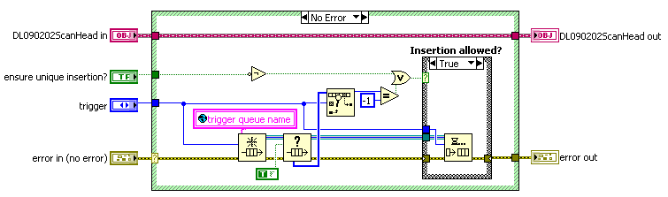
Problem & work-around
Problem: statechart may be too slow to handle value change events of slider / knob controls → accumulation of triggers in queue
Solution: use synchroneous statechart with your own Labview queue, which you have under precise control (check whether a specific trigger is already in the queue before inserting it again).

Slide 20

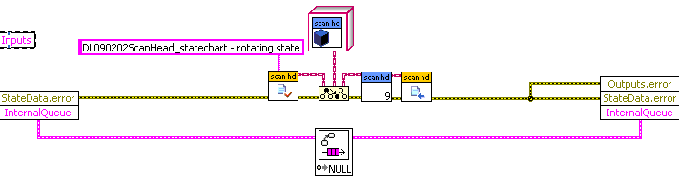
Problem & work-around
Problem: statechart editing becomes extremely slow when components are part of the input / state / output cluster.
Solution: Use check-out/check-in methods to access objects from within states/transitions.
input cluster
output cluster

Slide 21
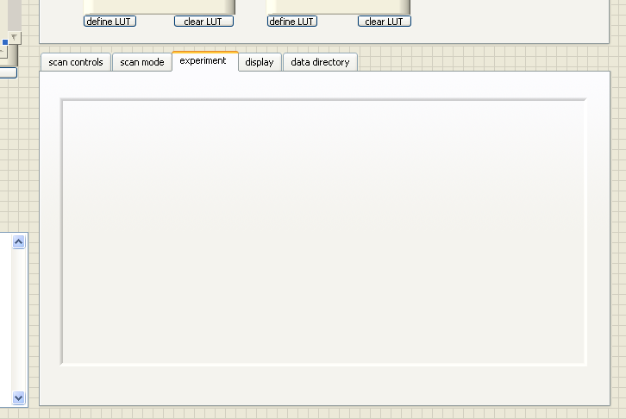
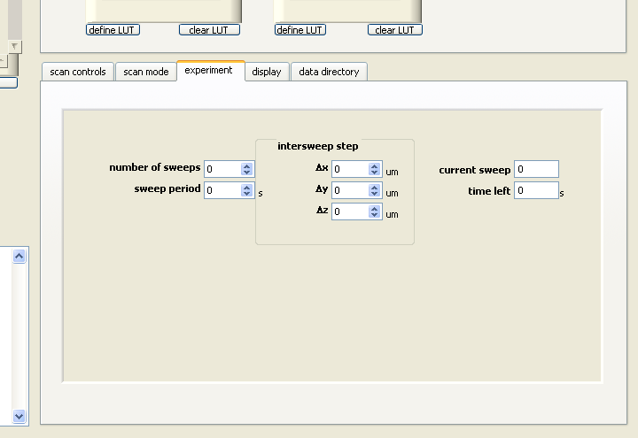
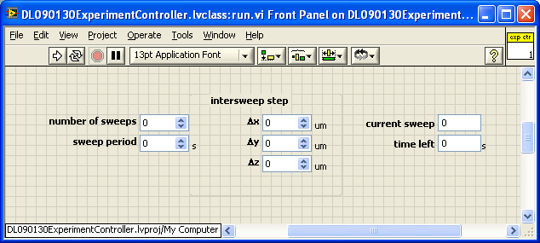
Components and subsystems
sub-panel on
top-level VI front panel
Front panels of top-level components are dynamically loaded into front panel of top-level VI.
component front panel

Slide 22
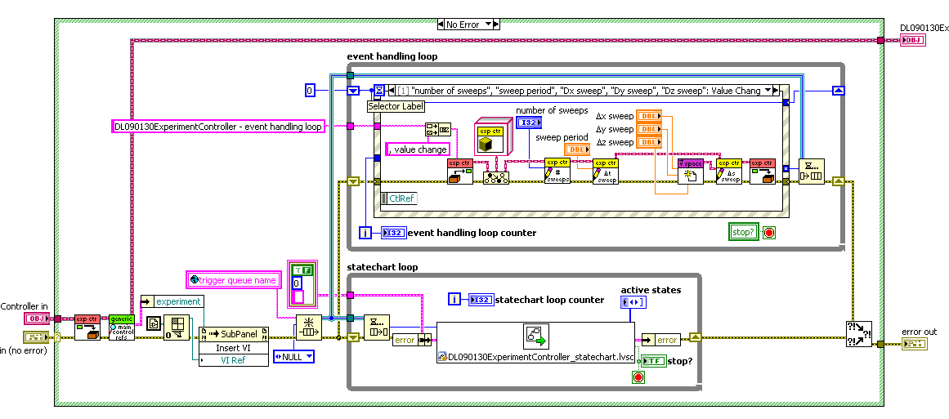
Block diagram of a top-level component
front panel event handling
trigger sent to statechart
load front panel into top-level VI subpanel
incoming trigger
compiled statechart

Slide 23
Conclusion
units of hardware and of functionality can be encapsulated in exchangeable object-oriented components
a specific work station can be configured as a combination of such components
components can be individually configured at class and instance level using XML config files
components can be exchanged at run-time
components are only loosely coupled → multiple independent developers can work on them simultaneously
but: top-level design is very important!

Slide 24
Thank you for your attention!
Dominik Langer
Brain Research Institute
University of Zurich
langer@hifo.uzh.ch

