Slide 1
PWN
linux_kernel_protection_and_bypass
By leafish

Slide 2
linux_kernel_protection_and_bypass
What are the linux kernel protection
How to bypass these protection

Slide 3
Content
Kaslr
Smep
Smap
KPTI

Slide 4
Part1
Kaslr (kernel address space layout randomization)

Slide 5
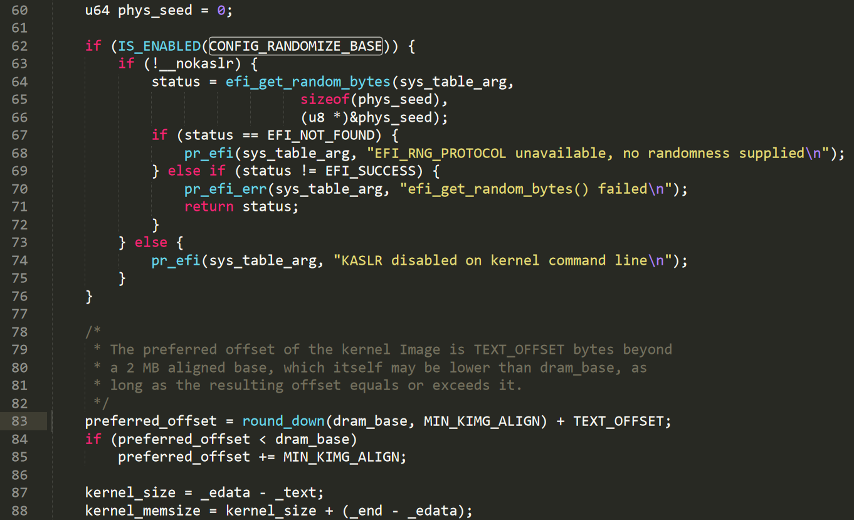
Kaslr

Slide 6
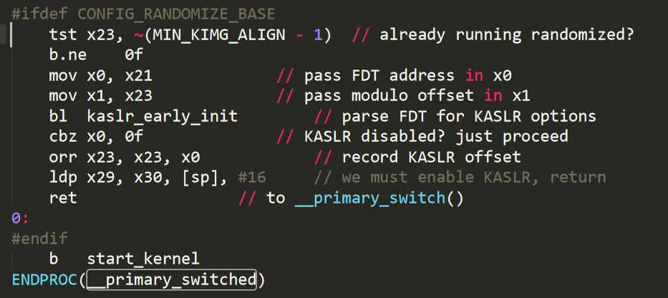
Kaslr

Slide 7
Kaslr
How to bypass these protection
Leak memory

Slide 8
Part2
Smep (Supervisor Mode Execution Protection)

Slide 9
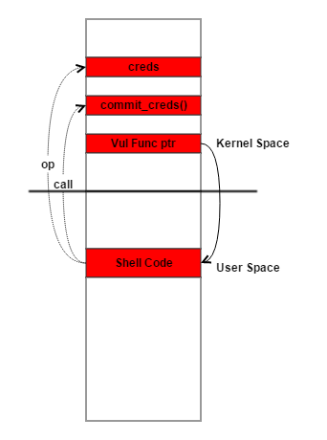
Smep
Ret2usr

Slide 10
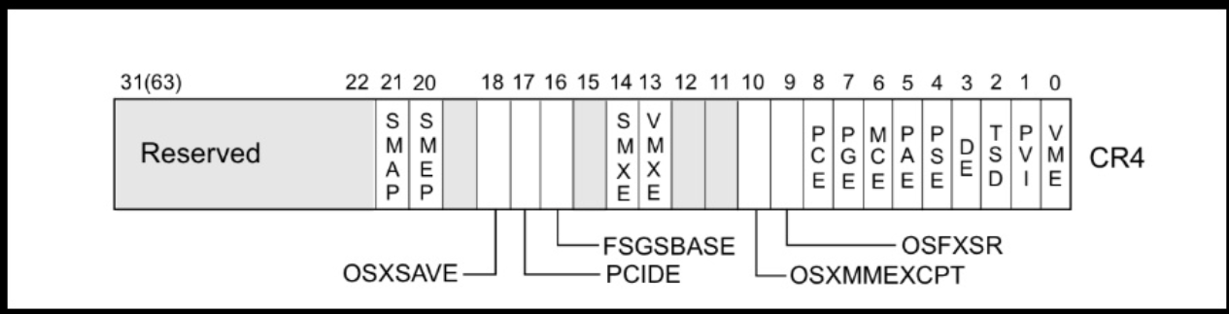
Smep
Bit 20 (CR4 register) is set 1
CR4 register value = 0x1407f0(0001 0100 0000 0111 1111 0000)

Slide 11
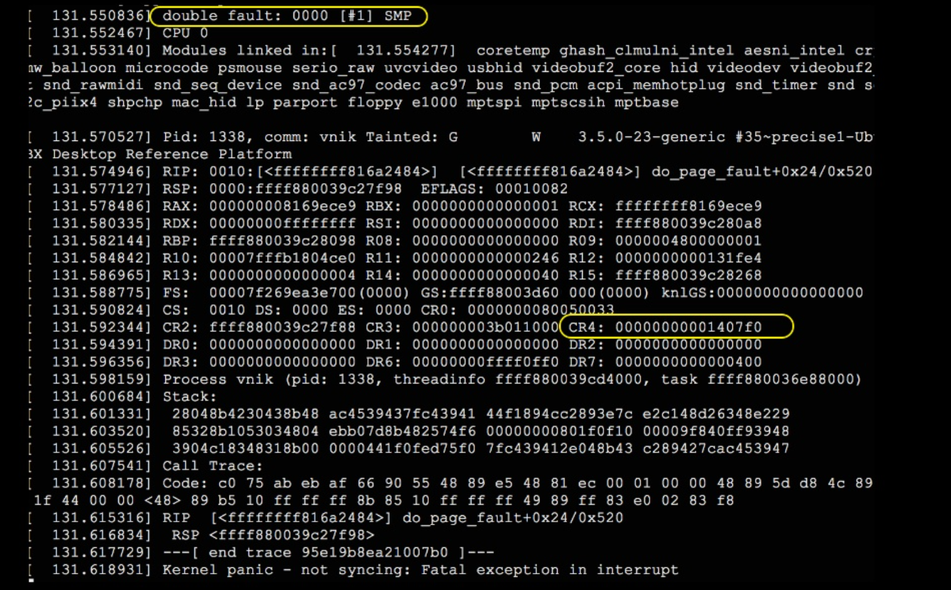
Smep

Slide 12
Smep
How to bypass these protection
ROP
addr_limit set_fs(-1)

Slide 13
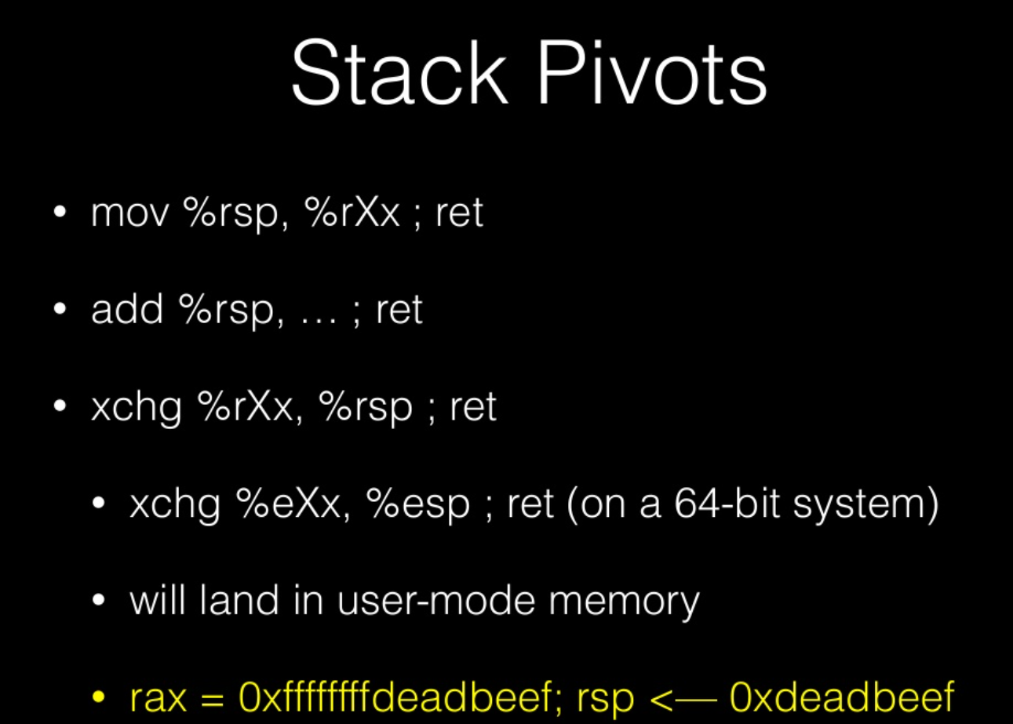
Smep

Slide 14
Part3
Smap (Supervisor Mode Access Protection)

Slide 15
Smep
Bit 21 (CR4 register) is set 1
CR4 register value = 0x2407f0(0010 0100 0000 0111 1111 0000)

Slide 16
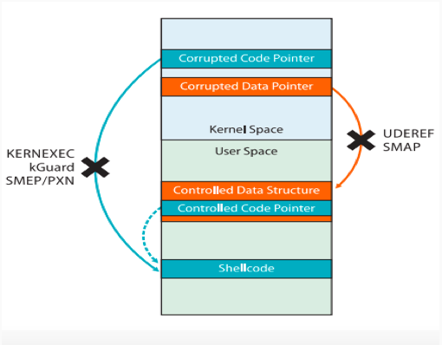
Smap

Slide 17
Smap
How to bypass these protection
Ret2dir
Ksma
modprobe_path call_userhelper()

Slide 18
Part4
KPTI (Kernel page-table isolation)

Slide 19
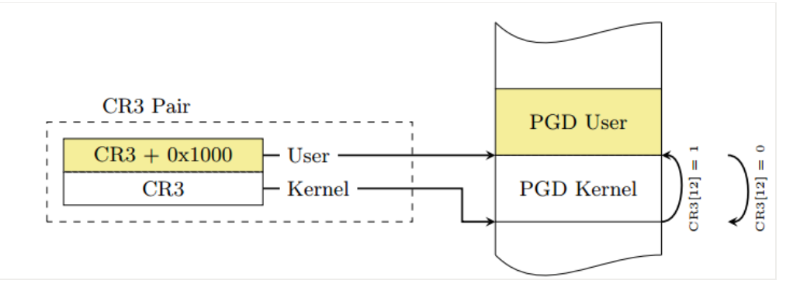
KPTI

Slide 20
KPTI
How to bypass these protection
ROP swapg

Slide 21
Thanks

