Slide 1
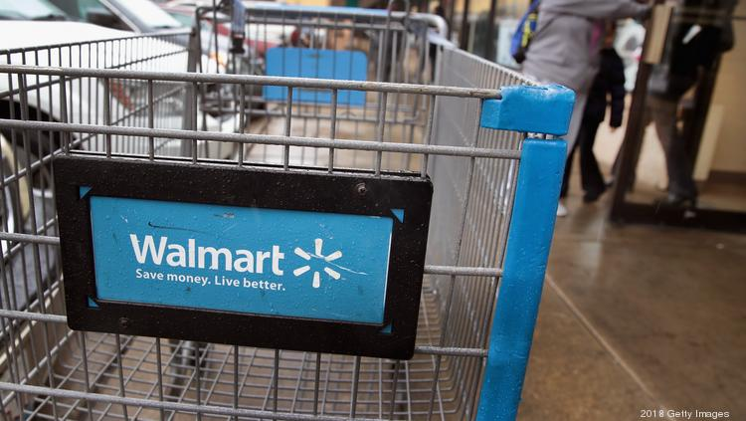
Self-Checkout Smart Shopping Cart

Slide 2
Overview
In the present scenario, it has been observed that after shopping in malls or any such place, customers waste a lot of time at the counter in the queue waiting for there turn of bill processing. We aim at designing the best substitute for the counter that could substitute and drastically reduce the time spent at the billing counters.

Slide 3
Solution
Our approach involves combining IOT and Android to offer a seamless shopping experience
Each Smart Cart has an in-built Raspberry Pi and Camera to detect the barcode associated with a product.
PIR and Weight sensors are also attached to the Cart to facilitate an anti-thievery mechanism.
While, an Android app is also provided for payment and self-checkout.

Slide 4

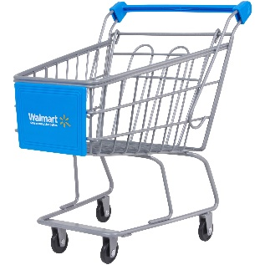
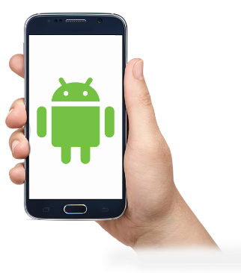
Workflow

Slide 5
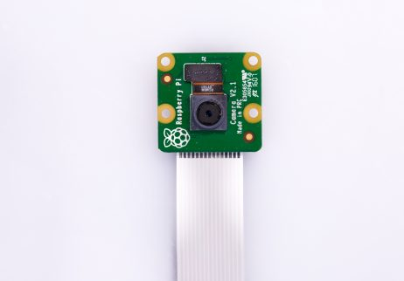
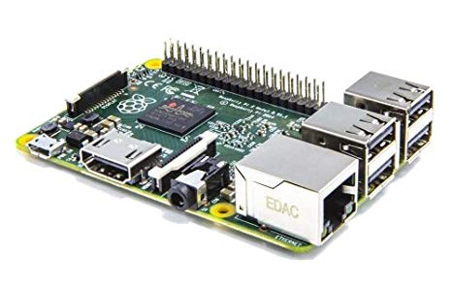
IOT Components
These basically includes the sensors and the raspberry pi combined to precisely generate the shopping bill.
Camera :
Captures the video feed and sends it to the Raspberry Pi for further processing.
Raspberry Pi :
Processes the video feed, decodes the barcode and sends the bill to the database.

Slide 6
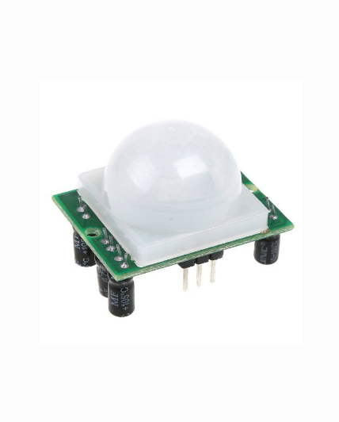
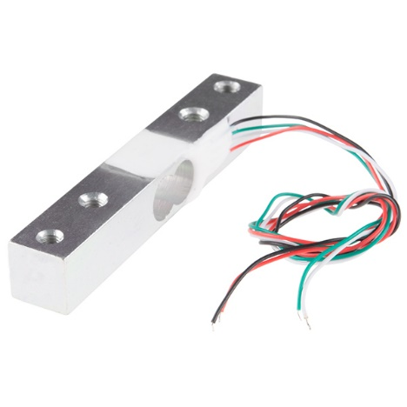
PIR sensor :
Prevents thievery from ‘NO’ section after the checkout.
Load sensor :
Verifies the weights of the scanned products.

Slide 7
YES / NO Sections in Cart
Our shopping cart consist of user friendly cart with two sections – namely YES section and a NO section. This feature has been incorporated so as to
make the life of customers easier. Items which are confirmed to be bought are placed in YES section while the items which are not confirmed to be bought are placed in NO section.

Slide 8
Estimated Cost
Raspberry pi : 2000
Raspberry pi camera (5 mp) : 700
Load sensor and load cell : 600
PIR SENSOR : 300
ATMEGA 328p MICROCONTROLLER 100
TOTAL 3700
“BUT THE COST CAN BE REDUCED BY THREE FOLDS IF WE DESIGN THE MICRONTOLLER WITH SPECIFIC FEATURES NEEDED FOR DESIGNIG THE SMART CART”

Slide 9
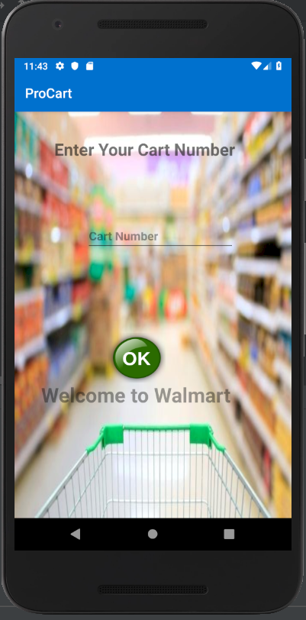
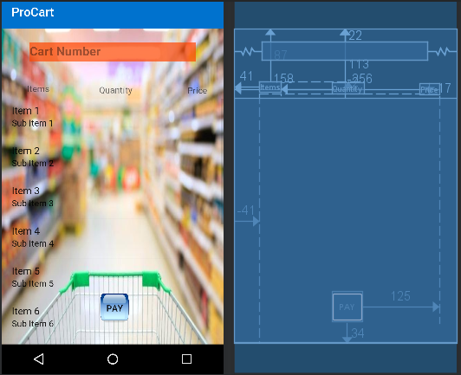
App Snippets

Slide 10
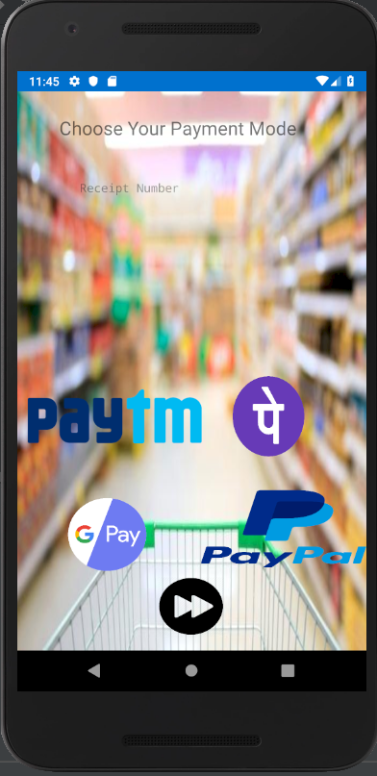
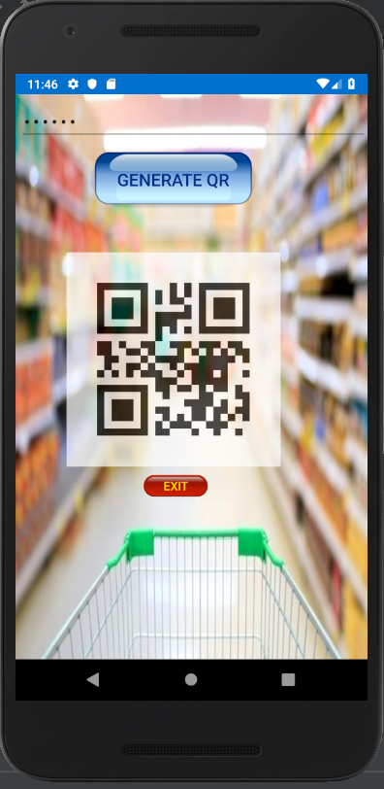
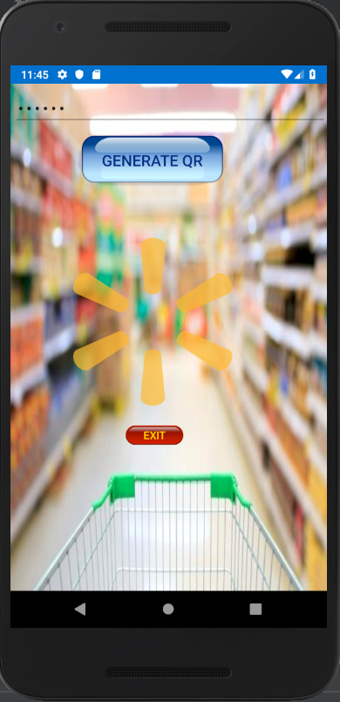

Slide 11
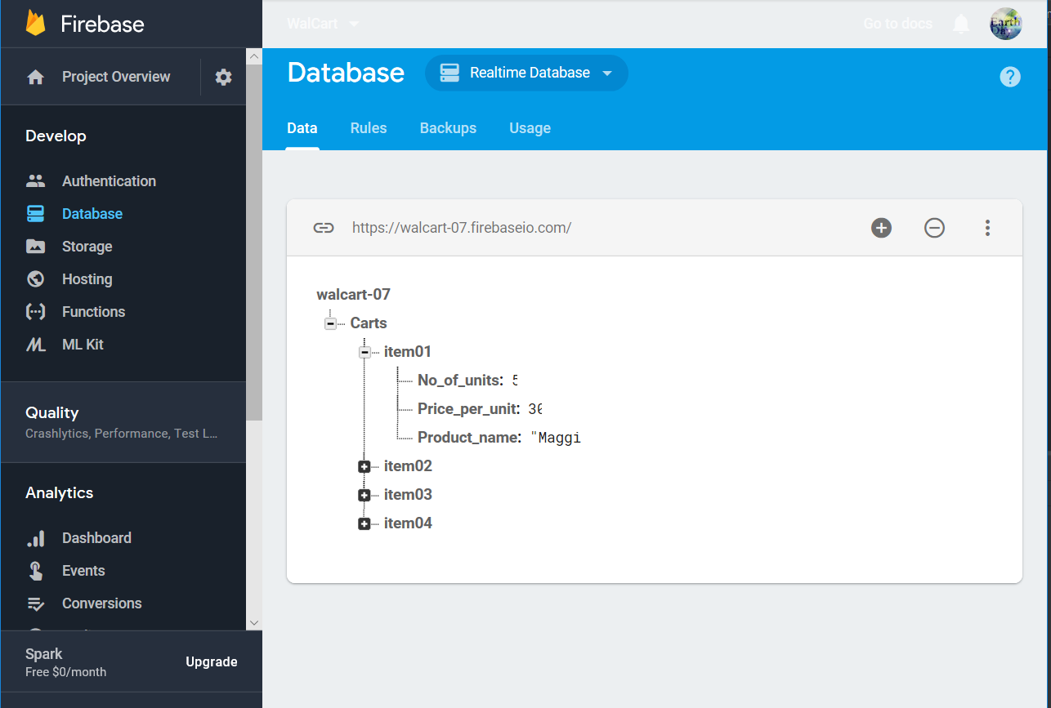
Firebase Database

Slide 12
Conclusion
This smart cart will help the customers drastically reduce their waiting time in the queue through it’s self checkout facility. It is also a cost-effective solution to this problem.
We have focused on providing a seamless shopping experience using a interactive Android UI and adding a ‘NO’ section for doubtful products. Anti-Thievery was also taken into account and a few measures to prevent this were also deployed.

