Slide 1


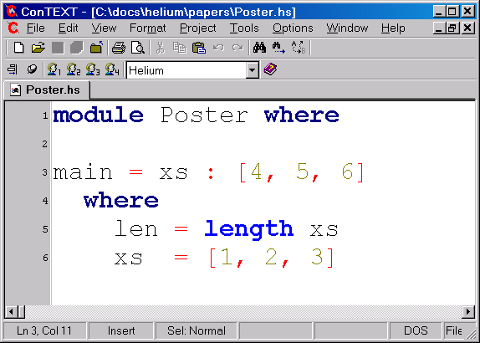
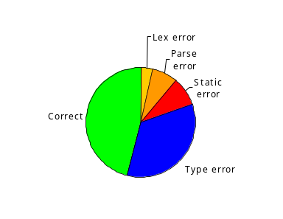

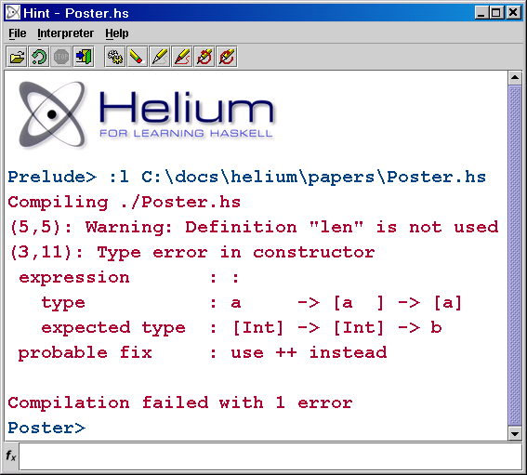
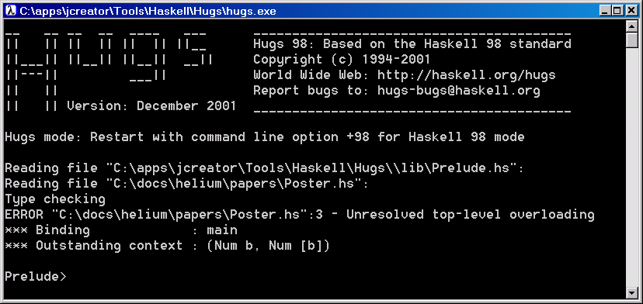

Bastiaan Heeren, Arjan van IJzendoorn, Daan Leijen
Rijk-Jan van Haaften, Arie Middelkoop
1. Introduction
Helium is a user-friendly compiler designed especially for learning the functional programming language Haskell. Quality of the error messages has been the main concern both in the choice of the language features and in the implementation of the compiler. Helium is almost full Haskell with as the most notable difference the absence of type classes. Our goal is to let students learn functional programming more quickly and with more fun. The compiler has been successfully employed in two introductory programming courses at our institute.
Features
Warnings for several common mistakes
Positions of error messages are exact
Hints and suggestions to fix programs
A graphical interpreter
2. The Type Inferencer
Extra effort has been spent on producing concise and understandable type error messages. As opposed to most modern compilers, the process of type inferencing is constraint-based, which clearly separates the collection of type constraints (the specification) from solving those constraints (the implementation). Therefore, the type inferencer can not only simulate well known algorithms such as W and M, but it can also solve constraints by using type graphs. A type graph is an advanced data structure to represent a substitution, which also keeps track of reasons for unifications. The extra information that is available during type inferencing paves the way for better type error messages.
4. The Logger
A special logging facility has been set up to record compiled programs during lab sessions for an introductory course on functional programming. The students involved in this experiment have been informed about the logger in advance, and, if desired, it can be turned off. The collection of recorded programs not only reflects the problems that students encounter while learning Haskell, but it also gives some insights in the learning process over time. By analyzing this (anonymized) set of programs, we hope to further improve the compiler.
Heuristics determine the most likely site of error and create a pre-cise error message. In many cases, a type error is accompanied by additional hints to guide the programmer in fixing ill-typed programs. The pro-cess of type inferen-cing can be tuned by supplying type in-ference directives ex-ternally.
This vertex represents an (instantiated) version of a → [a] → [a], which is the type for (:).
A program with a type error
4
Inconsistency: xs (which is assigned the type [Int]) is not of type Int (advocated by the three integer literals)
All the elements of a list should have the same type. Type variable t1 unifies the types of all elements.
Results of Compilations by Students
1
A typegraph for the function
main = xs : [4, 5, 6] (with xs :: [Int])
5. Future Extensions
Support for Haskell 98 type classes
A basic GUI library
Warnings and hints for incomplete pattern matches
Recognizing standard functions, such as map and filter
Additional heuristics to determine the most likely type error
2
3. The Lazy Virtual Machine
For a given source file, the Helium compiler produces an .lvm file, which can be executed by the Lazy Virtual Machine. The LVM is specifically designed to execute lazy (or non-strict) languages. It defines a portable instruction set and file format, similar to for instance the Java Virtual Machine (JVM). The instruction set is strongly based on the Spineless Tagless G- machine. At the
3
The message given
by Helium
present time, the generated code is unoptimized and rather naive. In spite of this, the runtime system performs quite well in practice. It is an order of magnitude faster than Hugs, and only about three times slower than un-optimized GHC code.
Acknowledgements
We would like to thank Arthur Baars, Jeroen Fokker, Jurriaan Hage, Martijn Lammerts, Andres Löh, Doaitse Swierstra and all the students who used Helium for their help.
The message given by Hugs
1
2
3
Speed comparison for three benchmarks
http://www.cs.uu.nl/helium
4

