Slide 1

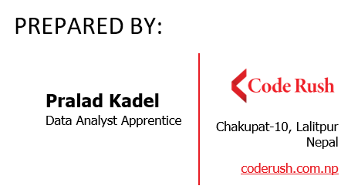
Default Prediction Model PROJECT PROPOSAL
6th Sep, 2022

Slide 2
Introduction
One of the main income earning assets for a bank is loan
Default on loans diminishes asset quality of a bank
Important for banks to invest their assets in safe hands

Slide 3
Objective
To build a default prediction model based on historical data that can predict whether it is safe to issue a loan to a particular applicant or not.

Slide 4
Dataset
From Kaggle website
Dataset contains columns simulating credit bureau data
No. of cases: 32,582
No. of Defaults:7,108 (21.82%)
No. of variables/features: 11
Total loan amount : 312,431,300
Total loan amount for default : 77,125,375 (24.68%)

Slide 5
Related Work
Reddy and Kavitha (2010) showed that using Neural Networks through attribute relevance analysis to build a prediction model increases the speed of Neural Network and feasible accuracy.
Shoumo et al. (2019) focused on applying appropriate dimensionally reduction approach using Recursive Feature Elimination with Cross-Validation (RFECV) and Principal Component Analysis (PCA), noise handling, parameters tuning, using a grid search with cross-validation and on handling the imbalanced data problem.

Slide 6
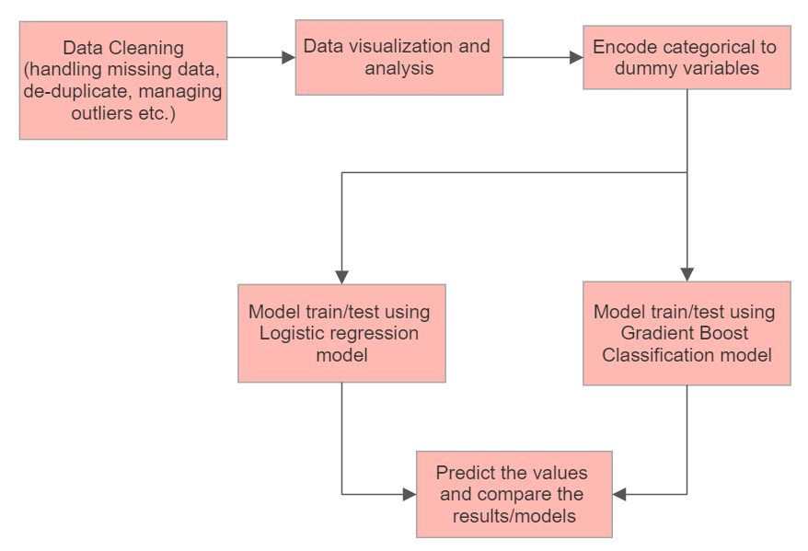
Methodology

Slide 7
Limitations
Cannot generalize the model as the data is taken from only one company/source
Other various factors/features/variables can affect the default process that are not included in the dataset

Slide 8
Conclusion
Being able to determine whether the customer are likely to become default or not is very beneficial.
We will pre-process the data, perform EDA and then build prediction models, plus, also evaluate the performance of the models.

Slide 9
Reference
A. Jeremy Mahoney (2020, Sep 9), Credit risk modeling with machine learning. towardsdatascience site, Last accessed 3rd Sep 2022: https://towardsdatascience.com/credit-risk-modeling-with-machine-learning8c8a2657b4c

Slide 10
THANK YOU

