Slide 1
HACK MSIT 2.0
Topic – Health Care
(MEDORA)

Slide 2
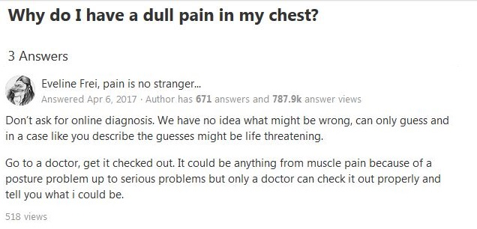
THE PROBLEM!!
SEE!! If I have a symptom I really don’t get the treatment or the solution to our problem and that is why we created MEDORA!!

Slide 3
THE IDEA
Give people the most user friendly solution to their symptoms, diseases and health related issues.
Make them aware of the cause and consequences of lack of attention to symptoms.
Provide costless and quick solutions to such worries and health related issues to literally everyone.
Ensure to create a responsive and helping community of helpful doctors and make sure a HEALTHY LIFE

Slide 4
IMPLEMENTATION
CREATE A WEBAPP
Our WebApp would consist of 3 pages
1 - HOME
2 - FORUM
3 - PLANS

Slide 5
The WebApp will be a very user friendly portal for the users to use. It will have different sections for various specialists where we can ask our problems for solutions and ask for our doctors advice. The team of doctors will be provided by us(the service provider) and they will be hired using the money raised by advertisements and the subscription plans offered by our service.
Some other important feature are :
1. Give people the most user friendly solution to their symptoms, diseases and health related issues.
2. Make them aware of the cause and consequences of lack of attention to symptoms.
3. Provide costless and quick solutions to such worries and health related issues to literally everyone.
4. Ensure to create a responsive and helping community of helpful doctors and make sure a **HEALTHY LIFE**.

Slide 6

HOME PAGE
Yes!! We have your whole body here from head to toe . Choose your specialist related to your issue and describe your issue.
But don’t forget we also have a team of renowned doctors for assured and correct treatment to your problem within 36 hours.

Slide 7
FORUM
This page is dedicated to the people and their home remedies.
People can freely ask about their problem without any hesitation and other people can share their method of treatment.
The doctors regularly visit the forums page to give correct and verified solutions which are compelling.

Slide 8
PLANS
We have three plans for our service.
1. BASIC – This plan is totally free. All services are available to everyone. The solution to your problem will be given in assured 36 hours.
2. STANDARD – This membership costs Rs. 1999/year. This plan assures you instant solutions to your problems with 24x7 service.(NO WAITING).
3. PREMIUM – For just Rs.3999/year not only you get instant solutions and other services but we also take care of your appointments with the doctors as well, costing you no appointment or consultation fee.(NO HIDDEN CHARGES)

Slide 9
TECHNOLOGY USED
LANGUAGES
1 – HTML5
2 – CSS 3
3 – JAVASCRIPT
JS LIBRARIES USED
1 – JQUERY

Slide 10
OUR TEAM
Himanshu Goel – MSIT (CSE – 1st YEAR)
Sarthak Khandelwal – USICT (CSE – 1st YEAR)
Madhav Malhotra – MSIT (CSE – 1st YEAR)

