Slide 1
Learning aims
Notes:
Open by asking the group who has used a database before. Ask individuals to explain what they have used it for and get a sense of prior knowledge. If necessary plan for a full skills analysis early on to understand the individuals.
Make note of the connection with spreadsheets – some similarity between the way information is stored in the worksheets of a spreadsheet and the tables of a database but a database can handle more complicated and larger stores of information.

Slide 2
In this unit you will:
A understand the uses of and tools/techniques
used in databases
B design a relational database
C develop and test a relational database
D review the finished relational database.
© Pearson Education Ltd 2012. Copying permitted for purchasing institution only.
Notes:
Explain that the unit is divided into four learning aims as shown.
Briefly describe the unit as first understanding the features and uses and then learning how to build a database and put a design together. Do this before creating and reviewing an actual database.
It is worth ensuring that the need to capture requirements and put a design together before starting to develop a database is well understood. Questioning – what can go wrong later?
Much of the unit is practical – learning how to create the various objects used in databases.

Slide 3
Learning aim A
Understand the uses of and tools/techniques used in databases
© Pearson Education Ltd 2012. Copying permitted for purchasing institution only.

Slide 4
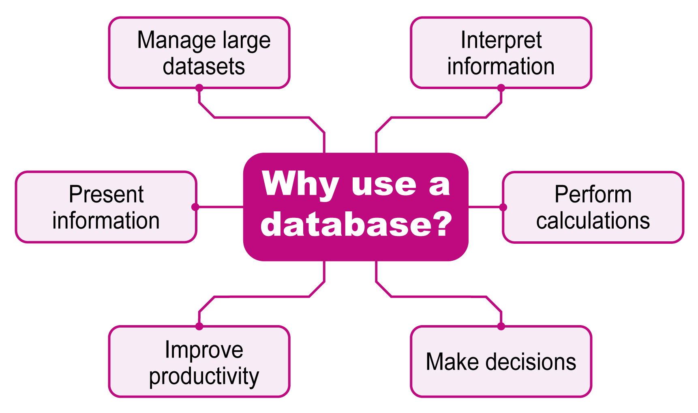
© Pearson Education Ltd 2012. Copying permitted for purchasing institution only.
Notes:
Different organisations will need to use databases for different reasons but the main reason that all of them need to use it is to (ask question of group)? Order of importance is not crucial but take reasons or examples for each from the group. The two that must be discussed in some detail are:
Manage large volumes of information (i.e. datasets) – give some examples in the school or college, for example, how many learners and how much information is stored about each one? Big companies = massive volumes.
Use the information to increase productivity and make decisions.
Make sure a number of different types of organisations are mentioned .

Slide 5
Tools and techniques
Four key database objects:
  Tables
  Forms
  Queries
  Reports
© Pearson Education Ltd 2012. Copying permitted for purchasing institution only.
Notes:
For each of the objects, add additional comment as below:
Tables – store the information – real databases have many tables according to the situation – for example schools would have a table for the students, another for the teachers, another for the courses, rooms, etc. Give another example if learners look unsure. Within each table are a series of records – each representing one thing, e.g. one student, or one course. These can be ordered ,sorted and indexed (explain indexing).
Forms – although you can enter information directly into tables, most times you create forms that can be easier to use and have extra features such as drop down lists.
Queries – these represent the questions that users ask and are mostly limited sets of fields or records (e.g. what students are there in Form 4B?).
Reports – these are the printed outputs.

Slide 6
Tools and techniques
Tables are connected by relationships
Example – this diagram shows that each student will take many exams. This is a one to many relationship.
Exams
Student
© Pearson Education Ltd 2012. Copying permitted for purchasing institution only.
Notes:
This is a key concept – and worth introducing here – if accepted then learners will confirm understanding later.
Talk through the 1:many symbol , show a 1:1 and many:many and ask them to guess.
Also note that this is something that spreadsheets cannot do.

Slide 7
Learning aim B
Design a relational database
© Pearson Education Ltd 2012. Copying permitted for purchasing institution only.

Slide 8
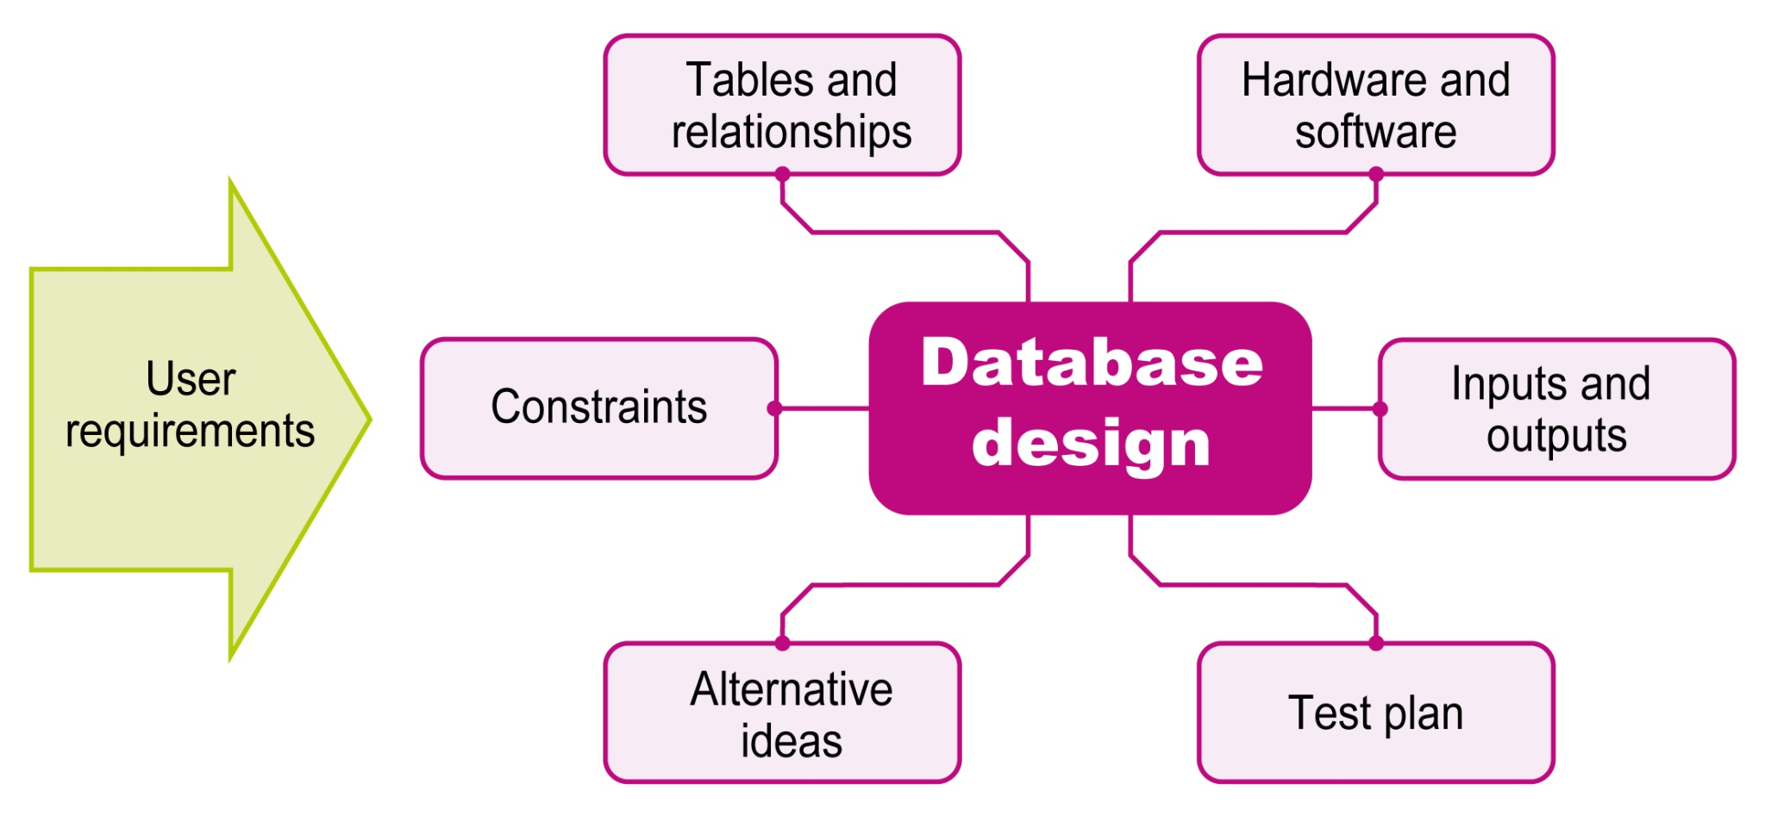
© Pearson Education Ltd 2012. Copying permitted for purchasing institution only.
Notes:
Emphasise importance of what the user needs.
Discuss each one with examples.
Question and confirm importance of doing the test plan at this early stage.

Slide 9
Learning aim C
Develop and test a relational database
© Pearson Education Ltd 2012. Copying permitted for purchasing institution only.

Slide 10
Developing and testing
This learning aim is mainly practical:
Creating the objects – tables, forms, queries and reports
Adding test data
Refining and improving the database
Testing
© Pearson Education Ltd 2012. Copying permitted for purchasing institution only.

Slide 11
Learning aim D
Review the finished relational database
© Pearson Education Ltd 2012. Copying permitted for purchasing institution only.

Slide 12
Reviewing
Two main areas to review:
  Does it work – are the outputs correct?
  Does it meet the needs of the user in
  terms of:
    working within the constraints
    usability
    fit for purpose?
© Pearson Education Ltd 2012. Copying permitted for purchasing institution only.

