Slide 1
Field characteristics

Slide 2
Field types
Every field must have a type
Type is chosen to reflect the data that is held in that field
Choosing the right type is important as it:
    starts the process of validation
    makes storage efficient
© Pearson Education Ltd 2012. Copying permitted for purchasing institution only.
Notes:
Three obvious types to offer as examples are text, number and date.
Talk through the setting of a date field as open text – ask what possible ways users might enter today’s date.. 4/5/2012, 4th May, May 4th 2012 – even 5/4/2012 if they are American. Setting the field to be of a special type called date enforces a particular style of entry that ensures the database captures what the user means.

Slide 3
‘Types’ of types
Text
Date and/or Time
Number
Currency
Yes/No
... and others
© Pearson Education Ltd 2012. Copying permitted for purchasing institution only.
Notes:
Text is the default one and by far the most commonly used.
Date and time are really the same value – in computer terms a particular point in time is stored as say 41004.75 The whole number is the number of days after 1900 and the decimal is the fraction of the current day in this case 6 pm in the evening. What is seen by the user depends on how that date is formatted.
Number – obvious but talk through a telephone number – what would happen if you set a field to be a number and entered 0789-56434 (0 ignored and – treated as minus sign)
Currency is really number but the dec places is set to 2 and it always shows a currency sign (in our case a £) at the front.
Yes/No – very efficient on space – only need a single bit –can be used to store something that is in one state or another – on/off , in/out, yes/no eg Retired or still working
Short shelf life or not
Breakable or not

Slide 4
Primary key
One field within each table is normally chosen to be the primary key
Unique identifier for each record
Usually a numeric or alphanumeric code
Ensures each record can be uniquely identified
© Pearson Education Ltd 2012. Copying permitted for purchasing institution only.
Notes:
Query learners on examples
Cars (reg plate)
Items for sale in shop (bar code or product reference)
Etc etc

Slide 5
Validation
Validation is used to try and avoid incorrect data entry
Choosing the right TYPE is part of validation but there is more …
Validation starts with the design of the table and the setting of the properties of each field
Additional validation controls can be placed on data entry forms, e.g. drop-down lists
© Pearson Education Ltd 2012. Copying permitted for purchasing institution only.
Notes:
Best to control the data as it goes in – as much validation on what people type as possible
If data in database cannot be relied upon then whole purpose of database waste of time..
Ideal form of validation is to give a drop down list – people only choose pick by mouse from a given list – no errors in data entry at all (unless they pick the wrong choice – that needs verification)

Slide 6
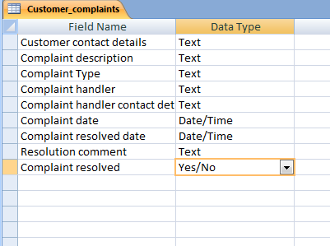
To validate, you can check:
Data type
Number range
Date range
Length of data item
Format
Choosing the best type is the first step in ensuring valid entries
© Pearson Education Ltd 2012. Copying permitted for purchasing institution only.
Notes:
Examples
The data type is the first line of defence: e.g. if you set a field as a yes/no then only those values will be accepted. Also if you set a data type as a number – you cannot enter a character. Avoids the letter O being entered instead of 0 for example
If you are adding dates of birth then you can limit the date range to ones that you know are realistic.
Much validation can take place when you are creating the table.

Slide 7
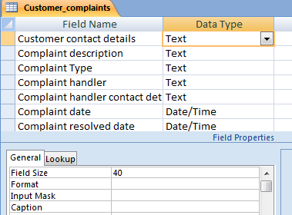
Field size
Text fields have default of 255 characters
Designer estimates the maximum length of any one value entered and sets accordingly
Advantage: if you know a code number has only 6 characters and set field size accordingly, people cannot enter 7 characters
Length of customer contact details set to 40 characters
© Pearson Education Ltd 2012. Copying permitted for purchasing institution only.
Notes:
If you need an open comment field and if the length of the comment is unknown but could be very large then use a memo field - but it adds complexity to the database creation and form layouts etc so suggest avoiding it.

Slide 8
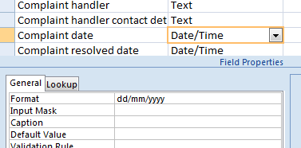
Format
This affects the ways the data is displayed and/or printed. It does not change the data in the field.
Examples
  > forces all text to upper case
  [red] forces text to be displayed in red
  dd/mm/yyyy works on date/time
  field to force
  format
Normal format for date shown; this can be altered if necessary
© Pearson Education Ltd 2012. Copying permitted for purchasing institution only.

Slide 9
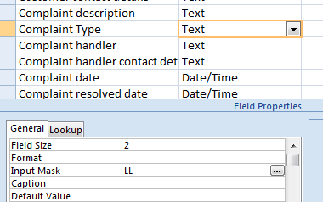
Input mask
Makes distinctions between text and numbers
Text set as L
Number set as 9
Example
If you set Field Size to 2 and input mask to LL you can only enter two text characters
© Pearson Education Ltd 2012. Copying permitted for purchasing institution only.
Notes:
This is a useful facility – particularly when a code can include alphabetic and numeric characters and you need to avoid I for 1, 0 for O.

Slide 10
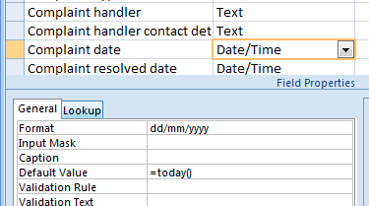
Default value
Any entry here will be the default value for that field
Can be changed by the user
Examples
  Date of an order – could be set to ‘today’ as most orders will be entered on the date they are created
  For a student age group field – if most are 16-19 and only a few 19+ then set default to 16-19
© Pearson Education Ltd 2012. Copying permitted for purchasing institution only.
Notes:
Default values can be overwritten.

Slide 11
Validation rule
Used with very specific set of values
Works with Validation Text
Example rule set – if all staff are in either Sales, Production or Marketing then set rule as:
  ‘Sales’ or ‘Production’ or ‘Marketing’
Data entry will only allow from this set of three and will display the Validation Text if not
© Pearson Education Ltd 2012. Copying permitted for purchasing institution only.
Notes:
Only validation mentioned in the learning aim content but verification also mentioned in the unit guidance so suggest a coverage of both. Some text books and websites do confuse the two so suggest keep to simple examples.

Slide 12
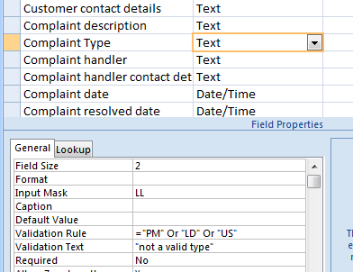
Validation Rule
Example
A useful example to control the input to a limited set of values
Validation Text is displayed if the validation rule is not followed
© Pearson Education Ltd 2012. Copying permitted for purchasing institution only.
Notes:
The combination of setting field size, input mask and validation rule creates a very tight situation and ensures that only valid data is entered.
It still does not stop the user entering a wrong (but valid) code.

Slide 13
Required values
Setting a field property to Required ensures that a user cannot leave the field blank – they must enter a value
  e.g. Surname, Postcode, Reference number
Use sparingly
Often seen on web data entry forms marked with *
© Pearson Education Ltd 2012. Copying permitted for purchasing institution only.
Notes:
Primary keys should always be required but if it is indexed then this will happen anyway. Can cause frustration at data entry time if overused.
When completing forms on the web for example, companies will insist on some fields being entered e.g. when giving a new password, you must enter it twice so that the system can check you know what you are typing..

Slide 14
Validation v verification
Verification is connected with validation and together they aim to make sure that the information entered is accurate and error free
Verification takes place before validation
Validation is:
  the process of detecting incomplete or unreasonable data – use of types or input masks are forms of validation
Verification is:
  used to check that the data entry is accurate – entering data twice is a form of verification
© Pearson Education Ltd 2012. Copying permitted for purchasing institution only.

