Slide 1
Design and Implementation of a Pan-Cancer Immune Interaction Database
Group G：Zhang Xinyu, Huang Yunzi, Tang Wanling,
Shen Yiqing, Li Yue

Slide 2
Background
The Need for Structured Pan-Cancer Data Integration
Abundant Data Foundation：Large-scale projects (e.g.TCGA) provide extensive pan-cancer data
Challenges:
Data fragmentation
Weak associations
Inconsistent formats: Heterogeneous data standards (e.g., TPM vs. log2(FPKM))
Why focus on immune-related data?
Core Biological Role: Immune signaling is a central driver of tumor initiation, progression, and therapeutic response
Functional Cohesion: Immune molecules form a well-defined, interconnected regulatory network, avoiding "disordered data aggregation" and ensuring focused analysis
To address the "data overload" issue and enhance research depth

Slide 3
Research Objectives
Build a normalized relational database dedicated to pan-cancer immune interactions:
Gene/protein annotations
Ligand-receptor interactions
Patient clinical data

Slide 4
Database Schema Design
Focused Cancer Types:
Breast Invasive Carcinoma (BRCA)
Colon Adenocarcinoma (COAD)
Lung Adenocarcinoma (LUAD)
Selection Rationale:
Sufficient data volume
Significant biological differences → easy to explore the "commonality + specificity" of secreted protein-receptors
Research hotspot matching
Table Design Principle: Third Normal Form (3NF)
Each entity (gene/cancer type/patient) corresponds to an independent table,
which is associated through foreign keys to avoid data redundancy

Slide 5
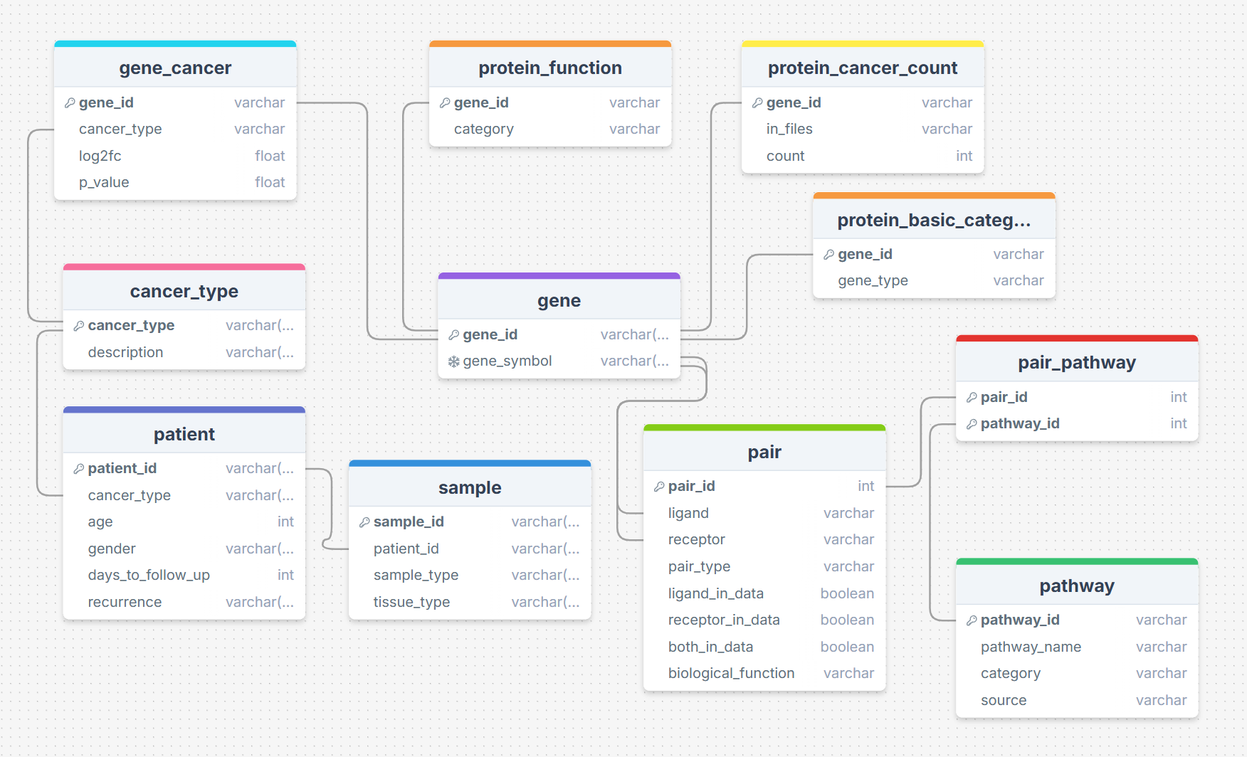
ER Diagram

Slide 6
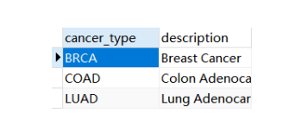
Cancer_Type Table
Primary Key

Slide 7
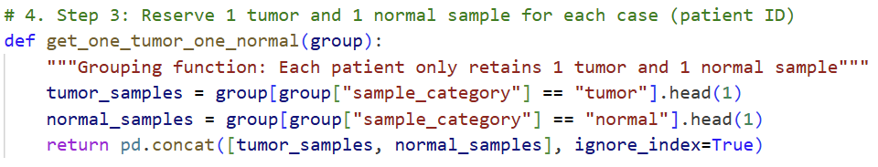
Patient & Sample Table
Data Source: TCGA database
Tool: python
Filter Criteria
Patient-Level Deduplication: Many are multiple - sample duplicates from the same patient (e.g. primary and metastatic lesion samples)

Slide 8
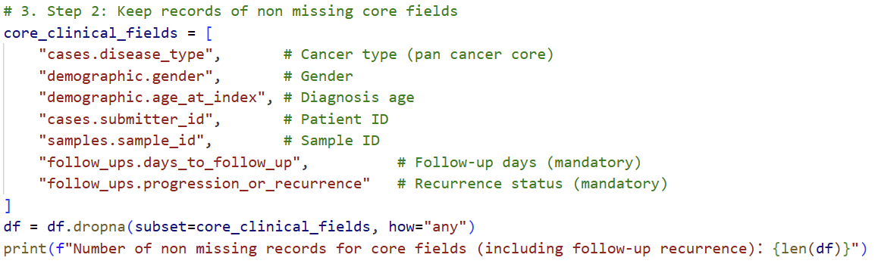
Patient & Sample Table
Data Source: TCGA database
Tool: python
Filter Criteria
Patient-Level Deduplication: Many are multiple - sample duplicates from the same patient (e.g. primary and metastatic lesion samples)
Core Field Non-Missing Filter: Cancer type, gender, and age are fundamental for pan-cancer analysis

Slide 9
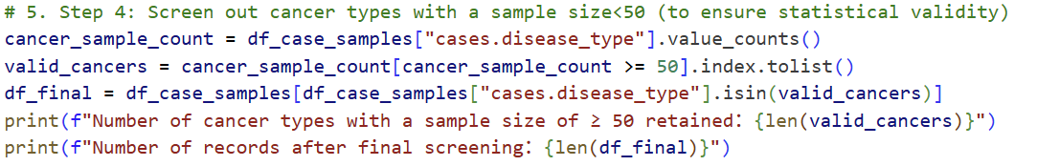
Patient & Sample Table
Data Source: TCGA database
Tool: python
Filter Criteria
Patient-Level Deduplication: Many are multiple - sample duplicates from the same patient (e.g. primary and metastatic lesion samples)
Core Field Non-Missing Filter: Cancer type, gender, and age are fundamental for pan-cancer analysis
Small-Cohort Filter: Patients with <50 samples lack statistical power and may bias pan-cancer conclusions

Slide 10
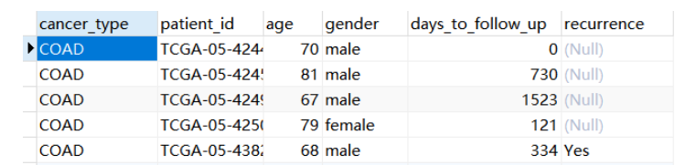
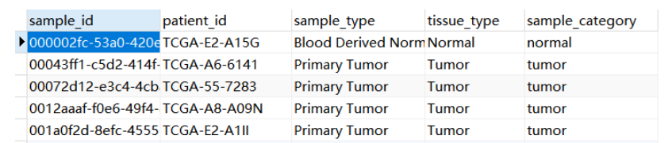
Patient & Sample Table
3NF, divided to two tables
patient table: primary key---patient_id, foreign key---cancer_type
sample table: primary key---sample_id, foreign key---patient_id

Slide 11
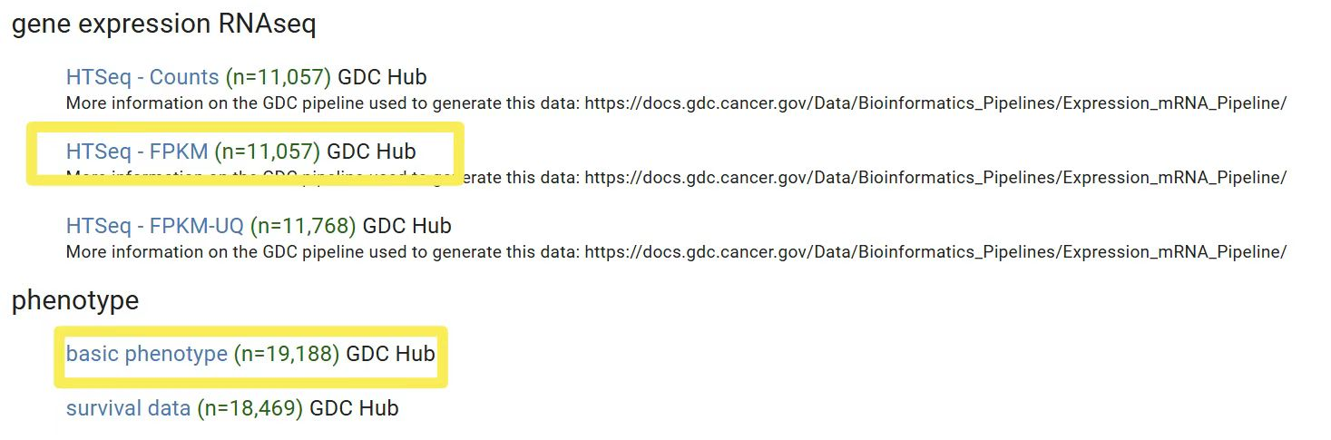
Gene_Cancer Table
Data Source:
- Expression Data: TCGA (via UCSC Xena)
- Gene Annotation: Human Protein Atlas (HPA)
Tool: R
Integration Logic：
Extract gene expression profiles of all patients from TCGA
- Format: Genes (rows) × Sample_id (columns)
- Values: FPKM_normalized expression
filtered for both tumor and matched normal tissue samples from patients with 3 interested cancers: BRCA, LUAD and COAD

Slide 12
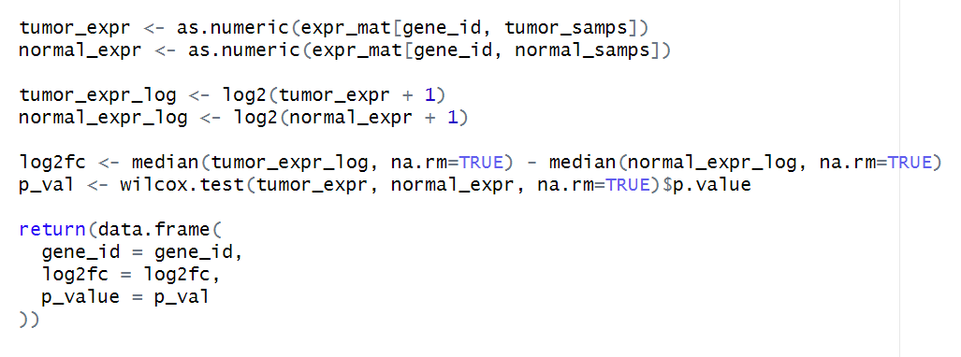
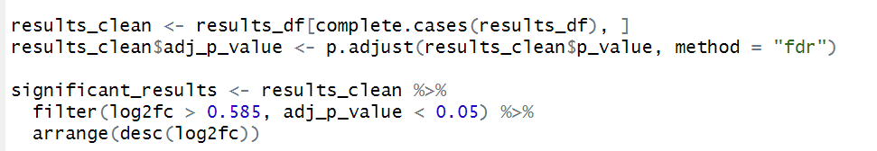
Gene_Cancer Table
Filter Logic：
Differential Expression Analysis:
-Calculate log₂FC (tumor vs. normal)
-Apply False Discovery Rate (FDR) correction
-Filter: |log₂FC| > 0.585 & adj.p < 0.05
Filter Immune-focused secreted and receptor screening basing on HPA
Merge cross-cancer gene data into a single structured table

Slide 13
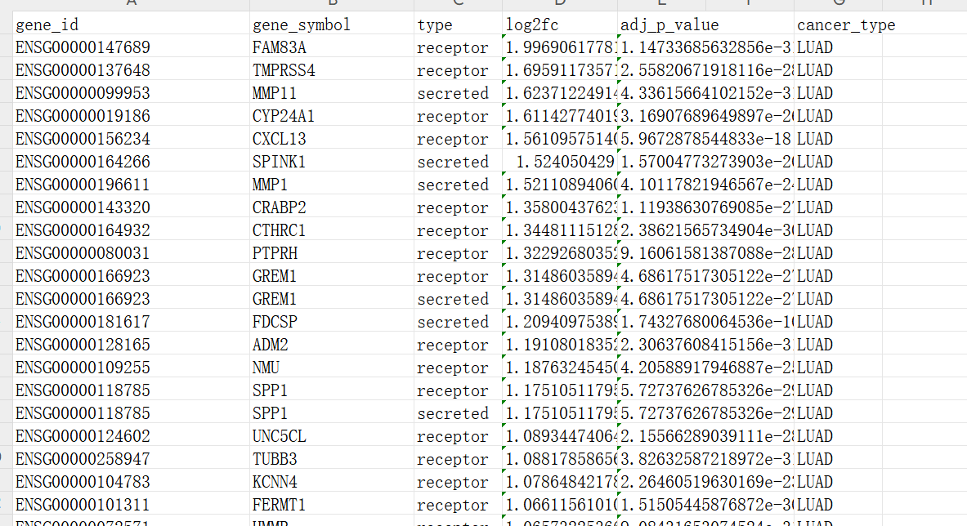
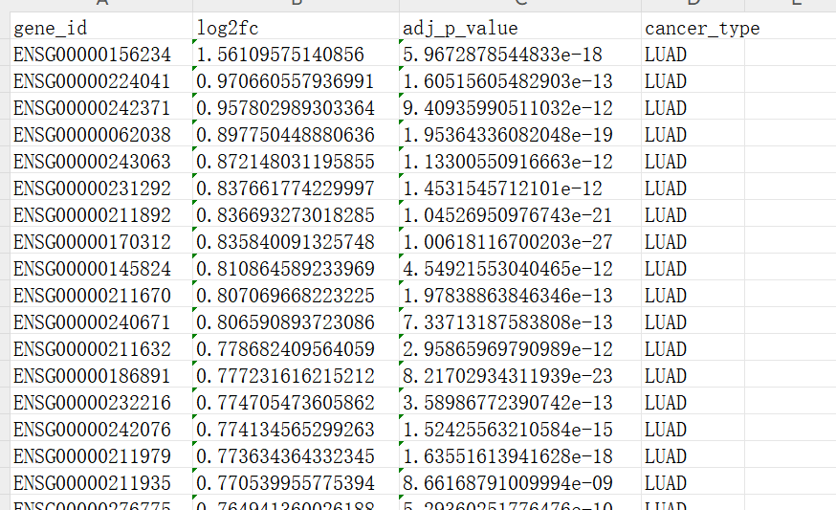
Gene_Cancer Table
Intermediate Table
Final Gene_cancer table

Slide 14
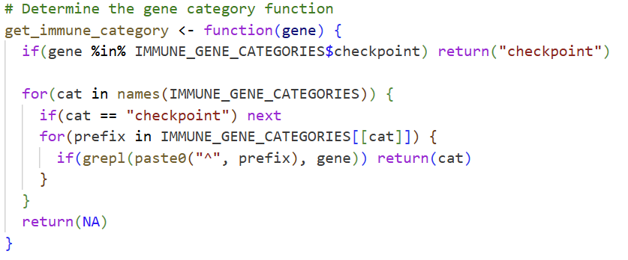
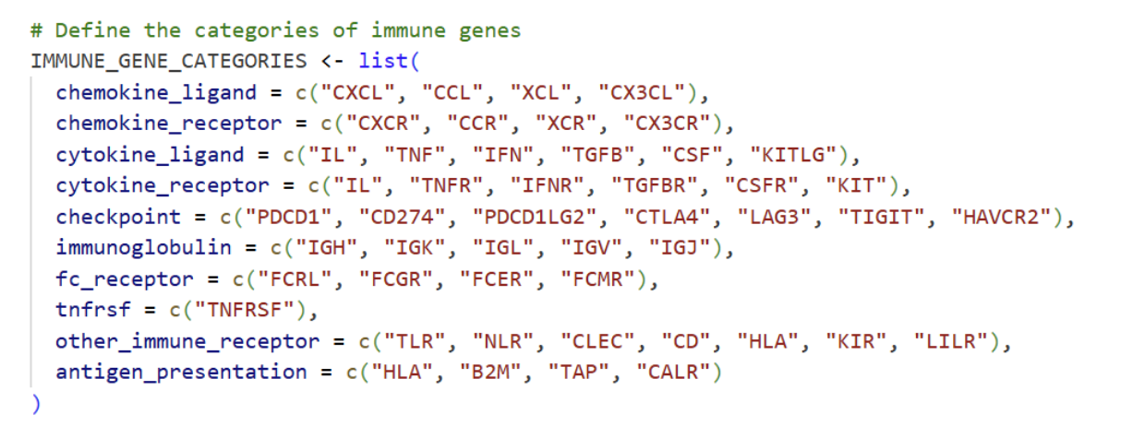
Gene & Protein Tables
Data Source: TCGA (via UCSC Xena)
Tool: R
Integration Logic:
Aggregate significant differential expression results across cancers
- Generate in_files indicator
- Count occurrences: number of cancers where gene is significant
Label immune category

Slide 15
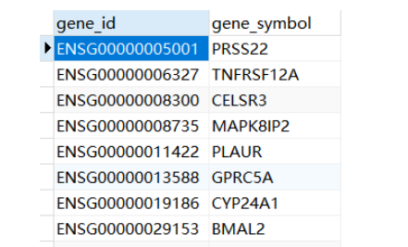
Gene Table
Gene Identifier Mapping:
Extract IDs
Extract unique gene_ids from filtered results
Reference
The latest HPA gene annotation file
File contains gene_ids to gene_symbol mappings
Execute Mapping
Match filtered genes with HPA file via gene_ids
Retrieve corresponding official gene_symbol for each id

Slide 16
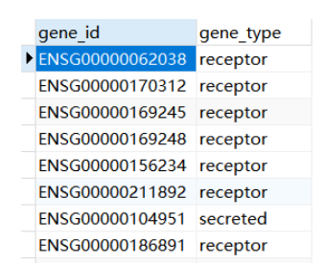
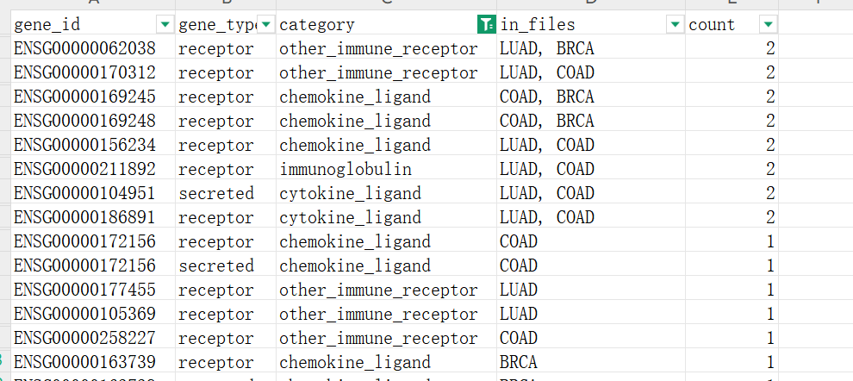
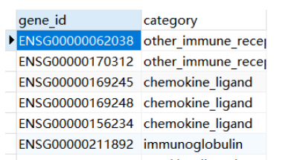
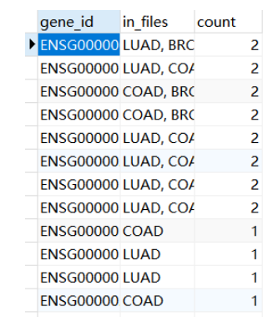
Protein Tables
Intermediate table
Devided 3 tables basing 3NF principle
protein_basic_category
table
protein_function
table
protein_cancer_count
table

Slide 17
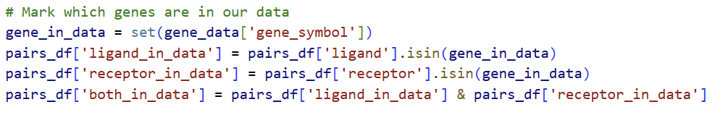
Pair Table
Data Source: CellphoneDB
Tool: python
Diverse Pair Types:
Includes Fc receptors, immune checkpoints, etc., requiring category-specific analysis
Functional Variability: Different pairs are involved in distinct biological functions, necessitating targeted selection based on research focus
Filtering Criteria:
Deduplication: One unique entry per gene_id
At Least One Principle: At least one of the ligand or receptor is present in the original gene data
Label each pair an Arabic numeral as pair_id

Slide 18
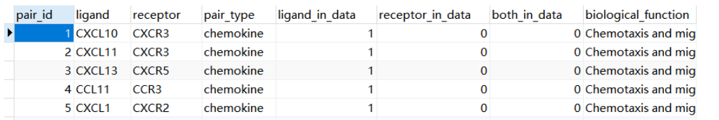
Pair Table
Data Source: CellphoneDB
Tool: python
Diverse Pair Types:
Includes Fc receptors, immune checkpoints, etc., requiring category-specific analysis
Functional Variability: Different pairs are involved in distinct biological functions, necessitating targeted selection based on research focus
Filtering Criteria:
Deduplication: One unique entry per gene_id
At Least One Principle: At least one of the ligand or receptor is present in the original gene data
Label each pair an Arabic numeral as pair_id

Slide 19
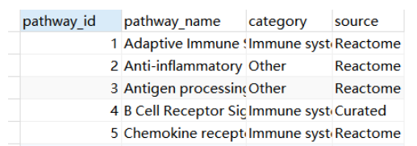
Pathway Table
Data Source: Reactome
Tool: python
Filtering Criteria:
Pathways related to immune system
Assign unique numerical pathway_id to each selected pathway

Slide 20
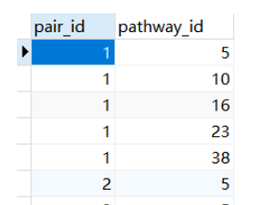
Pair_Pathway Table
Connects ligand-receptor pairs to their biological pathways
Enables many-to-many relationship analysis
Key Design:
Foreign Key Constrained
Composite Key: (pair_id, pathway_id)
Minimal Design: Stores only relationship mappings

Slide 21
Database Construction
MySQL for table creation and import
DrawSQL for ER diagram visualization
Construction Process:
Python/R for data preprocessing

Slide 22
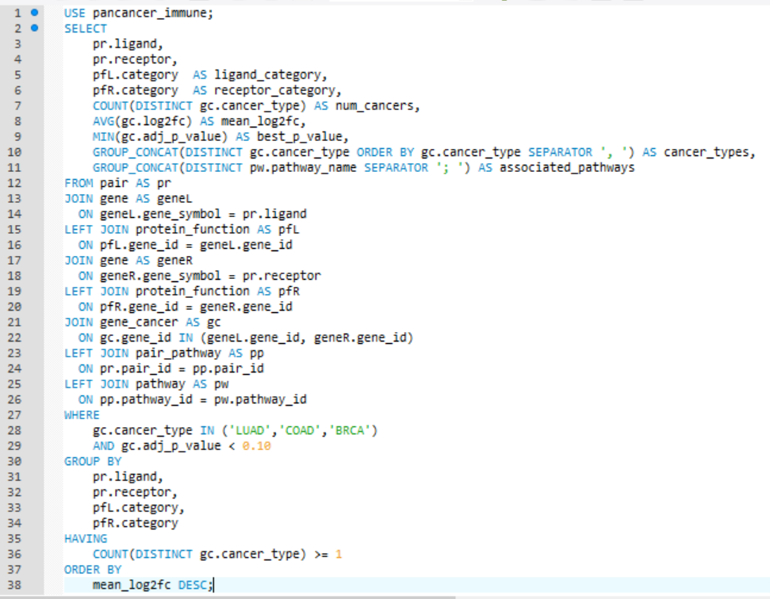
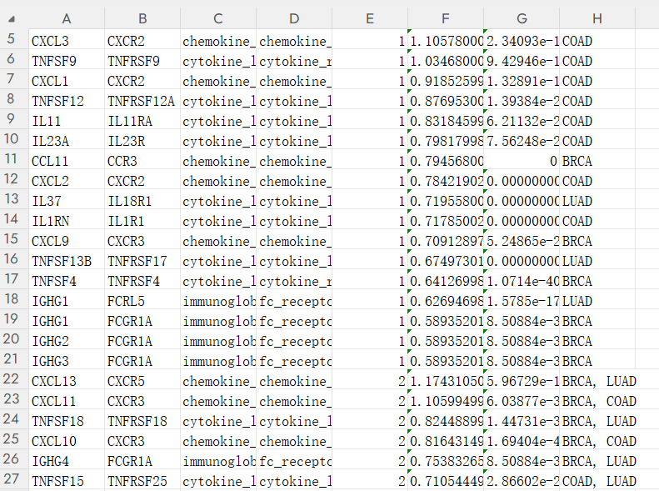
Example Query
Which ligand-receptor signaling pairs involved in immune function are recurrently and significantly dysregulated across LUAD, COAD, and BRCA, and what are their expression patterns and associated biological pathways?

Slide 23
Conclusion
Core Achievement: Build a streamlined, high-value pan-cancer immune interaction database
Problems Addressed
Cut redundant data processing
Enabled in-depth tumor-immune mechanism exploration
Connected pan-cancer data to clinical immune research
Future Directions
Expand data sources (single-cell, spatial transcriptomics)
Add immunotherapy response prediction modules
Develop a user-friendly web interface

Slide 24
Contribution
Huang Yunzi: Pathway table & Construct database &Presentation
Li Yue: Pair table & Make slides
Shen Yiqing: Pair table & Make slides
Tang Wanling: Pathway table & Presentation
Zhang Xinyu: Patient and sample table & Presentation
Together: Gene & Protein table

Slide 25
Thank you!

