Slide 1



Slide 2

5 STEP GAME PLAN
LOAD AFINN LEXICON
LOAD CORPUS OF POSITVE TWEETS AND NEGATIVE TWEETS
GET THE FREQUENCY OF SENTIMENT WORDS IN EACH TWEET
MACHINE LEARN THE RECOGNITION OF POLARITY OF TWEETS
APPLY ON FRESHLY MINED TWEETS

Slide 3
LOAD AFINN LEXICON
AFFIN IS A LEXICON OF WORDS CONVEYING SENTIMENT
WORDS ARE SCORED FROM -5 TO 5
-5 AS VERY NEGATIVE TO 5 AS VERY POSITVE
FOR EG:
WORDS | SCORE
damn | -4
fabulous | 4
failed | -2
good | 3

Slide 4
CATEGORIZING WORDS
SCORE | CATEGORY
-5 TO -4 | VERY NEGATIVE
-3 TO -1 | NEGATIVE
1 TO 3 | POSITIVE
4 TO 5 | VERY POSITIVE

Slide 5
5 STEP GAME PLAN
LOAD AFINN LEXICON
LOAD CORPUS OF POSITVE TWEETS AND NEGATIVE TWEETS
GET THE FREQUENCY OF SENTIMENT WORDS IN EACH TWEET
MACHINE LEARN THE RECOGNITION OF POLARITY OF TWEETS
APPLY ON FRESHLY MINED TWEETS

Slide 6
2. LOAD CORPUS
BACKGROUND CORPUS OF KNOWN POSITIVE TWEETS AND NEGATIVE TWEETS IS LOADED
THIS IS FOR MACHINE TO LEARN CATEGORIZING POSITIVE AND NEGATIVE TWEETS

Slide 7
5 STEP GAME PLAN
LOAD AFINN LEXICON
LOAD CORPUS OF POSITVE TWEETS AND NEGATIVE TWEETS
GET THE FREQUENCY OF SENTIMENT WORDS IN EACH TWEET
MACHINE LEARN THE RECOGNITION OF POLARITY OF TWEETS
APPLY ON FRESHLY MINED TWEETS

Slide 8
GETTING FREQUENCY
INDIVISUALL TWEETS ARE PROCESSED AND FREQUENCY OF vPOS ,POS, vNEG, NEG IS DETERMINED
TWEET | vNEG | NEG | POS | vPOS
Like freaking Japan was second in 4x100m but no one cares bc Bolt did what everyone knew he would do.\n#Olympics | 0 | 1 | 2 | 0
Let love be without hypocrisy. Abhor what is evil. Cling to what is good. -Romans 12:9- #Bible | 0 | 1 | 1 | 0
RT @KandeCHil: Happy Friday. Have a wonderful weekend! #weekend #happy #chilling #relaxingtime… https://t.co/IRgZ3rhmML | 0 | 0 | 1 | 1

Slide 9
BIND THE KNOWN SENTIMENT
SINCE WE ARE TAKING THE TWEETS FROM POSITIVE AND NEGATIVE CORPUS WE KNOW THE SENTIMENT OF THE TWEET FIRST HAND
TWEETS | vNEG | NEG | POS | vPOS | SENTIMENT
the people who are worth it know how much i love the da vinci code | 0 | 0 | 2 | 0 | POSITIVE
we're gonna like watch Mission Impossible or Hoot.( 0 0 1 0 positive | 0 | 0 | 1 | 0 | POSITIVE
The Da Vinci Code sucked big time. | 1 | 0 | 0 | 0 | NEGATIVE
I hated Da Vinci Code.. 0 1 0 0 negative | 0 | 1 | 0 | 0 | NEGATIVE

Slide 10
5 STEP GAME PLAN
LOAD AFINN LEXICON
LOAD CORPUS OF POSITVE TWEETS AND NEGATIVE TWEETS
GET THE FREQUENCY OF SENTIMENT WORDS IN EACH TWEET
MACHINE LEARN THE RECOGNITION OF POLARITY OF TWEETS
APPLY ON FRESHLY MINED TWEETS

Slide 11
GET A NAÏVE BAYES CLASSIFIER
WE GENERATE A NAÏVE BAYES CLASSIFIER FOR CLASSIFYING POLARITY OF TWEETS.
CLASSIFIER LEARNS FROM THE FREQUNCY OF vNEG, NEG, POS, Vpos results[,2:5] WORDS AND CORRESPONDING SENTIMENT results[,6].
classifier <- naiveBayes(results[,2:5], results[,6])

Slide 12
We run the classifier on the known polarity to check the accuracy of the classifier

Slide 13

CONFUSION MATRIX
A confusion matrix can help visualize the results of a classification algorithm.
actual
predicted positive negative
positive 3833 616
negative 162 2475
confTable <- table(predict(classifier, results), results[,6], dnn=list('predicted','actual'))

Slide 14
PERCENTAGE ACCURACY
binom.test(confTable[1,1] + confTable[2,2], nrow(results), p=0.5)
Since this experiment conforms to a Bernoulli Distribution.
On 95% confidence interval
program would get correct prediction between 88.2% and 89.7%
Making the percentage of success: 89.02%

Slide 15
ALMOST DONE!

Slide 16
5 STEP GAME PLAN
LOAD AFINN LEXICON
LOAD CORPUS OF POSITVE TWEETS AND NEGATIVE TWEETS
GET THE FREQUENCY OF SENTIMENT WORDS IN EACH TWEET
MACHINE LEARN THE RECOGNITION OF POLARITY OF TWEETS
APPLY ON FRESHLY MINED TWEETS

Slide 17
HARVEST THE TEST TWEETS
SETUP TWITTER WITH API CREDENTIALS FROM TWITTER
SEARCH THE TWITTER FOR KEYWORD
OUR CASE: #brexit
NOTE:
THE #TAG TO BE SEARCHED IS USER INPUT AND DYNAMICALLY PROCESSED .
USER CAN SCROLL THE NUMBER OF TWEETS TO BE ANALYSED.
USER CAN CHOOSE THE TYPE OF TWEETS TO BE MINED (mixed, recent, popular)
USER CAN CHOOSE THE “since” AND “until” FOR THE TWEETS
setup_twitter_oauth(api_key,api_secret,access_token,access_token_secret)
tweets = searchTwitter(“#brexit")

Slide 18
APPLY THE CLASSIFIER ON TEST TWEETS
prediction = predict(classifier, Result) #predicting polarity
Result = cbind(Result,prediction)

Slide 19
ANALYSED!!!
THE DATA FRAME “Result” CONTAINS THE COMPLETE ANALYSIS
SENTENCE | vNEG | NEG | POS | vPOS | PREDICTION
Co-op Bank warns low interest rates in the wake of Brexit will hit growth - | 1 | 2 | 3 | 1 | negative
This is not even a story, totally non-sensical. Has nothing to do with #Olympics or #Brexit. | 1 | 1 | 1 | 1 | negative
RT @Australiaunwra6: The UK pays child benefit and child tax credits to almost 50,000 children who live in another EU country, money spent… | 1 | 1 | 2 | 1 | positive
Co-op Bank warns low interest rates in the wake of Brexit will hit growth - https://t.co/mXUklJ0HR6 https://t.co/9ART6hqK8R | 1 | 2 | 3 | 1 | negative

Slide 20
DASHBOARD SNAPS!

Slide 21
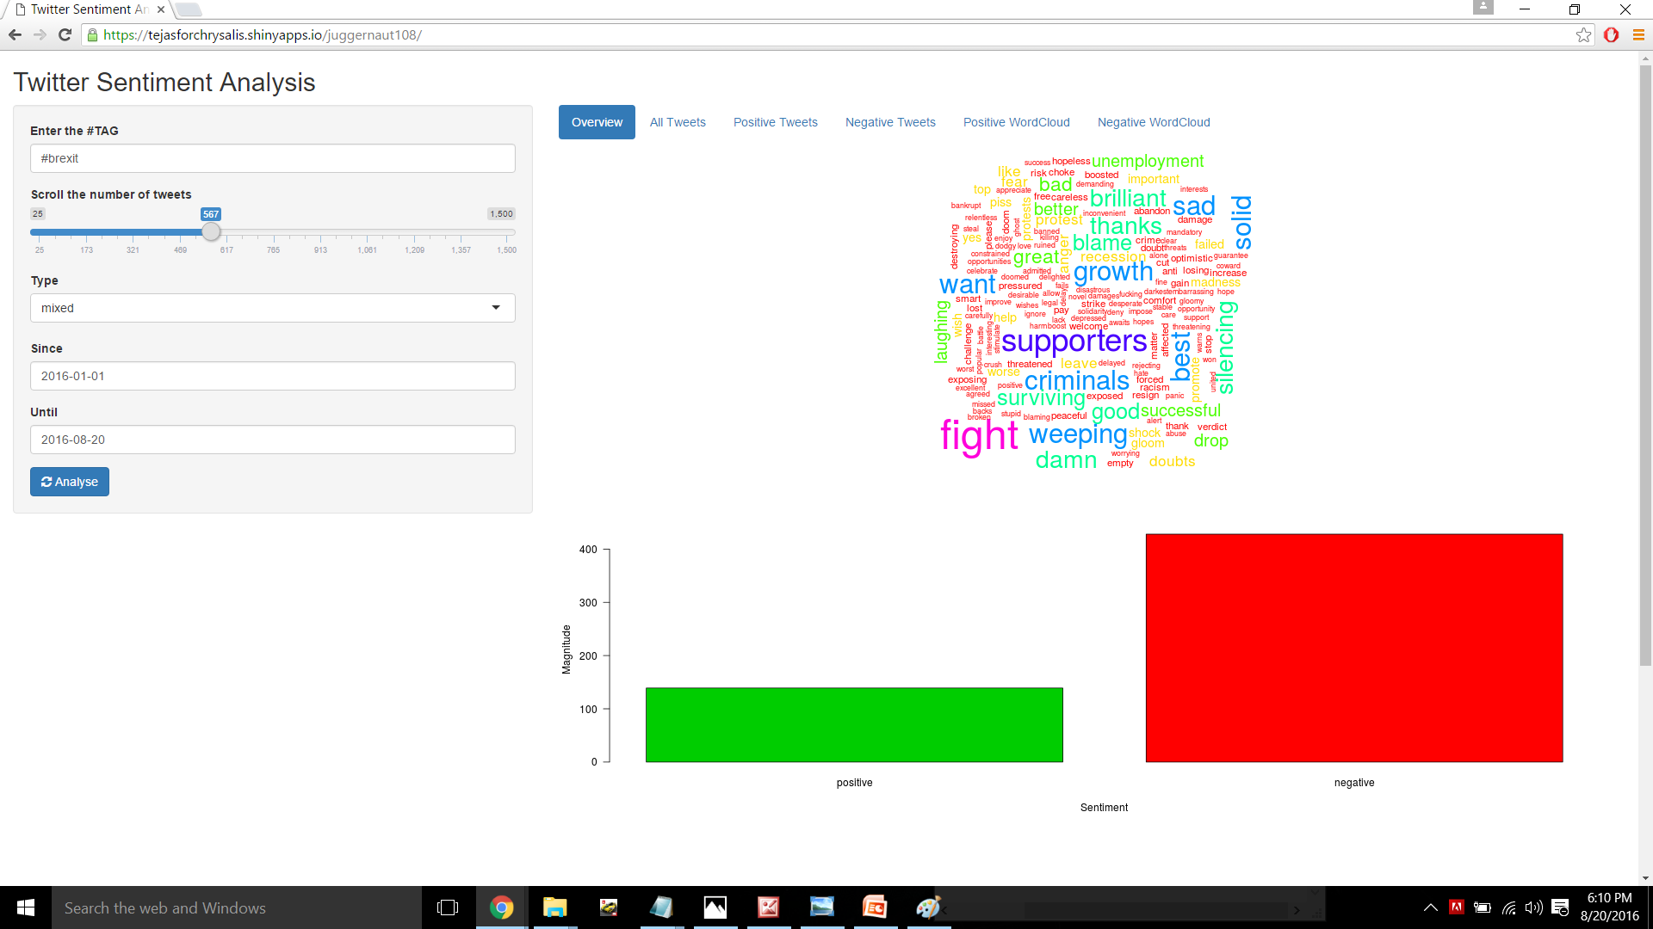

Slide 22
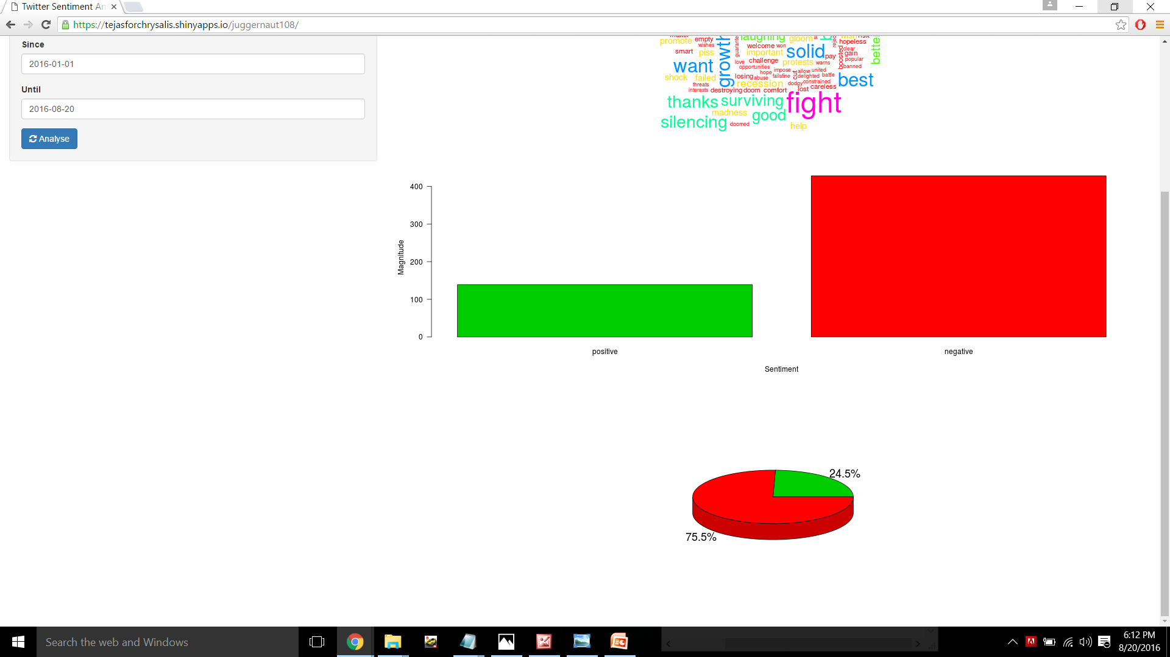

Slide 23
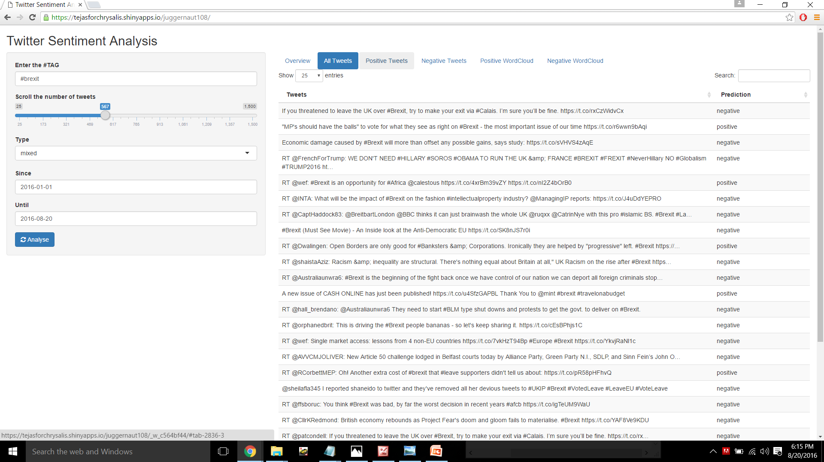

Slide 24
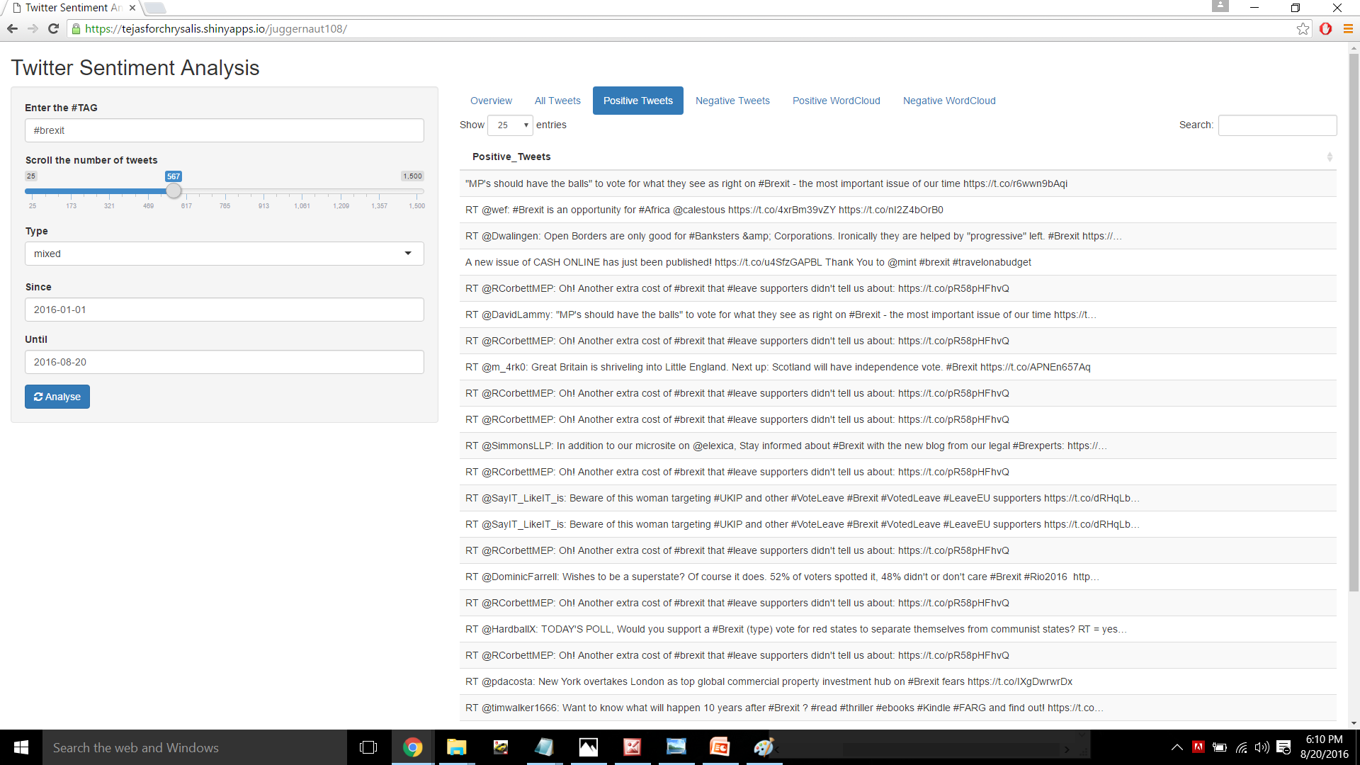

Slide 25
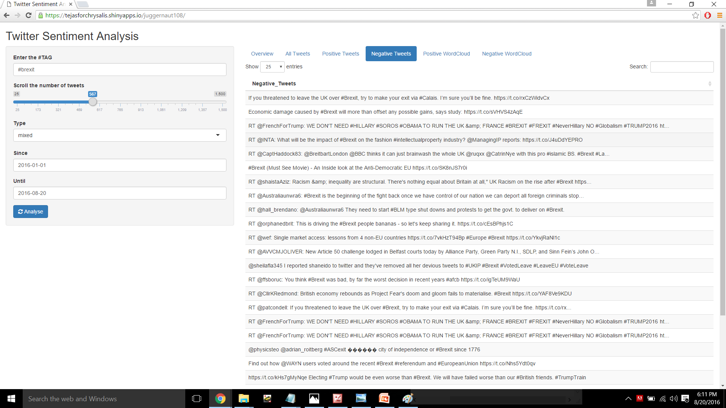

Slide 26
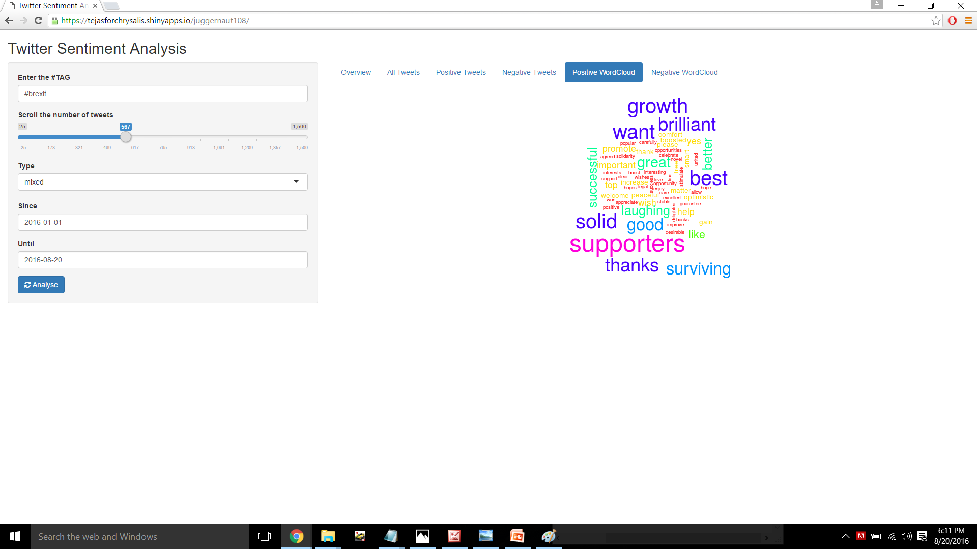

Slide 27
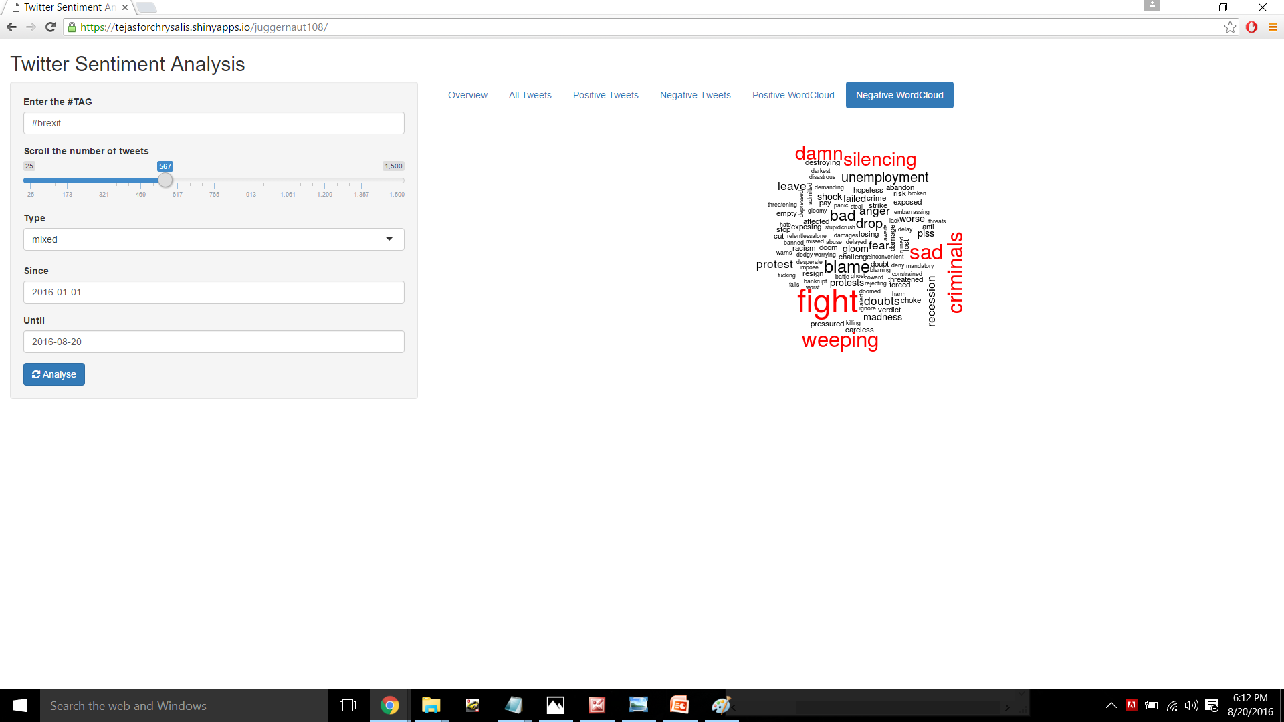

Slide 28


