Slide 2
Question 1
Significant research has been done to understand whether a breast tumor is benign or malignant. Aarushi wants to create a classifier that predicts whether a tumor is benign or not.
Draw the decision boundary that the knearest neighbors algorithm (with k = 3) would generate for this problem

Slide 3
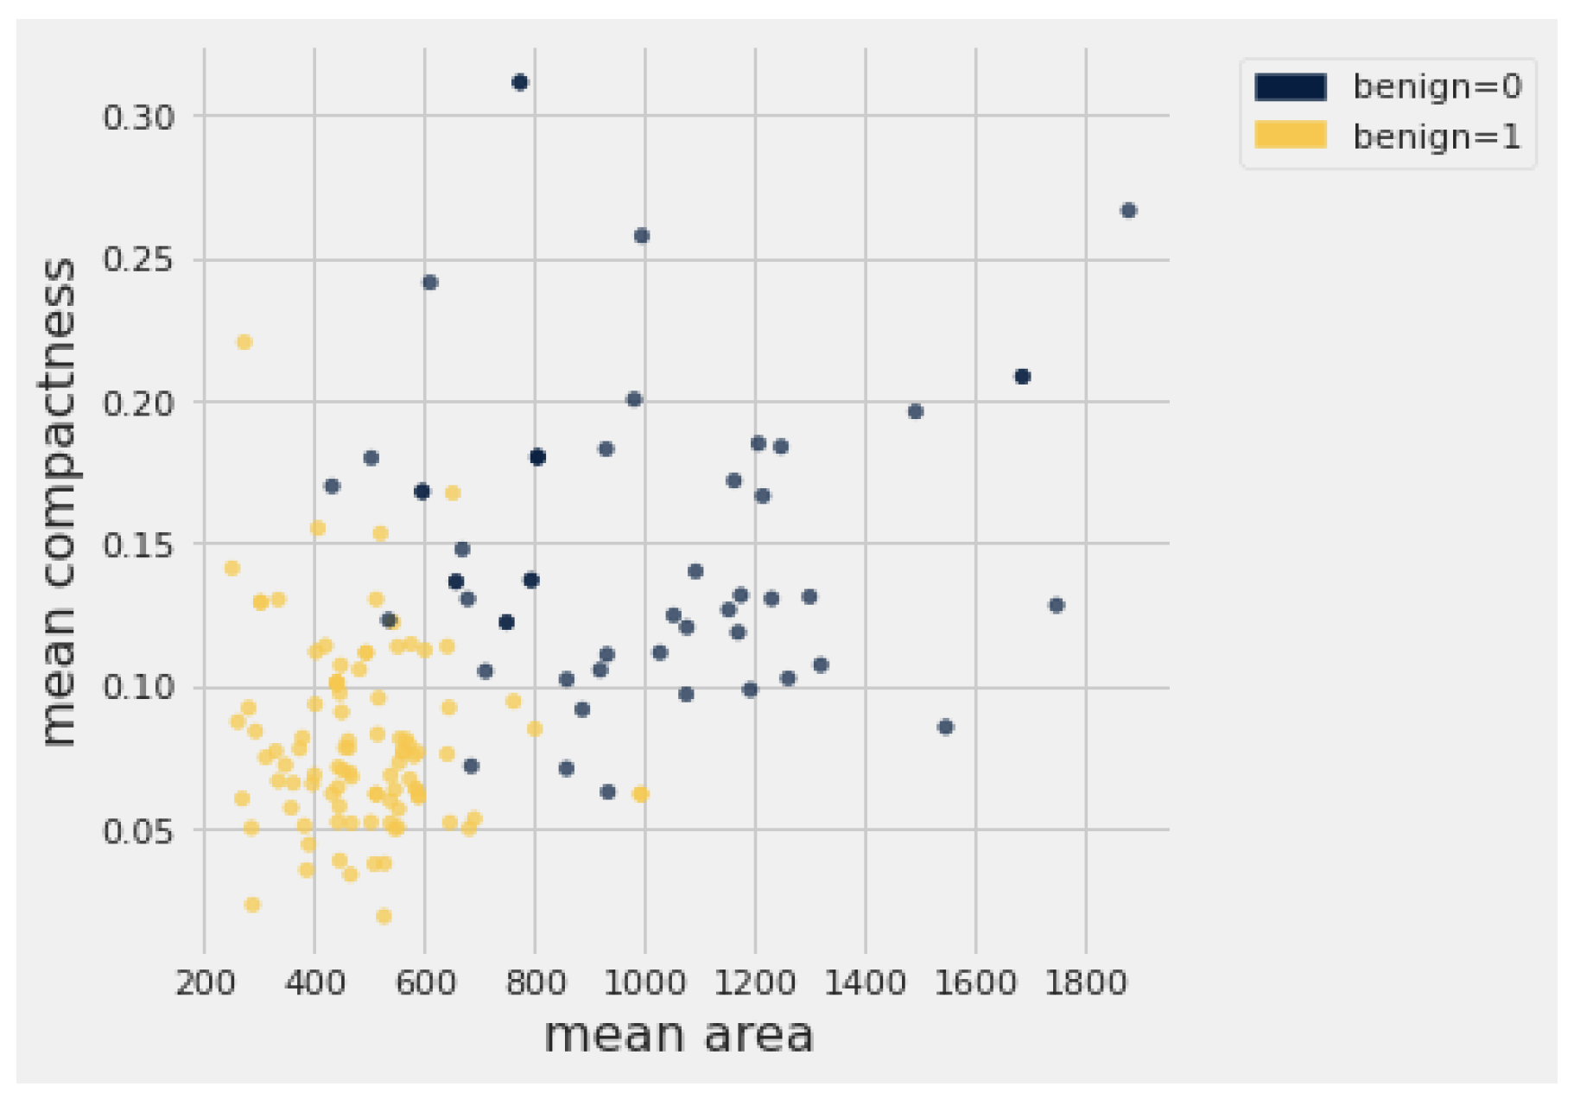
Question 1

Slide 4
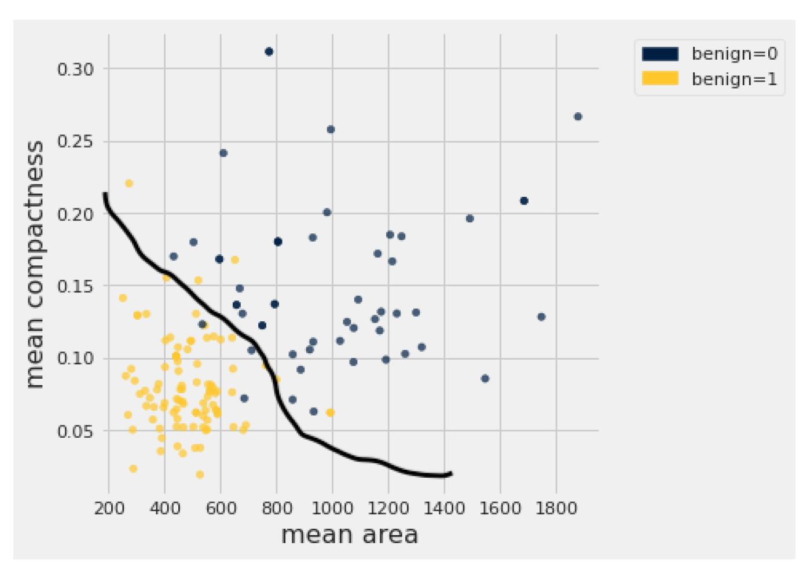
Question 1 answer

Slide 5
Steps
Compute the euclidean distance between the new point and all the points in our dataset.
Sort all the data based on the calculated distance.
Take the top 3 neighbors and take a majority vote.

