Slide 1
Regression Error

Slide 2
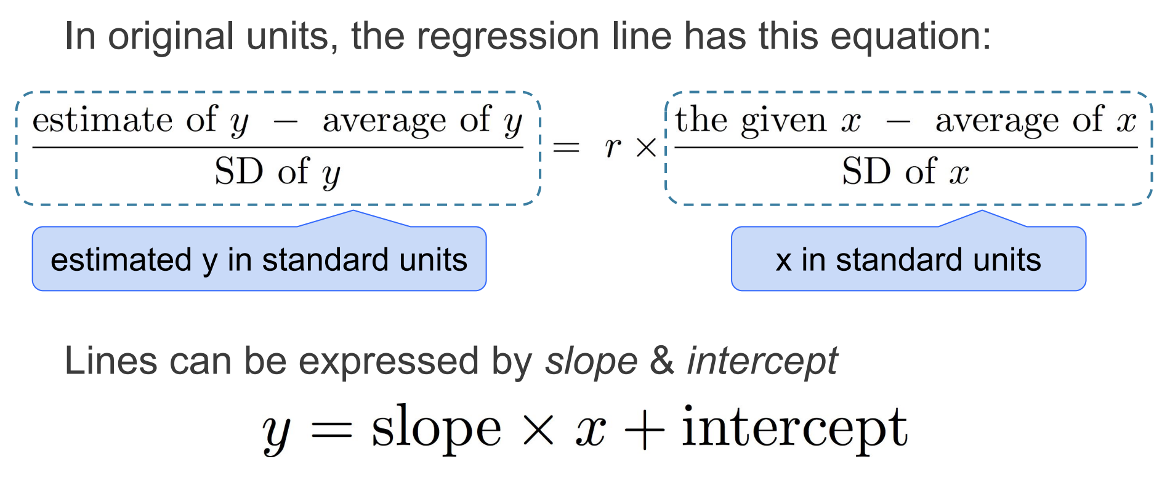
Regression Line Equation

Slide 3
Regression Estimate
Goal: Predict y using x
To find the regression estimate of y:
Convert the given x to standard units
Multiply by r
That’s the regression estimate of y, but:
It’s in standard units
So, convert it back to the original units of y

Slide 4
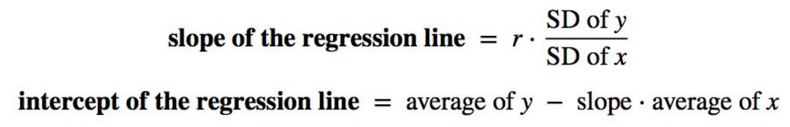
Slope and Intercept in Original Units
estimate of y = slope * x + intercept

Slide 5
Error in Estimation
error = actual value − estimate
Typically, some errors are positive and some negative
To measure the rough size of the errors
square the errors to eliminate cancellation
take the mean of the squared errors
take the square root to fix the units
root mean square error (rmse)

Slide 6
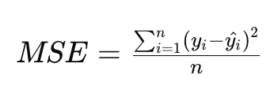

Root Mean Square Error
The mean squared error or MSE is a measure of the average squared difference between the observed values and the values predicted by a model. It's commonly used to evaluate the performance of regression models.
The root mean square error (RMSE) is another commonly used metric to evaluate the performance of regression models. It's similar to the mean squared error (MSE), but it's the square root of the average of the squared differences between the observed values and the predicted values.
The regression line is the line that minimizes the RMSE

Slide 7
Numerical Optimization
Numerical minimization is approximate but effective
If the function mse(a, b)returns the mse of estimation using the line “estimate = ax + b”,
then minimize(mse)returns array [a₀, b₀]
a₀ is the slope and b₀ the intercept of the line that minimizes the mse among lines with arbitrary slope a and arbitrary intercept b (that is, among all lines)

Slide 8
Least Squares Line
Minimizes the root mean squared error (rmse) among all lines
Equivalently, minimizes the mean squared error (mse) among all lines
Names:
“Best fit” line
Least squares line
Regression line

Slide 9
Residuals
Error in regression estimate
It is the difference between the regression estimate and the actual value we are trying to estimate
One residual corresponding to each point (x, y)
residual
= observed y - regression estimate of y
= observed y - height of regression line at x
= vertical distance between the point and the best line

