Slide 1
Regular Expression Equivalence via Derivatives
Fabian Hellauer
Notes:
a development which is in the archive of formal proofs

Slide 2
Languages
Words are lists.
Notes:
(infinite languages also have infinite derivatives)
if the representations of languages are finite, we can hope to get a machine to compare them.

Slide 3
Languages
Words are lists.
Languages are sets of words.
Notes:
(infinite languages also have infinite derivatives)
if the representations of languages are finite, we can hope to get a machine to compare them.

Slide 4
Languages
Words are lists.
Languages are sets of words.
Interesting languages are the infinite ones.
Notes:
(infinite languages also have infinite derivatives)
if the representations of languages are finite, we can hope to get a machine to compare them.

Slide 5
Languages
Words are lists.
Languages are sets of words.
Interesting languages are the infinite ones.
Regular expressions (REs) are finite representations of languages
Notes:
(infinite languages also have infinite derivatives)
if the representations of languages are finite, we can hope to get a machine to compare them.

Slide 6
Regular Expressions
L(∅) = ∅
L(ε) = {[]}
L(a) = {[a]}
L(r + s) = L(r) ∪ L(s)
L(r · s) = L(r)L(s)
L(r*) = (L(r))*

Slide 7

Regular Expressions
L(∅) = ∅
L(ε) = {[]}
L(a) = {[a]}
L(r + s) = L(r) ∪ L(s)
L(r · s) = L(r)L(s)
L(r*) = (L(r))*
Equivalence problem:
Is L($r_{1}$) = L($r_{2}$) ?

Slide 8
Goal
Equivalence checker for REs
Sample goal:
L ((ε + a ⋅ b)* ⋅ (b + a)) = L ((a ⋅ b + ε)* ⋅ (a + b))
→ have the machine prove that for us
Notes:
This is a decidable theory, so there is such an algorithm
complete: if L($r_{1}$) = L($r_{2}$), the method should prove it
Implications for the design: We are only interested in verfying partial correctness, for the termination we are happy with an informal proof

Slide 9
The textbook method
A naive algorithm to decide RE equivalence:

Slide 10
The textbook method
A naive algorithm to decide RE equivalence:
construct NFAs from the REs

Slide 11
The textbook method
A naive algorithm to decide RE equivalence:
construct NFAs from the REs
convert the NFAs to DFAs

Slide 12
The textbook method
A naive algorithm to decide RE equivalence:
construct NFAs from the REs
convert the NFAs to DFAs
minimize the DFAs

Slide 13
The textbook method
A naive algorithm to decide RE equivalence:
construct NFAs from the REs
convert the NFAs to DFAs
minimize the DFAs
For each of these steps, we would have to
express an algorithm

Slide 14
The textbook method
A naive algorithm to decide RE equivalence:
construct NFAs from the REs
convert the NFAs to DFAs
minimize the DFAs
For each of these steps, we would have to
express an algorithm
prove that this algorithm preserves the represented language

Slide 15
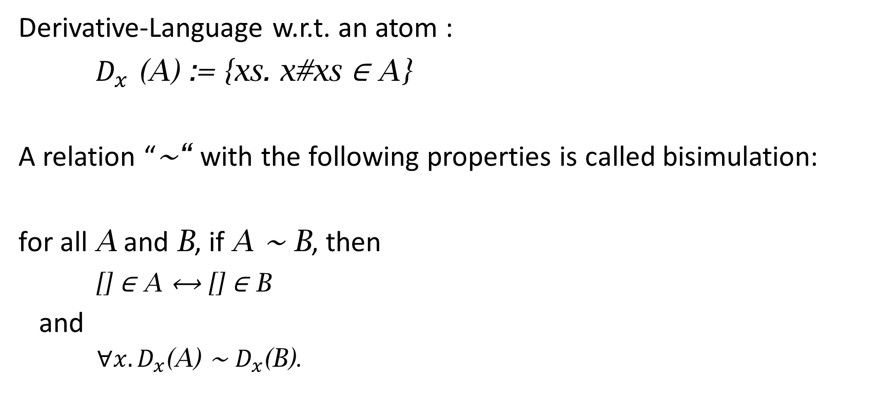
Bisimulation
Derivative-Language w.r.t. an atom :
$D_{x}$ (A) := {xs. x#xs ∈ A}
A relation “∼“ with the following properties is called bisimulation:
for all A and B, if A ∼ B, then
[] ∈ A ⟷ [] ∈ B
and
${∀x. D}_{x}$(A) ∼ $D_{x}$(B).
Notes:
A Bisimulation is a _relation_ with the following properties
(
Now assume we have a RE expression that describes the derivative language of another RE.
We can then make this bisimulation property computable by instantiating the languages here with L (…)
)

Slide 16
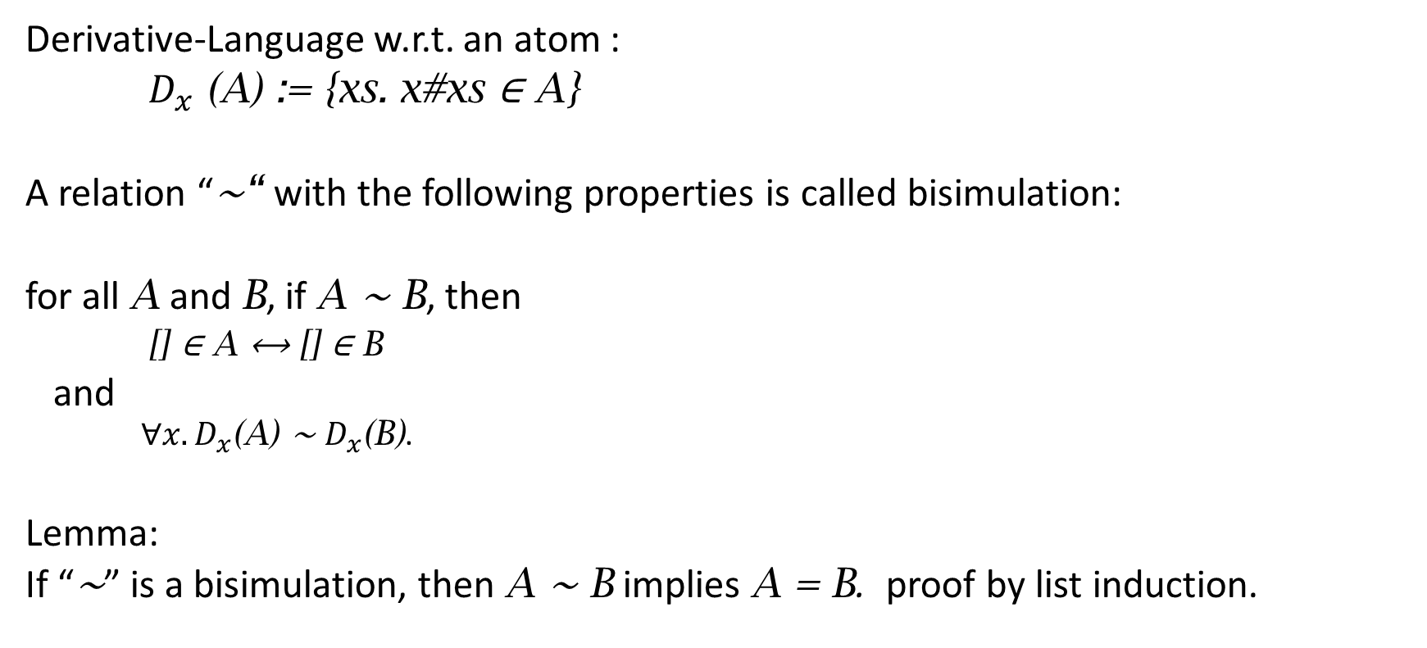
Bisimulation
Derivative-Language w.r.t. an atom :
$D_{x}$ (A) := {xs. x#xs ∈ A}
A relation “∼“ with the following properties is called bisimulation:
for all A and B, if A ∼ B, then
[] ∈ A ⟷ [] ∈ B
and
${∀x. D}_{x}$(A) ∼ $D_{x}$(B).
Lemma:
If “∼” is a bisimulation, then A ∼ B implies A = B. proof by list induction.
Notes:
A Bisimulation is a _relation_ with the following properties
(
Now assume we have a RE expression that describes the derivative language of another RE.
We can then make this bisimulation property computable by instantiating the languages here with L (…)
)

Slide 17

Derivatives of REs
D is not useful, it works on the extensional representation
use operation on REs instead: d
goal: ${L(d}_{a}(r))$ = $D_{a}(L\left(r\right))$
with d :: ‘a ⇒ ‘a rexp ⇒ ‘a rexp computable
Notes:
“rexp” is the type constructor of regular expressions

Slide 18
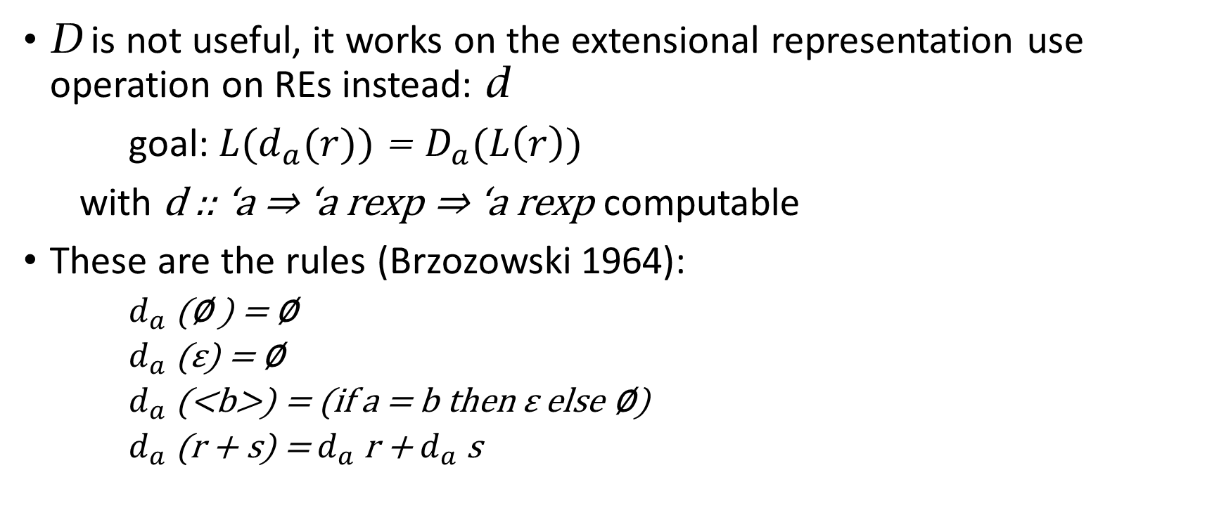
Derivatives of REs
D is not useful, it works on the extensional representation use operation on REs instead: d
goal: ${L(d}_{a}(r))$ = $D_{a}(L\left(r\right))$
with d :: ‘a ⇒ ‘a rexp ⇒ ‘a rexp computable
These are the rules (Brzozowski 1964):
$d_{a}$ (∅ ) = ∅
$d_{a}$ (ε) = ∅
$d_{a}$ (<b>) = (if a = b then ε else ∅)
$d_{a}$(r + s) = $d_{a}$ r + $d_{a}$ s
Notes:
“rexp” is the type constructor of regular expressions

Slide 19

Derivatives of REs (cont.)
$d_{a}$(r ⋅ s) =
(let drs = $d_{a}$ (r) ⋅ s
in if [ ] ∈ L(r) then drs + $d_{a}$ (s) else drs)
$d_{a}$(r*) = $d_{a}$(r) ⋅ r*
Notes:
“[] \in L(r)” is computable by a simple recursion
This means that we can replace the languages in the bisimulation def by REs
… and now, we can hope to construct it. The simple approach “add all missing REs” works

Slide 20

Derivatives of REs (cont.)
$d_{a}$(r ⋅ s) =
(let drs = $d_{a}$ (r) ⋅ s
in if [ ] ∈ L(r) then drs + $d_{a}$ (s) else drs)
$d_{a}$(r*) = $d_{a}$(r) ⋅ r*
${L(d}_{a}(r))$ = $D_{a}(L\left(r\right))$ follows by structural induction.
Notes:
“[] \in L(r)” is computable by a simple recursion
This means that we can replace the languages in the bisimulation def by REs
… and now, we can hope to construct it. The simple approach “add all missing REs” works

Slide 21
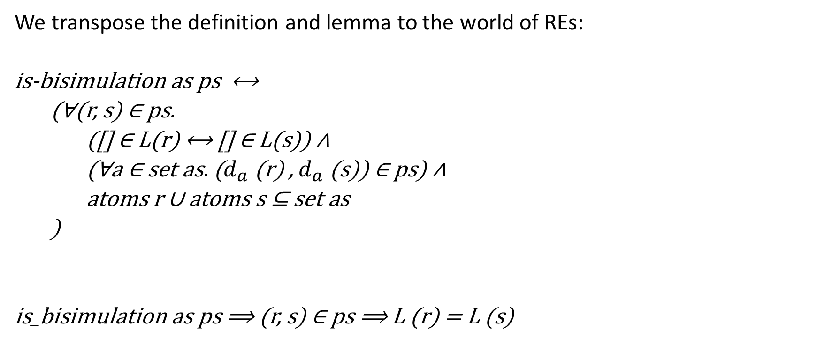
Bisimulations (cont.)
We transpose the definition and lemma to the world of REs:
is-bisimulation as ps ⟷
(∀(r, s) ∈ ps.
([] ∈ L(r) ⟷ [] ∈ L(s)) ∧
(∀a ∈ set as. ($d_{a}$ (r) , $d_{a}$ (s)) ∈ ps) ∧
atoms r ∪ atoms s ⊆ set as
)
is_bisimulation as ps ⟹ (r, s) ∈ ps ⟹ L (r) = L (s)
Notes:
ps will be relation, a list of pairs (or set of pairs if you want)
as is needed for an optimization: it suffices to consider the atoms that actually do occur in the REs. The lemma is not affected
This is a simple consequence of the lemma from the slide, it will make our correctness statement
And we will only prove this direction
Now the goal is to construct such a ps

Slide 22
Algorithm
Assume we have a function that iterates a step s until a test t fails:
fun while where while t s state =
(if t s then while t s (s state) else state)
Notes:
We want to construct such a bisimulation, using a work set algorithm.
left: work set right: relation which we hope to make a bisimulation

Slide 23
Algorithm
Assume we have a function that iterates a step s until a test t fails:
fun while where while t s state =
(if t s then while t s (s state) else state)
In our case, state has the type
(α rexp × α rexp) list × (α rexp × α rexp) list
Notes:
We want to construct such a bisimulation, using a work set algorithm.
left: work set right: relation which we hope to make a bisimulation

Slide 24
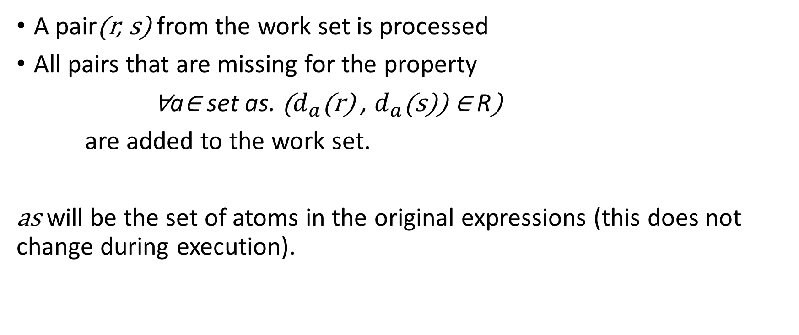
step
A pair(r, s) from the work set is processed
All pairs that are missing for the property
∀a∈ set as. ($d_{a}$(r) , $d_{a}$(s)) ∈ R)
are added to the work set.
as will be the set of atoms in the original expressions (this does not change during execution).
Notes:
1: standard work set algorithm
2: This property is one half of the bisiumlation property, the other half is intrinsic to the pairs and checked when these are moved over to the relation

Slide 25
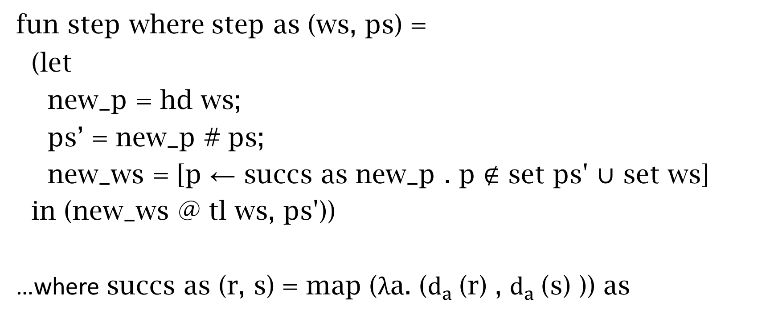
step
fun step where step as (ws, ps) =
(let
new_p = hd ws;
ps’ = new_p # ps;
new_ws = [p ← succs as new_p . p ∉ set ps' ∪ set ws]
in (new_ws @ tl ws, ps'))
…where succs as (r, s) = map (λa. ($d_{a}$(r) , $d_{a}$(s) )) as
Notes:
It expects a while-condition, of course, that one is still missing.

Slide 26
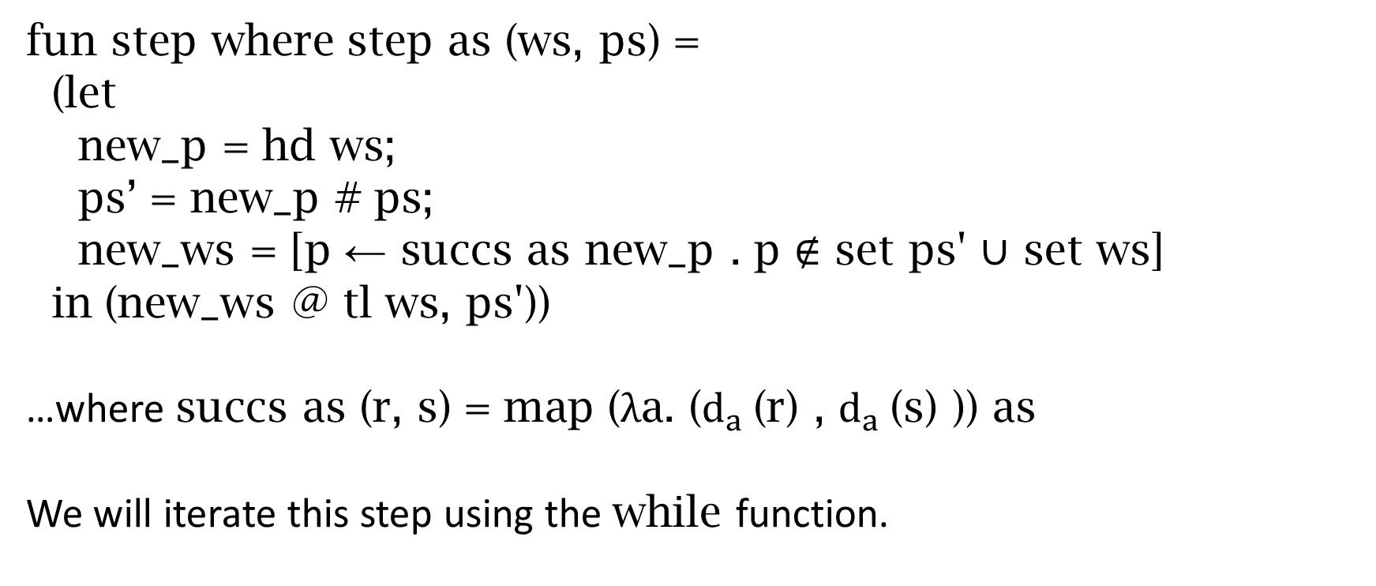
step
fun step where step as (ws, ps) =
(let
new_p = hd ws;
ps’ = new_p # ps;
new_ws = [p ← succs as new_p . p ∉ set ps' ∪ set ws]
in (new_ws @ tl ws, ps'))
…where succs as (r, s) = map (λa. ($d_{a}$(r) , $d_{a}$(s) )) as
We will iterate this step using the while function.
Notes:
It expects a while-condition, of course, that one is still missing.

Slide 27
test
test (ws,_) ⟷ (case ws of
[] ⇒ False |
(r, s)#_ ⇒ [] ∈ L(r) ⟷ [] ∈ L(s)
)
The loop terminates if either
the work set is empty (bisimulation constructed)
a definitely nonequivalent pair of REs is to be processed (counterexample found)
Notes:
These two cases are absolutely crucial to understand. If you want to, I can go back to the definition of bisimulation
Maybe define the “iterated derivate language” ^D_a1…an L = {w | a1…an @ w \in L}

Slide 28
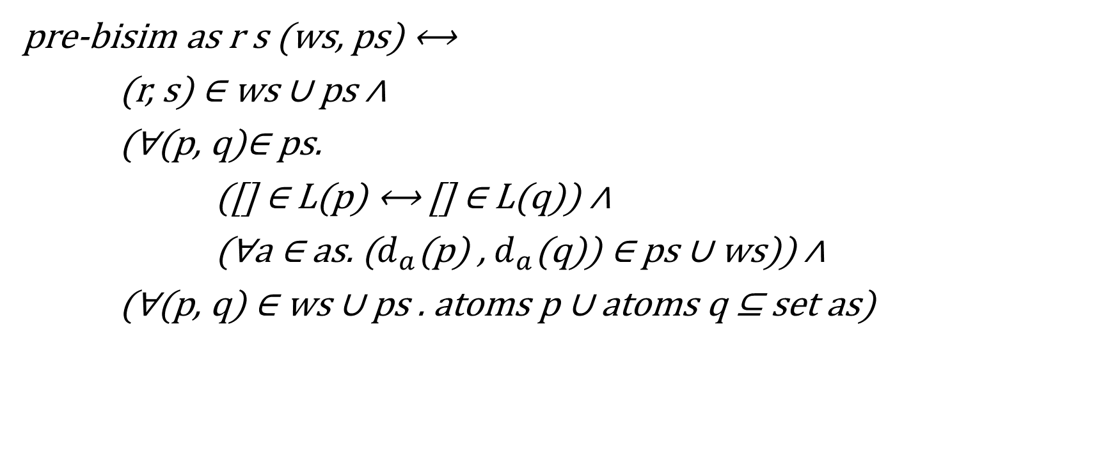
Invariant
pre-bisim as r s (ws, ps) ⟷
(r, s) ∈ ws ∪ ps ∧
(∀(p, q)∈ ps.
([] ∈ L(p) ⟷ [] ∈ L(q)) ∧
(∀a ∈ as. ($d_{a}$(p) , $d_{a}$(q)) ∈ ps ∪ ws)) ∧
(∀(p, q) ∈ ws ∪ ps . atoms p ∪ atoms q ⊆ set as)
Notes:
To improve readablity, I omitted the all the conversion functions to set
it holds initially (ps is empty an ws a singleton)
if it holds, it also holds after a step
together with the negated while-condition, it implies a bisimulation
what is missing to make this useful is the part where it terminates…

Slide 29
Towards termination
Notes:
and sometimes this does not terminate
so, can we do simplifications like these during the derivations WITHOUT sacrificing soundness ?
Remember that the goal was to apply the bisimulation lemma at the end. It worked on languages, weather we add a RE or its simplified variant makes no difference.
I will later give a sufficient condition for termination, but this is already enough for a small example.

Slide 30
Towards termination
We now have soundness, but the execution often accumulates large REs of the form
∅⋅ (…) + ∅⋅ (…) + ∅⋅ (…) + … or
ε ⋅ ε ⋅ ε ⋅ ε ⋅ (…)
Notes:
and sometimes this does not terminate
so, can we do simplifications like these during the derivations WITHOUT sacrificing soundness ?
Remember that the goal was to apply the bisimulation lemma at the end. It worked on languages, weather we add a RE or its simplified variant makes no difference.
I will later give a sufficient condition for termination, but this is already enough for a small example.

Slide 31
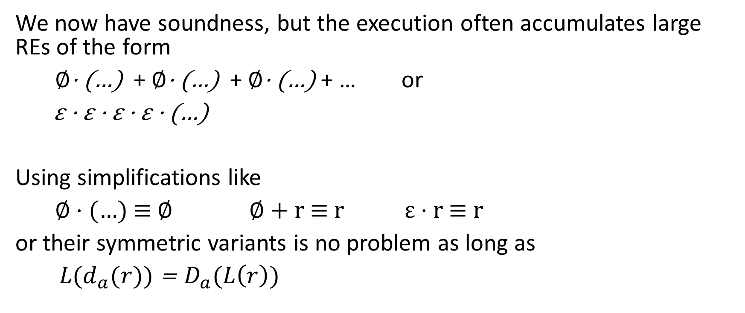
Towards termination
We now have soundness, but the execution often accumulates large REs of the form
∅⋅ (…) + ∅⋅ (…) + ∅⋅ (…) + … or
ε ⋅ ε ⋅ ε ⋅ ε ⋅ (…)
Using simplifications like
∅ ⋅ (…) ≡ ∅ ∅ + r ≡ r ε ⋅ r ≡ r
or their symmetric variants is no problem as long as
${L(d}_{a}(r))$ = $D_{a}(L\left(r\right))$
Notes:
and sometimes this does not terminate
so, can we do simplifications like these during the derivations WITHOUT sacrificing soundness ?
Remember that the goal was to apply the bisimulation lemma at the end. It worked on languages, weather we add a RE or its simplified variant makes no difference.
I will later give a sufficient condition for termination, but this is already enough for a small example.

Slide 32
Example goal
L ((a ⋅ b)* ⋅ a) = L (a ⋅ (b ⋅ a)*)
Notes:
This our _goal_. But later, it will be just one of many equivalences that we show.
As we can see, +-terms may appear even if they were not present …
Also, some terms get larger during the derivation
What happens if a derivation creates larger and larger terms and accumulates them with a plus?
Need to tweak the plus.
In the 60s, Janusz Brzozowski showed that this is already enough
alternatively
L ((ε + a)* ⋅ a) = L (a ⋅ (a + ε)*)
L ((ε + a ⋅ b)* ⋅ (a + b)) = L ((a ⋅ b + ε)* ⋅ (a + b))

Slide 33
Brzozowki’s result about termination
ACI-equivalence
equality modulo associativity, commutativity and idempotence of +
Notes:
With soundness we are done, termination might be a problem
So the choice operator “+” might be a problem
That means that we modify the algorithm to only add RE-pairs to the work set if no ACI-equivalent pair is in it already.
In other words, there are only finitely many ACI-equivalence classes among equivalent REs.
As we already discussed for the simplifications, this does not impede soundness.
So we have termination, and termination is the same as completeness here.

Slide 34
Brzozowki’s result about termination
ACI-equivalence
equality modulo associativity, commutativity and idempotence of +
In each step, we add the following to the work set:
{(r,s) ← succs as (hd ws) . (r,s) ∉ set ps' ∪ set ws}
Notes:
With soundness we are done, termination might be a problem
So the choice operator “+” might be a problem
That means that we modify the algorithm to only add RE-pairs to the work set if no ACI-equivalent pair is in it already.
In other words, there are only finitely many ACI-equivalence classes among equivalent REs.
As we already discussed for the simplifications, this does not impede soundness.
So we have termination, and termination is the same as completeness here.

Slide 35
Brzozowki’s result about termination
ACI-equivalence
equality modulo associativity, commutativity and idempotence of +
In each step, we add the following to the work set:
{(r,s) ← succs as (hd ws) . (r,s) ∉ set ps' ∪ set ws}
If the ∉-filter also considers ACI-equivalent REs to be equal,
then the computation terminates.
Notes:
With soundness we are done, termination might be a problem
So the choice operator “+” might be a problem
That means that we modify the algorithm to only add RE-pairs to the work set if no ACI-equivalent pair is in it already.
In other words, there are only finitely many ACI-equivalence classes among equivalent REs.
As we already discussed for the simplifications, this does not impede soundness.
So we have termination, and termination is the same as completeness here.

Slide 36
Decidability of ACI-equivalence (not verified)
equality modulo associativity, commutativity and idempotence of +
Notes:
meaning that two REs are ACI-equal iff they can be transformed using only these rules on the subterms
We need to work bottom up, for star and concatenation, this might require a lexicographic ordering.
3.3: this identifies SOME equivalent REs, but not all of them.
aa* is equivalent to a*a, but this technique cannot prove it, because there is no “+” in it to transform

Slide 37
Decidability of ACI-equivalence (not verified)
equality modulo associativity, commutativity and idempotence of +
ACI-equality of two REs can be reduced to equality by recursively sorting subterms of nested + terms, and eliminating duplicates
Notes:
meaning that two REs are ACI-equal iff they can be transformed using only these rules on the subterms
We need to work bottom up, for star and concatenation, this might require a lexicographic ordering.
3.3: this identifies SOME equivalent REs, but not all of them.
aa* is equivalent to a*a, but this technique cannot prove it, because there is no “+” in it to transform

Slide 38
Decidability of ACI-equivalence (not verified)
equality modulo associativity, commutativity and idempotence of +
ACI-equality of two REs can be reduced to equality by recursively sorting subterms of nested + terms, and eliminating duplicates
Use some arbitrary order on the constructors: ∅ < ε < a < (_)* < (_⋅ _)
Notes:
meaning that two REs are ACI-equal iff they can be transformed using only these rules on the subterms
We need to work bottom up, for star and concatenation, this might require a lexicographic ordering.
3.3: this identifies SOME equivalent REs, but not all of them.
aa* is equivalent to a*a, but this technique cannot prove it, because there is no “+” in it to transform

Slide 39
Decidability of ACI-equivalence (not verified)
equality modulo associativity, commutativity and idempotence of +
ACI-equality of two REs can be reduced to equality by recursively sorting subterms of nested + terms, and eliminating duplicates
Use some arbitrary order on the constructors: ∅ < ε < a < (_)* < (_⋅ _)
The calls also make lists out of nested +’s.
Notes:
meaning that two REs are ACI-equal iff they can be transformed using only these rules on the subterms
We need to work bottom up, for star and concatenation, this might require a lexicographic ordering.
3.3: this identifies SOME equivalent REs, but not all of them.
aa* is equivalent to a*a, but this technique cannot prove it, because there is no “+” in it to transform

Slide 40
Decidability of ACI-equivalence (not verified)
equality modulo associativity, commutativity and idempotence of +
ACI-equality of two REs can be reduced to equality by recursively sorting subterms of nested + terms, and eliminating duplicates
Use some arbitrary order on the constructors: ∅ < ε < a < (_)* < (_⋅ _)
The calls also make lists out of nested +’s.
Afterwards, check for equality.
Notes:
meaning that two REs are ACI-equal iff they can be transformed using only these rules on the subterms
We need to work bottom up, for star and concatenation, this might require a lexicographic ordering.
3.3: this identifies SOME equivalent REs, but not all of them.
aa* is equivalent to a*a, but this technique cannot prove it, because there is no “+” in it to transform

Slide 41
Decidability of ACI-equivalence (not verified)
equality modulo associativity, commutativity and idempotence of +
ACI-equality of two REs can be reduced to equality by recursively sorting subterms of nested + terms, and eliminating duplicates
Use some arbitrary order on the constructors: ∅ < ε < a < (_)* < (_⋅ _)
The calls also make lists out of nested +’s.
Afterwards, check for equality.
alternative: keep the REs in this normal form, as an invariant
Notes:
meaning that two REs are ACI-equal iff they can be transformed using only these rules on the subterms
We need to work bottom up, for star and concatenation, this might require a lexicographic ordering.
3.3: this identifies SOME equivalent REs, but not all of them.
aa* is equivalent to a*a, but this technique cannot prove it, because there is no “+” in it to transform

Slide 42
Extensions
“⊆” goals: Use the rule A ⊆ B⟷ A ∪ B = B
Notes:
…extended REs are not more expressive, but they can be much more succinct
… and then we‘re done already for the soundness.
As for the termination, luckily these extensions are included in Brzozowski‘s result

Slide 43

Extensions
“⊆” goals: Use the rule A ⊆ B⟷ A ∪ B = B
extended regular expressions:
$\overline{r}$ (complement)
$r\&s$ (intersection)
Notes:
…extended REs are not more expressive, but they can be much more succinct
… and then we‘re done already for the soundness.
As for the termination, luckily these extensions are included in Brzozowski‘s result

Slide 44
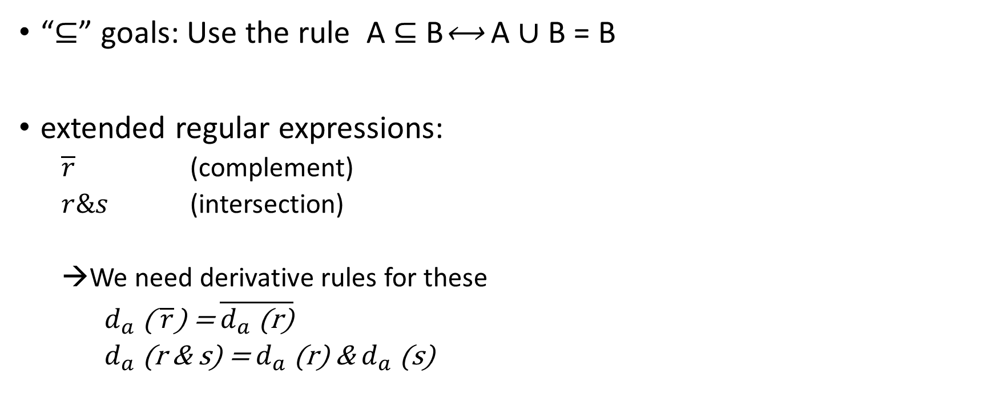
Extensions
“⊆” goals: Use the rule A ⊆ B⟷ A ∪ B = B
extended regular expressions:
$\overline{r}$ (complement)
$r\&s$ (intersection)
We need derivative rules for these
$d_{a}$( $\overline{r}\text{)}$ = $\overline{d_{a} \text{(}\text{r}\text{)}}$
$d_{a}$(r & s) = $d_{a}$ (r) & $d_{a}$ (s)
Notes:
…extended REs are not more expressive, but they can be much more succinct
… and then we‘re done already for the soundness.
As for the termination, luckily these extensions are included in Brzozowski‘s result

Slide 45
Questions

