Slide 1
Regular Expression Equivalence via Derivatives
Fabian Hellauer
Notes:
a development which is in the archive of formal proofs

Slide 2
Goal
equivalence checker for regular expressions which is
automatic: without user interaction
complete: if r
elegant, i.e. easy to prove correct
… for an Isabelle proof method
Notes:
complete means that for any two regular expressions the algorithm terminates and return a result (equivalent/not equivalent)
The last requirement comes at a price: the algorithm won‘t have an optimal performance
(Personal use case: something like automatatutor.com)
Implications for the design: We are only interested in partial correctness (there is a termination proof due to Brzozowski, but there is no need (and it requires linorder on the atoms?))

Slide 3
Shortcuts compared to the textbook method
Avoid having to formalize and prove correct the automata
construction (notation!)
determinization
minimization
Notes:
To-do: wirklich relevant und leicht genug verständlich? Evtl. besser so erklären wie der letzte Absatz vor Abschnitt 1.1?

Slide 4
Correctness Statement
is_bisimulation as ps
⟹ (r, s) ∈ ps ⟹ L (r) = L (s)
Notes:
ps will be relation, a list of pairs (or set of pairs if you want)
And we will only prove this direction
Now the goal is to construct such a ps

Slide 5
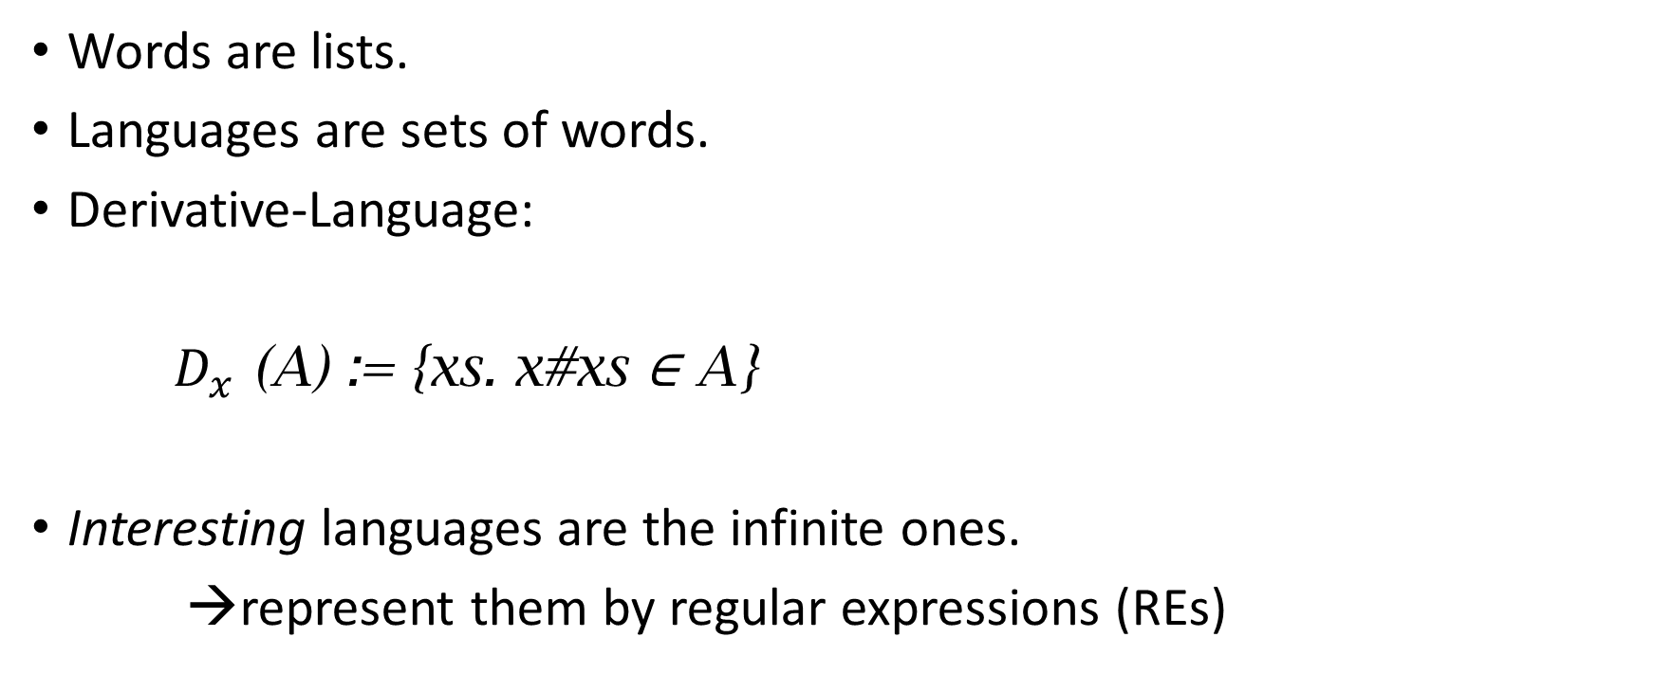
Languages
Words are lists.
Languages are sets of words.
Derivative-Language:
$D_{x}$ (A) := {xs. x#xs ∈ A}
Interesting languages are the infinite ones.
→represent them by regular expressions (REs)
Notes:
_Derivatives_
if a representation is finite, we can at least hope to be able to construct it.

Slide 6

Bisimulation
Definition:
for all A and B, if A ∼ B, then
[] ∈ A ⟷ [] ∈ B
and
${∀x. D}_{x}$ (A) ∼ $D_{x}$ (B).
If “∼” is a bisimulation, then A ∼ B implies A = B.
proof by list induction.
Notes:
A Bisimulation is a _relation_ with the following properties
We use “~”

Slide 7
Regular Expressions
L(∅) = ∅
L(ε) = {[]}
L(a) = {[a]}
L(r + s) = L(r) ∪ L(s)
L(r · s) = L(r)L(s)
L(r*) = (L(r))*
Notes:
brackets <…> are constructors which produce a singleton RE ?

Slide 8
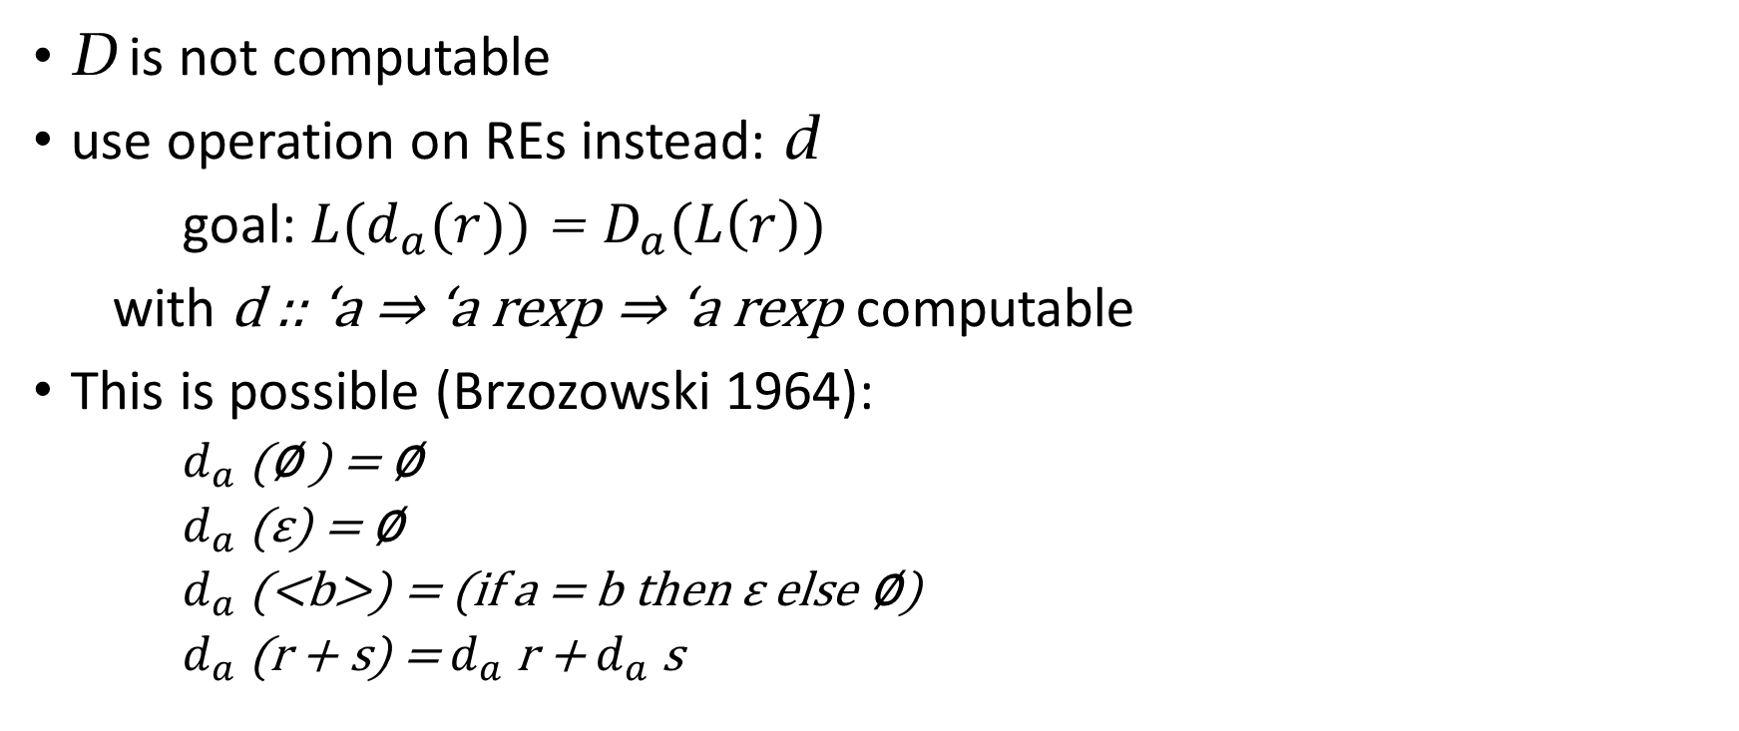
Derivatives of REs
D is not computable
use operation on REs instead: d
goal: ${L(d}_{a}(r))$ = $D_{a}(L\left(r\right))$
with d :: ‘a ⇒ ‘a rexp ⇒ ‘a rexp computable
This is possible (Brzozowski 1964):
$d_{a}$ (∅ ) = ∅
$d_{a}$ (ε) = ∅
$d_{a}$ (<b>) = (if a = b then ε else ∅)
$d_{a}$(r + s) = $d_{a}$ r + $d_{a}$ s
Notes:
“rexp” is the type constructor of regular expressions

Slide 9

Times and Star
$d_{a}$(r ⋅ s) =
(let drs = $d_{a}$ (r) ⋅ s
in if nullable r then drs + $d_{a}$ (s) else drs)
$d_{a}$(r*) = $d_{a}$(r) ⋅ r*
${L(d}_{a}(r))$ = $D_{a}(L\left(r\right))$ follows by structural induction.
Notes:
nullable erklären (oder evtl. vorher ersetzen durch “[] \in L(r)” ?) todo
This means that we can replace the languages in the bisimulation def by REs <---- to-do: Eigene Folie dafür?
… and now, we can hope to construct it. The simple approach “add all missing REs” works

Slide 10
Algorithm
Assume we have a function that iterates a step s until a test t fails:
fun while where while t s state =
(if t s then while t s (s state) else state)
In our case, state has the type
(α rexp × α rexp) list × (α rexp × α rexp) list
Notes:
left: work set right: relation which we hope to make a bisimulation

Slide 11
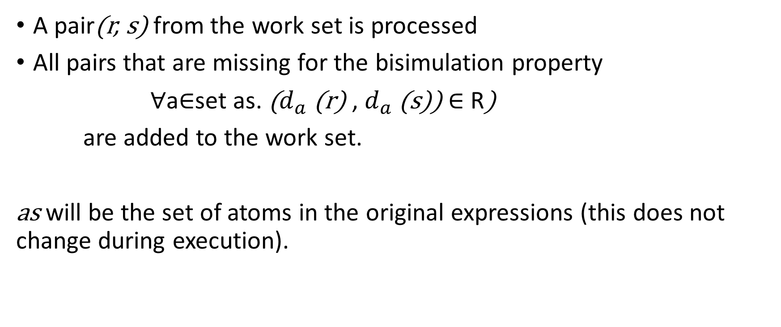
step
A pair(r, s) from the work set is processed
All pairs that are missing for the bisimulation property
∀a∈set as. ($d_{a}$ (r) , $d_{a}$ (s)) ∈ R)
are added to the work set.
as will be the set of atoms in the original expressions (this does not change during execution).
Notes:
1: standard work set algorithm

Slide 12
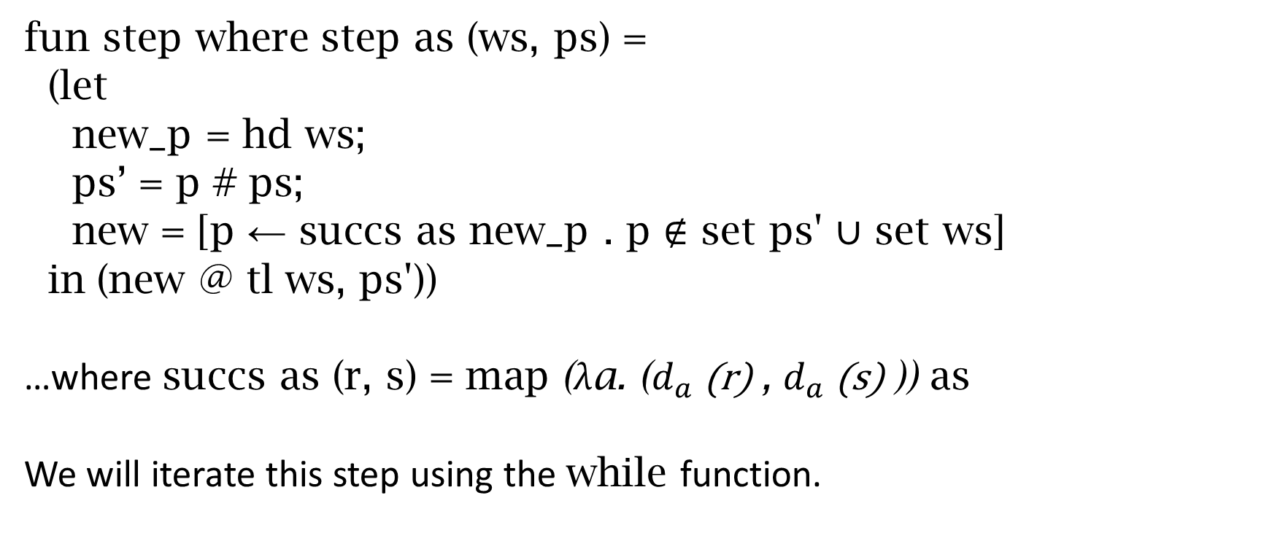
step
fun step where step as (ws, ps) =
(let
new_p = hd ws;
ps’ = p # ps;
new = [p ← succs as new_p . p ∉ set ps' ∪ set ws]
in (new @ tl ws, ps'))
…where succs as (r, s) = map (λa. ($d_{a}$(r) , $d_{a}$(s) )) as
We will iterate this step using the while function.
Notes:
It expects a while-condition, of course, that one is still missing.

Slide 13
test
test (ws,_) ⟷ (case ws of
[] ⇒ False |
(p, q)#_ ⇒ nullable p ⟷ nullable q
)
The loop terminates if either
the work set is empty (bisimulation constructed)
a nonequivalent pair of REs is to be processed (counterexample found)
Notes:
These two cases are absolutely crucial to understand. If you want to, I can go back to the definition of bisimulation
Maybe define the “iterated derivate language” ^D_a1…an L = {w | a1…an @ w \in L}

Slide 14
Example
<on the board>
result
L ((ε + a)* ⋅ a) = L (a ⋅ (a + ε)*)
Notes:
to-do: alternatively
L ((ε + a ⋅ b)* ⋅ (a + b)) = L ((a ⋅ b + ε)* ⋅ (a + b))

Slide 15
ACI
equality modulo associativity, commutativity and idempotence of +
ACI-equality of two REs can be reduced to equality by recursively sorting subterms of nested + terms, and eliminating duplicates
Use some arbitrary order on the constructors: ∅ < ε < a < (_)* < (_⋅ _)
The calls also make lists out of nested +’s.
Afterwards, check for equality.
alternative: keep the REs in this normal form, as an invariant
Notes:
meaning that two REs are ACI-equal iff they can be transformed using only these rules on the subterms
We need to work bottom up, for star and concatenation, this might require a lexicographic ordering.
3.3: this identifies SOME equivalent REs, but not all of them.
aa* is equivalent to a*a, but this technique cannot prove it, because there is no “+” in it to transform

Slide 16
Brzozowki’s result about termination
In each step, we add the following to the work set:
[p ← succs as (hd ws) . p ∉ set ps' ∪ set ws]
If the ∉ filter also considers ACI-equivalent REs to be equal,
then the computation terminates.
The resulting relation will still be a bisimulation.
Notes:
In other words, there are only finitely many ACI-equivalence classes among equivalent REs.
We are allowed to strengthen this filter: Remember that the goal was to apply the bisimulation lemma at the end. It worked on languages, and the language pair is already added I f
to-do: maybe swap formulation on the slides with the explanation?

Slide 17

Extensions
“⊆” goals
extended regular expressions:
$\overline{r}$ (complement)
$r\&s$ (intersection)
We need a computable derivative for these
$d_{a}$( $\overline{r}\text{)}$ = $\overline{d_{a} \text{r}}$
$d_{a}$(r & s) = $d_{a}$ r & $d_{a}$ s
Notes:
…extended REs are not more expressive, but they can be much more succinct
… and then we‘re done already for the soundness.
As for the termination

Slide 18
Questions

