Slide 1
Regular Expression Equivalence via Derivatives
Fabian Hellauer
Notes:
a development which is in the archive of formal proofs

Slide 2
Goal
equivalence checker for regular expressions which is
automatic: without user interaction
complete
elegant, i.e. easy to prove correct
… for an Isabelle proof method
Notes:
complete means that for any two regular expressions the algorithm terminates and return a result (equivalent/not equivalent)
The last requirement comes at a price: the algorithm won‘t have an optimal performance
(Personal use case: something like automatatutor.com)
Implications for the design: We are only interested in partial correctness (there is a termination proof due to Brzozowski, but there is no need (and it requires linorder on the atoms?))

Slide 3
Correctness Statement
is_bisimulation as ps ⟹ (r, s) ∈ ps ⟹ L r = L s
Notes:
Now the goal is to construct such a ps

Slide 4
Shortcuts
Avoid having to formalize and prove correct the automata
construction (notation!)
determinization
minimization
Notes:
To-do: wirklich relevant und leicht genug verständlich? Evtl. besser so erklären wie der letzte Absatz vor Abschnitt 1.1?

Slide 5
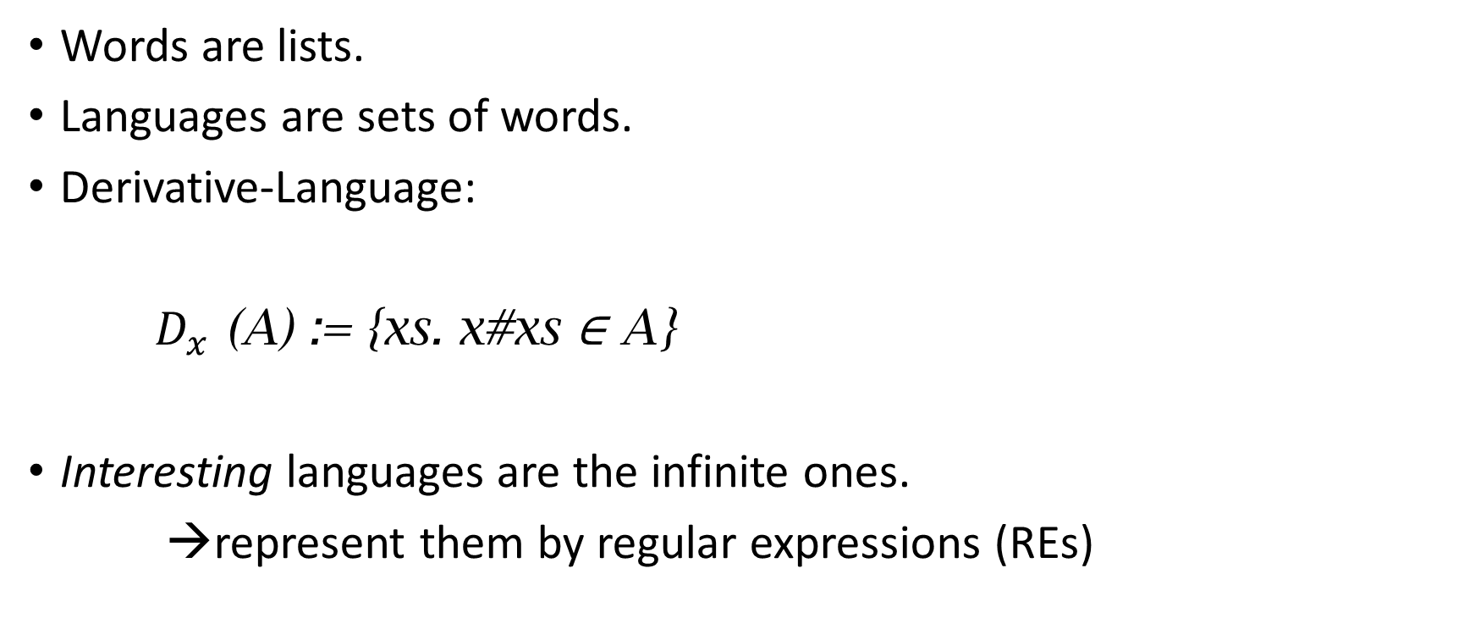
Languages
Words are lists.
Languages are sets of words.
Derivative-Language:
$D_{x}$ (A) := {xs. x#xs ∈ A}
Interesting languages are the infinite ones.
→represent them by regular expressions (REs)
Notes:
_Derivatives_
if a representation is finite, we can at least hope to be able to construct it.

Slide 6
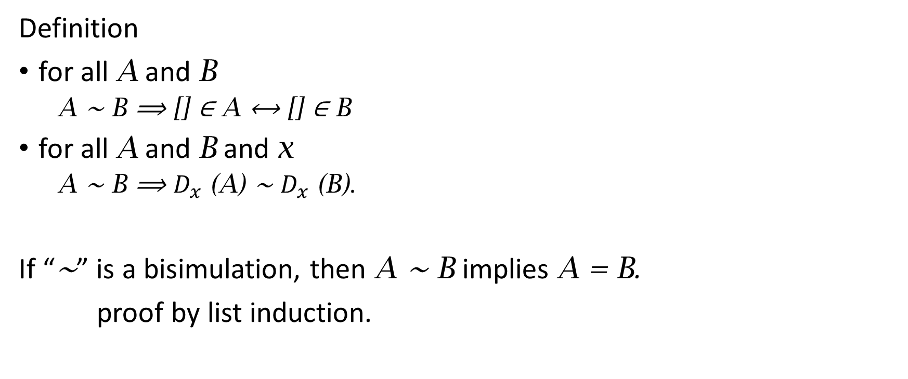
Bisimulations
Definition
for all A and B
A ∼ B ⟹ [] ∈ A ⟷ [] ∈ B
for all A and B and x
A ∼ B ⟹ $D_{x}$ (A) ∼ $D_{x}$ (B).
If “∼” is a bisimulation, then A ∼ B implies A = B.
proof by list induction.
Notes:
A Bisiumlation is a _relation_ with the following properties
We use “~”

Slide 7
Regular Expressions
L(∅) = ∅
L(ε) = {[]}
L(a) = {[a]}
L(r + s) = L(r) ∪ L(s)
L(r · s) = L(r)L(s)
L(r*) = (L(r))*
Notes:
brackets <…> are constructors which produce a singleton RE ?

Slide 8
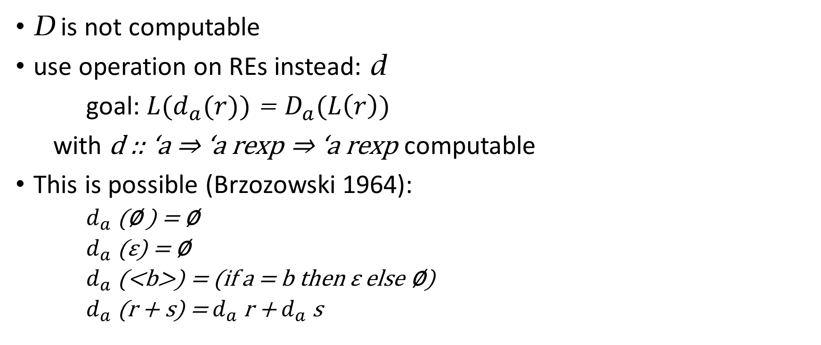
Derivatives of REs
D is not computable
use operation on REs instead: d
goal: ${L(d}_{a}(r))$ = $D_{a}(L\left(r\right))$
with d :: ‘a ⇒ ‘a rexp ⇒ ‘a rexp computable
This is possible (Brzozowski 1964):
$d_{a}$ (∅ ) = ∅
$d_{a}$ (ε) = ∅
$d_{a}$ (<b>) = (if a = b then ε else ∅)
$d_{a}$(r + s) = $d_{a}$ r + $d_{a}$ s
Notes:
“rexp” is the type constructor of regular expressions

Slide 9

Times and Star
$d_{a}$(r ⋅ s) =
(let drs = $d_{a}$ (r) ⋅ s
in if nullable r then drs + $d_{a}$ (s) else drs)
$d_{a}$(r*) = $d_{a} ($r) ⋅ r*
―
${L(d}_{a}(r))$ = $D_{a}(L\left(r\right))$ follows by structural induction.
Notes:
nullable erklären (oder evtl. vorher ersetzen durch “[] \in L(r)” ?) todo
This means that we can replace the languages in the bisimulation def by REs <---- to-do: Eigene Folie dafür?
… and now, we can hope to construct it. The simple approach “add all missing REs” works

Slide 10
Algorithm
Assume a definition
fun while where while tst stp state =
(if tst state then while tst stp (stp state) else state)
In our case, state has the type
('a rexp × 'a rexp) list × ('a rexp × 'a rexp) list
Notes:
left: work set right: relation

Slide 11
Step and Test
fun stp where stp as (ws, ps) =
(let ps' = hd ws # ps;
new = [p←succs as (hd ws) . p ∉ set ps' ∪ set ws]
in (new @ tl ws, ps'))
…where succs as (r, s) = map (λa. (nderiv a r, nderiv a s)) as
test (ws,_) ⟷
(case ws of [] ⇒ False | (p, q)#vs ⇒ nullable p ⟷ nullable q)

Slide 12
Example
<on the board>
result
L ((ε + a ⋅ b)* ⋅ (a + b)) = L ((a ⋅ b + ε)* ⋅ (a + b))

Slide 13
In each step
A pair from the work set is processed
All pairs missing for the property
∀a∈set as. (―r, nderiv a s) ∈ R)
are added to the work set
“as” will be the set of atoms in the expressions (this does not change during execution)
Notes:
1: standard work set algorithm

Slide 14
ACI
associativity, commutativity and idempotence of +
the auxiliary function norm establishes a normal form
➔ ACI-equal terms are identified at that step already
to verify this, one would have to state ACI-equivalence formally.
the REs in the (emergent) bisimulation are kept in this normal form, as an invariant
Notes:
so, for a position of the subterms in the sequence … + … + … + … (Wich is a tree, but due to associativity we can transform into a list) to be uniquely determined, we can just define an arbitrary order on the topmost constructors. Then every subterm is already in the “correct section the a list” and then, its subparts get normed again.
Actually, the correct way is to work bottom up, but you get the idea.

Slide 15
Closure computation
terminates if either
the work set is empty (bisimulation constructed)
a nonequivalent pair of REs is to be processed (counterexample found)

Slide 16

Extensions
“⊆” goals
extended regular expressions:
$\overline{r}$ (complement)
$r\&s$ (intersection)
We need a computable derivative for these
$d_{a}$( $\overline{r}\text{)}$ = $\overline{d_{a} \text{r}}$
$d_{a}$(r & s) = $d_{a}$ r & $d_{a}$ s
Notes:
…extended REs are not more expressive, but they can be much more succinct
… and then we‘re done already for the soundness.
As for the termination

Slide 17
Questions

