Slide 1


Finance Tracker
Stoyan Tomicin
TOLGA FERAD

Slide 2







Main Functionality
Registration, login and logout
Profile editing, check user data
Delete profile and retrieve forgotten password
Adding, deleting and updating account
Getting account info and filtering account data
Adding, deleting and editing budgets
Retrieving data for budgets

Slide 3

More on functionalities
Data filters
Categories
Planned payments
Transactions

Slide 4










What I used?
Technologies and API's
Java 15
Spring Boot
Spring Rest
Spring Boot Validation
Spring Boot Starter Email
JPA
Lombok
Hibernate
BCrypt
Swagger
Maven
MySQL
Model Mapper
JUnit
Itext PDF
PDF Box
Software
IntelliJ IDEA
Postman
MySQL Workbench
Git

Slide 5
Design Patterns
Singleton
DAO (Data Access Object)
DTO (Data Transfer Object)
POJO (Plain Old Java Object)
Repository and Service

Slide 6
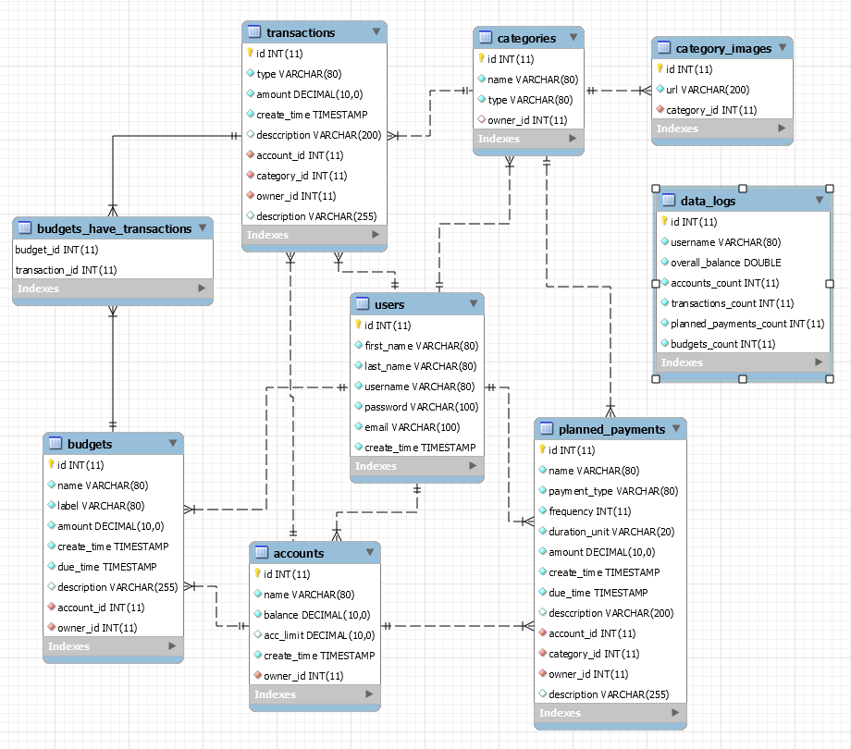
Database Diagram

Slide 7
Class Diagram
Entity | DTO | DAO | Controller | Service | Repository
User | User - x7 | UserDao | UserController | UserService | UserRepository
Account | Account - x4 | AccountDao | AccountController | AccountService | AccountRepository
Budget | Budget - x4 | BudgetDao | BudgetController | BudgetService | BudgetRepository
Transaction | Transaction - x4 | TransactionDao | TransactionController | TransactionService | TransactionRepository
Planned Payment | PlannedPayment - x4 | PlannedPaymentDao | PlannedPayment Controller | PlannedPayment Service | PlannedPayment Repository
Category | Category - x4 | CategoryDao | CategoryController | CategoryService | CategoryRepository

Slide 8
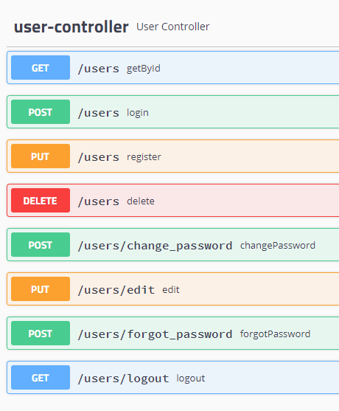
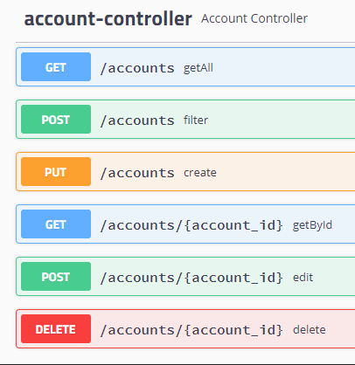
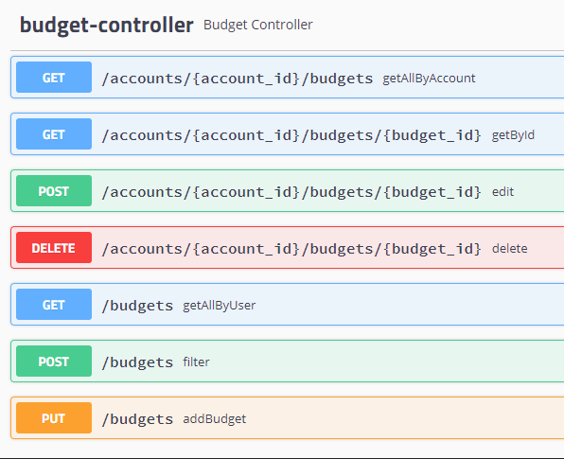
Swagger – End Points

Slide 9
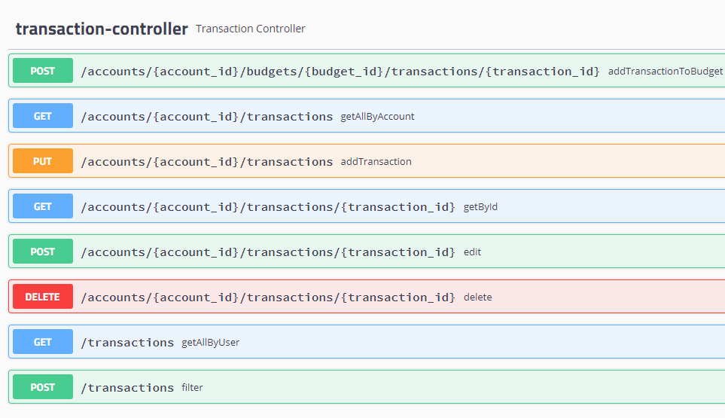
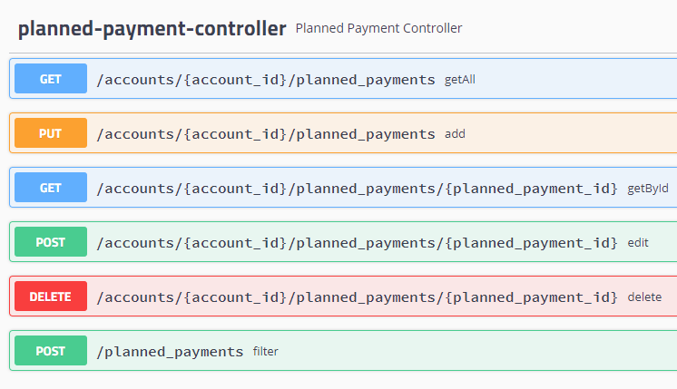

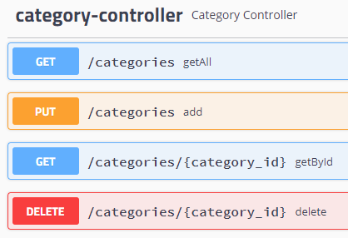
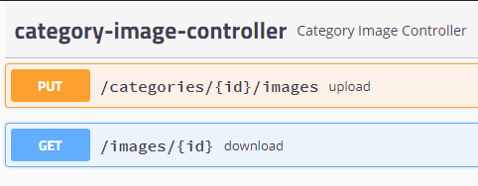
Swagger – End Points

Slide 10

DEMO TIME

Slide 11
Thank you for your attention!
Questions time!

