Slide 1

Decentralized Chatting
Crypto Chat
Solidity , Socket.io , hardhat
MADE BY
ABHAY SHARMA
HARI OM SINGH
Password to access:-abhay5624

Slide 2
INDEX
INTRODUCTION
ABSTRACT
PROCESS MODEL
REQUIREMENT
ANALYSIS
DESIGN
IMPLEMENTATION
TESTING
DEPLOYMENT
MAINTANANCE AND UPGRADE
CONCLUSION

Slide 3
INTRODUCTION
In blockchain, decentralization refers to the transfer of control and decision-making from a centralized entity (individual, organization, or group thereof) to a distributed network.
Solidity is an object-oriented programming language created specifically by the Ethereum Network team for constructing and designing smart contracts on Blockchain platforms.
React is a JavaScript based library that works like a framework.
Our project is basically focused on building a decentralization the chatting.

Slide 4
ABSTRACT
Crypto Chat is a chatting application where we use decentralization technology such as solidity.
This project is made by using simple Process Model that can be categorized into different parts such as requirement & analysis, designing, implementation, testing and maintenance .
Several software/websites used here are Solidity, Socket.io, Color space, React, hardhat, Udemy for learning purpose.
Blockchain wallet such as MetaMask is used to make a connection with different account.

Slide 5
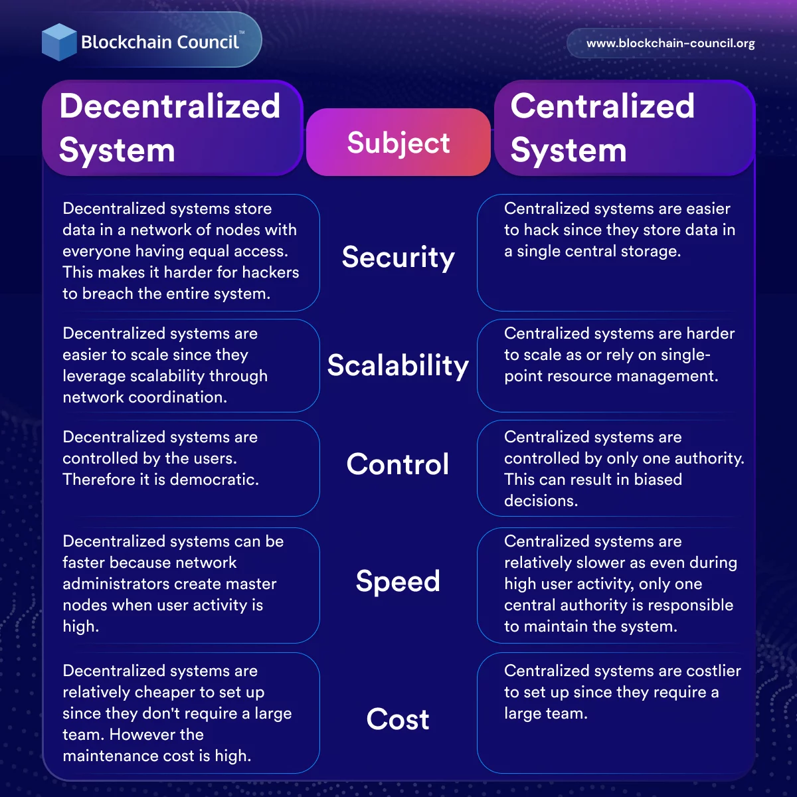

Slide 6
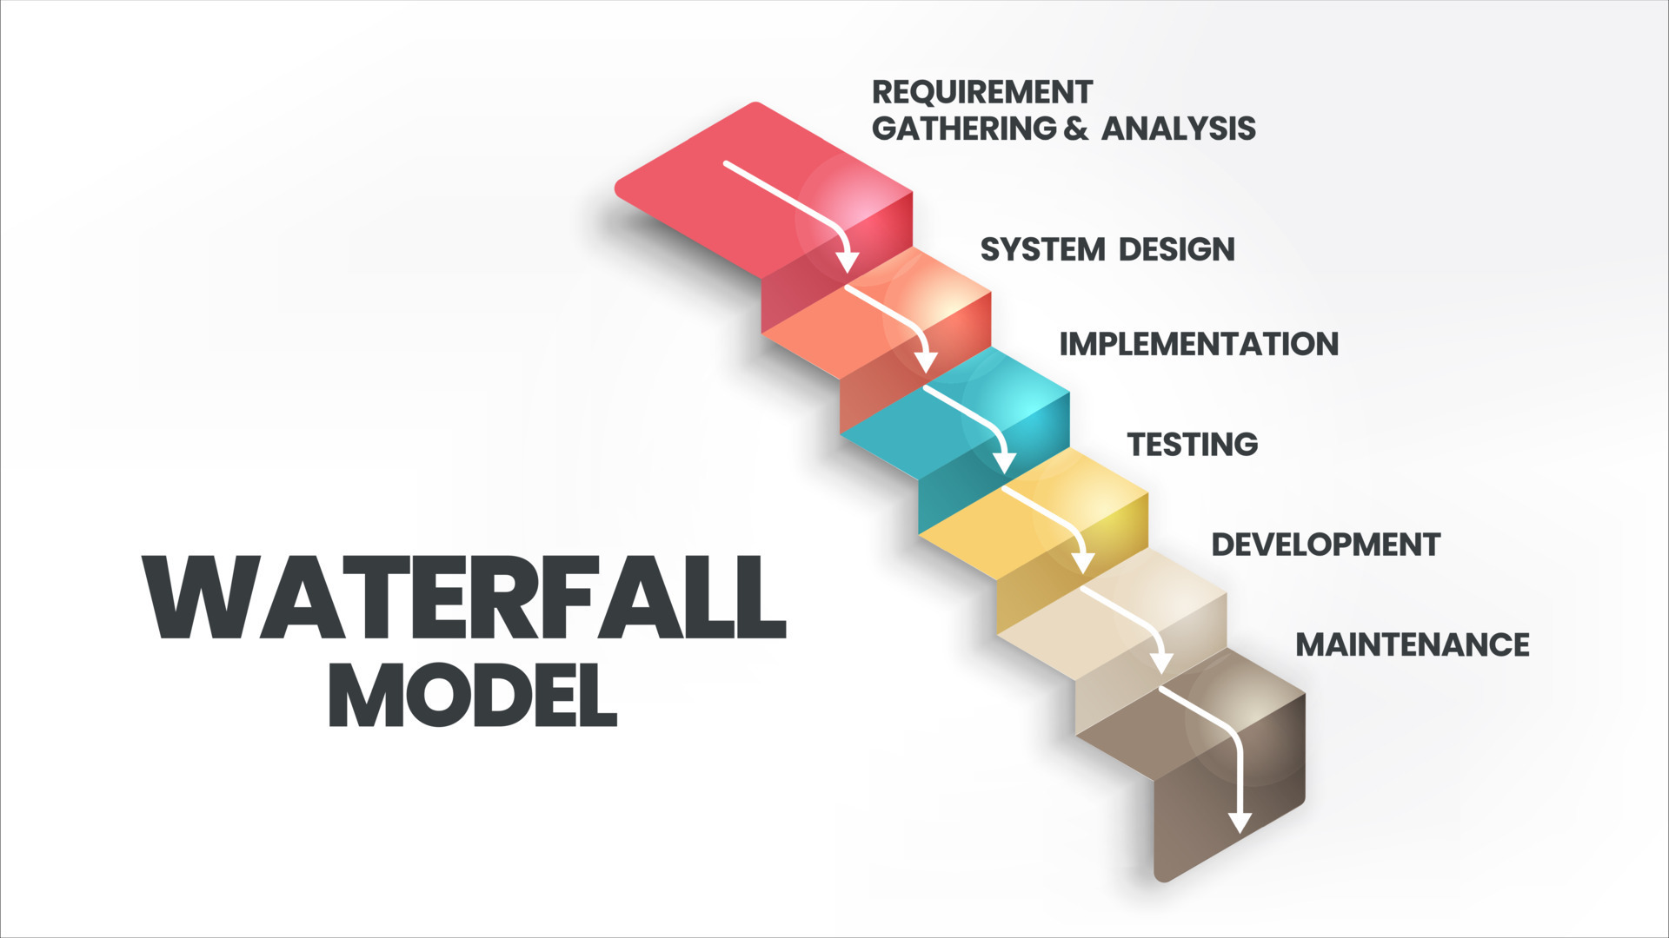
Waterfall Process MODEL
The waterfall model is a linear, sequential approach to the software development lifecycle (SDLC) that is popular in software engineering and product development. The waterfall model uses a logical progression of SDLC steps for a project, similar to the direction water flows over the edge of a cliff.

Slide 7
Requirements:-
Real time.
Connectivity with Blockchain.
User Friendly frontend Design.
An attractive color scheme.
SEO Friendly.
Platform friendly.

Slide 8
Analysis:-
Real Time Connectivity with Socket.io .
Contract.
Hosting Contract with Hardhat.
Platform for Coding and Deployment.
React
Different assets such as avatar svg.
Colorspace for color palate selection.

Slide 9
DESIGN:-
For Designing of CryptoChat figma was used as it contains many designing tools and it is user friendly.
Link of every designed online page:-
https://www.figma.com/file/Oquxz4Mx8ltIbNXiK8q7ZQ/Major-project?type=design&node-id=0-1&t=Ex0fRY6tVVVFgfik-0
https://www.figma.com/file/Oquxz4Mx8ltIbNXiK8q7ZQ/Major-project?type=design&node-id=1-3&t=Ex0fRY6tVVVFgfik-0

Slide 10
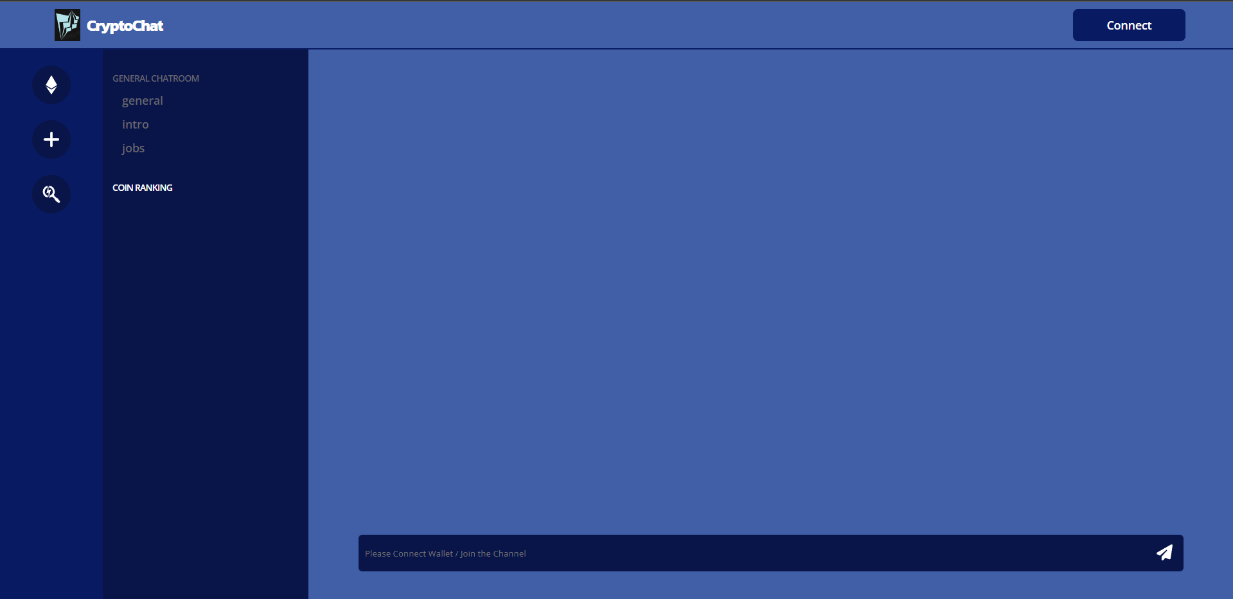

Slide 11
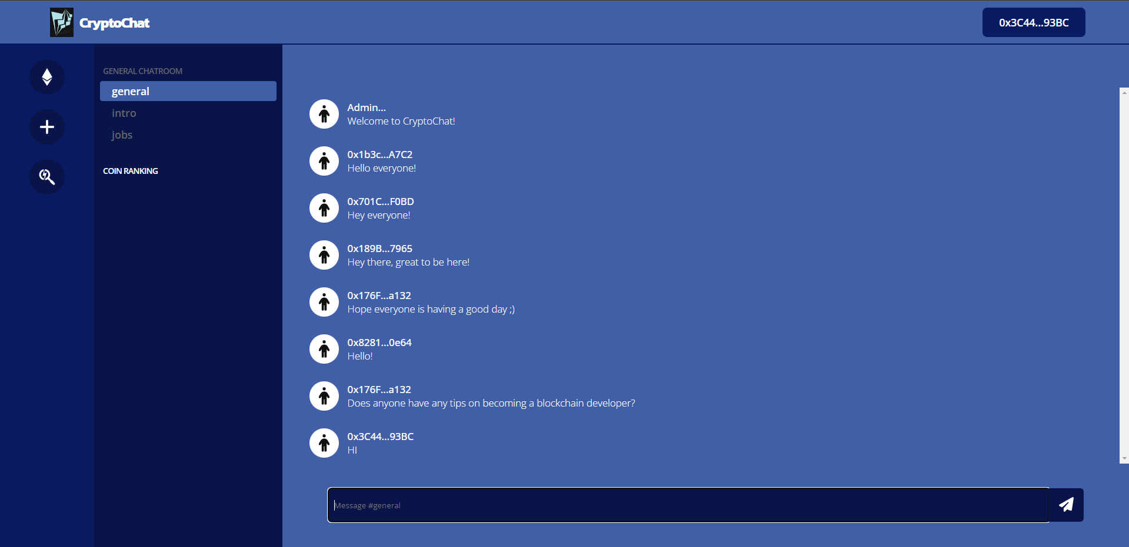

Slide 12
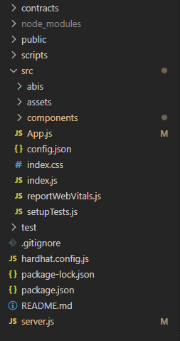
Implementation:-
First we have to import a basic template for react app using npm create react app.
Then second step was to create proper folder structure to make our project neat and organized.
Contracts:- Contract folder is used to store contract.
Component folder- Contains components such as navigation bar, library, library songs, player.
Test folder-contains test file.
Assets: contain all svg ang png used in project.

Slide 13
Create a Contract .
// SPDX-License-Identifier: UNLICENSED
pragma solidity ^0.8.9;
import "@openzeppelin/contracts/token/ERC721/ERC721.sol";
contract Dappcord is ERC721 {
uint256 public totalSupply;
uint256 public totalChannels;
address public owner;
struct Channel {
uint256 id;
string name;
uint256 cost;
}
mapping(uint256 => Channel) public channels;
mapping(uint256 => mapping(address => bool)) public hasJoined;
modifier onlyOwner() {
require(msg.sender == owner);
_;
}
constructor(string memory _name, string memory _symbol)
ERC721(_name, _symbol)
{
owner = msg.sender;
}

Slide 14
function createChannel(string memory _name, uint256 _cost)
public
onlyOwner
{
totalChannels++;
channels[totalChannels] = Channel(totalChannels, _name, _cost);
}
function mint(uint256 _id) public payable {
require(_id != 0);
require(_id <= totalChannels);
require(hasJoined[_id][msg.sender] == false);
require(msg.value >= channels[_id].cost);
hasJoined[_id][msg.sender] = true;
totalSupply++;
_safeMint(msg.sender, totalSupply);
}
function getChannel(uint256 _id) public view returns (Channel memory) {
return channels[_id];
}
function withdraw() public onlyOwner {
(bool success, ) = owner.call{value: address(this).balance}("");
require(success);
}
}

Slide 15
Create a Server
const express = require('express')
const app = express()
const PORT = process.env.PORT || 3030
const server = app.listen(PORT, () => console.log(`Listening on ${PORT}\n`))
const messages = [
{
channel: "1",
account: "0xcA8Fa8f0b631EcdB18Cda619C4Fc9d197c8aFfCa",
text: "Welcome to My Project!"
},
{
channel: "2",
account: "0xcA8Fa8f0b631EcdB18Cda619C4Fc9d197c8aFfCa",
text: "Welcome to ProjectHub everyone! Our name is Abhay and Hariom We are BCA Student"
},
{
channel: "1",
account: "0x1b3cB81E51011b549d78bf720b0d924ac763A7C2",
text: "Hello everyone!"
},
{
channel: "2",
account: "0x1b3cB81E51011b549d78bf720b0d924ac763A7C2",
text: "Hey there! My name is Aakash and I'm an aspiring blockchain developer!"
},
]
const { Server } = require("socket.io");
const io = new Server(server, {
cors: {
origin: "http://localhost:3000"
}
})
io.on('connection', (socket) => {
console.log('a user connected')
socket.on('get messages', () => {
io.emit('get messages', messages)
})
socket.on('new message', (msg) => {
messages.push(msg)
io.emit('new message', messages)
})
})

Slide 16
Testing:-
For Testing purpose ,we have used hardhat test packages.
We write different test such as :-
1. deployment
2. Creating Channels
3. Joining Channels
4. Withdrawing

Slide 17
const { expect } = require("chai")
const tokens = (n) => {
return ethers.utils.parseUnits(n.toString(), 'ether')
}
describe("Dappcord", function () {
let deployer, user
let dappcord
const NAME = "Dappcord"
const SYMBOL = "DC"
beforeEach(async () => {
// Setup accounts
[deployer, user] = await ethers.getSigners()
// Deploy contract
const Dappcord = await ethers.getContractFactory("Dappcord")
dappcord = await Dappcord.deploy(NAME, SYMBOL)
})
})
})
// Create a channel
const transaction = await dappcord.connect(deployer).createChannel("general", tokens(1))
await transaction.wait()
})
describe("Deployment", function () {
it("Sets the name", async () => {
const result = await dappcord.name()
expect(result).to.equal(NAME)
})
it("Sets the symbol", async () => {
const result = await dappcord.symbol()
expect(result).to.equal(SYMBOL)
})
it("Sets the owner", async () => {
const result = await dappcord.owner()
expect(result).to.equal(deployer.address)
})
})
describe("Creating Channels", () => {
it('Returns total channels', async () => {
const result = await dappcord.totalChannels()
expect(result).to.be.equal(1)
})
it('Returns channel attributes', async () => {
const channel = await dappcord.getChannel(1)
expect(channel.id).to.be.equal(1)
expect(channel.name).to.be.equal("general")
expect(channel.cost).to.be.equal(tokens(1))
})
})

Slide 18
describe("Joining Channels", () => {
const ID = 1
const AMOUNT = ethers.utils.parseUnits("1", 'ether')
beforeEach(async () => {
const transaction = await dappcord.connect(user).mint(ID, { value: AMOUNT })
await transaction.wait()
})
it('Joins the user', async () => {
const result = await dappcord.hasJoined(ID, user.address)
expect(result).to.be.equal(true)
})
it('Increases total supply', async () => {
const result = await dappcord.totalSupply()
expect(result).to.be.equal(ID)
})
it('Updates the contract balance', async () => {
const result = await ethers.provider.getBalance(dappcord.address)
expect(result).to.be.equal(AMOUNT)
})
})
describe("Withdrawing", () => {
const ID = 1
const AMOUNT = ethers.utils.parseUnits("10", 'ether')
let balanceBefore
beforeEach(async () => {
balanceBefore = await ethers.provider.getBalance(deployer.address)
let transaction = await dappcord.connect(user).mint(ID, { value: AMOUNT })
await transaction.wait()
transaction = await dappcord.connect(deployer).withdraw()
await transaction.wait()
})
it('Updates the owner balance', async () => {
const balanceAfter = await ethers.provider.getBalance(deployer.address)
expect(balanceAfter).to.be.greaterThan(balanceBefore)
})
it('Updates the contract balance', async () => {
const result = await ethers.provider.getBalance(dappcord.address)
expect(result).to.equal(0)

Slide 19
Deployment:-
For Deployment we have to use following commands
1. npm install :- to install all the dependence.
2. npx hardhat test:- to run all the test we have written.
3. npx hardhat node:- Get access to demo Account.
4. npx hardhat run ./scripts/deploy.js --network localhost:- to host contract.
5. node server.js:- to start the server.
6. npm run start:- to start the frontend

Slide 20
Conclusion:-
We created a Chatting blockchain based application which is used for creating a channel where different people chat. There were various processes involved in making this project.
We widely used react along with solidity and socket.io, hardhat for the completion of this project. For designing purpose we used figma and for
colour coordination we have used Colorspace.

Slide 21
THANK YOU
Contributors:
ABHAY KUMAR SHARMA (0424802020)
HARI OM SINGH (02324802020)

