Slide 1
IBM University Engagement Project Submission
“Exploring the Power of Agentic AI with IBM Granite and IBM Bob”

Slide 2

Project Tile – [CAREERX - Agentic AI Career Navigator]
Domain of Project – Education / Career Development
Student Name | Recent Passport Photo | Email ID | Mobile number [WhatsApp]
SYED MAHIN SABRY |  | mahinsabry2004@gmail.com | +916263811891

Slide 3
Problem Statement -
Problem Statement : CAREERX
The Challenge
Industry hiring requirements are constantly changing, and students often struggle with diet planning, portion control, and tracking careeral intake. Information about industry requirements, specific job role skills, and necessary projects is scattered and vague. Without personalized, real-time guidance, many fail to maintain balanced diets or make informed food choices.
The Objective
Build an AI-powered CAREERX that delivers personalized learning insights and guidance for students, freshers, and university placement cells. The solution should:
Personalized Learning Roadmaps – Recommend step-by-step weekly plans based on existing skills, available hours, and chosen career path.
Career Data RAG Retrieval – Fetch and summarize industry role requirements from a curated knowledge base.
Skill Gap Analysis – Compare student skills to industry benchmarks and provide priority-based gap analysis.
Project Recommendation Focus – Suggest diets for chronic disease management (e.g., diabetes-friendly or heart-healthy plans).
Multi-Agent System –
Career Research Agent (fetches career data)
Learning Path Agent (personalized roadmaps)
Project & Cert Agent (gap-closing recommendations)
Skill Gap Agent (identifies missing skills)
Visualization Dashboard – Show daily/weekly Career Match Score, priority skill gaps, and roadmap timelines.

Slide 4
Proposed Solution -
Proposed Solution: AI-Powered CAREERX
The proposed solution is a multi-agent AI-powered CAREERX built using IBM Bob, IBM watsonx.ai, and Granite Models to provide personalized, real-time career guidance. The system addresses challenges in career planning, skill gap analysis, and learning roadmaps through an intelligent, modular architecture.
At its core, the solution uses a Retrieval-Augmented Generation (RAG) pipeline to fetch accurate role requirements from curated industry knowledge bases. This data is embedded and stored in a vector database, enabling the system to retrieve and summarize career competencies, skills, and projects using Granite models.
The system consists of four key agents:
Career Research Agent retrieves and summarizes careeral information using RAG.
Learning Path Agent generates personalized roadmaps based on student inputs like current skills and chosen roles.
Project & Cert Agent provides project recommendations that directly close identified skill gaps.
Skill Gap Agent allows users to analyze their profile and instantly receive actionable skill gap analysis.
The solution includes a user-friendly dashboard (built with Streamlit or React) that visualizes Career Match Score, priority skill gaps, and roadmap timelines.
IBM Bob is used to orchestrate agent workflows, while watsonx.ai ensures scalable model deployment, embeddings, and AI governance. Granite models power reasoning, summarization, and personalization.
Overall, this solution delivers an end-to-end intelligent career assistant that promotes better career outcomes through personalized roadmaps, gap analysis, and specific project recommendations.

Slide 5
Technology Used
IBM Bob platform -For designing and orchestrating multi-agent workflows visually
IBM Grainte model - for eg – ibm-granite-3-2-8b – For natural language understanding, reasoning, and personalization
IBM Cloud – It provides the infrastructure to build, deploy, and scale the CAREERX efficiently. IBM Cloud enables a reliable, secure, and scalable environment for deploying the CAREERX.
RAG– RAG to fetch real data first, then generate intelligent answers, making the CAREERX more trustworthy and effective.
IBM Watsonx.ai - For model deployment, embeddings, and AI governance
Vector Database (FAISS/Chroma) – For RAG-based careeral data retrieval

Slide 6
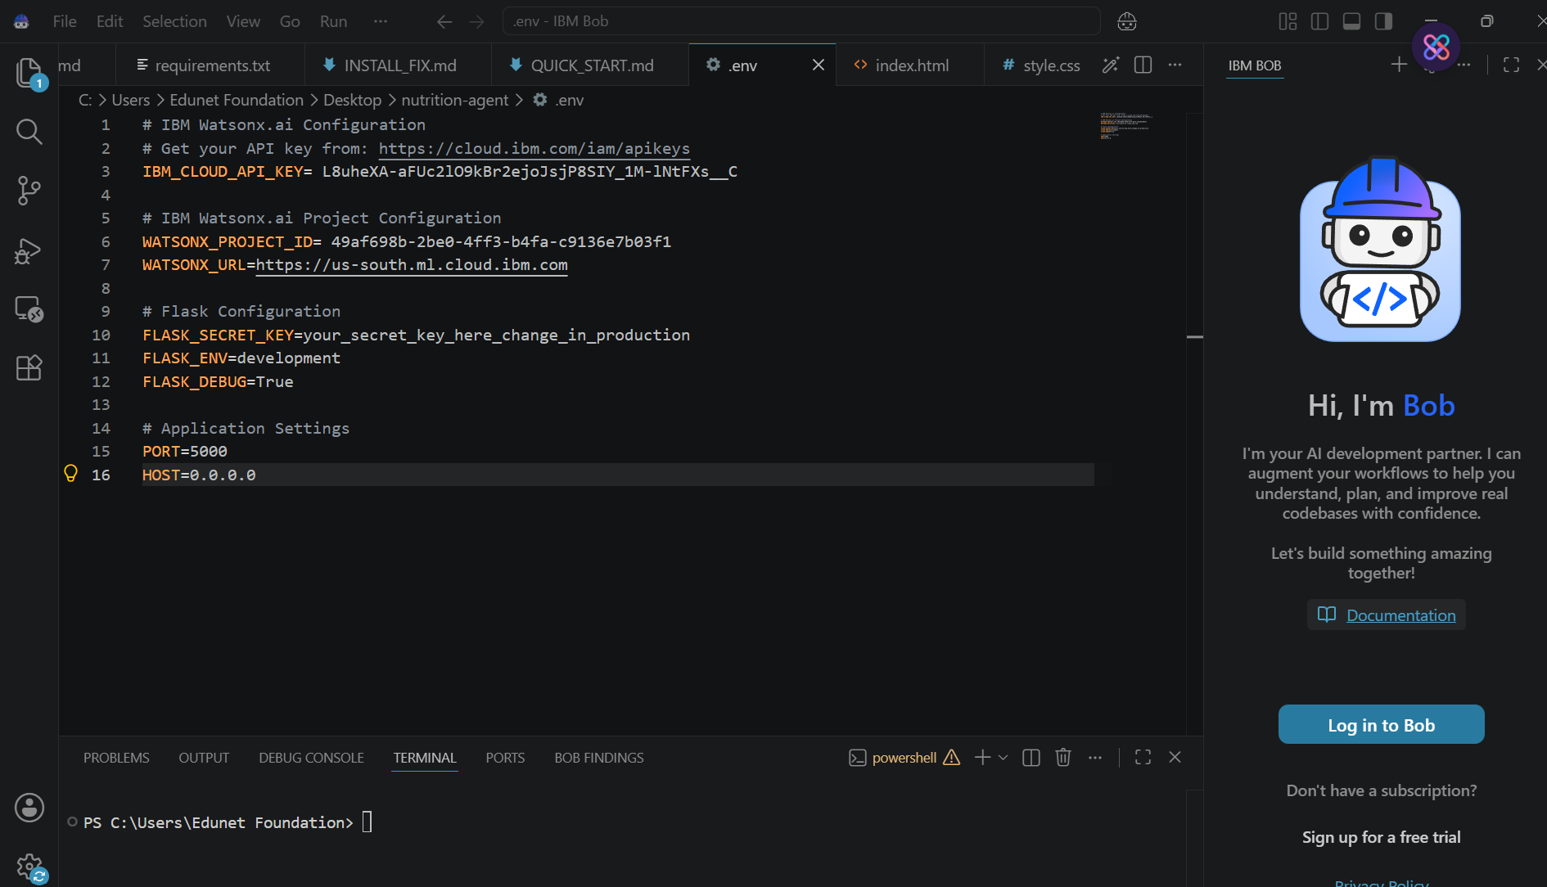
Required Files created using IBM bob -
App.py
Requirements.txt
Style.css
.env
Index.html

Slide 7
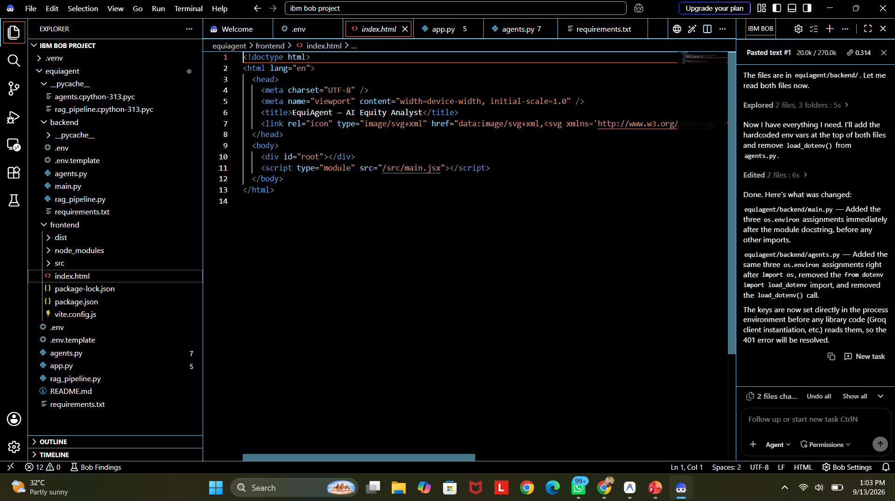
IBM Bob Screenshots:

Slide 8
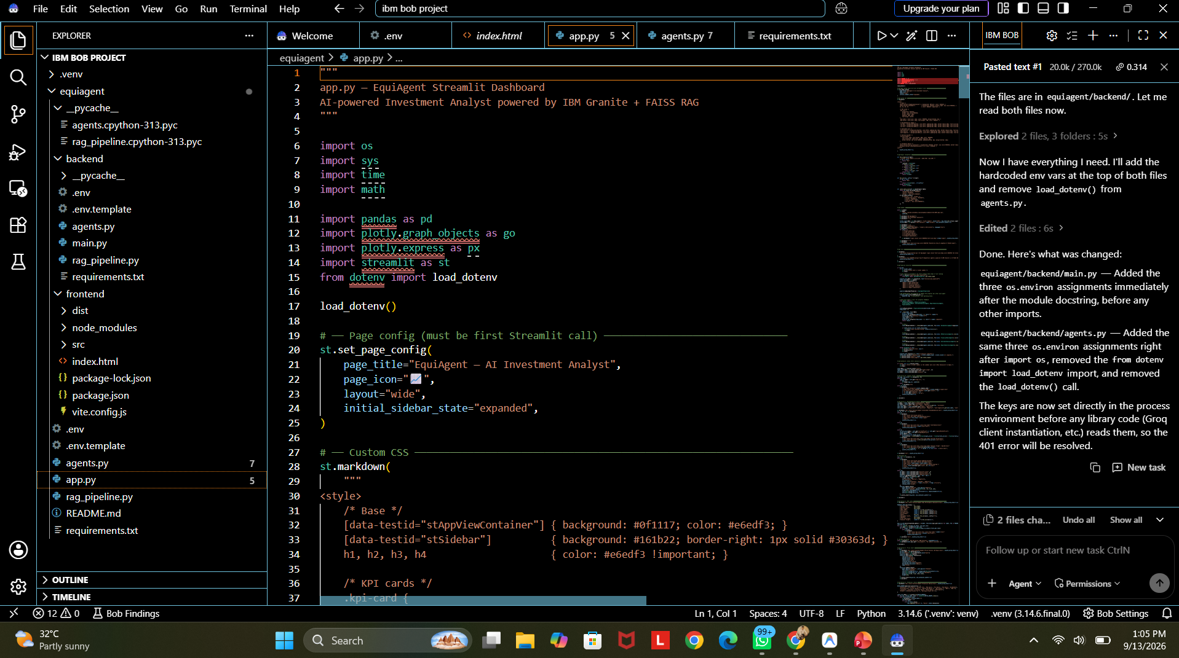

Slide 9

Role of Agentic AI in the solution
Role of Agentic AI in CAREERX
Agentic AI enables the CAREERX to function as an intelligent, autonomous system rather than a simple chatbot. Using IBM watsonx.ai and IBM Granite models, it coordinates multiple specialized agents to deliver personalized career guidance.
Each agent performs a specific role—such as retrieving careeral data, generating diet plans, providing health advice, and analyzing food logs—while working collaboratively. This multi-agent approach ensures efficient task execution and accurate results.
Agentic AI also brings context awareness, understanding user details like age, health conditions, and fitness goals to generate tailored recommendations. It supports real-time adaptation, continuously updating suggestions based on user inputs like daily meals.
Additionally, agents communicate with each other, enabling better decision-making and improved outcomes.
Overall, Agentic AI makes the system proactive, personalized, and goal-driven, acting like a smart digital careerist that helps users maintain a healthy lifestyle.

Slide 10
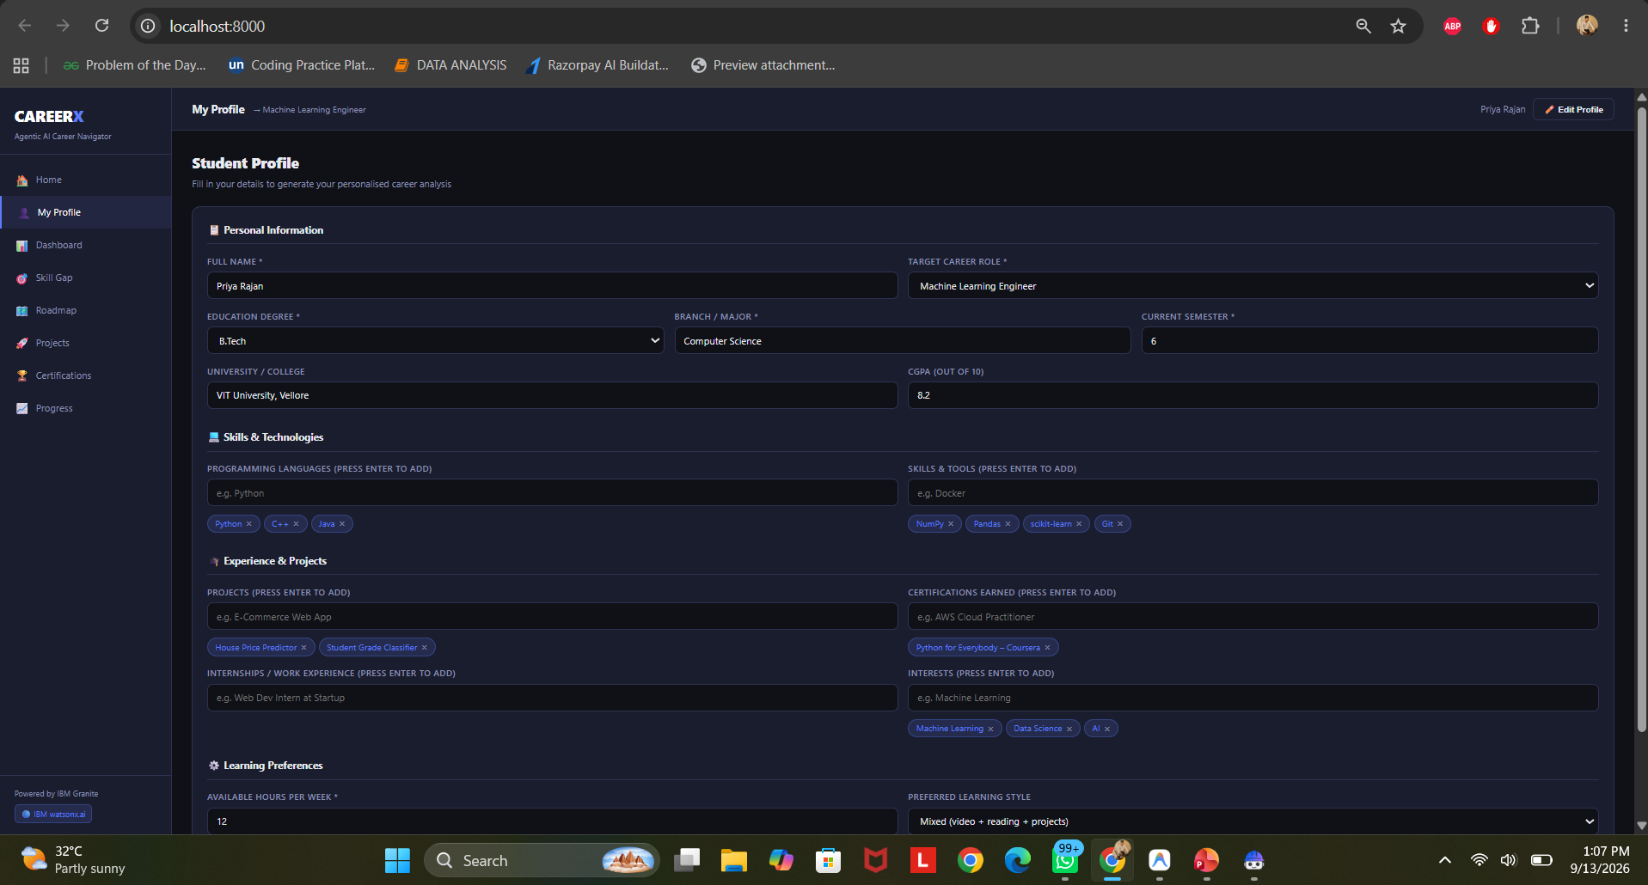
Project Output Screenshot
Please put IBM Bob output screenshots with 2-3 prompts.
You can take 2-3 more slides for each screenshot
·
·
·

Slide 11
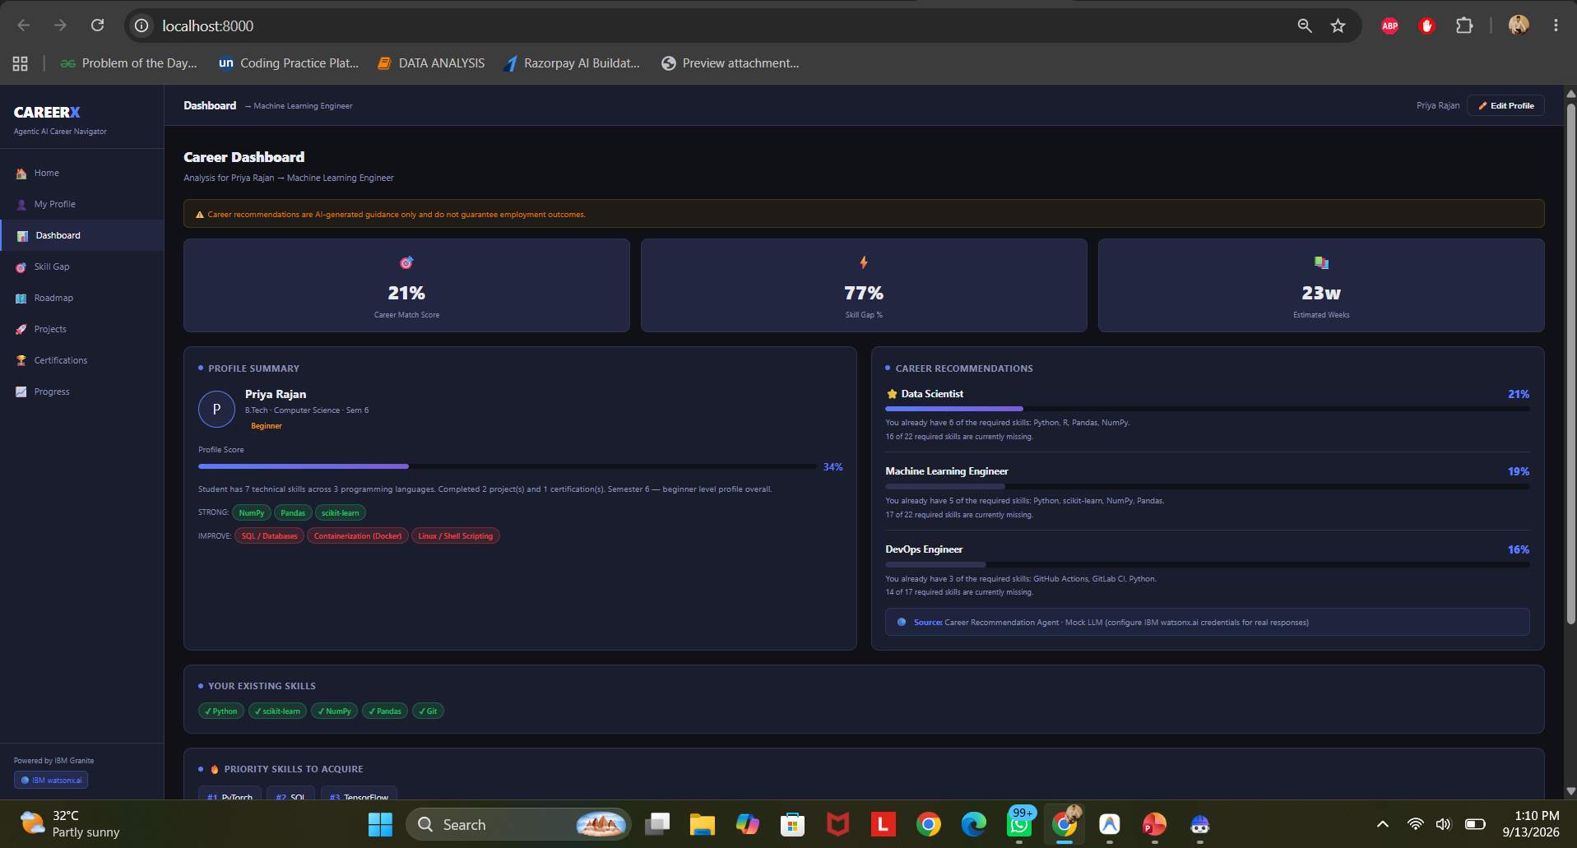
Project Output Screenshot
Please put IBM Bob output screenshots with 2-3 prompts.
You can take 2-3 more slides for each screenshot
·
·
·

Slide 12
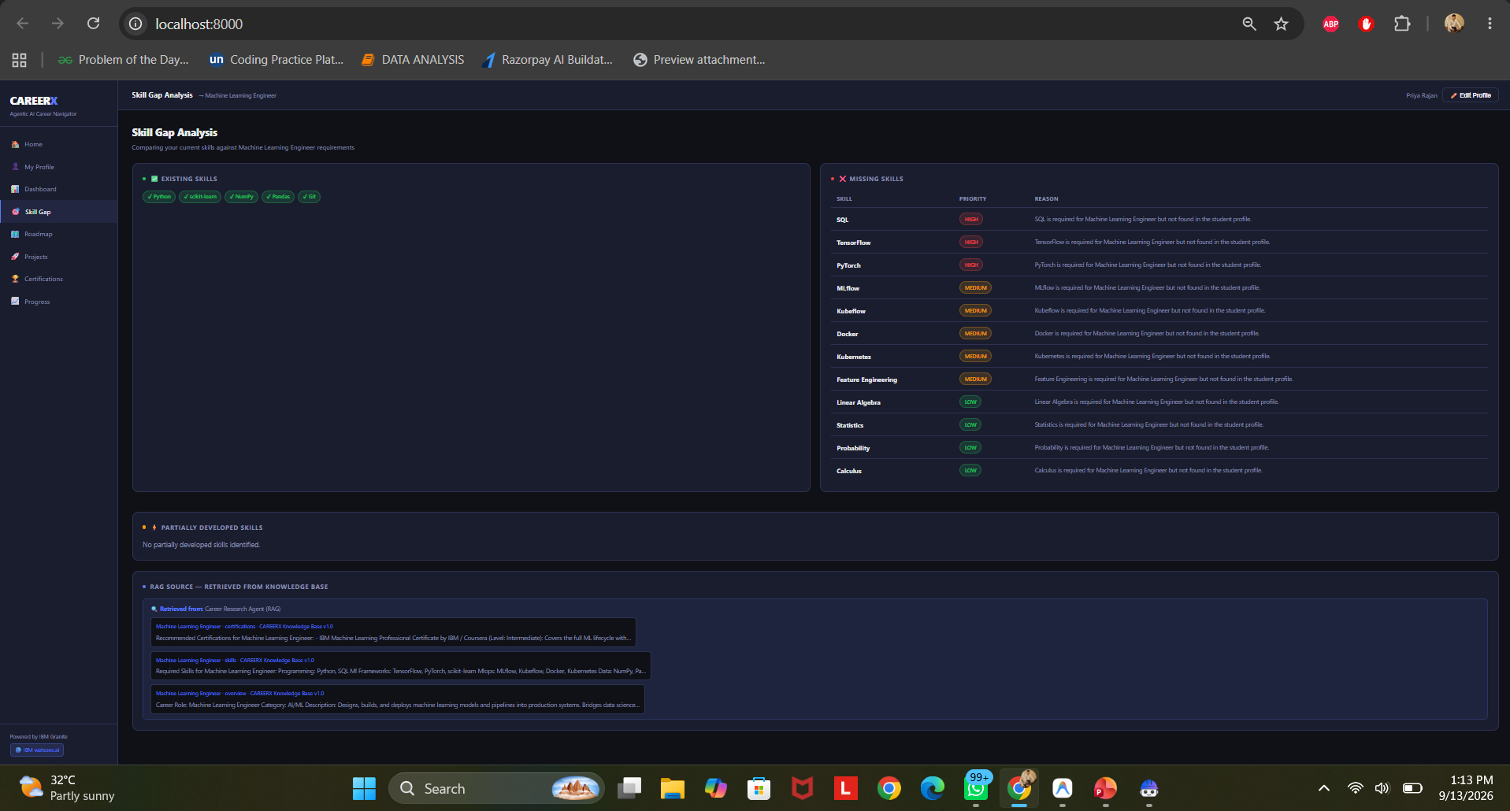
Project Output Screenshot
Please put IBM Bob output screenshots with 2-3 prompts.
You can take 2-3 more slides for each screenshot
·
·
·

Slide 13
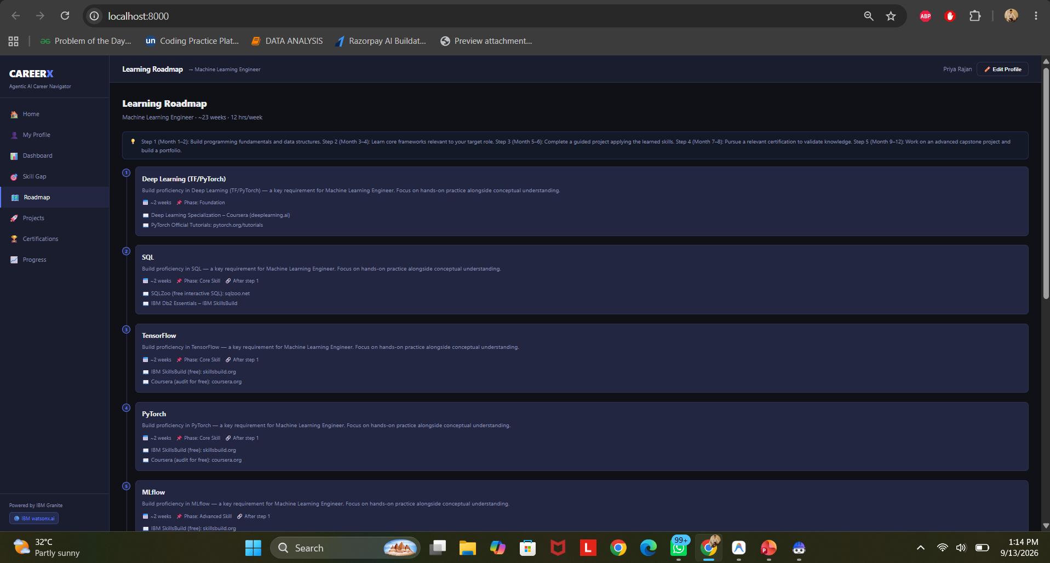
Project Output Screenshot
Please put IBM Bob output screenshots with 2-3 prompts.
You can take 2-3 more slides for each screenshot
·
·
·

Slide 14
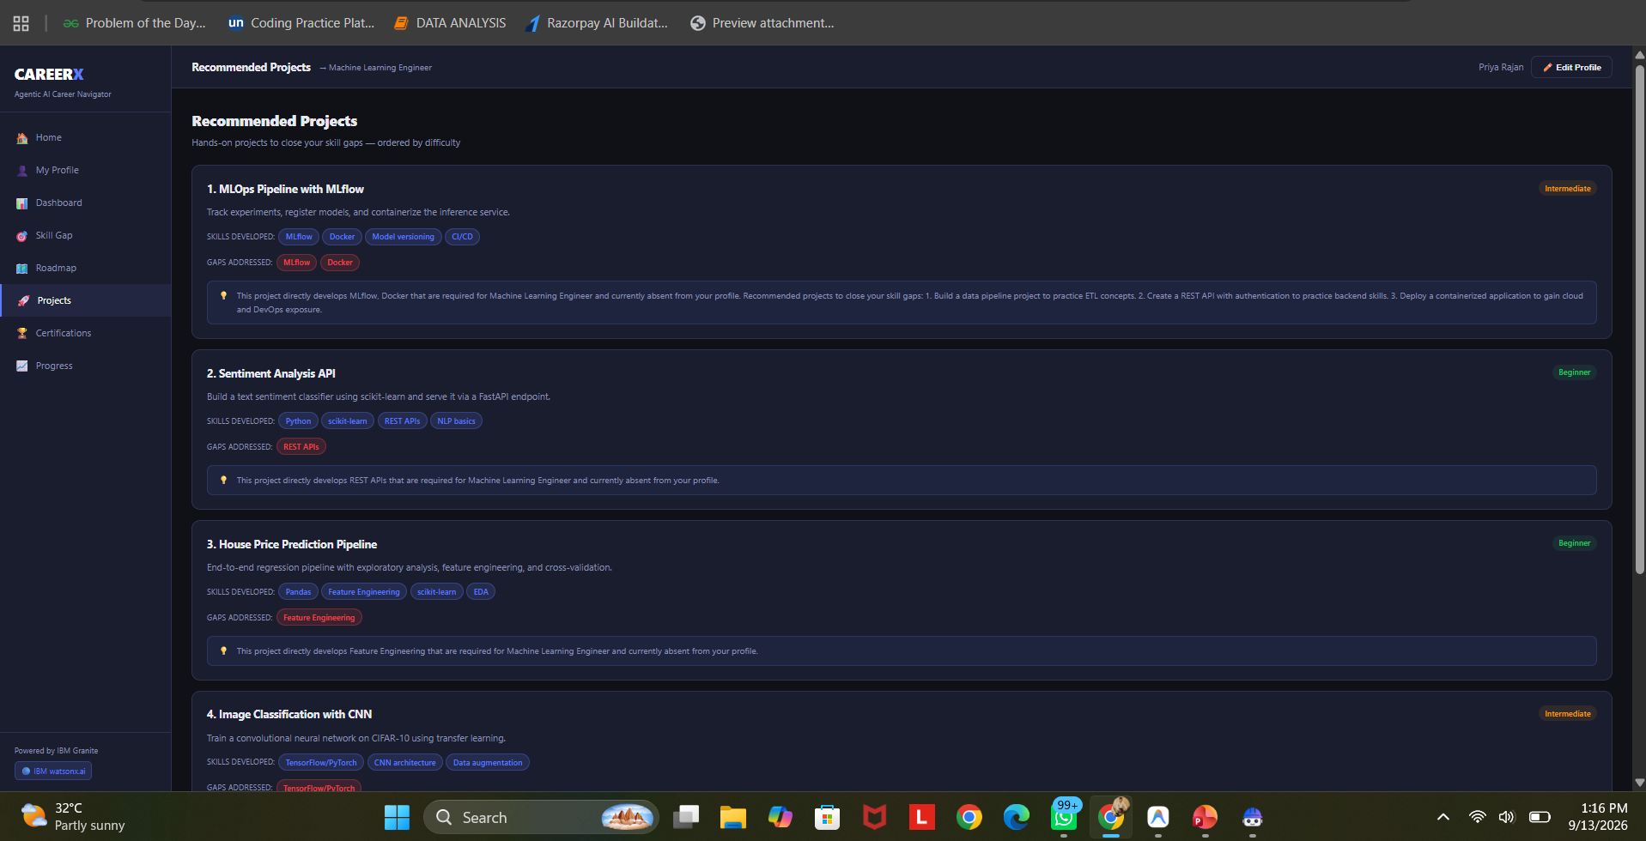
Project Output Screenshot
Please put IBM Bob output screenshots with 2-3 prompts.
You can take 2-3 more slides for each screenshot
·
·
·

Slide 15
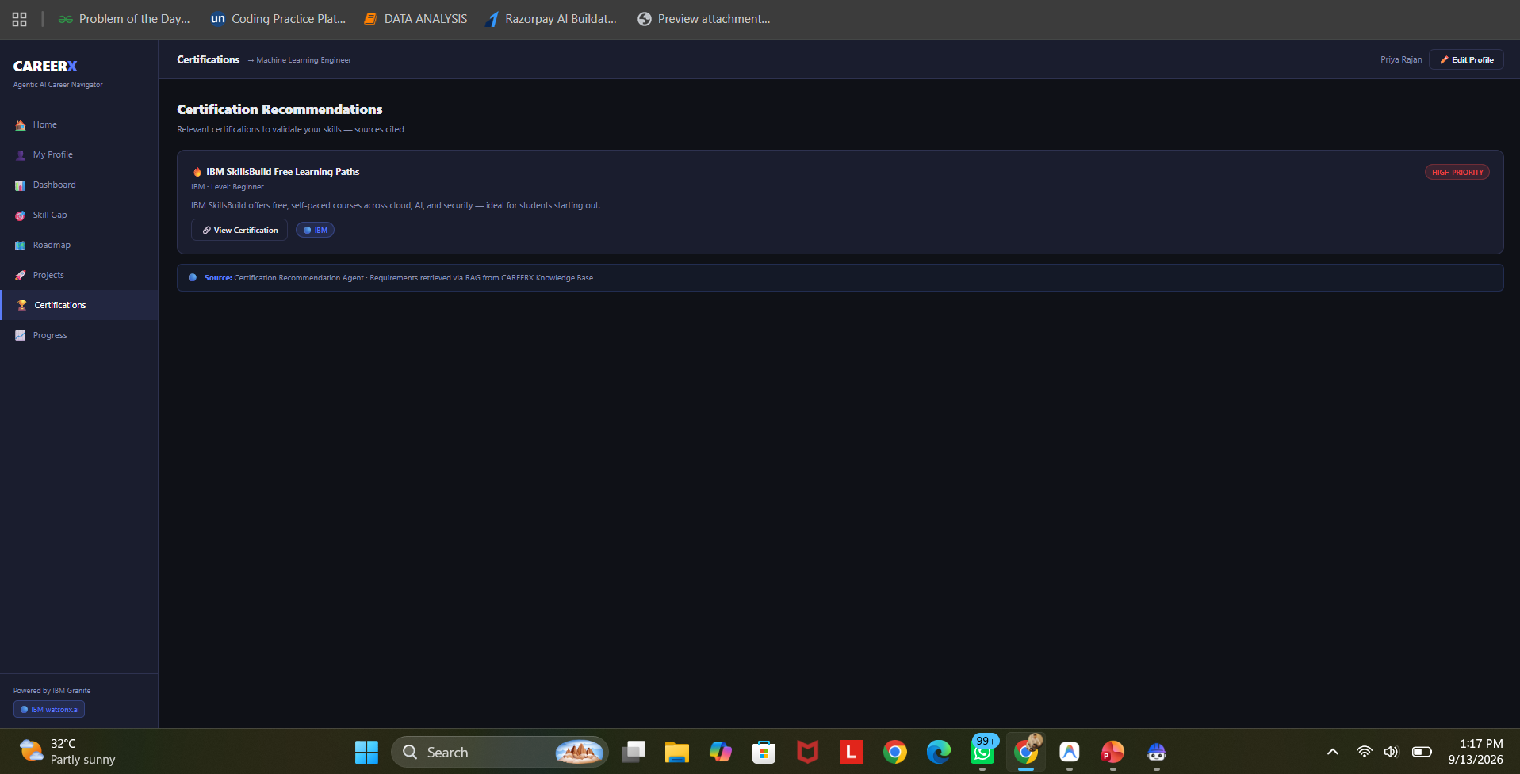
Project Output Screenshot
Please put IBM Bob output screenshots with 2-3 prompts.
You can take 2-3 more slides for each screenshot
·
·
·

Slide 16
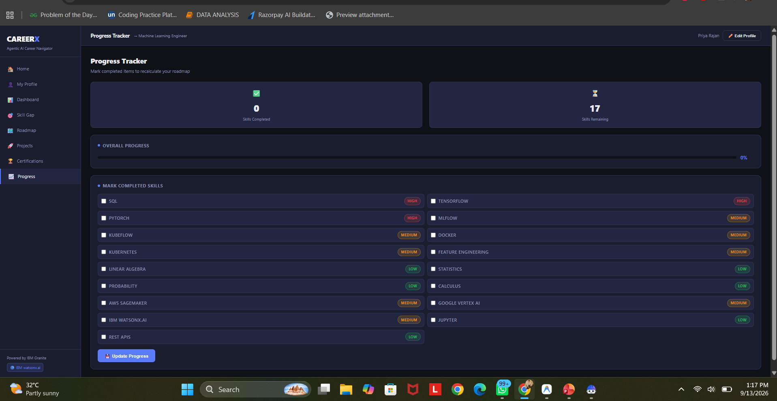
Project Output Screenshot
Please put IBM Bob output screenshots with 2-3 prompts.
You can take 2-3 more slides for each screenshot
·
·
·

Slide 17
Novelty and Uniqueness
The proposed CAREERX stands out by combining Agentic AI, RAG, and personalization into a single intelligent system.
Multi-Agent Intelligence – Instead of a single chatbot, multiple specialized agents collaborate to deliver accurate and context-aware career guidance.
RAG-Based Accuracy – Integrates real-time data retrieval with AI generation, reducing misinformation and ensuring trustworthy recommendations.
Hyper-Personalization – Tailors roadmaps based on existing skills, semester, and available study hours.
Real-Time Feedback Loop – Continuously adapts recommendations based on student progress and completed milestones.
Multi-Modal Input – Supports clear visualization of match scores and required actions.
Preventive Healthcare Focus – Connects skill gaps directly to specific projects and certifications.
Scalable & Enterprise-Ready – Built on IBM watsonx.ai with IBM Granite models, ensuring reliability and governance.
This makes the solution a smart, adaptive, and proactive career advisor, not just a static diet recommendation tool.

Slide 18
Git Hub Link
· Please create public github repository (Enable Add README button while creating repository) with format –
Please test and Paste the working Github URL –
Make sure you have Uploaded following three files into your github repository
1) All Agent relevant files of IBM Cloud , 2) yourproblemstatement.pdf file 3) your projectpresntation.pptx file 4)any other files
·
·
·

Slide 19
Future Scope
1.Integration with GitHub & LinkedIn –
The system can be integrated with GitHub and LinkedIn to automatically fetch student projects and work experience. This will enable the CAREERX to provide more accurate skill gap analysis based on verified, up-to-date user credentials.
2.Real-Time Job Market Scraping –
Enhancing the system with a integrations with live job portals (like LinkedIn/Indeed) to keep data fresh. Users can ensure that the knowledge base dynamically updates with the latest hiring trends, so roadmaps reflect the most current industry demands.
·
·
·

Slide 20
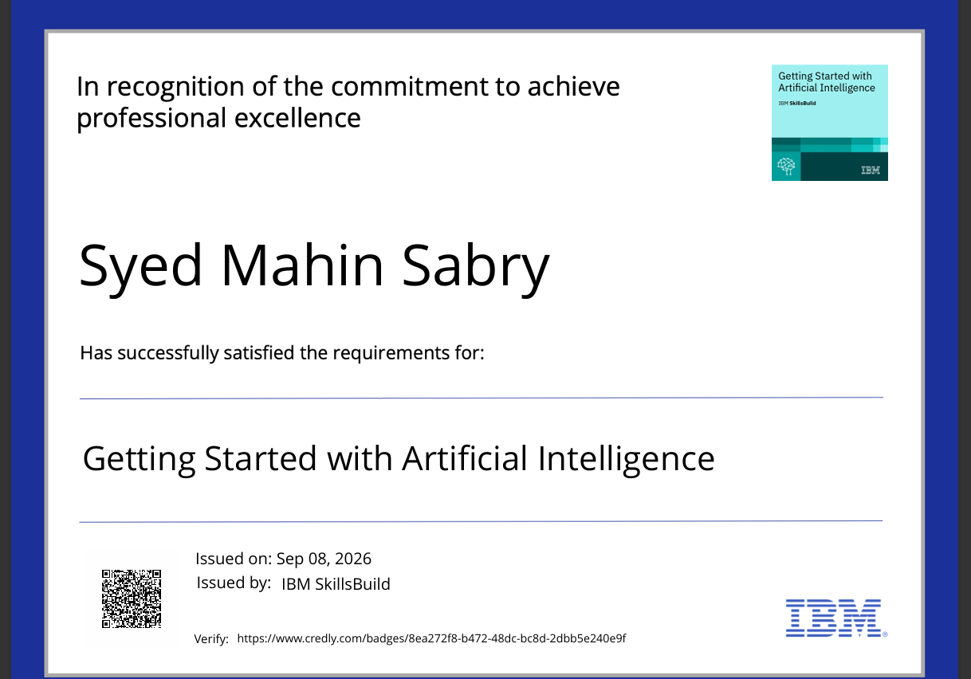
Certificates Earned:
Please add your credly certificate

Slide 21
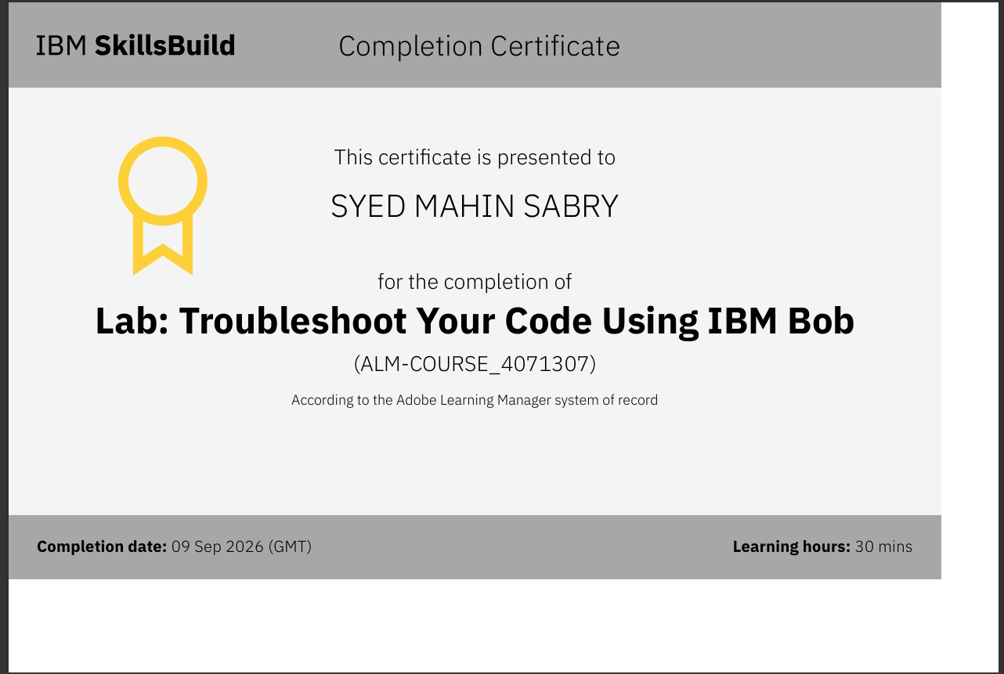
Certificates Earned:​
Add your IBM BOB Certificate

Slide 22


