Slide 1
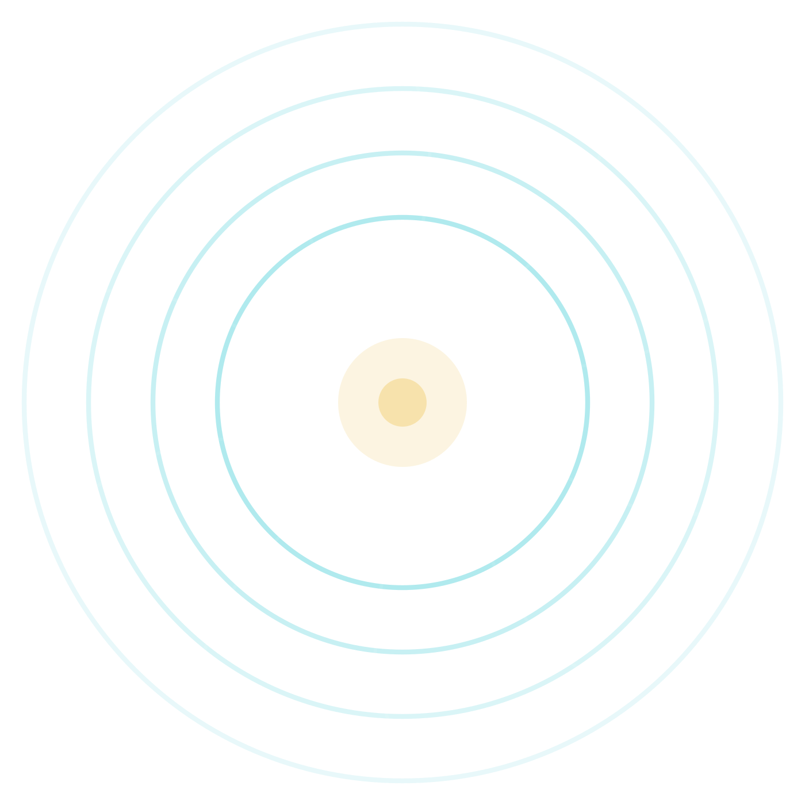

TEAM NEXGEN
DrishtiAI
Explainable AI for Diabetic Retinopathy Screening in Rural India
Smartphone-based, explainable screening that shows a health worker not just the result — but why.
Digital Campus on Google Cloud Hack Sprint
SSTC Bhilai
Sep 2026
A hackathon prototype — screening & decision support, not a medical diagnosis.
Notes:
Open strong: we are Team NexGen from SSTC Bhilai. DrishtiAI brings explainable diabetic-retinopathy screening to rural India using just a smartphone. The one thing to remember: it does not only give a result, it shows the health worker WHY. Frame it clearly as a screening and decision-support tool, not a diagnosis.

Slide 2








THE PROBLEM
Diabetic Retinopathy Goes Undetected
77M
1 in 3
up to 90%
< 1
Diabetics in India
Develop retinopathy
Vision loss preventable
Eye specialists / lakh (rural)
Among the largest diabetic populations in the world.
Roughly a third of diabetics develop DR over time.
When DR is caught early through routine screening.
Screening rarely reaches villages in time.
HOW PREVENTABLE BLINDNESS HAPPENS
Diabetes
No eye screening
DR progresses
Vision loss
Blood sugar quietly damages retinal vessels.
No specialist within reach; eyes go unchecked.
Damage advances silently, without symptoms.
Often irreversible — yet it was preventable.
DrishtiAI · Explainable DR Screening
02 / 10
Notes:
Set up the stakes. India has one of the world's largest diabetic populations, about a third develop retinopathy, and up to 90% of the resulting vision loss is preventable IF caught early. The catch: rural India has almost no eye specialists. Walk the bottom strip left to right — diabetes, no screening, silent progression, preventable blindness. That gap is exactly what we target.

Slide 3






OUR SOLUTION
From Retinal Image to Explainable Screening
1
2
3
4
5
Upload fundus
AI classification
Grad-CAM
Auto report
Screening record
Retinal photo from a phone
DR stage predicted
Heatmap of attention
Plain-language PDF
Saved to dashboard
Five DR stages the model classifies
Who is it for?
No DR
Mild
Moderate
Severe
Proliferative
ASHA & rural health workers
Frontline workers with no ophthalmology training capture a photo and get a clear, visual result they can act on — bringing retinal screening closer to the village.
Increasing severity → earlier referral matters more
Output is a screening classification and referral cue — never a standalone diagnosis.
DrishtiAI · Explainable DR Screening
03 / 10
Notes:
This is the whole product in one line: upload a fundus photo, the AI classifies the DR stage, Grad-CAM explains it visually, a plain-language PDF is generated, and the record is saved to a dashboard. The model sorts images into five standard DR stages, from No DR to Proliferative. And crucially, it is designed for ASHA and rural health workers with no eye-care training.

Slide 4


POSITIONING
Why DrishtiAI?
DrishtiAI
DeepMind DR
IDx-DR
Remidio
Aravind AI
Ours
Research
USA, clinical
Device-based
In-hospital
Runs on any smartphone camera
No specialised fundus hardware
Grad-CAM visual explainability
Built for the ASHA field workflow
Free / low-cost to run
Shareable PDF report & history
Existing tools are clinically strong but built for hospitals and specialised cameras. DrishtiAI is positioned for the field-screening gap — combining smartphone capture, visual explainability and an ASHA-worker workflow that these tools were not designed for.
DrishtiAI · Explainable DR Screening
04 / 10
Notes:
Be fair and specific here. Tools like IDx-DR, Remidio and Aravind's system are clinically strong — but they assume a hospital setting and specialised fundus cameras, and none pair the result with a visual explanation for a non-specialist. Our edge is not accuracy claims; it is the combination: any smartphone, Grad-CAM explainability, and a workflow an ASHA worker can actually use in a village.

Slide 5








TECHNOLOGY
The Stack — and Why Each Piece
FRONTEND
BACKEND
AI MODEL
React + Tailwind CSS
Python · FastAPI
EfficientNet-B3
Fast, component-based medical UI
High-performance async API layer
Lightweight CNN for image classification
EXPLAINABILITY
AI REPORT
DATABASE
Grad-CAM
Gemini Vision API
Firebase Firestore
Visualises where the model looked
Drafts a plain-language report
Real-time screening records
AUTH
DEPLOYMENT
REPORT PDF
Firebase Auth
Docker · Cloud Run
jsPDF
Secure Google sign-in
Serverless, auto-scaling
Client-side PDF generation
DrishtiAI · Explainable DR Screening
05 / 10
Notes:
We chose a Google-Cloud-native stack. React and Tailwind for a quick, clean UI; FastAPI on Cloud Run for a serverless backend; EfficientNet-B3 as a lightweight image classifier; Grad-CAM for explainability; Gemini Vision to draft the report text; Firebase for auth and real-time records; Docker to package the model; jsPDF for the report. Two tiles are highlighted — the model and the explainability — because they are the heart of the project.

Slide 6




SYSTEM ARCHITECTURE
How DrishtiAI Works, End to End
USER
ASHA worker
Firebase Auth
Fundus upload
Smartphone
Google sign-in
Retinal photo
APPLICATION
Receives the image and orchestrates the AI pipeline
FastAPI backend
on Cloud Run
AI & ML
Gemini Vision
Grad-CAM
EfficientNet-B3
Report text
Attention heatmap
DR stage
CLOUD & DATA
jsPDF report
Firestore
ASHA dashboard
Downloadable PDF
Screening records
Village history
DrishtiAI · Explainable DR Screening
06 / 10
Notes:
Follow the arrows. The ASHA worker signs in and uploads a fundus photo. It goes to the FastAPI backend on Cloud Run, which runs EfficientNet-B3 to get the DR stage, then Grad-CAM for the heatmap, then Gemini to draft the report. The result becomes a jsPDF report, is stored in Firestore, and shows up on the village dashboard. Four clean layers — user, application, AI, and cloud.

Slide 7

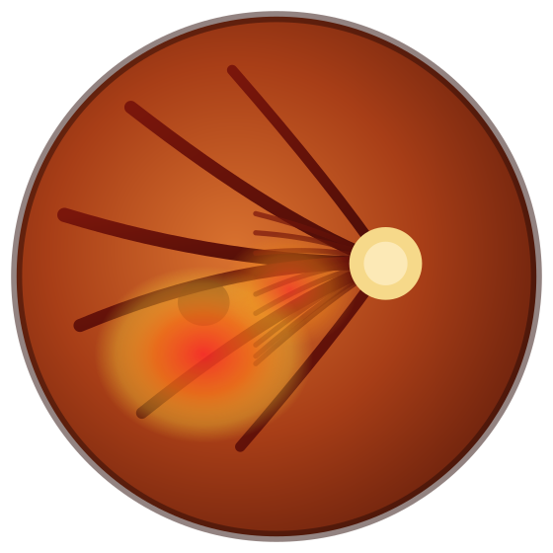

AI & EXPLAINABILITY
The Intelligence Behind DrishtiAI
EfficientNet-B3
Explainable result
Predicts DR stage
Stage + the regions that
influenced it, shown visually
Severe
Fundus image
Grad-CAM heatmap
EfficientNet-B3
Grad-CAM
What it does A lightweight CNN that sorts a fundus image into one of five DR stages.
What it does Highlights the image regions that most influenced the prediction.
Why it matters Pre-trained, so it runs fast on Cloud Run without days of training.
Why it matters Gives the health worker a visual reason, not just a label.
Grad-CAM provides model interpretability — it indicates influence on the prediction, not clinical proof of a lesion.
DrishtiAI · Explainable DR Screening
07 / 10
Notes:
This is our strongest technical idea, so slow down. EfficientNet-B3 predicts the DR stage — here, Severe. But a label alone is not trustworthy to a health worker. Grad-CAM produces a heatmap over the same image showing which regions drove that prediction. For each, say what it does and why it matters. End on the disclaimer: the heatmap shows influence on the model, not clinical proof — we are careful about that claim.

Slide 8


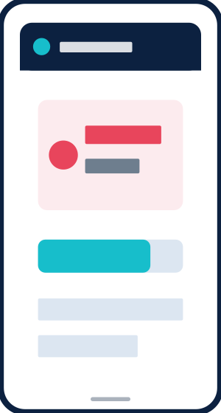



USER EXPERIENCE
Designed for Rural Health Workers
1
2
3
4
5
Sign in
Capture
Result
Explain
Report
Google sign-in
Photograph the retina
Stage + confidence
Grad-CAM heatmap
Download PDF
Village screening dashboard
Patient 014
Patient 021
Patient 033
Patient 047
Every screening — stage, confidence and date — in one shared, searchable record.
Severe
Mild
Moderate
No DR
DrishtiAI · Explainable DR Screening
08 / 10
Notes:
Now the worker's point of view. Five taps: sign in, capture the retina, see the stage with a confidence score, view the Grad-CAM heatmap, and download the PDF report the patient carries to a hospital. Everything is a clean card, not raw numbers. And every screening lands on a shared village dashboard, so a whole community's history is visible at a glance.

Slide 9

EXECUTION
From Prototype to Deployment
Sep 19
Sep 20
Sep 21
Sep 22
Sep 23
Setup
Core build
Integration
Test & deck
Ship
Dataset, Firebase, Cloud Run, repo
EfficientNet + Grad-CAM, FastAPI, React upload
Gemini report, jsPDF, dashboard, UI polish
Test images, demo video, README
Final tests, Cloud Run deploy, submit (GFG)
Syed Mahin Sabry
Ansh Naokarkar
Kangana Batghare
Priyanshi Singh
Sarah Khan
Captain · AI, Backend & Deploy
Frontend Lead
ML & Visualization
Reports & Presentation
QA & Documentation
Model, Grad-CAM, FastAPI, Cloud Run, Firebase, Gemini
React UI, image upload, result cards, responsive design
Grad-CAM overlay, confidence display, OpenCV
jsPDF template, dashboard UI, pitch deck
Demo video, README, test images, submission
DrishtiAI · Explainable DR Screening
09 / 10
Notes:
Five days, five people, clear ownership. Sep 19 is setup; the 20th is the core AI, API and frontend; the 21st is full integration; the 22nd is testing and the deck; the 23rd we deploy to Cloud Run and submit on the GFG portal. Mahin leads AI, backend and deployment; Ansh owns the frontend; Kangana handles visualization; Priyanshi does reports and this deck; Sarah runs QA and documentation.

Slide 10

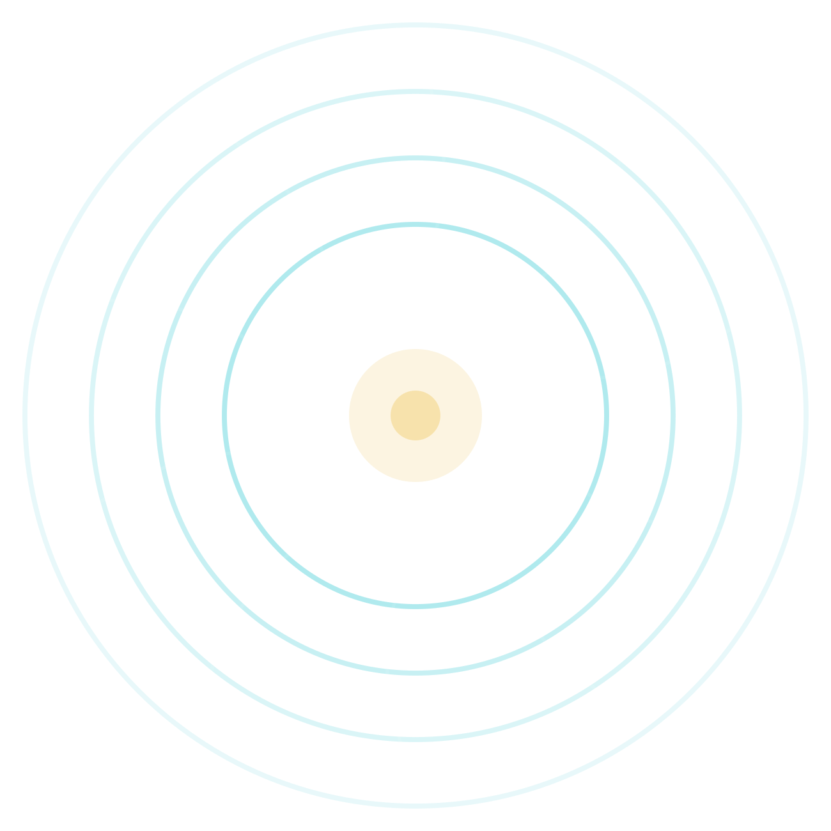




IMPACT & DEMO
Making Explainable Screening Accessible
Rural reach
Screening that travels to the village, on a phone
Explainable
A visual reason with every result
Early, explainable DR screening — on any smartphone, understandable by any health worker.
Low-cost
Runs on Google Cloud free-tier services
ASHA-first
Built for workers with no eye-care training
Records & referral
Team NexGen · SSTC Bhilai
History and PDFs that guide next steps
THE LIVE DEMO
Upload
Predict
Explain
Report
Dashboard
DrishtiAI · Explainable DR Screening
10 / 10
Notes:
Land the plane. The impact is fourfold: it reaches rural patients, it explains itself, it is low-cost on free-tier cloud, and it fits the ASHA worker. Then invite the demo directly: upload, predict, explain, report, dashboard — we will now show it live. Close on the line on the right, and keep it honest: this is screening and decision support that makes early detection reachable, not a cure or a diagnosis.

