Slide 1
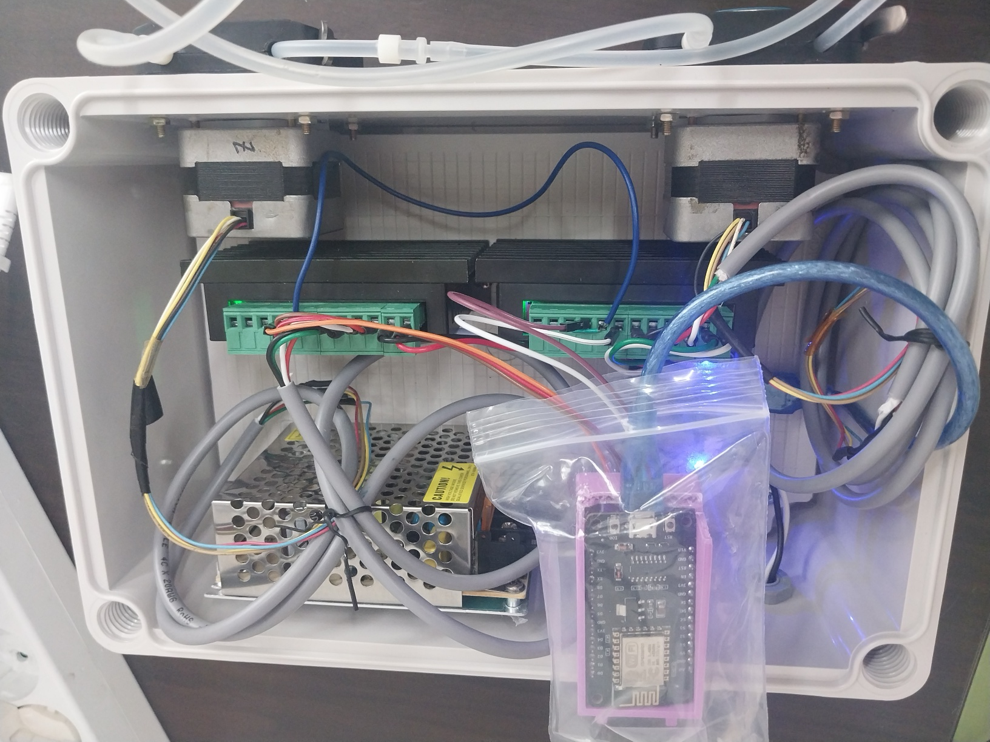
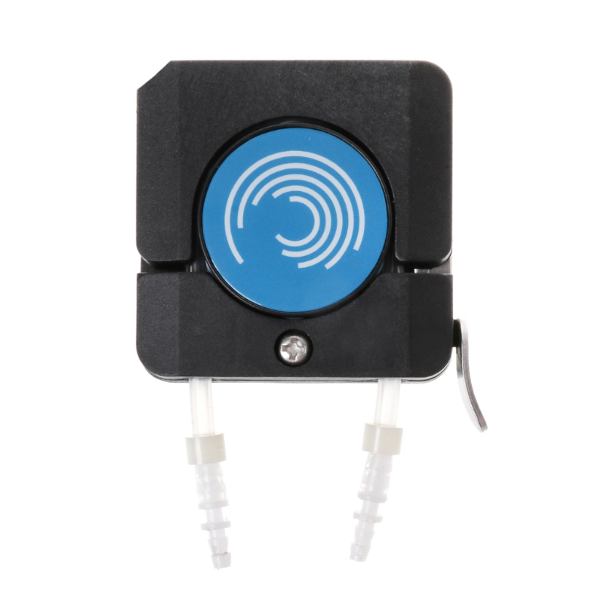
■ Tube pump Web Server
ESP8266 NodeMCU
TB6600 (2EA)
Stepper motor (2EA)
Tube pump Head (2EA)
// wiring (결선)
// nodemcu - TB6600 (Motor1), TB6600(Motor2)
// D1 - DIR+
// D2 - PUL+
// GND - PUL- - PUL-
// D5 - DIR+
// D6 - PUL+
Tube pump Head

Slide 2
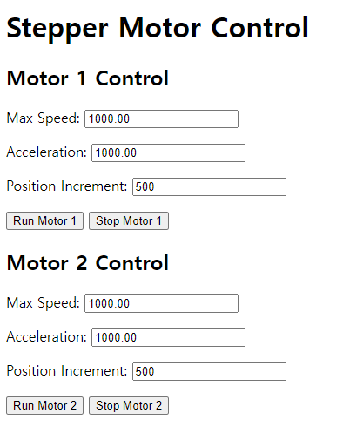
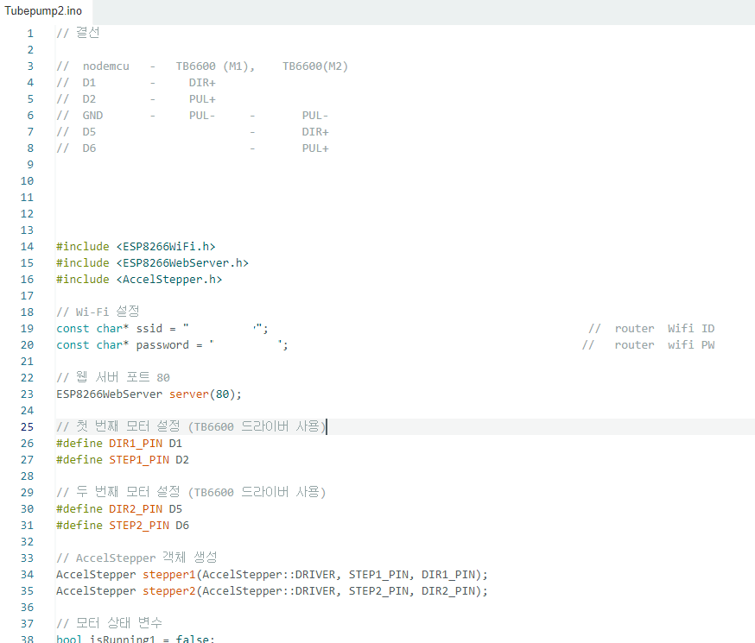
■ Tube pump Web Server
Web Server UI
Firmware

Slide 3
■ Tube pump Web Server
Web Server UI
NodeMCU Firmware

Slide 4
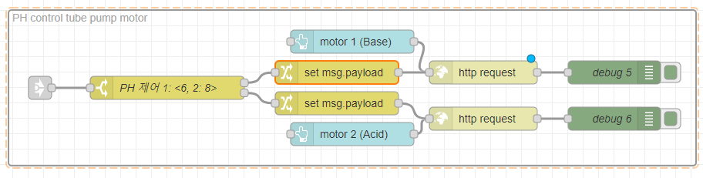
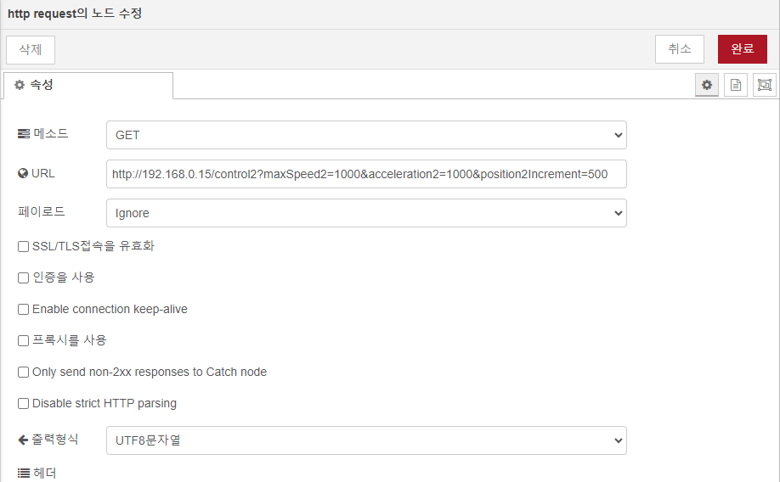
■ Tube pump Web Server PH 제어 Node red 예시
http://192.168.0.15/control1?maxSpeed1=1000&acceleration1=1000&position1Increment=500
측정값

