Slide 1
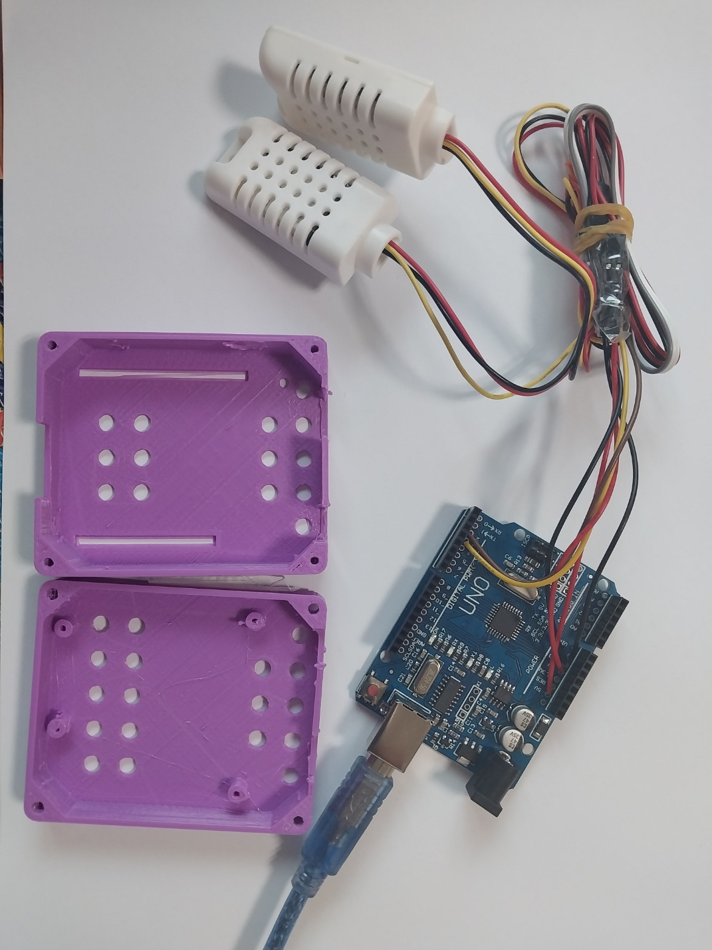
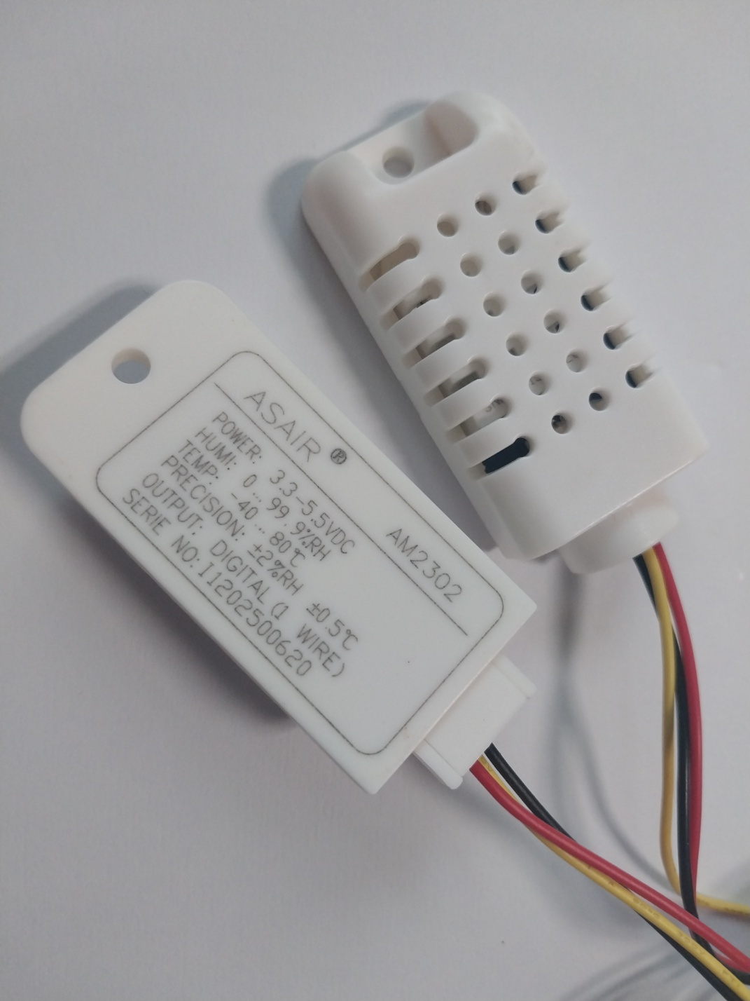
Temperature & Humidity Monitor
1) Arduino Uno R3
2) ASAIR AM2302
3) Case 3D model
https://www.thingiverse.com/thing:101985

Slide 2
Temperature & Humidity Monitor
1) Wiring
Sensor 11
AM2302
5V
Arduino Uno
R3
GND
D2
Sensor 22
D3
AM2302

Slide 3
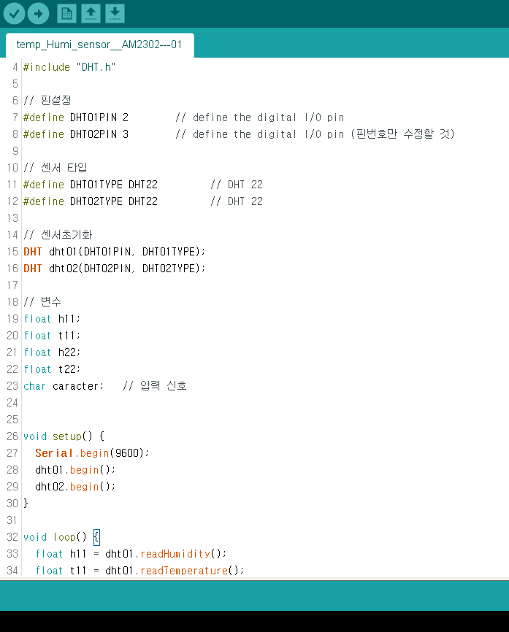
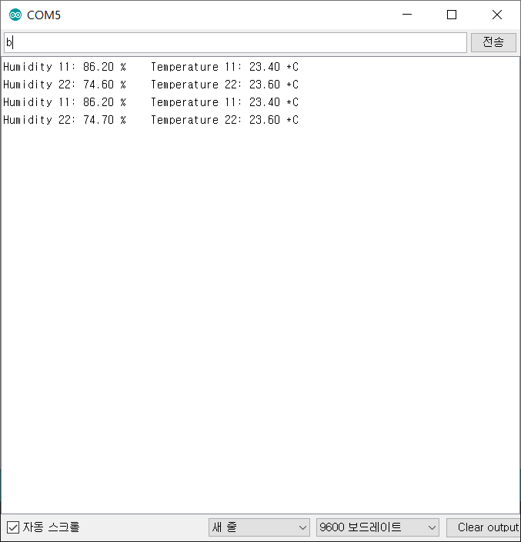
Temperature & Humidity Monitor
1) Firmware
a
: sensor11
b
: sensor22

Slide 4
Temperature & Humidity Monitor
1) Firmware
void loop() {
float h11 = dht01.readHumidity();
float t11 = dht01.readTemperature();
float h22 = dht02.readHumidity();
float t22 = dht02.readTemperature();
delay(500);
if (Serial.available()) {
caracter = Serial.read();
if (caracter == 'a') { // 'a' 입력시 1번센서 출력
Serial.print("Humidity 11: ");
Serial.print(h11);
Serial.print(" %\t");
Serial.print("Temperature 11: ");
Serial.print(t11);
Serial.println(" *C");
}
if (caracter == 'b') { // 'b' 입력시 2번센서 출력
Serial.print("Humidity 22: ");
Serial.print(h22);
Serial.print(" %\t");
Serial.print("Temperature 22: ");
Serial.print(t22);
Serial.println(" *C");
}
}
}
// 라이브러리
#include "DHT.h"
// 핀설정
#define DHT01PIN 2 // define the digital I/O pin
#define DHT02PIN 3 // define the digital I/O pin (핀번호만 수정할 것)
// 센서 타입
#define DHT01TYPE DHT22 // DHT 22
#define DHT02TYPE DHT22 // DHT 22
// 센서초기화
DHT dht01(DHT01PIN, DHT01TYPE);
DHT dht02(DHT02PIN, DHT02TYPE);
// 변수
float h11;
float t11;
float h22;
float t22;
char caracter; // 입력 신호
void setup() {
Serial.begin(9600);
dht01.begin();
dht02.begin();
}

Slide 5
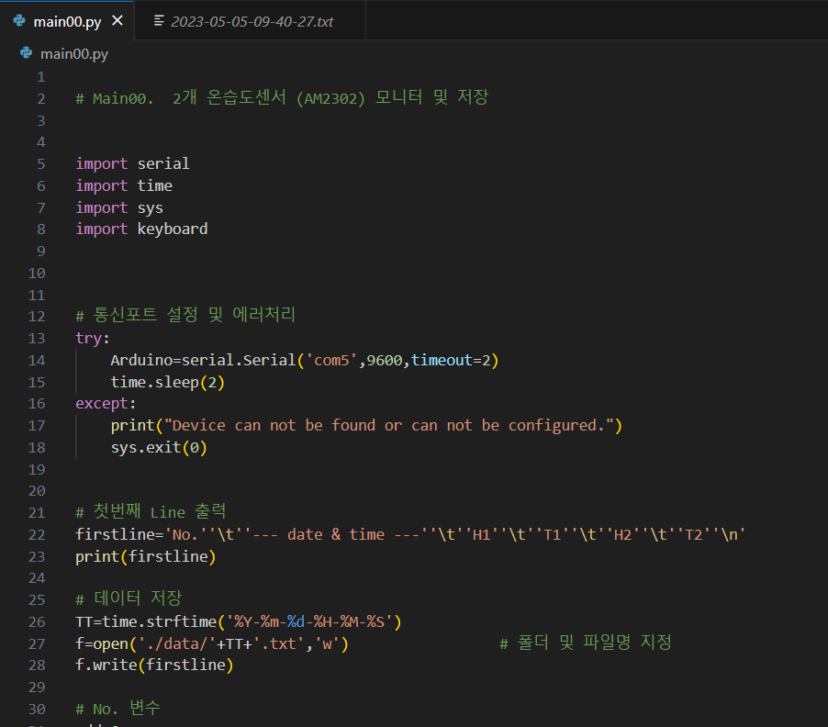
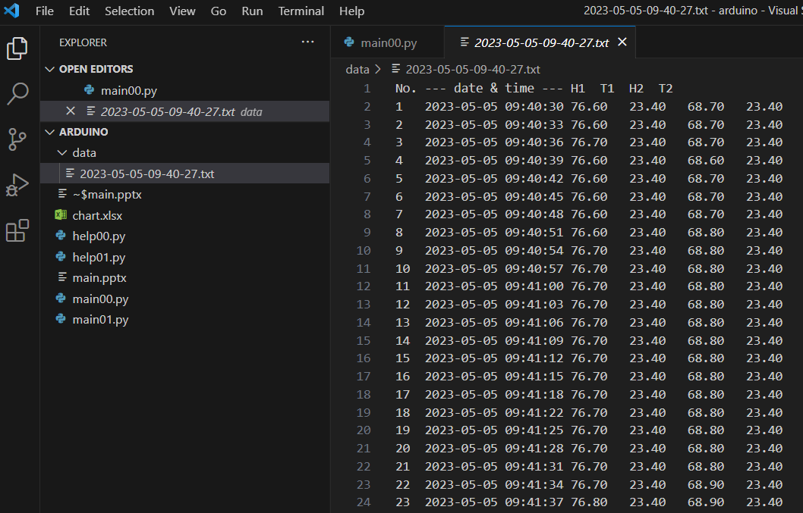
Temperature & Humidity Monitor
1) Python

Slide 6
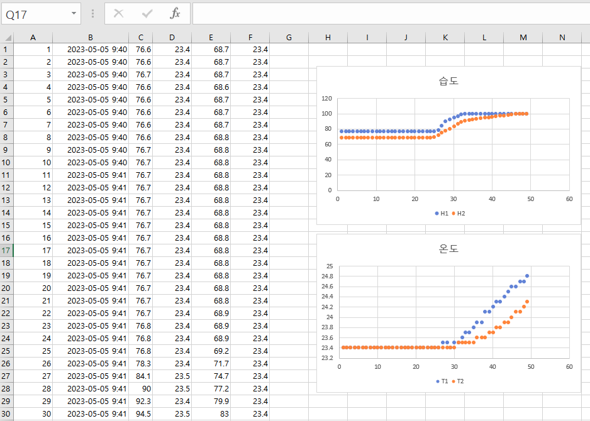
Temperature & Humidity Monitor
1) Excel

