Slide 1
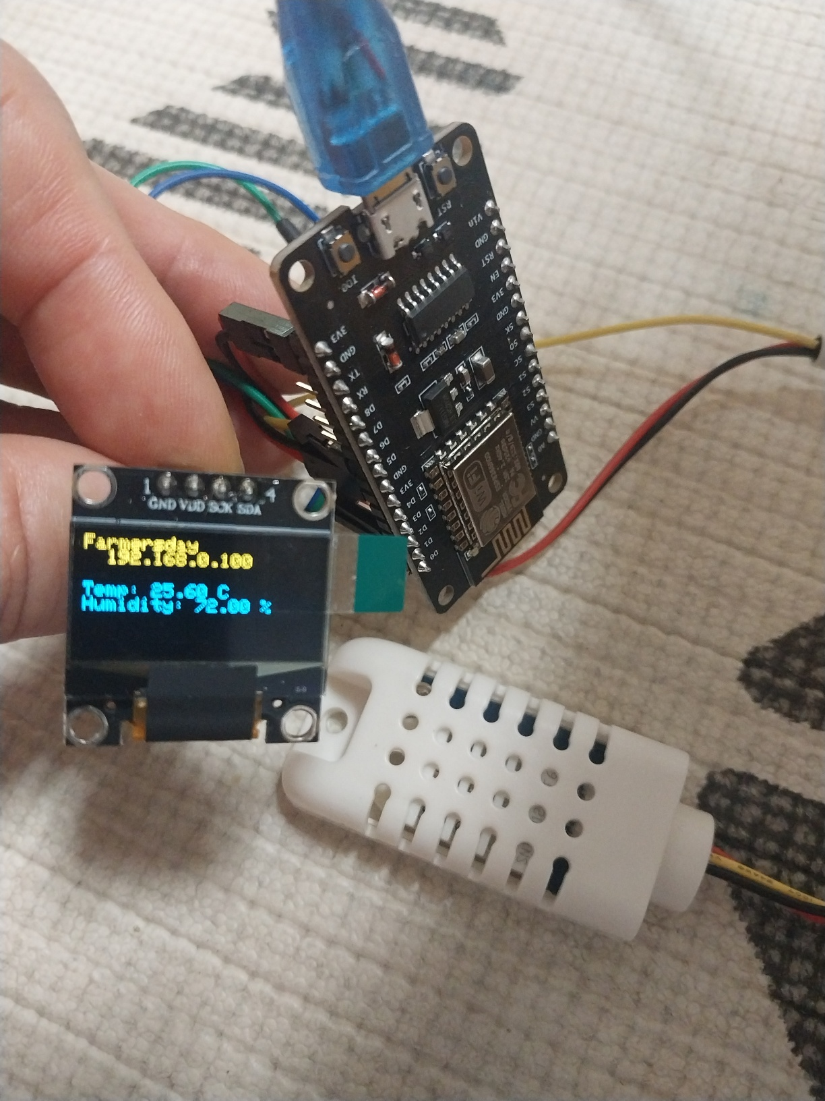
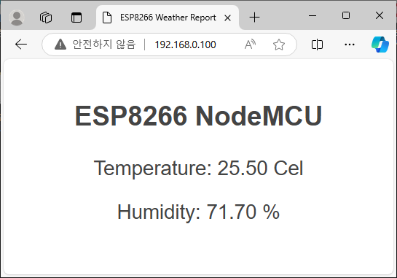
■ Temperature Humidity Web Server
ESP8266 NodeMCU
AM2302 (DHT22)
OLED (0.96 inch)
// wiring ---------i------------------------------------
// DHT22 sensor
// VCC -> 3.3V (NodeMCU)
// GND -> GND (NodeMCU)
// Data -> D5 (GPIO14)
// OLED display (0.96inch I2C OLED display (128x64))
// VCC -> 3.3V (NodeMCU)
// GND -> GND (NodeMCU)
// SCL -> D1 (GPIO5)
// SDA -> D2 (GPIO4)

