Slide 1

GamesWorld
by the AP-Einsteins

Slide 2




Meet the Creative Team
Bethany
Dan
TJ
Kui

Slide 3
Concept
interactive multiplayer and single player gaming website

Slide 4
Motivation & technologies used
to utilize modern web development technologies, APIs, javascript, jQuery,
create an entertainment website with social interaction in a fun space theme

Slide 5
APIs used
SWAPI – Star Wars API
opentdb.com – multi-category trivia API

Slide 6
other technologies used
sweetalerts I and II (for modals)
fontawesome (icons)
bootstrap 3 & 4
javascript, AJAX, jQuery

Slide 7
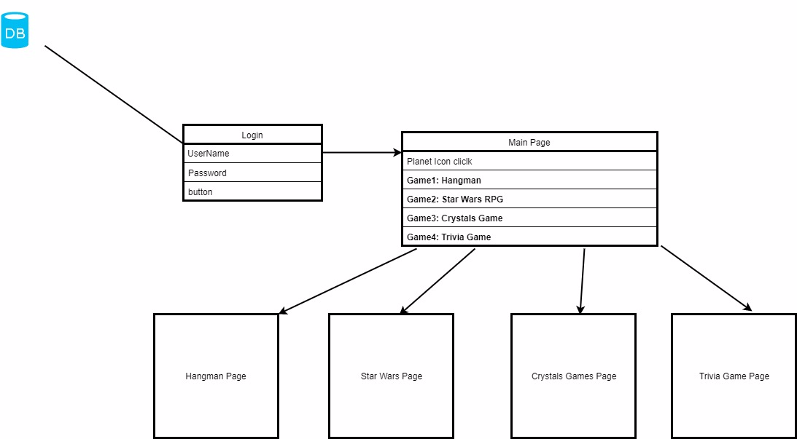
Design process

Slide 8
Demonstration
https://tdsteph1.github.io/GamesWorld
Login demo
Landing page
Star Wars Battle
Hangman Planet
Trivia Planet

Slide 9
Future developement
Leaderboard
Profile page
Voice chat
Google/Facebook authentication
integrate user persistence throughout all apps
more games!!

Slide 10

Questions?
This Photo by Unknown Author is licensed under CC BY

