Slide 1
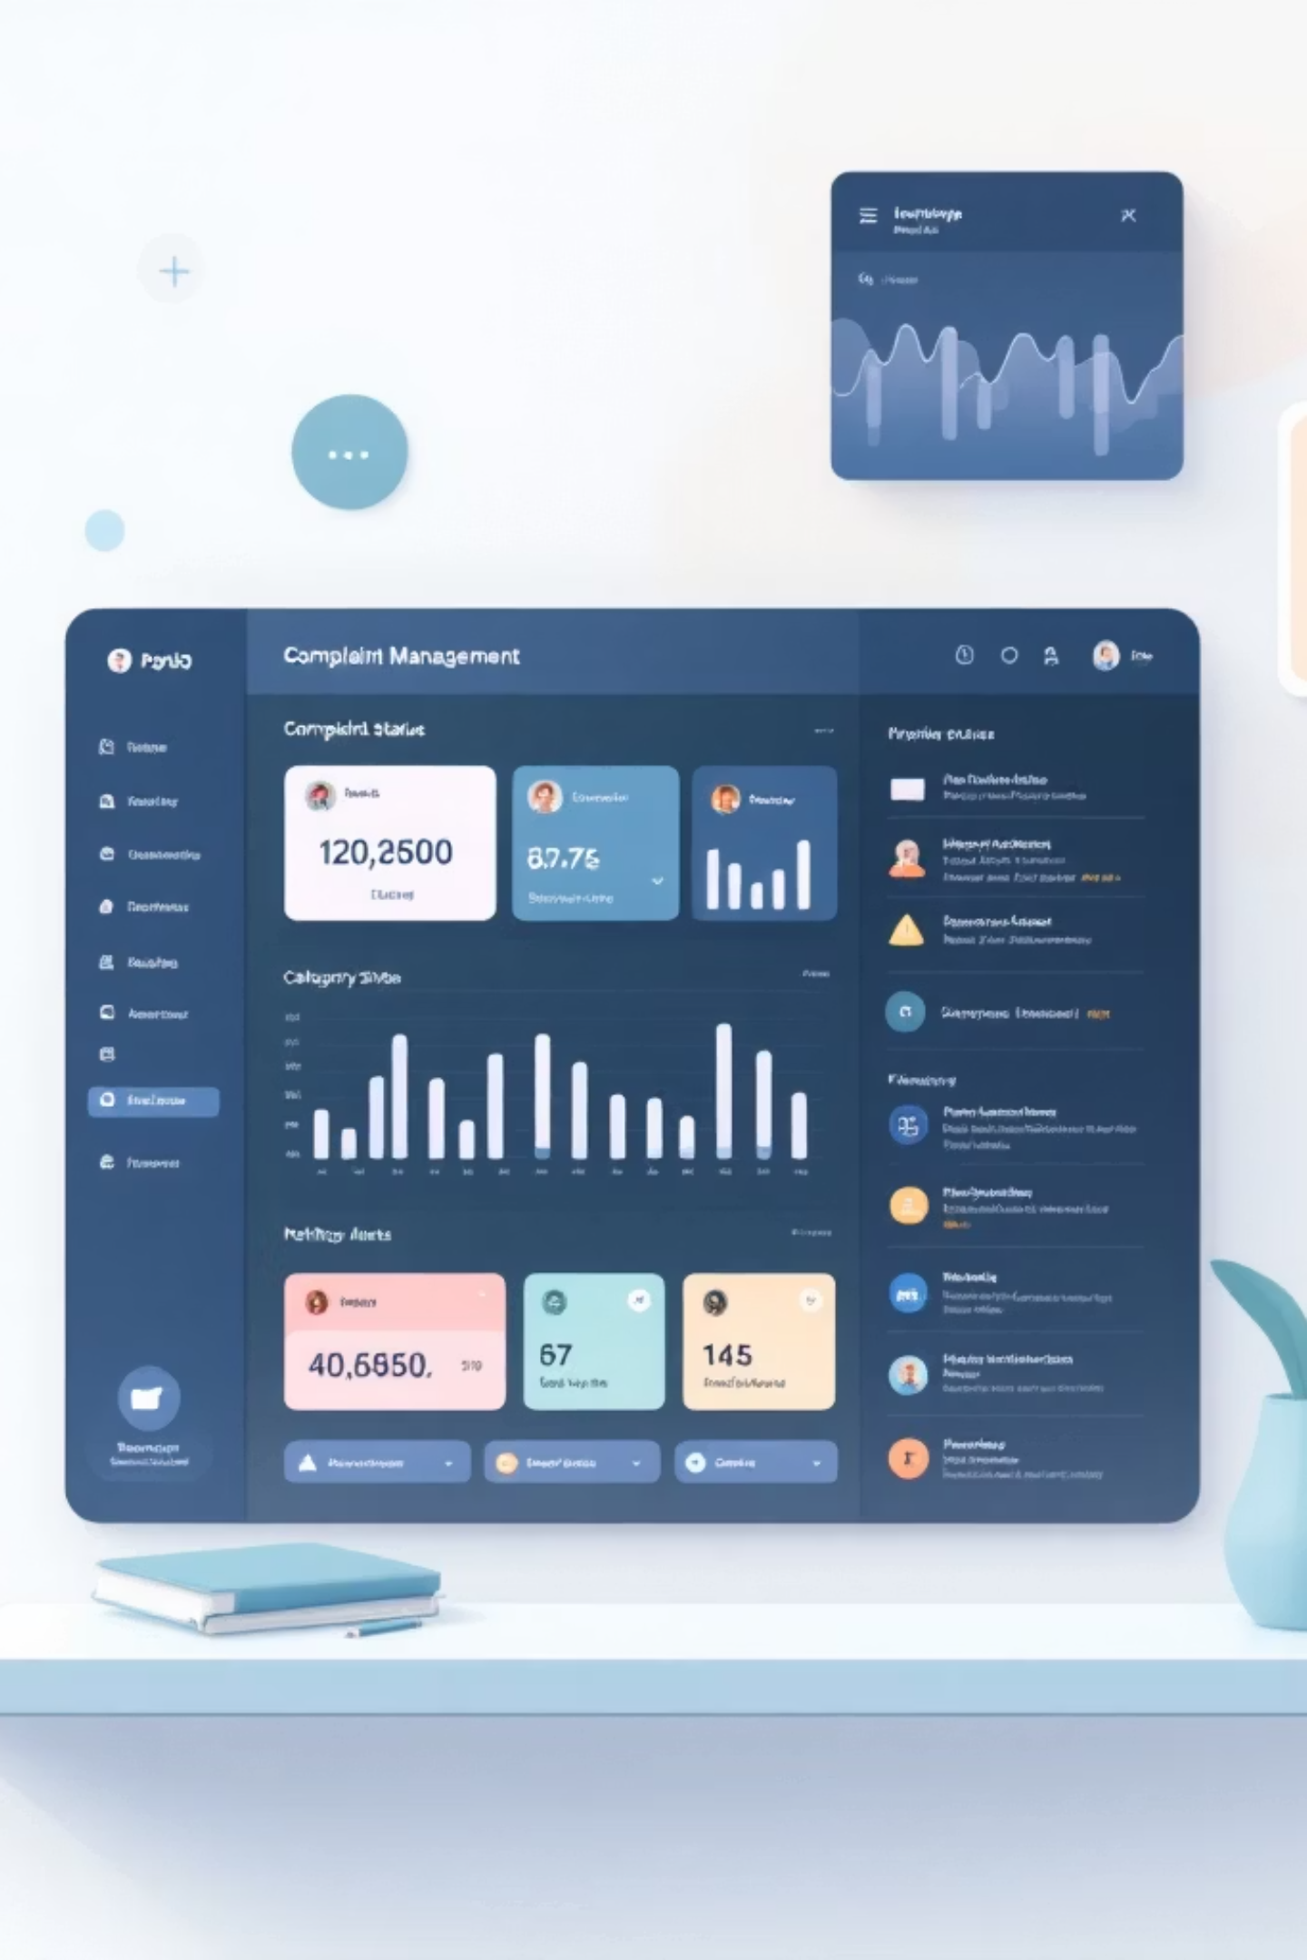
ComplaintSystem
Role-Based Complaint Management System
A web-based platform built with Django, HTML, CSS, JavaScript, and SQLite to streamline complaint handling across multiple stakeholder roles.

Slide 2

Project Overview
Transforming Complaint Management
ComplaintSystem is a web-based platform designed to modernize how organizations handle citizen complaints. The system connects citizens, administrators, and department staff through a unified interface that prioritizes transparency and operational efficiency.
By implementing role-based access control, the platform ensures appropriate permissions while maintaining data security. Citizens can submit complaints with ease, administrators can manage workflows, and departments can track and resolve issues—all within a single integrated system.

Slide 3






Key Features
Role-Based Authentication
Complaint Submission & Tracking
Secure login system with distinct access levels for citizens, administrators, and department staff.
Citizens submit detailed complaints with document attachments and track real-time status updates.
Status Updates & Feedback
Intelligent Escalation
Automated notifications keep users informed while feedback mechanisms ensure service quality.
Automated escalation triggers when complaints exceed resolution timeframes, preventing delays.
Analytics Dashboard
Report Generation
Visual analytics provide insights into complaint patterns, resolution times, and department performance.
Export complaint data and performance metrics as PDF reports for official documentation.

Slide 4

Technology Stack
Backend Framework
Frontend Technologies
Django (Python)
HTML & CSS
Robust web framework providing ORM, authentication, and admin interface. Handles business logic and API endpoints efficiently.
Semantic markup and responsive styling ensuring cross-browser compatibility and accessible design principles.
SQLite
JavaScript
Lightweight database engine storing user data, complaints, and system metadata. Easy deployment and maintenance.
Interactive client-side functionality including form validation, dynamic content loading, and real-time updates.
Pillow
Chart.js
Image processing library enabling complaint document uploads and thumbnail generation for efficient storage.
Interactive data visualization library rendering analytics dashboards with bar charts, pie charts, and line graphs.

Slide 5


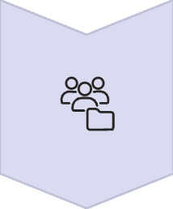


System Workflow
The complaint management process follows a structured four-stage workflow ensuring accountability and timely resolution.
Citizen Registration & Submission
Citizens create accounts and submit complaints with detailed descriptions, categories, and supporting documents.
Administrator Assignment
Administrators review incoming complaints and assign them to appropriate departments based on complaint category and urgency.
Department Processing
Assigned departments update complaint status, add resolution notes, and mark issues as resolved upon completion.
Automatic Escalation
System automatically escalates complaints that exceed predefined resolution timeframes to higher authorities.
Citizen Feedback
Citizens rate resolution quality and provide feedback, contributing to continuous service improvement.

Slide 6





System Modules
User Management
Complaint Module
Administrator Dashboard
Handles user registration, authentication, and role-based permission management. Includes password reset and account settings.
Core complaint lifecycle management including submission, categorization, status tracking, and document management features.
Centralized control panel for managing users, assigning complaints, monitoring system performance, and generating reports.
Department Panel
Analytics & Reports
Dedicated interface for departments to view assigned complaints, update progress, and document resolution actions.
Comprehensive analytics dashboard displaying complaint trends, resolution statistics, and performance metrics with export capabilities.

Slide 7

Conclusion & Future Vision
Project Impact
Future Enhancements
AI-powered complaint classification and automatic department routing
Cloud deployment using AWS or Azure for enterprise-scale operations
Mobile application for iOS and Android platforms
Integration with SMS and email notification services
Enhanced Efficiency
Improved Transparency
Scalable Architecture
Streamlined complaint handling reduces processing time and eliminates manual tracking overhead.
Real-time tracking and status updates build trust between citizens and service providers.
Designed for expansion to government systems with thousands of users and concurrent complaints.

