Slide 1
JavaScript
Anil K

Slide 2

Dom Manipulation
The JavaScript is used for browser side scripting and to provide dynamic nature to any website.
JavaScript provides dynamic nature to any webpage using the concept called DOM Manipulation.
First let's understand the concept of DOM (Document Object Model).
Whenever browser gets a HTML ﬁle before displaying the content on the browser, first it reads the entire HTML page and prepares a tree like structure using all the HTML tags /elements. This Tree like structure is called DOM Tree. Each html element inside the DOM Tree is called as ’DOM Node’.
Example:

Slide 3
The above diagram denotes a Node Tree or DOM Tree.
Once this tree structure is built, then the browser renders each html element / tag and display them on the browser / webpage.
How the JavaScript provides the dynamic nature to HTML is, by using JavaScript we will fetch each of the HTML tag / element / DOM Node from the DOM Tree and adds our own content so that browser parses the new DOM Tree nodes and displays them on the browser.
This DOM Tree of Nodes are responsible for the display of content on the webpage. So in the backend by using JavaScript we will change the DOM Nodes using the Concept called DOM Manipulation then we will get the Dynamic view on the webpage.
By Using JavaScript we can do the following to the DOM Tree.
1) Change the existing DOM Node Content
2) Add a new DOM Node to the DOM Tree
3) Remove a DOM Node from the DOM Tree
Note: Please note HTML Element, HTML Tag, DOM Node all denotes the same.
So for each HTML Document there will be one DOM Tree. So by using JavaScript we can change the HTML Content to be displayed on the webpage.

Slide 4
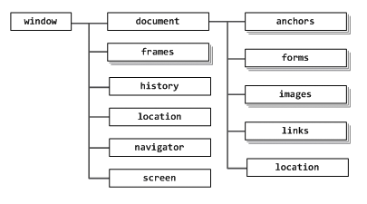
By using JavaScript we can change not only DOM Nodes but also Browser related properties.
In a Browser each tab is represented with one DOM Tree. A Browser _itself is also an Object and it contains a collection of DOM Trees.
This is called as Browser Object Modal.
In Browser Object Model the browser itself is treated as an Object and it contains a longlist of Objects as follows,
1) Document(DOM Tree)
2) Navigation buttons
3) URL All these Objects are modeled together and is called as BOM (Browser Object Model).
NOTE: In the BOM Model the top level object is ‘window' and it represents the entire Browser itself.
In the DOM Model the top level object is 'Document' and it represents the entire Document itself.

Slide 5
Let’s discuss some of the operations that we can perform on BOM Objects by using JavaScript.
window.innerWidth; // to access the width of the Browser
window.innerHeight; // to access the height of the Browser
window.open(); // to open a new Tab
window.document; // to access the Document object
We can access the Document Object using either ‘window. document’ or directly by using ‘document’.
Let’s understand the DOM Manipulation using JavaScript as follows,
We can manipulate the DOM Nodes using the Document Object’s properties and methods/functions.

Slide 6
DOM Properties
The following are the various DOM properties to be accessed by JavaScript.
//To access the complete body element
var body = document.body;
//To access the title of the current webpage
var title = document.title;
// to access the URL of the current webpage
var url = document.URL;

Slide 7
DOM Methods / Functions
The following are the various methods to be used by JavaScript to manipulate the DOM nodes.
// to select a HTML Element with the specific ID (main-nav)
document.getElementById(‘main-nav’);
// to select all the HTML Elements with the class name (container)
document.getElementsByClassName('container’);
// to select all the HTML Elements using the HTML tag (img)
document.getElementsByTagName(‘img’);
// to select the first element matching the selector (.main—nav a)
document.querySelector(‘.main-nav a’);
// to select all the HTML elements matching the selector (.container p)
document.querySelectorAll(‘.container p’);

Slide 8
Let's discuss some of the examples
<div id="text-div">
<p id=“green—p">This is a Green Color Text</p>
<button onclick="blue();">Change to Blue</button>
<button onclick="red();">Change to Red</button>
</div>
<script>
function blue() {
document.getElementById( 'green-p' ).style.color = 'blue';
}
function red() {
document.getElementById('green-p').style.color = 'red';
}
</script>

Slide 9
In the above example we will change the text color dynamically while pressing blue , red buttons using DOM Manipulation.
Example:
<div id="image-div">
<img src="../img/google.jpg" width=“366px” height="269px" id="myImage">
<br>
<button onclick=“facebook();”>Facebook</button>
<button onclick="youtube();">Youtube</button>
</div>
<script>
function facebook() {
document.getElementById('myImage').setAttribute('src','../img/facebook.jpg');
function youtube() {
document.getElementById('myImage').setAttribute('src','../img/youtube.jpg’);
}
</script>
In the Above Example if click on ’Facebook' button we will get the Facebook image and if we click on YouTube button we will get the YouTube image dynamically by using JavaScript DOM manipulation.

Slide 10
JavaScript DOM Events
Any kind of operation or an action that can be performed on a browser IS called as an event.
The moment a user is performing an action on a browser is an event.
Let’s discuss some of the DOM Events,
1) Opening a browser is an event
2) Open address bar and enter URL is an event
3) User clicks on a link is an event
4) Move a mouse cursor is an event
5) Click on a button is an event
6) Focus on an input ﬁeld is an event.
Mouse Events | Keyboard Events | Form Events | Document Events
Click | Keypress | Submit | Load
Dbclick | Keydown | Change | Resize
Mouseenter | Keyup | Focus | Scroll
mouseleave |  |  | unload

Slide 11
JS DOM Event Handling
In JavaScript we can perform the DOM Manipulation using various event handling methods as specified above.
The Actual Event handling event handling works as follows,
1) Find a node to which we trigger an event
2) Find the events of the node
3) Write a script to trigger an event for that node.
Example:
<div id="image-div">
<img src="../img/google.jpg" width="306px" height="200px" id="myImage">
<br>
<button onclick="facebook();">Facebook</button>
<button onclick="youtube();">Youtube</button>
</div>
function facebook() {
document.getElementById(‘myImage').setAttribute(‘src','../img/facebook jpg‘);
}
function youtube() {
document.getElementById(‘myImage').setAttribute('src','../img/youtube.jpg’);
}

Slide 12
JS DOM Event Listeners
In the process of DOM Manipulation first we will get a html element and hook up and event method and we can perform some operations on it.
In the process of event listeners, we normally hook up an event listener to the specific HTML element and attach an event handling method to it. If the specified event happens then the hooked up event handling method will be executed.
Syntax of Event listener is as follows,
htmlElement.addEventListener(‘event_name’ ,event_handling_function);
Let’s discuss an example of Event Listeners,
<textarea id="text-area" rows='5' cols='10'></textarea>
var textArea = document.querySelector("#text-area");
textArea.addEventListener('keypress',start);
function start() {//statements of event handling
console.log("Characters left: " + (500 - this.value.length));
}

Slide 13
In the above example of Event Listeners way of event handling works as follows,
1) First we needs to fetch the required HTML Element using any DOM manipulation methods.
2) We needs to hookup an event handling method to it along with the event name and event handling function name.
3) In the last we have define a method / function for handling that event.
Note: Whenever the 'keypress' event happened for the text-area then start() will be executed.

Slide 14
JavaScript Scopes
JavaScript Scopes 8t Closures is one of the important concept to learn in JavaScript.
Without these concepts also we can write the JavaScript code, but once we learn these concept code we may write more elegant code and most of the bug free code.
Now let's understand the concept of scopes and then closures concept.
Scopes & Block Scoping:
Scopes concept is not only specific to JavaScript, these kind of terms we can even see in other OOPS languages.
A scope is considered as a block where the accessibility of variables exists. The variables declared inside the block are not accessible outside.
Example:
var a = 10;

Slide 15
If we declare a variable somewhere in the middle of a program, can we guess what are all the places it is accessible?. It is purely depend on the scope where we declare that variable is declared.
If the variable declared in the global scope, It will be accessed throughout the program.
If the variable is declared in any block, then we can access the variable inside of that block only, outside of that block it is not accessible.
Example:
A Fish in an aquarium is having its scope inside of that aquarium only, when we bring the ﬁsh outside the aquarium then it will die. Means the scope of the fish is inside the aquarium only. So a variable declared inside of a block / scope is not accessible outside of that block or scope.
Let’s discuss the concept of scope hierarchy

Slide 16
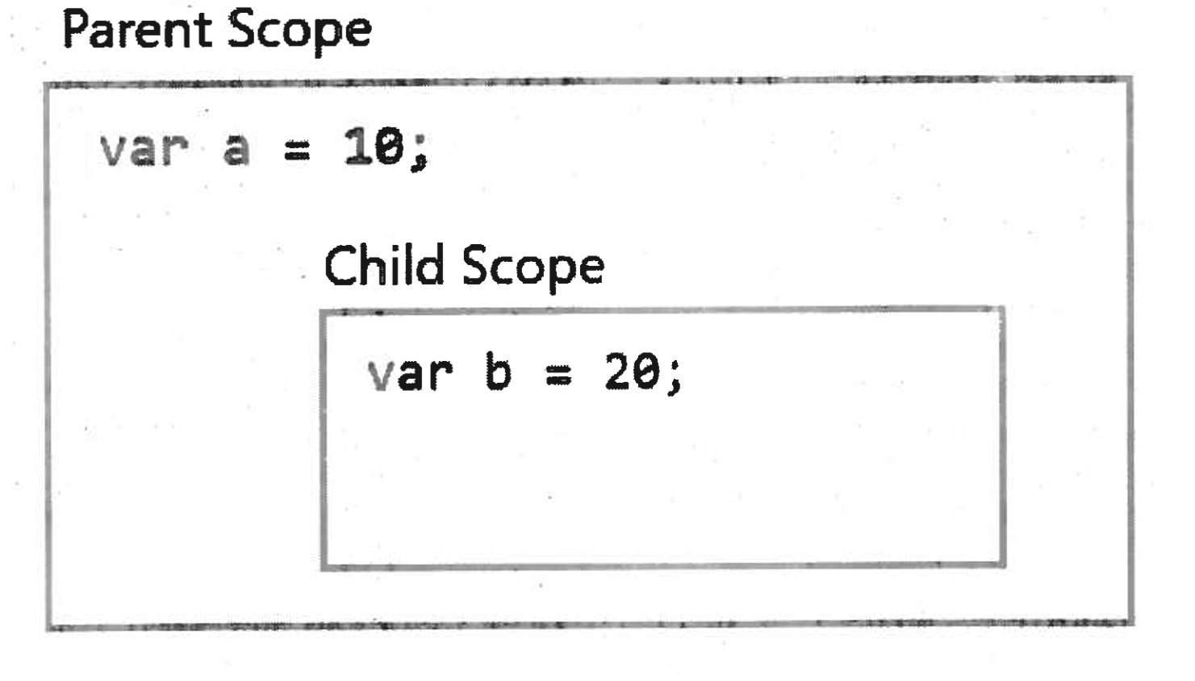
Scope Hierarchy
Scope Hierarchy means a chain of scopes which contains a parent scope and child scope.
Whatever the variable is declared inside ‘parent scope are by default available to the child scope.
So ‘a’ is accessible in child scoped block.
But whatever the variable is declared in child scope is not available to parent scope by default.
So ‘b’ is not accessible outside of child scope and also inside parent scoped block.

Slide 17
Scopes Creation
In any other OOPS languages like C++ or Java, we will be creating scopes as
Example:
// Block Scoping{
var x = 20;
}
// Block Scoping
if(age <= 18){
// some statements
}
So in Java, C++ just placing any code inside curly braces {} creates scope of a variable of block and outside of this block the variable is not accessible, this is called as block scoping.
But JavaScript does not supports block scoping and JavaScript supports Function Scoping. ln JavaScript just by creating a block it will not be a separate scope creation.
We can create a new scope using functions in JavaScript.

Slide 18
Function Scoping
In JavaScript, creation of scoping is not block level but it is a function level.
JavaScript does not encourage block scoping but in in JavaScript it is only Function Scoping.
Simply creating a block Will not create a new scope In JavaScript.
Example:
var name = 'John';
if(name === 'John'){
var designation = 'Software Engineer';
}
console.log(name); // John
console.log(designation); //Software Engineer
Note: In the above example We declared a variable designation inside if block and still we can access that variable outside of the if block It clearly state that JavaScript doesn't support Block Scoping. JavaScript supports Function Scoping.

Slide 19
Now let’s keep the same code inside a function.
Example:
var name = 'John’;
function allotDepartment{
if(name === 'Naveen’){
var designation = 'Software Engineer’;
}
}
console.log(name); // John
console.log(designation); // ReferenceError: designation is not defined
Now discuss few examples on Scoping Concepts
Example 1:
var top = 10;
function guess() {
var inner = 20;
console.log(inner);
}
guess();

Slide 20
In the above example we declared a variable 'inner' inside guess() function and we accessed that variable inside of that function only.
Example 2:
var top = 30;
var inner = 30;
function guess() {
var inner = 40;
}
console.log(inner); // 30
Here in the above example we declare two inner variables one is outside of the function and one is inside a function. But we are accessing an inner variable outside of the function then obviously we cannot access the variable which is declared inside of the function. we can access the variable declared outside of the function, because we are executing console log outside of the function only.

Slide 21
IIFE (Immediately Invoked Function Expression)
We normally create variables outside of functions and they can be accessed anywhere of the program. These variables are called as global scoped variables.
But in JavaScript creating variables in global scope is not a good idea.
For any web application there may be a lot of JavaScript files will be executing on the browser. Then the variable created in global scope are stored in the same memory area of all the JavaScript ﬁles global scoped variables and it is accessible to all the other JavaScript files also. This kind of behavior causes very serious issues in JavaScript programming.
So placing everything in global scope is not at all recommended and it is not a good programming practice.
In order to avoid the global scoping, we can create those variable inside a function.
Example:
function addFn() {
var a = 10;
var b = 20;
console.log(a + b);
}
addFn();

Slide 22
In order to avoid creating a, b variables globally we have created inside a function. But just by creating a function and adding variables will not get printed anything on the console. So we needs to call the function also.
But here there is a new problem arises, we have created variables inside the function and we are calling the function ‘addFn()’ from global scope.
Let’s assume, if any other JavaScript ﬁle is also have the same function and we are calling that function. Now again the same problem with global scoping.
In order to avoid this problem we can use IIFE as follows,
(function(){
var a = 10;
var b = 20;
console.log(a + b);
})();
// output : 30
Advantages of IIFE:
1) Avoids creating variables in global name space.
2) Functions doesn't have a name to collide with any other JavaScript files.
3) Avoid Global scoping of function call.

