Slide 1
Cascading Style Sheet
By Anil K

Slide 2
CSS Selectors
First we have to select the element / elements, and then only we can apply some styles to it.
“Selector” is a “syntax to select”. It is used to select the desired elements in the web page.
When we use a selector, the browser searches the entire web page for the matching elements and returns the matching elements; and we apply styles only for those matching elements.
List of CSS Selectors
1. Tag Selector
2. ID Selector
3. Class Selector
4. Compound Selector
5. Grouping Selector
6. Child Selector
7. Direct Child Selector
8. Attribute Selector
9. Hover Selector
10. Focus Selector
11. Universal Selector

Slide 3
Tag Selector
It selects all the instances of the specified tag.
You can specify any tag name.
Syntax: tag
Example: p
ID Selector
It selects a single instance of the tag, based on the id.
“ID” is “identification name”.
“ID” should be unique (can’t be duplicate) in the web page.
# is symbol of ID selector.
Syntax: #id
Example: #p1
Class Selector
It selects one or more elements, based on the class name.
We use same class for similar elements.
"." is the symbol of class selector.
Syntax: .class
Example: .c1

Slide 4
Compound Selector
It selects the instances of specific tag, which have specified class.
Syntax: tag.class
Example: p.c1
Grouping Selector
It selects the specified group of tags.
"," is the symbol of grouping selector.
Syntax: tag1,tag2,tag3,…
Example: div,p,h2
Child Selector
It selects all the child tags (including grand children) of the specified parent tag.
"space" is the symbol of child selector.
Syntax: parenttag childtag
Example: div p

Slide 5
Direct Child Selector
It selects only the direct child tags (excluding the grand children) of the specified parent tag.
">" is the symbol of direct child selector.
Syntax: parenttag>childtag
Example: div>p
Attribute Selector
It selects all the tags that are having specified attribute.
"[ ]" are the symbols of attribute selector.
We can use any attribute of any html tag.
Syntax: tag[attribute=”value”]
Example: img[width=”120px”]
Hover Selector
It applies the style only when the user places the mouse pointer on the element, at run time.
It automatically removes the style, if the mouse pointer is moved outside the element.
It is also called as “pseudo class”. Whenever the selector starts with “:”, it is called as “pseudo class”.
Pseudo = unrealistic
Syntax: tag:hover
Example: p:hover

Slide 6
Focus Selector
It applies the style only when the focus (cursor) is inside the element.
It automatically removes the style when the cursor gets out of the element.
It is also called as “pseudo class”.
Syntax: tag:focus
Example: input:focus
Universal Selector
It selects all the tags in the web page (including <html>, <head>, <body> etc.).
It is used to apply global styles.
Syntax: *
Example: *

Slide 7
CSS Style Precedence
The css styles are applied in the following order (lowest priority to highest priority).
The higher priority style overrides the same property’s value of the lower priority.
1. Browser default style
2. Tag Selector
3. Direct Child Selector
4. Child Selector
5. Class Selector
6. Attribute Selector
7. ID Selector
Note: “!important” is used to override the “style precedence”.

Slide 8
Hyperlink Styles
It is used to apply styles to hyperlinks.
a:link: Applies styles to unvisited hyperlinks.
a:hover: Applies styles to hyperlinks, when we place mouse pointer on it.
a:active: Applies styles to hyperlinks, when we click and hold it.
a:visited: Applies styles to visited hyperlinks.
Example on Hyperlink Styles
<html>
<head>
<title>CSS - Links</title><style>
/* unvisited link */
a:link{
background-color: darkgreen;
font-size: 20px;
color: white;
padding: 2px;
text-decoration: none;
font-weight: bold;
}

Slide 9
/* mouse over link */
a:hover{
background-color: yellow;
color: darkgreen;
text-decoration: underline;
}
/* selected link */
a:active{
background-color: darkred;
color: cyan;
}
/* visited link */
a:visited{
background-color: black;
color: yellow;
</style>
</head>
<body>
<a href="http://www.google.com">Google</a>
<a href="http://www.facebook.com">Facebook</a>
<a href="http://www.twitter.com">Twitter</a>
</body>
</html>

Slide 10
Menubar
Menubar is a collection of hyperlinks arranged vertically / horizontally.
<html>
<head>
<title>CSS - Menu Bar</title>
<style type="text/css">
.menubar{
background-color: #00ffcc;
height: 40px;
font-size: 24px;
font-family: 'Tahoma';
width: 800px;
margin: auto;
}
.menubar ul{
list-style-type: none;
padding: 0px; }
.menubar ul li{
display: inline;
width: 200px;
float: left;
height: 40px;
text-align: center;
}

Slide 11
.menubar ul li a{
line-height: 40px;
text-decoration: none;
}
.menubar ul li:hover{
background-color: #33cc99;
cursor: pointer;
text-decoration: underline;
}
</style>
</head>
<body>
<div class="menubar">
<ul>
<li><a href="#">Home</a></li>
<li><a href="#">About</a></li>
<li><a href="#">Contact</a></li>
<li><a href="#">Services</a></li>
</ul>
</div>
</body>
</html>

Slide 12
Border Radius
It is used to apply rounded corners for any html element.
Syntax: border-radius: pixels;
Example: border-radius: 10px;
Border Radius – Cornerwise
Syntax: border-radius: topleft topright bottomright bottomleft;
Example: border-radius: 10px 20px 15px 5px;

Slide 13
Shadow
Box-Shadow
It is used to apply shadow for the element.
Syntax: box-shadow: HorizontalPosition VerticalPosition BlurRadius Spread ShadowColor;
Example: box-shadow: 5px 5px 5px 2px red;
Text-Shadow
It is used to apply shadow for the text of the element.
Syntax: text-shadow: HorizontalPosition VerticalPosition BlurRadius ShadowColor;
Example: text-shadow: 2px 2px 5px 1px red;

Slide 14
Transitions
Transition is a process of changing a CSS property’s value gradually, based on the specified no. of seconds.
Transitions support only pixels based color based properties. Ex: width, height, opacity, fontsize, border-width, background-color, color, border-color etc.
Syntax:
selector {
property: startvalue;
transition: property seconds;
}
selector:hover {
property: endvalue;
}

Slide 15
Example on Transitions - Width
<!DOCTYPE html>
<html>
<head>
<title>CSS 3 - Transitions - Width</title>
<style type="text/css">
#div1{
width: 300px;
height:100px;
background-color: darkred;
color: yellow;
transition: width 2s;
}
#div1:hover{
width: 600px;
}
</style>
</head>
<body>
<div id="div1">hover me</div>
</body>
</html>

Slide 16
Example on Transitions - Height
<!DOCTYPE html>
<html>
<head>
<title>CSS 3 - Transitions - Height</title>
<style type="text/css">
#div1{
width: 300px;
height:100px;
background-color: darkred;
color: yellow;
transition: height 2s;
}
#div1:hover{
height: 300px;
}
</style>
</head>
<body>
<div id="div1">hover me</div>
</body>
</html>

Slide 17
Example on Transitions - Font-size
<!DOCTYPE html>
<html>
<head>
<title>CSS 3 - Transitions - Font-Size</title>
<style type="text/css">
#div1{
width: 200px; height: 200px;
color: yellow; background-color: darkgreen;
position: relative;
font-size: 30px;
transition: font-size 3s;
}
#div1:hover{
font-size: 60px;
}
</style>
</head>
<body>
<div id="div1">hover me</div>
</b0dy>
</html>

Slide 18
Example on Transitions - Multiple Properties
<!DOCTYPE html>
<html>
<head>
<title>CSS 3 - Transitions - Multiple Properties</title>
<style type="text/css">
#div1{
width:100px; height:100px;
color: yellow; background-color: darkgreen;
position: relative;
font-size: 25px;
transition: background-color 2s, font-size 1s, width 2s;
}
#div1:hover{
background-color: blue;
font-size: 50px;
width: 400px;
}
</style>
</head>
<body>
<div id="div1">hover me</div>
</body>
</html>

Slide 19
Example on Transitions - Opacity
<!DOCTYPE html>
<html>
<head>
<title>CSS 3 - Transitions - Opacity</title>
<style type="text/css">
#div1{
width: 300px; height: 300px;
color: yellow; background-color: darkgreen;
position: relative;
opacity: 1;
transition: opacity 1.5s;
}
#div1:hover{
opacity: 0;
}
</style>
</head>
<body>
<div id="div1">hover me</div>
</body>
</html>

Slide 20
Example on Transitions - Position
<!DOCTYPE html>
<html>
<head>
<title>CSS 3 - Transitions - Position</title>
<style type="text/css">
#div1{
width: 200px; height: 200px;
color: yellow; background-color: darkgreen;
position: relative;
left: 0px;
top: 0px;
transition: left1.5s, top 1.5s;
}
#div1:hover{
left: 50px;
top: 50px;
}
</style>
</head>
<body>
<div id="div1">hover me</div>
</body>
</html>

Slide 21
Transformations
Transformations are used to display the element in a different visual dimension.
Types of transformations:
1. Rotate Transformation
2. Skew Transformation
3. Scale Transformation
4. Translate Transformation

Slide 22
1. Rotate Transformation
It is used to rotate the element, based on the specifies no. of degrees. Ex: 45deg.
Syntax: transform: rotate(degrees);
Example: transform: rotate(45deg);
2. Skew Transformation
It wrists the element.
Syntax: transform: skew(degrees);
Example: transform: skew(30deg);
3. Scale Transformation
It shows the element in large size / small size, visually.
Syntax: transform: scale(number);
Example: transform: scale(2);
1 = 100% size 2 = 200% size 0.5 = 50% size 1.5 = 150% size …
4. Translate Transformation
It changes the visual position of the element.
Syntax: transform: translate(x, y);
Example: transform: translate(30px, 30px);

Slide 23
Multiple Transformations
We can apply more than one transformation at-a-time.
Syntax: transform: rotate(degrees) scale(n) translate(x, y) skew(degrees);
Example: transform: rotate(40deg) scale(1.5) translate(30px, 30px) skew(20deg);
transform-origin
This property specifies the fixed point for rotate transformation and sale transformation etc.
Syntax: transform-origin: top left | top center | top right | center left | center center | center right | bottom left | bottom center | bottom right;
Example: transform-origin: top left;

Slide 24
Example on Rotate Transformation
<html>
<head>
<title>CSS 3 - Transformations - Rotate Transformation</title>
<style type="text/css">
#div1{
width: 200px;
height: 200px;
background-color: #OOCCFF;
margin-left: 150px;
cursor: pointer;
box-shadow: 10px 10px 10px 10px #ff0000;
}
#div1:hover{
transform: rotate(45deg); /* 0 to 360 deg */
}
</style>
</head>
<body>
<h3>CSS 3 Transformations - Rotate Transformation</h3>
<div id="div1">Hello</div>
</body>
</html>

Slide 25
Example on Skew Transformation
<html>
<head>
<title>CSS 3 - Transformations - Skew Transformation</title>
<style type="text/css">
#div1{
width: 200px;
height: 200px;
background-color: #OOCCFF;
margin-left: 150px;
cursor: pointer;
box-shadow: 10px 10px 10px 10px #ff0000;
}
#div1:hover{
background-color: #0099FF;
transform: skew(30deg); /* 0 to 360 deg */
}
</style>
</head>
<body>
<h3>CSS 3 Transformations - Skew Transformation<lh3>
<div id="div1">Hello</div>
</body>
</html>

Slide 26
Example on Scale Transformation
<html>
<head>
<title>CSS 3 - Transformations - Scale Transformation</title>
<style type="text/css">
#div1{
width: 200px;
height: 200px;
background-color: #OOCCFF;
margin-left: 150px;
cursor: pointer;
box-shadow: 10px 10px 10px 10px #ff0000;
}
#div1:hover{
background-color: #0099FF;
transform: scale(1.5); /*0 to n*/
}
</style>
</head>
<body>
<h3>CSS 3 Transformations - Scale Transformation</h3>
<div id="div1">Hello</div>
</body>
</html>

Slide 27
Example on Translate Transformation
<html>
<head>
<title>CSS 3 - Transformations - Translate Transformation</title>
<style type="text/css">
#div1{
width: 200px;
height: 200px;
background-color: #OOCCFF;
margin-left: 150px;
cursor: pointer;
box—shadow: 10px 10px 10px 10px #ff0000;
}
#div1:hover{
background-color: #0099FF;
transform: translate(30px,30px); /* (x, y) */
}
</style>
</head>
<body>
<h3>CSS 3 Transformations - Translate Transformation</h3>
<div id="div1">Hello</div>
</body>
</html>

Slide 28
Example on Multiple Transformations
<html>
<head>
<title>CSS 3 - Transformations - Multiple Transformation5</title>
<style type="text/css">
#div1{
width: 200px; height: 200px;
background-color: #OOCCFF;
margin-left: 150px;
margin-top: 100px;
cursor: pointer;
box—shadow: 10px 10px 10px 10px #ff0000;
}
#div1:hover{
background-color: #0099FF;
transform: rotate(30deg) scale(1.5);
}
</style>
</head>
<body>
<h3>CSS 3 Transformations - Multiple Transformations<lh3>
<div id="div1">Hello</div>
</body>
</html>

Slide 29
Example on Transform Origin
<html>
<head>
<title>CSS 3 - Transformations - Transform Origin</title>
<style type="text/c55">
#div1{
width: 200px; height: 200px;
background-color: #OOCCFF;
margin-left: 150px; margin-top: 100px;
cursor: pointer;
box-shadow: 10px 10px 10px 10px #ff0000;
}
#div1:hover{
background-color: #0099FF;
transform: rotate(30deg);
transform-origin: top left;
}
</style>
</head>
<body>
<h3>CSS 3 Transformations - Transform Origin</h3>
<div id="div1">Hello</div>
</body>
</html>

Slide 30
Example on Transformation with Transition
<html>
<head>
<title>CSS 3 - Transformations - with Transition</title>
<style type="text/css">
#div1{
width: 200px; height: 200px;
background-color: #OOCCFF;
margin-left: 150px;
cursor: pointer;
box—shadow: 10px 10px 10px 10px #ff0000;
transition: transform 0.85;
}
#div1:hover{
background-color: #0099FF;
transform: scale(1.5) skew(30deg);
}
</style>
</head>
<body>
<h3>CSS 3 Transformations - Transformation with Transition</h3>
<div id="div1">Hello</div>
</body>
</html>

Slide 31
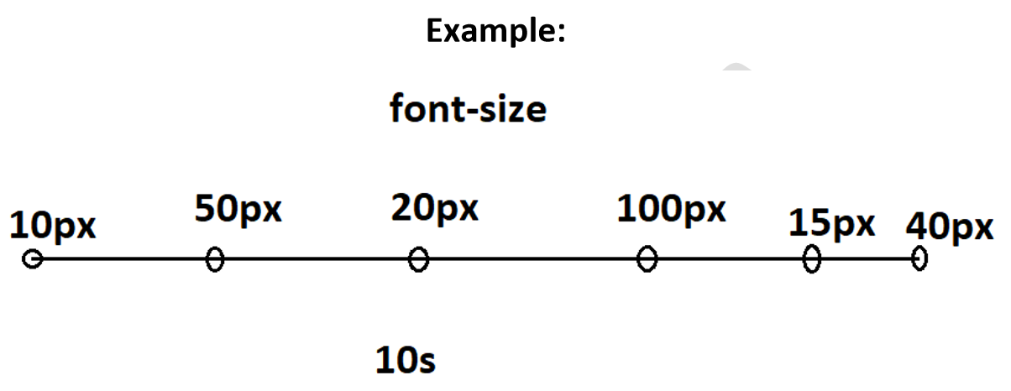
Animations
Animations are “group of transitions”, which will be performed one after another.
Transition contains two points only (starting point + ending point).
Animation contains multiple points of milestones.
Syntax:
selector {
animation: animationname seconds;
}
@keyframes animationname {
0% { property:value; property:value; … },
25% { property:value; property:value; … },
50% { property:value; property:value; … },
75% { property:value; property:value; … },
100% { property:value; property:value; … }
}

Slide 32
Example on Animations
<!DOCTYPE html>
<html>
<head>
<title>Animation5</title>
<style>
#div1{
background-color: #2edaS9; font-size: 35px; margin: 60px; width: 300px; height: 220px;
}
#div1:hover{
cursor: pointer;
animation: myanimation 10s;
}
@keyframes myanimation{
0% { transform: translate(0px, 0px); }
25% { transform: translate(50px, 0px); }
50% { transform: translate(50px, 100px);}
75% { transform: translate(0px, 100px);}
100% { transform: translate(0px, 0px); }
}
</style>
</head>
<body>
<div id="div1">
<img src="usa.jpg" width="300px">
America
</div>
</body>
</html>

Slide 33

Responsive Web Design
“Responsive Web Design” (RWD) is used to make the web page automatically fit based on the current device resolution.
It is used to display the content differently on different devices, based on the screen resolution.
We divide the devices into 4 types, based on the browser width:

Slide 34
Sl. No | Type of Device | Screen width (pixels) | Examples
1 | Extra Small Devices | 1px to 575px | iPhone 2G, 3G (320px / 480px height)
2 | Small Devices | 576px to 767px | iPhone 4, 4S (640px width / 960px height) iPhone 5, 5C, 5C, SE (640px width / 1136px) iPhone 6, 6S, 7, 8 (750px width / 1134px height)
3 | Medium Devices | 768px to 991px | Samsung Note 1 (800px width / 1280px height)
4 | Large Devices | 992px to 1199px | iPhone 6 Plus (1080px width / 1920px height) iPhone 10 (1125px width / 2436px height)
5 | Extra Large Devices | 1200px to unlimited | iPhone 7+, 8+ (1242px width / 2208px height) Most-used laptops

Slide 35
Media Queries
We use “Media Queries” to create responsive web design.
The media queries apply the styles only when the current device / browser's width meet the given condition / requirements.
1. Extra Small devices (1px to 575px):
@media (min-width: 1px) and (max-width: 575px) { }
2. Small devices (576px to 767px):
@media (min-width: 576pxpx) and (max-width: 767px) { }
3. Medium devices (767px to 991px):
@media (min-width: 767pxpx) and (max-width: 991px) { }
4. Large devices (992px to 1199px):
@media (min-width: 992px) and (max-width: 1199px) { }
5. Extra Large devices (1200px to unlimited):
@media (min-width: 1200px) { }

Slide 36
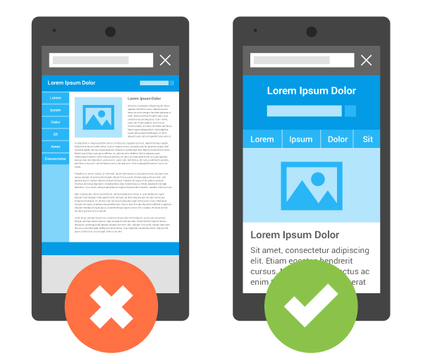
View port meta tag
This tag tells to the mobile browsers that we are using “responsive web design”, and don’t treat it as pc-based web page.
Without viewport meta tag, the mobile browsers treat the web page as pc-based web page and apply the pc-based media query.
With viewport meta tag, the mobile browsers apply the appropriate “mobile-based media query” to the web page.

Slide 37
Example on Responsive Web Design
<!DOCTYPE html>
<html>
<head>
<title>Responsive Web Design</title>
<meta name="viewport" content="width=device-width">
<style>
body{ font-family: Verdana; font-size: 20px; margin: 0px; padding: 0px;}
.div1{ background-color: #2ef314; height: 50px; }
.div2{ background-color: #14abbe; height: 50px; }
.div3{ background-color: #0cb35f; height: 50px; }
.div4{ background-color: #149af3; height: 50px; }
.div5{ background-color: #f3b814; height: 50px; }
.div6{ background-color: #eb3948; height: 50px; }
@media (min-width:100px) and (max-width:575px){
.div1{ width: 50%;float: left; }
.div2{ width: 50%; float: left; }
.div3{ width: 100%; clear: left; }
.div4{ width: 100%;}
.div5{ width: 100%; }
.div6{width: 100%;}
}

Slide 38
@media (min-width:576px) and (max-width:767px){
.div1{
width: 50%; float: left;
}
.div2{
width: 50%; float: left;
}
.div3{
width: 50%; clear: left; float: left;
}
.div4{
width: 50%;float: left;
}
.div5{
width: 50%;clear: left; float: left;
}
.div6{
width: 50%; float: left;
}
}

Slide 39
@media (min-width:768px) and (max-width:991px){
.div1{
width: 33%;float: left;
}
.div2{
width: 33%;float: left;
}
.div3{
width: 34%; float: left;
}
.div4{
width: 33%; clear: left; float: left;
}
.div5{
width: 33%; float: left;
}
.div6{
width: 34%; float: left;
}
}

Slide 40
@media (min-width:992px) and (max-width:1199px){
.div1{
width: 25%; float: left;
}
.div2{
width: 25%; float: left;
}
.div3{
width: 25%; float: left;
}
.div4{
width: 25%; float: left;
}
.div5{
width: 50%; clear: left; float: left;
}
.div6{
width: 50%; float: left;
}
}

Slide 41
@media (min-width:1200px){
.div1{
width: 17%;float: left;
}
.div2{
width: 17%;float: left;
}
.div3{
width: 17%;float: left;
}
.div4{
width:17%;float: left;
}
.div5{
width: 16%; float: left;
}
.div6{
width:16%;float: left;
}
}
</style>
</head>

Slide 42
<body>
<div class="container">
<div class="div1">
div 1
</div>
<div class="div2">
div 2
</div>
<div class="div3">
div 3
</div>
<div class="div4">
div 4
</div>
<div class="div5">
div 5
</div>
<div class="div6">
div 6
</div>
</div>
</body>
</html>

Slide 43
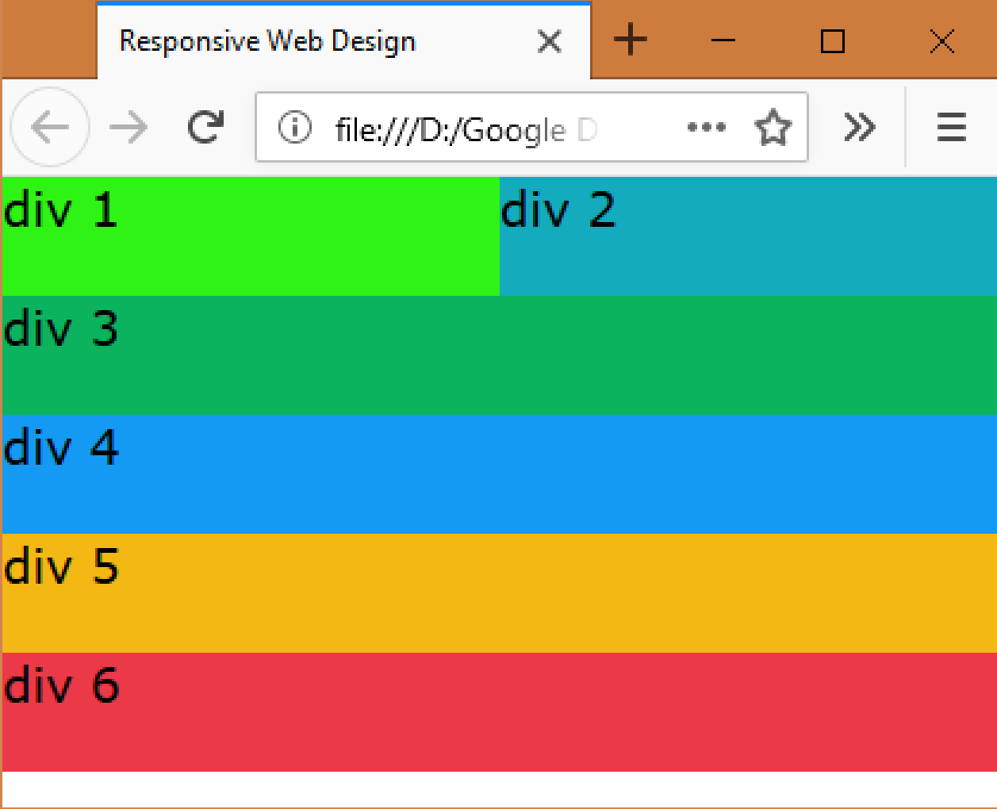
Extra Small Devices:

Slide 44
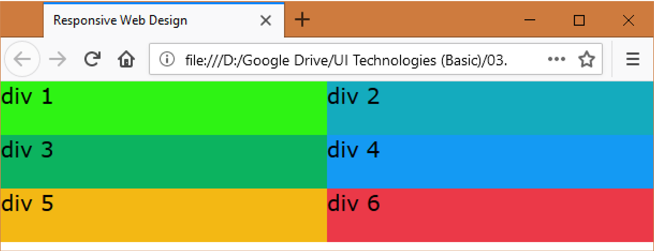
Small Devices:

Slide 45
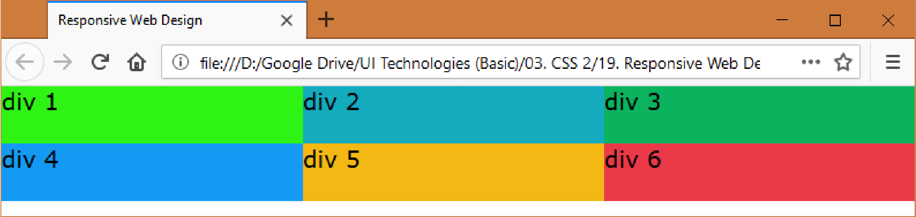
Medium Devices:

Slide 46
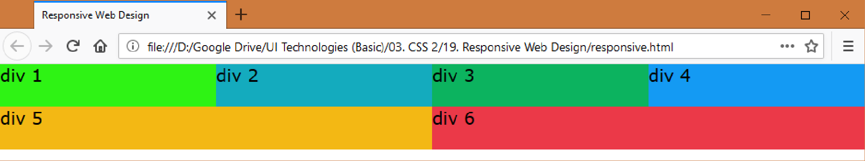
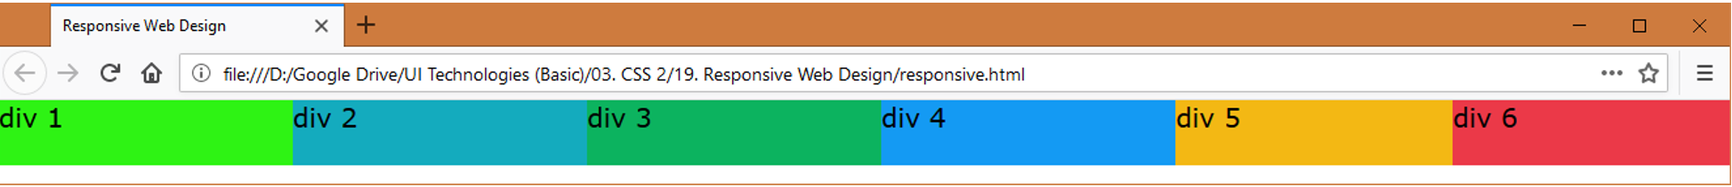
Large Devices:
Extra Large Devices:

