Slide 1
JavaScript
Anil K

Slide 2
DOM
DOM (Document Object Model) is the tree structure of html elements (tags) that are present within the web page.
When the web page has been opened in the browser, DOM will be automatically created by the browser.
The changes made to DOM are called as “DOM manipulations”. DOM manipulations are performed using JavaScript.
The entire browser window is called as "window".
The webpage running on the browser is called as "document".
It has only one main element called <html>.
It has two children <head> and <body>.
There are many children for both <head> and <body>.

Slide 3
Example:
<html>
<head>
<title>DOM (Document Object Model)</title>
</head>
<body>
<div>
<h1>Heading</h1>
<p>Paragraph</p>
</div>
<div>
<b>bold</b>
<i>italic</i>
</div>
</body>
</html>

Slide 4
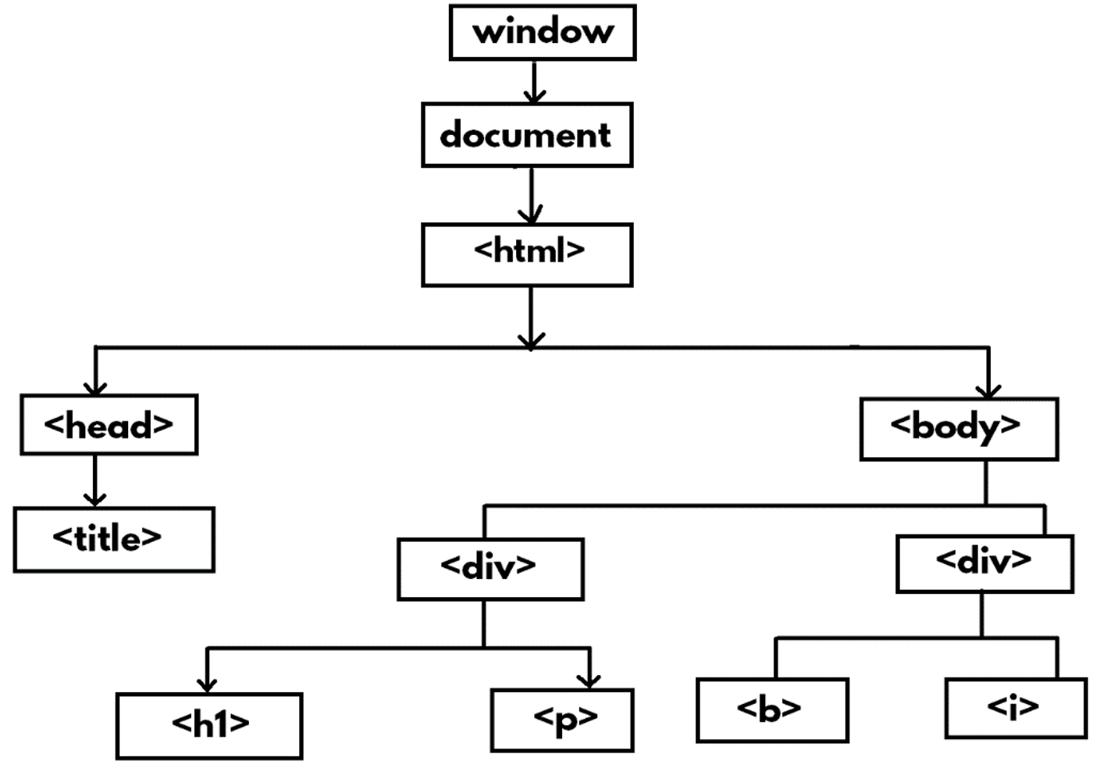

Slide 5
Objects inside DOM
I. Window
II. Document
III. Element

Slide 6
window
"window" object represents the entire browser window.
It has the following properties and methods:
1. location.href
2. navigator.userAgent
3. screen
4. screen
5. alert( )
6. confirm( )
7. print( )
8. setTimeout( )
9. setInterval( )
10. scrollTo
11. open( )

Slide 7
1. location.href
This property represents url of the current web page running in the browser window.
Syntax: window.location.href
2. navigator.userAgent
This property represents the name of current browser.
Syntax: window.navigator.userAgent
3. navigator.screen
This property represents X value of current browser position on the screen.
Syntax: window.navigator.screenX
4. navigator.screen
This property represents Y value of current browser position on the screen.
Syntax: window.navigator.screenY

Slide 8
5. alert()
This method displays an information dialogbox (message dialogbox) to the user.
It contains only OK button.
Syntax: window.alert("message")
Example: window.alert("Hello");
6. confirm()
This method displays an confirmation dialogbox to the user.
It contains OK and Cancel buttons.
It returns "true", if the user clicks on "OK" button; It returns "false", if the user clicks on "Cancel" button.
Syntax: window.confirm("message")
7. print()
This method displays print dialogbox, which is used to print the current webpage through selected printer.
In Google Chrome, it shows "Print Preview" also.
Syntax: window.print()

Slide 9
8. setTimeout()
This method calls the specified function, after completion of specified no. of milli seconds.
Note: 1000 milli seconds = 1 second
Syntax: window.setTimeout(function, milli seconds)
9. setInterval()
This method calls the specified function repeatedly, for every completion of specified no. of milli seconds.
Note: 1000 milli seconds = 1 second
Syntax: window.setInterval(function, milli seconds)
10. scrollTo()
This method scrolls the web page horizontally / vertically to the specified X and Y co-ordinates.
The X and Y co-ordinates are calculated in the form of pixels.
Syntax: window.scrollTo(x, y)

Slide 10
11. open()
This method opens a browser child window / popup window.
It is mainly useful for opening ads.
Syntax: window.open("url", "logical name", "width=pixels, height=pixels");

Slide 11
document
The "document" object represents the current working web page.
It has properties and methods to manipulate web page.
1. title
This property represents title of the web page.
Syntax: document.title
2. head
This property represents <head> tag of the web page.
Syntax: document.head
3. body
This property represents <body> of the web page.
Syntax: document.body
4. images
This property represents all images of the web page, as an array.
Syntax: document.images

Slide 12
5. links
This property represents all hyperlinks (<a> tags) of the web page, as an array.
Syntax: document.links
6. URL
This property represents url of the web page.
Syntax: document.URL

Slide 13
document.write()
This method displays the given message in the web page.
Syntax: document.write("message")
document.getElementById()
This method retrieves the single element that has specified ID.
Syntax: document.getElementById("id")
document.getElementsByName()
This method retrieves the array of elements that have specified name.
Syntax: document.getElementsByName("name")
document.getElementsByTagName()
This method retrieves the array of elements that have specified tag name.
Syntax: document.getElementsByTagName("tag name")
document.getElementsByClassName()
This method retrieves the array of elements that have specified class name.
Syntax: document.getElementsByClassName("class name")

Slide 14
document.querySelectorAll()
This method retrieves the array of elements that are matching with specified selector.
You can use any CSS selectors:
1. Tag Selector : tag
2. ID Selector : #id
3. Class Selector : .classname
4. Grouping Selector : tag1,tag2,…
5. Child Selector : parent child
Syntax: document.querySelectorAll("selector")
document.querySelector()
This method retrieves the first element that matches with specified selector.
Syntax: document.querySelector("selector")

Slide 15
element
The "element" object represents a single tag.
It has properties and methods to manipulate the element.
tagName
This property represents name of the tag.
Syntax: document.getElementById("id").tagName
id
This property represents id of the tag.
Syntax: document.getElementById("id").id
innerHTML
This property represents content of the tag.
Syntax: document.getElementById("id").innerHTML
innerText
This property represents content of the tag, without tags.
Syntax: document.getElementById("id").innerText

Slide 16
Style
This property represents css style of the tag.
Syntax: document.getElementById("id").style.property
parentElement
This property represents parent element of the tag.
Syntax: document.getElementById("id").parentElement
Children
This property represents child elements of the tag.
Syntax: document.getElementById("id").children
scrollTop
This property moves vertical scrollbar, based on the specified no. of pixels.
Syntax: document.getElementById("id").scrollTop

Slide 17
setAttribute()
This method sets an attribute to the tag.
Syntax: document.getElementById("id").setAttribute("attribute name", "value")
getAttribute()
This method gets the value of specified attribute of the tag.
Syntax: document.getElementById("id").getAttribute("attribute name")
removeAttribute()
This method removes the specified attribute of the tag.
Syntax: document.getElementById("id").removeAttribute("attribute name")
Attributes
This property retrieves all the attributes of the tag, along with values.
Syntax: document.getElementById("id").attributes
hasAttribute()
This method checks whether the element has specified attribute or not; returns "true" if it contains; returns "false" if it doesn't contain.
Syntax: document.getElementById("id").hasAttribute("attribute name");

Slide 18
focus()
This method places the cursor inside the element.
Syntax: document.getElementById("id").focus( )
click()
This method clicks the specified element (equal to manual mouse click).
Syntax: document.getElementById("id").click( )
remove()
This method removes the current element.
Syntax: document.getElementById("id").remove( )
document.createElement()
This method creates a new element for the specified tag.
Syntax: document.createElement("tag name")
appendChild()
This method adds new child element to the current element.
Syntax: document.appendChild(newelement)

Slide 19
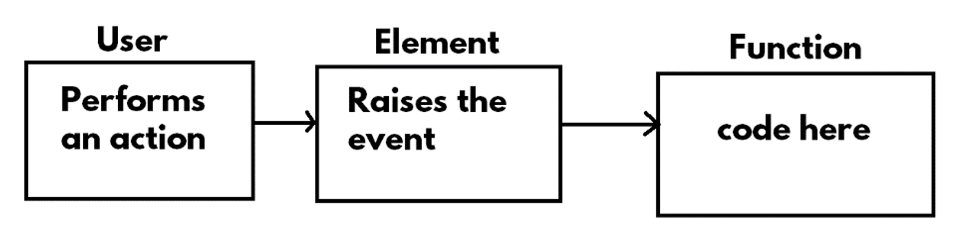
Events
Introduction to Events
“Event” is a keyboard / mouse action, that is performed by the user, at run time.
“Event Handling” is a concept of attaching the event with a function.
Whenever the user performs an action, automatically the element raises the event; then we can call a function.
Syntax: addEventListener(“event name”, functionname)
Example: addEventListener(“click”, fun1)

Slide 20
List of Events
1. click
2. dblclick
3. mouseover
4. mouseout
5. mousemove
6. keyup
7. keypress
8. focus
9. blur
10. change
11. contextmenu
12. cut
13. copy
14. paste

Slide 21
“Click” event
The “click” event executes when the user clicks on the element.
Syntax:
addEventListener(“click”, functionname);
function functionname( ) {
//code here
}
“Dblclick” event
The “dblclick” event executes when the user double clicks on the element.
Syntax:
addEventListener(“dblclick”, functionname);
function functionname( ) {
//code here
}

Slide 22
“Mouseover” and “Mouseout” events
“Mouseover” event
The “mouseover” event executes when the user moves the mouse pointer from outside to inside the element.
Syntax:
addEventListener(“mouseover”, functionname);
function functionname( ) {
//code here
}
“Mouseout” event
The “mouseout” event executes when the user moves the mouse pointer from inside to outside the element.
Syntax:
addEventListener(“mouseout”, functionname);
function functionname( ) {
//code here
}

Slide 23
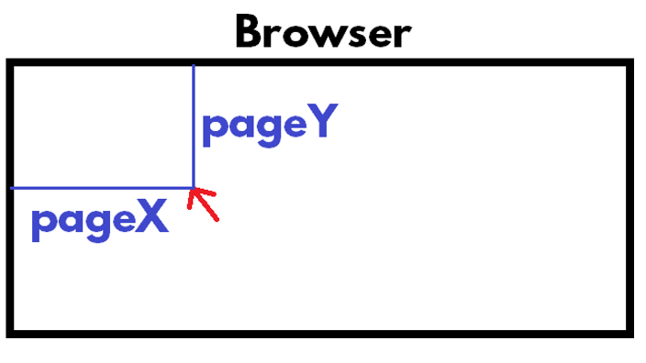
“Mousemove” event
The “mousemove” event executes when the user moves the mouse pointer across the element.
Syntax:
addEventListener(“mousemove”, functionname);
function functionname( ) {
//code here
}
event Represents the information, given by the browser.
Whenever the user performs an action, the browser collects some information, and it passes the same information to the function automatically.
This is called “event”.
event.pageX: Represents “X” co-ordinate of mouse pointer position.
event.pageY: Represents “Y” co-ordinate of mouse pointer position.

Slide 24
“Keyup” event
The “keyup” event executes when the user presses any key on the keyboard, while the cursor is inside the element.
Syntax:
addEventListener(“keyup”, functionname);
function functionname( ) {
//code here
}

Slide 25
“Keypress” event
The “keypress” event executes when the user presses any key on the keyboard, while the cursor is inside the element.
“Keypress” event is very similar to “keyup” event.
When you press any key on the keyboard, the following process happens:
1. “Keypress” event executes.
2. The character will be added in the textbox.
3. “Keyup” event executes.
“Keypress” event executes before accepting the currently pressed character into the element. “Keyup” event executes after accepting the currently pressed character into the element.
In “keypress” event, we can accept / reject the currently pressed character, because it executes “before accepting” the character.
In “keyup” event, we can’t reject the currently pressed character, because it executes “after accepting” the character.
Syntax:
addEventListener(“keypress”, functionname);
function functionname( ) {
//code here
}

Slide 26
event.which:
Represents the ASCII value of currently pressed character. That means when the user presses a character, the browser automatically identifies its ASCII value and passes the same to the function, as “event.which”.
ASCII = American Standard Code for Information Interchange
As per ASCII, every character has a number.
▪ 65 to 90 : A-Z
▪ 97 to 122 : a-z
▪ 48 to 57 : 0-9
▪ 32 : Space
▪ 8 : Backspace
▪ 9 : TAB
▪ 13 : Enter
event.preventDefault( ):
It stops the default functionality. That means it rejects the currently pressed character. If this method is not used, by default it accepts the currently pressed character.

Slide 27
“Focus” and “Blur” events
“Focus” event
The “focus” event executes when the cursor enters into the element.
Syntax:
addEventListener(“focus”, functionname);
function functionname( ) {
//code here
}
“Blur” event
The “blur” event executes when the cursor goes out of the element.
Syntax:
addEventListener(“blur”, functionname);
function functionname( ) {
//code here
}

Slide 28
“Change” event
The “change” event executes when the value of the element has been changed.
That means it executes in following cases:
1. When the user modifies the value of textbox and presses TAB key.
2. When the user checks / unchecks the checkbox.
3. When the user selects the radio button.
4. When the user selects an item in the dropdownlist.
Syntax:
addEventListener(“change”, functionname);
function functionname( ) {
//code here
}

Slide 29
“Contextmenu” event
The “contextmenu” event executes when the user right clicks on an element.
Syntax:
addEventListener(“contextmenu”, functionname);
function functionname( ) {
//code here
}
event.preventDefault():
It disables the right click menu (context menu).

Slide 30
“Cut”, “Copy”, “Paste” events
“Cut” event
The “cut” event executes when the user selects “cut” option with keyboard / mouse.
Syntax: addEventListener(“cut”, functionname); function functionname( ) { }
event.preventDefault( ):
It disables the cut operation.
“Copy” event
The “copy” event executes when the user selects “copy” option with keyboard / mouse.
Syntax: addEventListener(“copy”, functionname); function functionname( ) { }
event.preventDefault( ):
It disables the copy operation.
“Paste” event
The “paste” event executes when the user selects “paste” option with keyboard / mouse.
Syntax: addEventListener(“paste”, functionname); function functionname( ) { }
event.preventDefault( ): It disables the paste operation.

