Slide 1
JavaScript
Anil K

Slide 2
Regular Expressions
Regular expression represents “pattern” of the value.
Regular expressions are useful in validations, to check whether it is matching with the specified pattern or not.
List of Important Regular Expressions:
Sl. No | Description Regular | Expression
1 | Digits only | ^[0-9]*$
2 | Alphabets only | ^[a-zA-Z ]*$
3 | Indian Mobile Number | ^[789]\d{9}$
4 | Email | \w+([-+.']\w+)*@\w+([-.]\w+)*\.\w+([-.]\w+)*
5 | Usernames: Alphabets, Digits and Hyphens only | ([A-Za-z0-9-]+)
6 | Passwords: 6 to 15 characters; at least one upper case letter, one lower case letter and one digit | ((?=.*\d)(?=.*[a-z])(?=.*[A-Z]).{6,15})

Slide 3
Syntax to check Regular Expressions in JavaScript:
/regular expression/.test(value)
Example on Regular Expressions
<html>
<head>
<title>Regular Expressions</title>
<style>
.error{
color: red;
}
</style>
</head>
<body>
<h1>Regular Expressions</h1>
<form id="f1" action="http://localhost/serverpage.aspx">
Email:
<input type="text" id="txtemail">
<span id="spanemail" class="error"></span><br>
Mobile:
<input type="text" id="txtmobile">
<span id="spanmobile" class="error"></span><br>
<input type="submit" value="Login">
</form>

Slide 4
<script>
document.getElementById("f1").addEventListener("submit", fun1);
function fun1(event){
//event = browser given information
var s1 = document.getElementById("txtemail").value;
var regexpemail = /\w+([-+.']\w+)*@\w+([-.]\w+)*\.\w+([-.]\w+)*/;
alert(regexpemail.test(s1))
if (regexpemail.test(s1) == false){
event.preventDefault();
document.getElementById("spanemail").innerHTML = "Invalid email";
}else{
document.getElementById("spanemail").innerHTML = "";
}
var s2 = document.getElementById("txtmobile").value;
var regexpmobile = /"[789]\d{9}$/;
alert(regexpemail.test(s2))
if (regexpmobile.test(s2) == false){
event.preventDefault();
document.getElementById("spanmobile").innerHTML = "Invalid mobile";
}else{
document.getElementById("spanmobile").innerHTML = "";
}
}
</script>
</body>
</html>

Slide 5
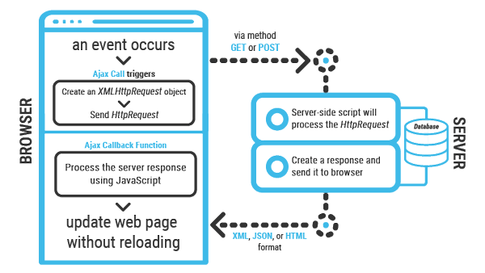
AJAX
AJAX stands for Asynchronous JavaScript and XML. AJAX is a new technique for creating better, faster, and more interactive web applications with the help of XML, HTML, CSS, and Java Script.
Using Ajax we can:
Read data from a web server
Update a web page without reloading the page
Send data to a web server

Slide 6
Steps of AJAX Operation
A client event occurs.
An XMLHttpRequest object is created.
The XMLHttpRequest object is configured.
The XMLHttpRequest object makes an asynchronous request to the Webserver.
The Webserver returns the result containing XML document.
The XMLHttpRequest object calls the callback() function and processes the result.
The HTML DOM is updated.

Slide 7
Ajax Example
<!DOCTYPE html>
<html>
<body>
<h2>Javascript AJAX</h2>
<button type="button" onclick="func()">Ajax</button>
<div id="result"></div>
<script>
function func() {
var xhttp = new XMLHttpRequest();
xhttp.onreadystatechange = function() {
if (this.readyState == 4 && this.status == 200) {
document.getElementById("result").innerHTML =
this.responseText;
}
};
xhttp.open("GET", "URL", true);
xhttp.send();
}
</script>
</body>
</html>

Slide 8
Hoisting in JavaScript
The concept of hoisting is that, no matter where we declare the variables, after compilation step and before interpretation step happens all the declarations will be hoisted to the top of the declared scope.
This concept is called Hoisting in JavaScript.
Example:
a = 10;
console.log(b) ;
c++;
var a;
var b;
var c;
In the process of compilation it scans the entire JavaScript file and it looks for variable declarations hoist or move to the top of the declared scope.
Once the compilation step is over then interpretation follows the scope chain along with the variables declarations and starts executing them.

Slide 9
Once all the variables are hoisted to the top of the program, then before interpretation step the code may looks as follows,
var a;
var b;
var c;
a= 10;
console.log(b);
c++;
Note: This hoisting process is not only applies to variables, it also applies to functions.
Example:
//function execution
sum();
//function definition
function sum() {
// Logic to sum
}

Slide 10
Note: even though the function declaration is placed after the functions execution, in with the process of hoisting in JavaScript (in Compilation Phase) the definition of the function is hoisted to the top.
Note: The hoisting is not possible for function expressions.
Example:
greet();
var greet = function() {
console.log(“Hello Good Morning");
} //0utput : TypeError: greet is not a function
In the above code first compilation step takes care about the variable declaration, and it just creates a variable 'greet' in the global scope with ‘undeﬁned’ as the value.
Now the interpreter comes to execute the function in line number 1, as this variable al ready contains a value as ‘undefined’ and interpreter can’t be able to execute the ‘greet()’ as this is not a function at this point of time.
Due to this reason Hoisting is not possible for Function Expressions and the hoisting works for function declaration.
Note: While using function expressions in a JavaScript codebase, make sure you write a function expression and then execute that function expression.

Slide 11
Strict Mode
If we are trying to apply the write operation on non-declared variables, it is allowed in JavaScript but the JavaScript itself creates that variable in 'Global' scope instead of its declared scope.
In any programming language declaring any variables in the global scope is bad, it is even worst in JavaScript programming.
var myName = ‘John’;
// some serious logic
myname = ‘Doe’;
// some serious logic
Let’s understand the above example, at line number 1 we have created a variable ‘myName’ and assigned a value, after some serious code, we have assigned a value to some other variable called ‘myname’ instead of ‘myName’ and which is not declared at all. As in JavaScript the variable names are case sensitive, and both are two different variables.
As the variable ‘myname’ is not declared anywhere else in the program, and as it is a write operation and also write operation is possible for non-declared variables so JavaScript creates this variable in the global scope (check the window object on the browser)

Slide 12
Due to the global variables are bad in JavaScript and we haven’t expected the behavior of JavaScript creating a variable in the global scope.
In order to avoid this, from ESS version we got a new feature called Strict Mode.
If we run any JavaScript in Strict Mode, It warns the non-declared variables as follows,
"use strict";
var myName = 'John';
// some serious logic
myname = 'Doe';// ReferenceError: assignment to undeclared variable myname
Note: We can use this Strict Mode to the entire JavaScript to run it in the strict mode just by adding this line to the top of any JavaScript File.
"use strict";
We can even execute only a function in strict mode, by adding the above line inside a function.
function greet(){
"use strict";
// Some serious logic
}
Note: We should always run the JavaScript in Strict Mode to avoid such errors as mentioned above.

Slide 13
Closures
This is one of the most important concept in JavaScript along with Scopes. This allows the programmers to write better, creative and expressive code.
A Closure is an inner function that has access to the outer (enclosing) function’s variables scope chain.
The Closure is having three scope chains as follows,
1) It have access to its own scope (the variables defined in its curly braces).
2) It has access to the outer functions variables.
3) It has access to the Global Variables.

Slide 14
Example:
// Closure Example 1
var a = 10;
function outer() { var b = 20;
function inner() {
console.log(a);
console.log(b);
}
inner();
}
outer(); // Output : 10 20
In the above example variable ‘a’ is created in the global scope and variable ‘b’ is created in the outer scope.
We are executing the ‘outer()’ function in the global scope, it goes to outer() function deﬁnition and creates a variable 'b' and also executes the inner() function.
While executing the inner(), there is no variable ‘a’ in the inner() and outer() function, so the variable gets from the global scope and prints it on the console. And trying to access the variable ‘b’ in the inner() and it is not there in the inner() and then the control goes one level up and gets the variable ‘b’ and prints it on the console.

Slide 15
Example:
// Closure Example 2
var a = 10;
function outer() {
var b = 20;
Var inner = function() {
console.log(a);
console.log(b);
}
return inner;
}
var innerFun = outer();
innerFun();
// Output : 10 20
In the above Example, instead of a normal function inner(), we have created a function expression, this is an isolated function inside outer().
At line number 12, we are executing the function outer(), here the variable 'b' will created in the outer() scope and the isolated function will be returned and which is assigned to ‘innerFn’.
At Line number 13, we are executing an isolated function and here there is not outer involved. At this place the variable ‘a’ is declared in the global scope and it is available to ‘innerFn’ , but the scope of variable ‘b’ is to outer() only and how does the variable ‘b’ is accessible here? (this is the concept of closure).The Whole concept of closures is, at the time a function creation it remembers its scope chain and if we execute that function in a totally different context, it still remembers it’s scope chain. This is the concept of closure.

Slide 16
Example:
// Closure Example 3
var a = 10;
function outer() {
var b = 20;
var inner = function() {
console.log(a);
console.log(b);
}
return inner;
}
function processEngine(fName) {
fName();
}
var innerFun = outer();
processEngine(innerFun);
// Output : 10 20
In the above Example, at line number 17 we got an isolated function 'innerFun', this variable we are passing to another function called ‘processEngine()’ this is even inside a different context.
Here in line number 18, we are executing the processEngine() function, due to the concept of closures it still remembers its scope chain and prints the values 10, 20 to the console.

Slide 17
Example:
// Closure Example 4
var a = 10;
function outer() {
var b = 20;
var inner = function() {
console.log(a);
console.log(b);
}
return inner;
}
var innerFun1 = outer();
innerFun1(); // Output : 11 21
var innerFun2 = outer();
innerFun2(); // Output : 12 21
In the above example, whenever we execute a function, then a new copy of variables will created. And there will only one copy of global variable.
Due to the concept of closures and above information it prints the values as specified in the example.

Slide 18
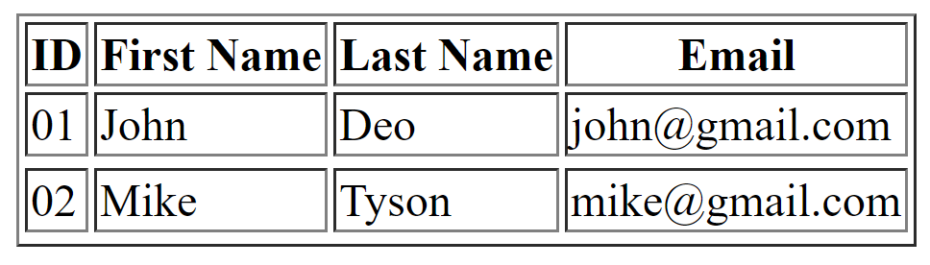
Example
var myjson = {
"students": [
{
"id":"01",
"firstname": "John",
"lastname": "Deo",
"email": "john@gmail.com"
},
{
"id":"02",
"firstname": "Mike",
"lastname": "Tyson",
"email": "mike@gmail.com"
}
]
}
<div id="mydiv"></div>
<script>
var mystudents = myjson.students;
var mydiv = document.getElementById("mydiv");
var mytable = "<table border='1'>"
mytable += "<thead>"
mytable += "<th>ID</th>"
mytable += "<th>First Name</th>"
mytable += "<th>Last Name</th>"
mytable += "<th>Email</th>"
mytable += "</thead>"
for(var i=0;i<mystudents.length;i++){
mytable += "<tr>"
for(key in mystudents[i]){
mytable += "<td>"+mystudents[i][key]+"</td>"
}
mytable += "<tr>"
}
mydiv.innerHTML = mytable;
</script>

