Slide 1
TypeScript
Anil K

Slide 2
TypeScript Basics

Slide 3
Variables
Variable is a named memory location in RAM, to store a value at run time.
Syntax: var variable : datatype = value;
Example: var a : number = 100;
TypeScript supports “optional static typing”. That means it is optional to specify datatype for the variable in TypeScript.
Static Typing: If you specify the data type for the variable, it is not possible assign other data type of value into the variable; if you do so, “tsc” compiler will generate coding-time and compile-time errors; but the code will be compiled and executed also, even though it is having errors.
Dynamic Typing: If you don’t specify the data type for the variable, we can assign any type of value into the variable.
In TypeScript, we have “optional static typing”. That means it is optional to specify datatype for the variable in TypeScript.

Slide 4
Data Types
“Data type” specifies what type of value that can be stored in a variable.
List of TypeScript Data Types:
number: All types of numbers (integer / floating-point numbers). Ex: 10, 10.3498
string: Collection of characters in double quotes or single quotes. Ex: “hello”
boolean: true or false
any: Any type of value

Slide 5
Variables and Data Types - Example
c:\angular\datatypes.ts
var a: number = 10;
var b: string = "Hello";
var c: boolean = true;
var d: any = 100;
console.log(a);
console.log(b);
console.log(c);
console.log(d);

Slide 6
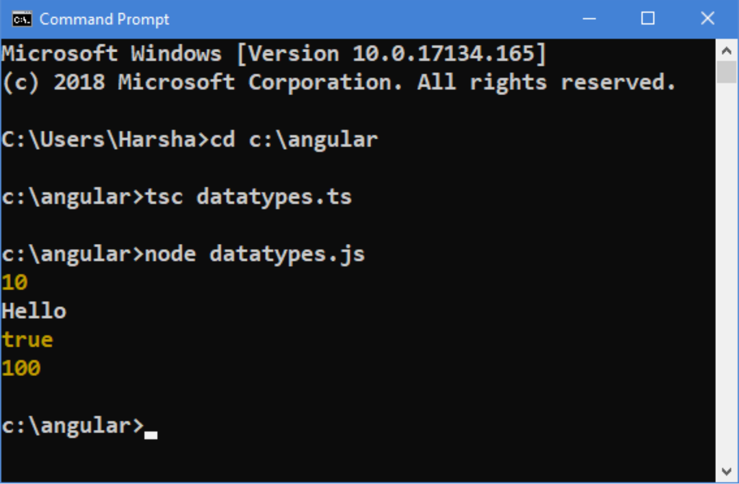
Compilation and Execution
Open Command Prompt
cd c:\angular
tsc datatypes.ts
node datatypes.js

Slide 7
TypeScript OOP
What is Object
Object is the primary concept in OOP (Object Oriented Programming).
“Object” represents a physical item, that represents a person or a thing.
Object is a collection of properties (details) and methods (manipulations).
For example, a student is an "object".
We can create any no. of objects inside the program.

Slide 8
TypeScript OOP
What is Property
Properties are the deails about the object.
Properties are used to store a value.
For example, studentname="Scott" is a property in the "student object".
Properties are stored inside the object.
The value of property can be changed any no. of times.

Slide 9
TypeScript OOP
What is Method
Methods are the operations / tasks of the object, which manipulates / calculates the data and do some process.
Method is a function in the object. In other words, a function which is stored inside the object is called as "Method".
Methods are stored inside the object.

Slide 10
Creating Object
Object can be created by using "Object Literal Pattern" in TypeScript.
"Object literal" is a collection of properties and methods, that are enclosed within curly braces { }.
Syntax to create Object:
{ property: value, …, method: function( ) { code here } }
Reference Variable
The "reference variable" is a variable, that can store the reference of an object.
We can access all the properties and methods of the object, by using the "reference variable".
Syntax to create Object and store its reference in the "reference variable":
var referenceVariable = { property: value, …, method: function() { code here } };

Slide 11
Objects - Example
c:\angular\objects.ts
var student = {
studentId: 1,
studentName: "Scott",
marks: 80,
getResult: function () {
if (this.marks >= 35) {
return "Pass";
} else {
return "Fail";
}
}
}
console.log(student);
console.log(student.studentId);
console.log(student.studentName);
console.log(student.marks);
console.log(student.getResult());

Slide 12
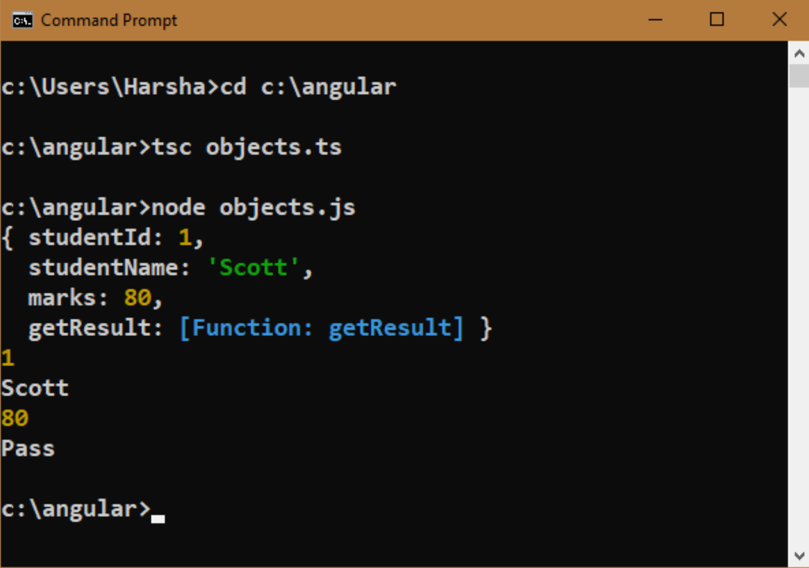
Compilation and Execution
Open Command Prompt
cd c:\angular
tsc objects.ts
node objects.js

Slide 13
Class
What is Class
“Class” represents a model of the object, which defines list of properties and methods of the object.
Ex: “Student” class represents structure (list of properties and methods) of every student object.
We can create any no. of objects based on a class, using "new" keyword.
All the objects of a class, shares same set of properties & methods of the class.
We can store the reference of the object in "reference variable"; using which you can access the object.
Syntax
class classname
{
properties
methods
}

Slide 14
Steps for working with classes and objects
Create a Class:
class classname
{
property: datatype = value;
…
methodname( parameter1: datatype, parameter2: datatype, … ) : returntype
{
code here
}
…
}
Create an Object & Store its address in Reference Variable
var referencevariablename = new classname( );
Access Properties and Methods using Reference Variable
referencevariablename.property
referencevariablename.method( );

Slide 15
Classes - Example
c:\angular\classes.ts
class Student{
studentId: number;
studentName: string;
marks: number;
getResult() {
if (this.marks >= 35) {
return "Pass";
} else {
return "Fail";
}
}
}
var s1= new Student();
s1.studentid = 101;
s1.studentName = "Scott";
s1.marks = 80;
console.log(s1.studentid); console.log(s1.studentName);
console.log(s1.marks); console.log(s1.getResult());
var s2 = new Student();
s2.studentld = 102;
s2.studentName = "Smith";
s2.marks = 72;
console.log(s2.studentld); console.log(s2.studentName);
console.log(s2.marks); console.log(s2.getResult());

Slide 16
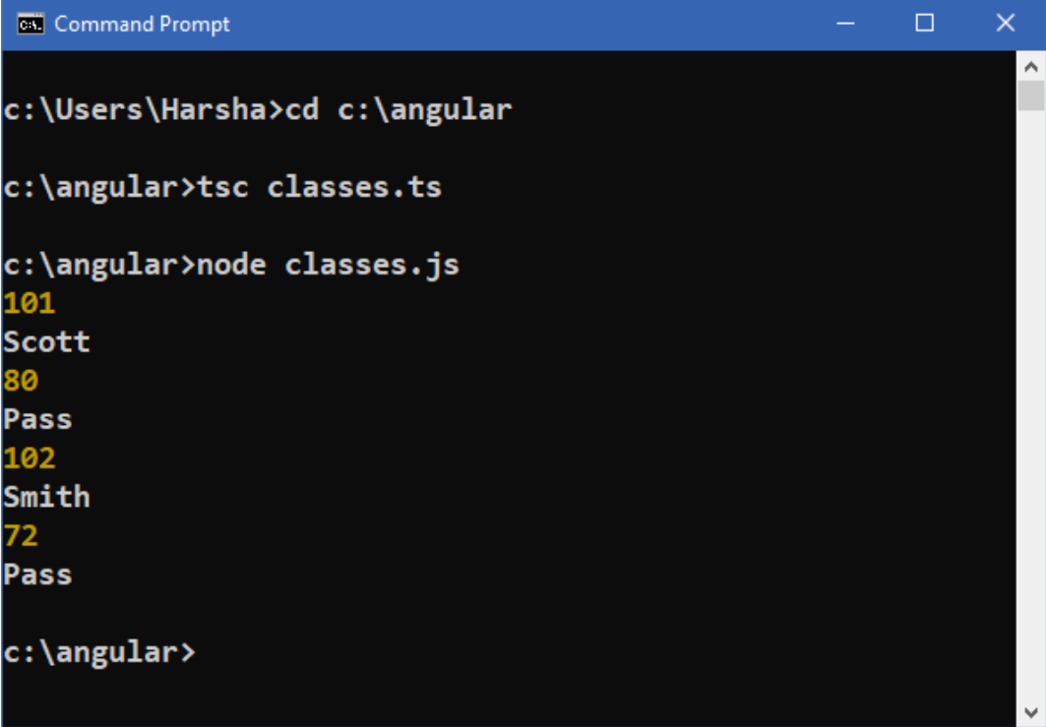
Compilation and Execution
Open Command Prompt
cd c:\angular
tsc classes.ts
node classes.js

Slide 17
Constructor
Constructor is a special function which is a part of the class.
Constructor will be called automatically when we create a new object for the class. If you create multiple objects for the same class, the constructor will be called each time when you create new object.
Constructor is used to initialize properties of the class.
Constructor’s name should be “constructor”.
Constructor can receive arguments; but can’t return any value.
In TypeScript, we can't define multiple constructors.
Syntax of Constructor
Constructor(parameter1: datatype,…)
{
code here
}

Slide 18
Constructor - Example
c:\angular\constructor.ts
class Student {
studentId: number;
studentName: string;
marks: number;
constructor(studentId: number = 0, studentName: string = "none", marks: number = 0) {
this.studentld = studentld;
this.studentName = studentName;
this.marks = marks;
}
getResult() {
if (this.marks >= 35) {
return "Pass";
}
else {
return "Fail";
}
}
}

Slide 19
Constructor - Example
c:\angular\constructor.ts
var s1 = new Student(101, "Scott", 80);
console.log(s1studentId);
console.log(s1.studentName);
console.log(s1.marks);
console.log(s1.getResult());
var s2 = new Student(102, "Smith", 45);
console.log(s2.studentId);
console.log(s2.studentName);
console.log(s2.marks);
console.log(s2.getResult());
var s3 = new Student();
console.log(s3.studentId);
console.log(s3.studentName);
console.log(s3.marks);
console.log(s3.getResult());

Slide 20
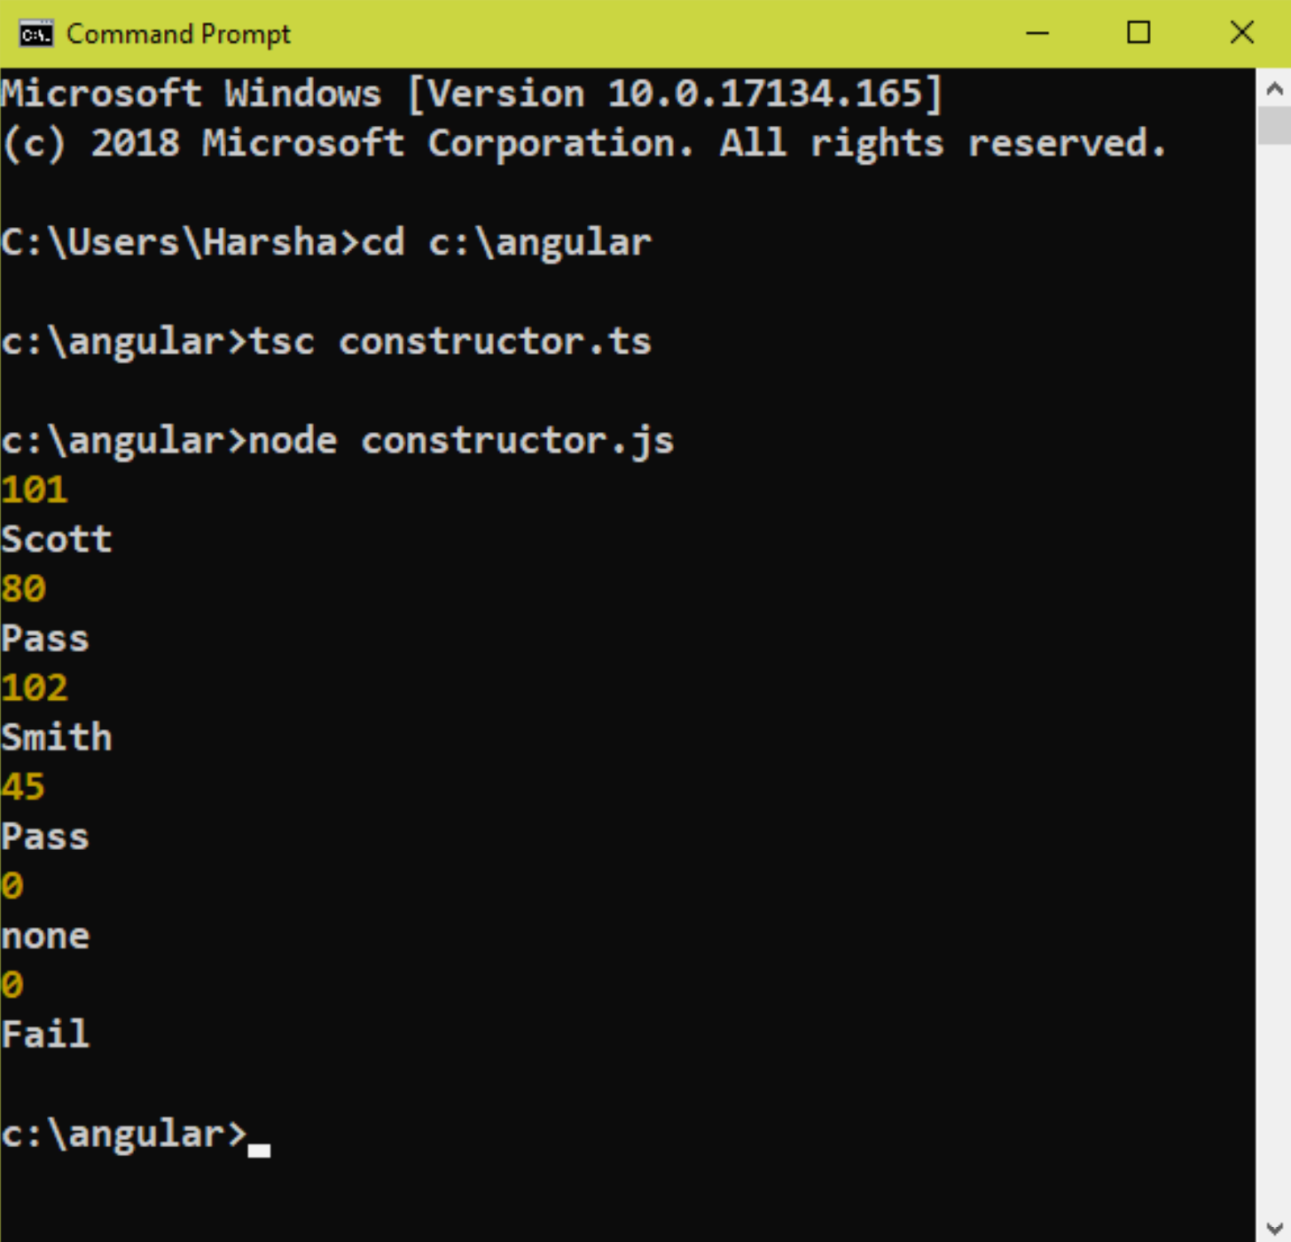
Compilation and Execution
Open Command Prompt
cd c:\angular
tsc constructor.ts
node constructor.js

Slide 21
Inheritance
Inheritance is a concept of extending the parent class, by creating the child class. The child class extends parent class. That means all the members of parent class will be inherited (derived) into the child class.
When you create an object for the child class, it includes all the members (properties and methods) of both child class and parent class. When you create an object for parent class, it includes all the members (properties and methods) of parent class only.
For example, the “Student” class extends “Person class”. The “Car” class extends “Vehicle” class.
When parent class has a constructor, the child class’s constructor must call the parent class’s constructor explicitly.
The “extends” keyword is used to create inheritance.
The “super” keyword represents current parent class. It can be used to call the constructor or method of parent class.

Slide 22
Types of Inheritance
Single Inheritance: One parent class with one child class.
Multiple Inheritance: Multiple parent classes with one child class.
Hierarchical Inheritance: One parent class with multiple child classes.
Multi-Level Inheritance: One parent class with one child class and the child class has another child class.
Hybrid Inheritance: One parent class with one child class(to be revised).

Slide 23
Syntax of Inheritance
Create parent class:
class parentclass
{
parent class’s members
}
Create child class:
class childclass extends parentclass
{
child class’s members
}
Create object for parent class:
var referencevariable = new parentclass( );
referencevariable.parentclassmember
Create object for child class:
var referencevariable = new childclass( );
referencevariable.childclassmember
referencevariable.parentclassmember

Slide 24
Inheritance - Example
c:\angular\inheritance.ts
class Person {
name: string
age: number; constructor(a: string, b: number) {
this.name = a;
this.age = b;
} getDetails(): string {
return this.name + "," + this.age;
}
}
class Student extends Person {
studentid: number;
marks: number; constructor(p: string, q: number, r: number, s: number) {
super(p, q);
this.studentid = r;
this.marks = s
} getDetails(): string {
return this.name + "," + this.age + "," + this.studentid + "," + this.marks;
}
}

Slide 25
Inheritance - Example
c:\angular\inheritance.ts
var p = new Person("Scott", 20);
console.log(p.name);
console.log(p.age);
console.log(p.getDetaits());
console.log("-----------------------");
var s = new Student("Smith", 22, 201, 67);
console.log(s.name);
console.log(s.age);
console.log(s.studentid);
console.log(s.marks);
console.log(s.getDetails());

Slide 26
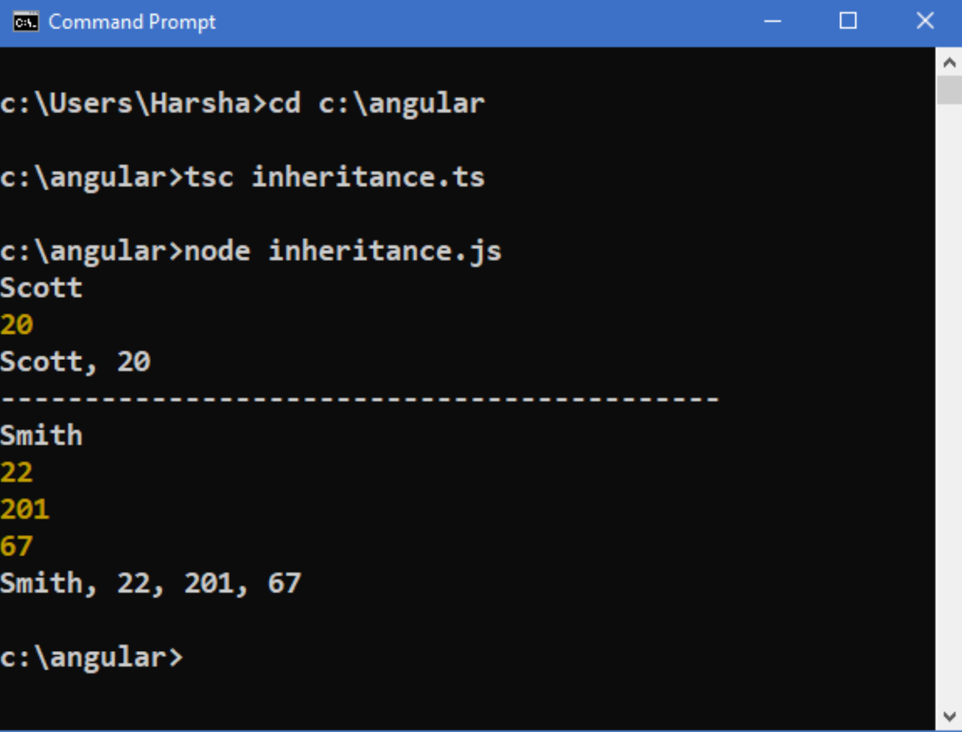
Compilation and Execution
Open Command Prompt
cd c:\angular
tsc inheritance.ts
node inheritance.js

Slide 27
Access Modifiers
Access Modifiers specify where the member of a class can be accessible.
That means it specifies whether the member of a class is accessible outside the class or not.
These are used to implement "security" in OOP.
For each member (property / method), we can specify the access modifier separately.
TypeScript compiler and Visual Studio Code Edtitor shows errors, if a developer try to access the member, which is not accessible.
"public" is the access modifier for all the members (property / method) in TypeScript class.
TypeScript supports three access modifiers:
1. public (default)
2. private
3. protected

Slide 28
Access Modifiers
1. public (default):
The public members are accessible anywhere in the program (in the same class and outside the class also).
2. private:
The private members are accessible within the same class only; If you try to access them outside the class, you will get compile-time error.
3. protected:
The protected members are accessible within the same class and also in the corresponding child classes; If you try to access them outside the same class or child class, you will get compile-time error.

Slide 29
Syntax of creating a member with access modifier:
Property:
class classname
{
accessmodifier property: datatype;
}
Method:
class classname
{
accessmodifier methodname( arguments) : returntype
{
}
}

Slide 30
Access Modifiers - Example
c:\angular\accessmodifiers.ts
/* current class */
class Student {
public studentid: number = 101;
private studentname: string = "Scott";
protected marks: number = 80;
public display(): void {
console.log("Studentdisplay");
console.log(this.studentid); //accessible
console.log(this.studentname); //accessible
console.log(this.marks); //accessible
}
}
/* Child class*/
class EngineeringStudent extends Student {
public display(): void {
console.log("EngineeringStudentdisplay");
console.log(this.studentid); //accessible
//console.log(this.studentname); //not accessible
console.log(this.marks); //accessible
}
}

Slide 31
Access Modifiers - Example
c:\angular\accessmodifiers.ts
/* Other class */
class Test {
sampleMethod() {
var s = new Student();
s.display(); //accessible
var s2 = new EngineeringStudent();
s2.display2(); //accessible
console.log("----------------------");
console.log(s.studentid); //accessible
//console.log(s.studentname); //not accessible
//console.log(s.marks); //not accessible
}
}
var t: Test = new Test();
t.sampleMethod();

Slide 32
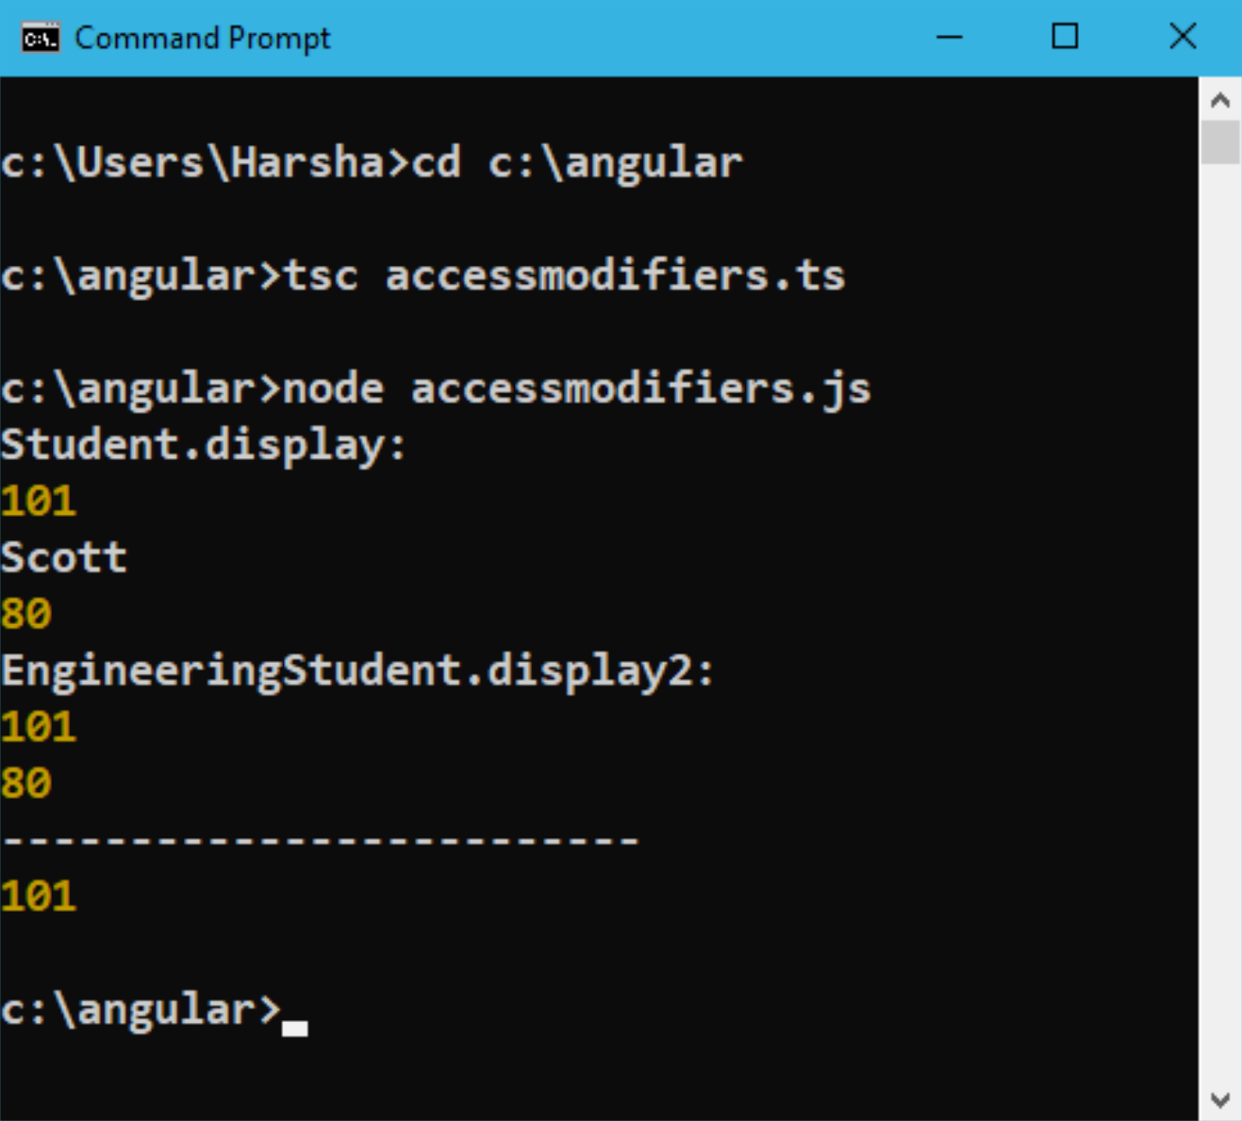
Compilation and Execution
• Open Command Prompt
cd c:\angular
tsc accessmodifiers.ts
node accessmodifiers.js

Slide 33
Interfaces
Interface is the model of a class, which describes the list of properties and methods of a class.
Interfaces doesn’t contain actual code; contains only list of properties and methods.
Interfaces doesn’t contain method implementation (method definition); it contains method declaration only, which defines method access modifier, method name, method arguments and method return type.
The child class that implements the interface must implement all the methods of the interface; if not, compile-time error will be shown at child class. The method name, parameters, return type and access modifier must be same in between "interface method (method at the interface)" and "class method (method at the class)".
Interfaces act as a mediator between two or more developers; one developer implements the interface, other developer creates reference variable for the interface and invokes methods; so interface is common among them.
The child class can implement the interface with “implements” keyword.
All the methods of interface is by default, "public".
One interface can be implemented by multiple classes; One class can implement multiple interfaces.
We can develop "multiple inheritance" by implementing multiple interfaces at-a-time in the same class.

Slide 34
Steps for development of Interfaces
Create an interface:
interface interfacename
{
property: datatype;
…
method( arguments ): returntype;
…
}
Create a child class for the interface and implement it:
class classname implements interfacename
{
property: datatype;
method( arguments ) : returntype
{
code here
}
}

Slide 35
Interfaces - Example
c:\angular\interfaces.ts
interface IStudent {
firstName: string;
lastName: string;
getFullName(): string;
}
class Student implements IStudent {
firstName: string
lastName: string
getFullName(): string {
return this.firstName + " " + this.lastName;
}
}
var s = new Student();
s.firstName = "Adam";
s.lastName = "Smith";
console.log(s.getFullName());

Slide 36
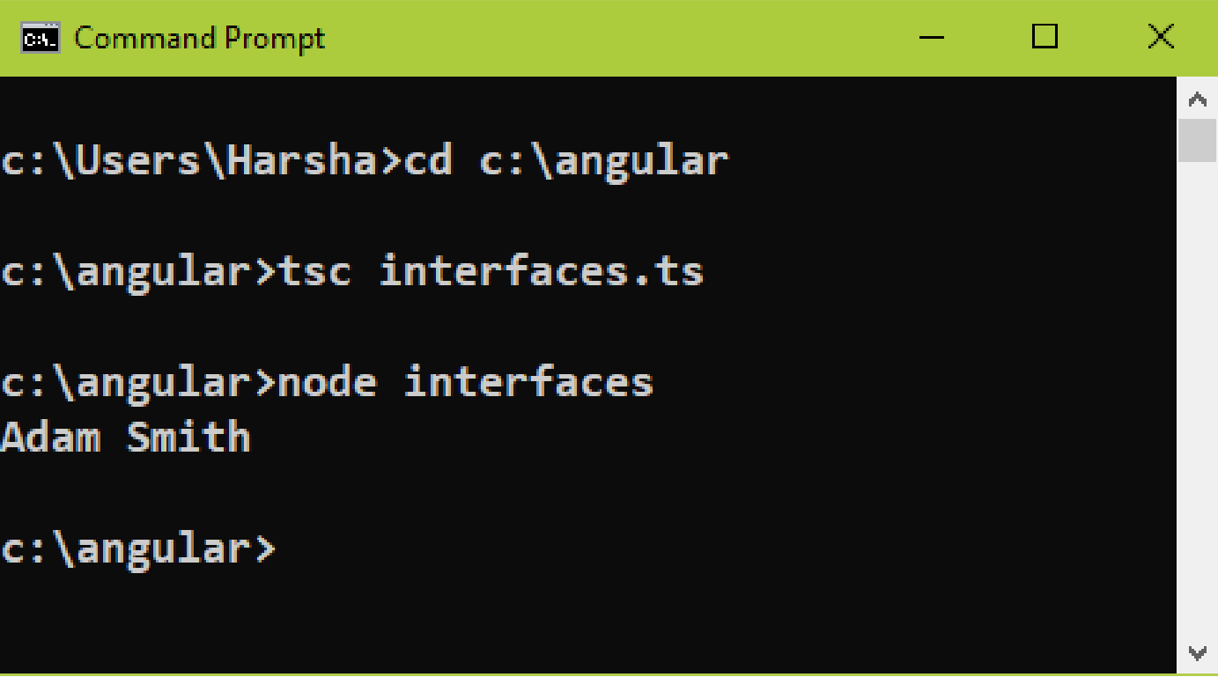
Compilation and Execution
Open Command Prompt
cd c:\angular
tsc interfaces.ts
node interfaces.js

Slide 37
Enumerations
Enumeration is a collection of constants.
Enumeration acts as a data type.
We can use "enumeration" as a data type for the "enumeration variable" or "enumeration property".
The enumeration variable or enumeration property can store any one of the constants of the same enumeration.
Every constant of enumeration is represented with a number (starts from 0).

Slide 38
Steps for development of enumeration
Create an enumeration:
enum enumerationName
{
constant1, constant2, …
}
Create a property of enumeration type:
class classname
{
property: enumerationName;
}
Create a variable of enumeration type:
variableName: enumerationName;
Assign the value into enumeration variable or enumeration property:
enumerationVariable = enumerationName.constant;
this.enumerationProperty = enumerationName.constant;

Slide 39
Enumerations - Example
c:\angular\enumerations.ts
enum courseNames {
Java, Blockchain, JavaScript
}
class Student {
studentName: string;
age: number;
course: courseNames;
}
var s = new Student();
s.studentName = "Scott";
s.age = 20;
s.course = courseNames.Blockchain;
console.log(s.studentName);
console.log(s.age);
console.log(s.course);
console.log(courseNames[s.course]);

Slide 40
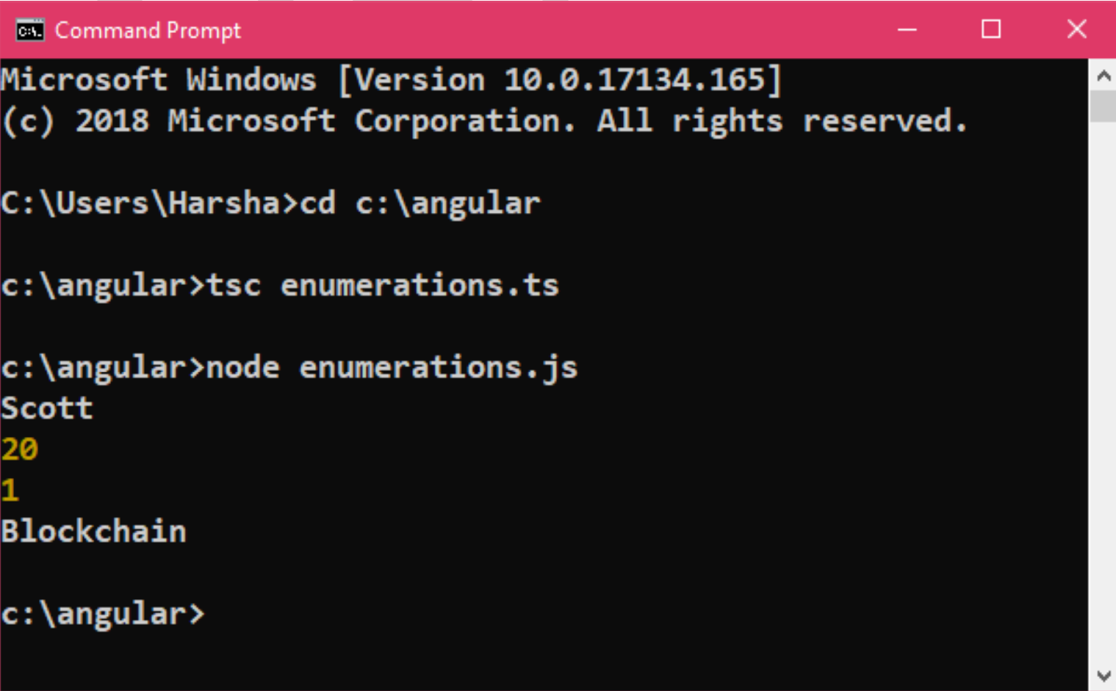
Compilation and Execution
Open Command Prompt
cd c:\angular
tsc enumerations.ts
node enumerations.js

Slide 41
Modules
In large scale applications, it is recommended to write each class in a separate file.
To access the class of one file in other file, we need the concept of "Modules".
Module is a file (typescript file), which can export one or more classes (or interfaces, enumerations etc.) to other files; The other files can import classes (or interfaces, enumerations etc.), that are exported by the specific file. We can't import the classes (or others) that are not exported.
We can export the class (or others), by using "export" keyword in the source file.
We can import the class (or others), by using "import" keyword in the destination file.
To represent:
1. current folder, we use "./".
2. sub folder in current folder, we use "./subfolder".
3. parent folder, we use "../".

Slide 42
Steps for development of modules
Export a class in file1.ts
export class className1
{
…
}
Import class in file2.ts:
import { className1 } from "./file1.ts";
class className2
{
}

Slide 43
Modules - Example
c:\angular\Student.ts
export class Student {
studentId: number;
studentName: string;
marks: number;
constructor(studentId: number, studentName: string, marks: number) {
this.studentId = studentId;
this.studentName = studentName;
this.marks = marks;
}
}

Slide 44
Modules - Example
c:\angular\StudentsList.ts
import { Student } from "./Student";
class StudentsList {
students: Student[] = [
new Student(101, "Scott", 80),
new Student(102, "Smith", 45),
new Student(103, "Allen", 97),
new Student(104, "Jones", 25)
];
getTopRanker(): Student {
var index;
var max = 0;
for (var i in this.students) { if (this.students[i].marks > max) {
max = this.students[i].marks;
index = i;
}
}
return this.students[index];
} }
var s: StudentsList = new StudentsList();
console.log(s.getTopRanker());

Slide 45
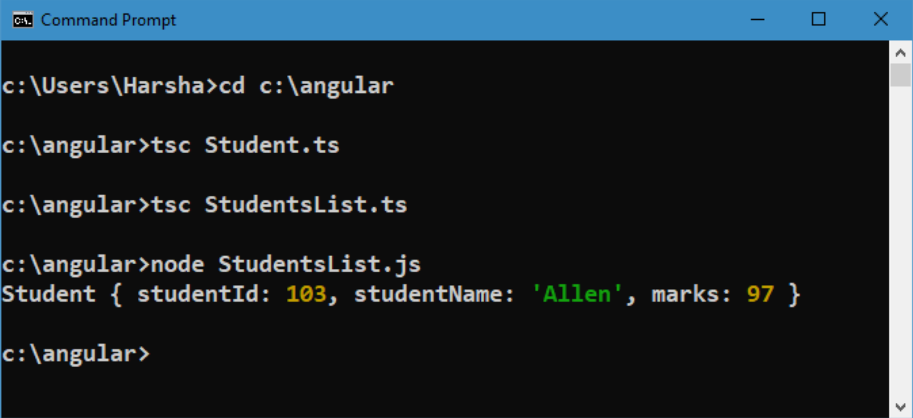
Compilation and Execution
Open Command Prompt
cd c:\angular
tsc Student.ts
tsc StudentsList.ts
node StudentsList.js

