Slide 1
Angular
Anil K

Slide 2
What is Angular?
Angular is a client side framework, which is used to create web applications. The framework provides skeleton of the project and specifies clear guidelines, where to write which type of code.
Angular can be used in combination with any server side platform such as Java, NodeJS, Asp.Net, PHP, Python etc.
Angular is developed using "TypeScript" language, which is a superset of JavaScript language.
Angular is the most-used client side framework.
Angular was developed by Google.
Angular is free-to-use (commercially too).
Angular is open-source. That means the source code of angular is available online for free of cost.
Angular is cross-platform. That means it works in all the operating systems.
Angular is cross-browser compatible. That means it works in all the browsers, except less than IE 9 (which is completely out-dated).
Angular is mainly used to create "data bindings". That means, we establish relation between a variable and html element; When the value of the variable is changed, the same will be automatically effected in the corresponding html element; and vice versa. So that the developer need not write any code for DOM manipulations (updating values of html tags, based on user requirements. for example, updating the list of categories when a new category added by the user). Thus the developer can fully concentrate on the application logic, instead of writing huge code for DOM manipulations. So we can achieve clean separation between "application logic" and "DOM manipulations".
Angular mainly works based on "Components". The component is a class, which represents a specific section (part) of the web page.

Slide 3
Goals of Angular
Separation of DOM manipulation from application logic.
Separation of HTML logic from application logic.
Make SPA (Single Page Application) development easier. SPA provides client-side navigation system; but can communicate with server only through AJAX; the web page never gets refreshed fully. Ex: Gmail.
Separation of business logic from application logic.
Enable Unit testing. The components can be unit tested individually.
Angular 2 : Sep 14th 2016
Angular 4: Mar 23rd 2017 [Angular 3.0 was skipped due to misalignment of router package 3.3.0]
Angular 5 : Nov 1st 2017
Angular 6 : May 3th 2018
Angular 7 : Oct 18th 2018
Angular 8 : May 28th 2019
Angular 9 : February 6 th 2020
Angular 10 : June 24 th 2020
Goals of Angular

Slide 4
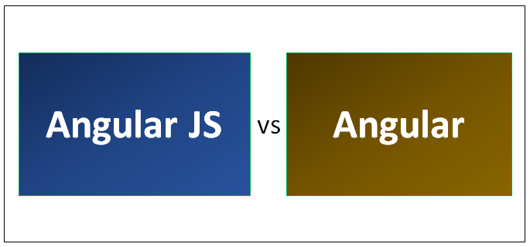
Angular (vs) AngularJS
“Angular 2” is not an extension to “Angular 1”; it is a completely “rebuilt” or “rewrite”. “Angular 2” is rewrite from the same team that built “AngularJS 1”.
“Angular 4”, “Angular 5” and “Angular 6” are mostly similar to “Angular 2”, except some internal changes for stability and performance.
“Angular 2+” means “Angular 2, Angular 4 and Angular 5”. Note: “Angular 3” is not released, to avoid the confusion of “router” package, which is already released with “3.3.0” version.

Slide 5
AngularJS | Angular
“AngularJS” has performance drawbacks because, the “digest loop” checks and updates all properties when a field or property has been modified. The digest loop may repeat up to 10 times, due to a watcher of one property can update other property. | “Angular” is faster in performance because it updates a single property that has been really modified. No digest loop and no need of any repetition.
“AngularJS” is based on “JavaScript”, which is “prototype-based OOP language”. | “Angular” is based on “TypeScript”, which is “class-based OOP language”.
“AngularJS” is based on “MVC architecture”. The code will be divided into three major parts called “Model”, “View” and “Controller”. Model is an object that stores data. View is a html file that contains presentation logic to display data. Controller is a function that manipulates data. | “Angular” is based on “Components”. Component is a class that contains stores data and also manipulates the data. View is a html file that contains presentation logic to display data.
“AngularJS” is mainly used for development of “Single Page Applications”. | “Angular” is also mainly used for development of “Single Page Applications”.
Apart from data bindings, Angular 1 provides many additional features such as validations, routing, animations, services, filters, providers, factories, configuration, AJAX etc. | Apart from data bindings, Angular 2 provides many additional features such as validations, routing, animations, services, pipes, AJAX etc.
Supports “Scopes” (Models) to store data | Doesn’t supports Scopes; but supports Components alternatively.
Supports only one expression syntax {{ }}. | Supports multiple expression syntaxes such as {{ }}, [], ().
Doesn’t provide CLI (Command Line Interface), to generate components and services easily from the command prompt commands. | Provides CLI (Command Line Interface), to generate components and services easily from the command prompt commands.

Slide 6
Angular (vs) jQuery
jQuery is a “library”, which provides a set of pre-defined functions to perform DOM manipulations directly.
Angular is a framework, which provides the complete application structure and set of concepts to organize the client side code completely, which enables the developers to work with “Data bindings” to avoid DOM manipulations directly.
Angular (vs) React
React just acts as a "view layer", which provides necessary concepts to create data bindings in the view.
Angular is a "complete client side framework", which provides the complete application structure and set of concepts to organize the client side code completely, which enables the developers to work with “Data bindings” to avoid DOM manipulations directly.
Angular provides so many concepts such as services, directives, dependency injection, routing etc., which are not supported by React.

Slide 7
Features of Angular
TypeScript based: Pre-defined code and User-defined code is developed based on TypeScript language.
Faster performance: “Angular 2+” executes faster than “AngularJS 1”.
Modular: Angular is divided into multiple small parts called “packages”. For example, "core", "common", "forms", "router" etc. The developer can use any of those modules based on the requirement.
Browser Compatibility of Angular 2+
Browser | Supported versions
Chrome | latest
Firefox | latest
Edge | 2 most recent major versions
IE | 11, 10, 9
IE Mobile | 11
Safari | 2 most recent major versions
iOS | 2 most recent major versions
Android | Nougat (7.0), Marshmallow (6.0), Lollipop (5.0, 5.1), KitKat (4.4)

Slide 8
Building Blocks of Angular
Angular is composed with the following “building blocks”:
1. Component : Application state + Application logic
2. Metadata : Details about the component / module etc.
3. Template : Design logic (HTML)
4. Data Binding : Connection between HTML element and Component property
5. Module : Group of components, directives and pipes.
6. Service : Re-usable code / business logic.
7. Dependency Injection : Injecting (loading) Service objects into Components.
8. Directive : Manipulating DOM elements
9. Pipe : Transforming values before displaying

Slide 9
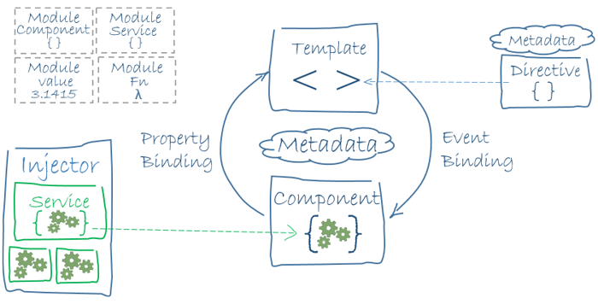
Angular Architecture

Slide 10
Types of compilation in Angular
Angular framework supports two types of compilation.
Just-In-Time Compilation
Templates (.html files) and angular compiler files will be loaded into the browser and then the templates will be compiled automatically at the time of execution, when the component is invoked.
The template will be compiled only for the first time, when it invoked, after loading the application files into the browser.
Disadvantage: Performance is slower, because every time when you run the application, the templates will be loaded into browser and compiled in the browser; it takes some time to compile.
Advantage: The developer need not compile it manually at command prompt, for each modification of code.
This is recommended during the development.
Bootstrapping (loading app module into the browser) is done by “@angular/platform-browser-dynamic” package.

Slide 11
Types of compilation in Angular
Angular framework supports two types of compilation.
Ahead-Of-Time Compilation
The developer gives “ngc” command in the Command Prompt; Then the “ngc” compiler compiles the templates into javascript code; the compiled javascript code will be loaded into the browser and it directly executes. There is no need of loading “templates (.html files)” and “angular compiler scripts” into the browser.
Advantage: Performance is faster, because the templates are already compiled.
Disadvantage: The developer need to compile it manually at command prompt, for each modification of code.
This is recommended in the production server only.
Bootstrapping is done by “@angular/platform-browser” package.

Slide 12
Steps to create first application in Angular
1) Installing NodeJS
2) Installing TypeScript
3) Installing Visual Studio Code
4) Creating Application Folder
5) Install “@angular/cli” package
6) Creating New Angular App
7) Open the App in Visual Studio Code
8) Edit code in app.component.html
9) Compile the application
10) Run the application

Slide 13
1) Installing NodeJS
Angular 2+ framework is available as a collection of packages; those packages are available in “npm” (NodeJS Package Manager). To use “npm”, NodeJS must be installed.
If you have already installed nodejs in your system, you can skip this step and go to step 2.
If you have not installed nodejs in your system, you continue this step.
Go to “https://nodejs.org”.
2) Installing TypeScript
Open “Command Prompt”.
Type npm install typescript -g in the Command prompt and press Enter.
3) Installing Visual Studio Code
If you have installed Visual Studio Code already, you can skip this step and go to step 4.
If you don’t have installed Visual Studio Code, continue this step.
“Visual Studio Code” is the recommended editor for typescript and angular.
Go to https://code.visualstudio.com

Slide 14
4) Create Application Folder
If you have already created “c:\angular” folder, you can skip this step and go to step 5.
If you don’t have created “c:\angular” folder, continue this step.
Go to “Computer” (or) “This PC”.
Go to “c:\”. and create a new folder as “angular”
The “c:\angular” folder is ready now.
5) Install @angular/cli package
Open “Command Prompt” and run the following command:
cd c:\angular npm install @angular/cli -g
The “@angular/cli” package provides a set of commands to create new angular applications and also to create items in the project such as modules, components, pipes, services, directives etc.
Installing “@angular/cli” package globally will download the package files from internet into “C:\Users\Anil\AppData\Roaming\npm\node_modules\@angular\cli” folder, which can be used from any folder in the entire system.

Slide 15
6) Creating New Angular Application
Open “Command Prompt” and run the following command:
cd c:\angular
ng new app1
Now new application at “c:\angular\app1” folder is created.
7) Open the Application in Visual Studio Code
Go to “Start” > “Visual Studio Code”.
Select the folder “c:\angular\app1”.
8) app.component.html
Go to “app1\src\app1\app.component.ts” in “Explorer” window in Visual Studio Code.

Slide 16
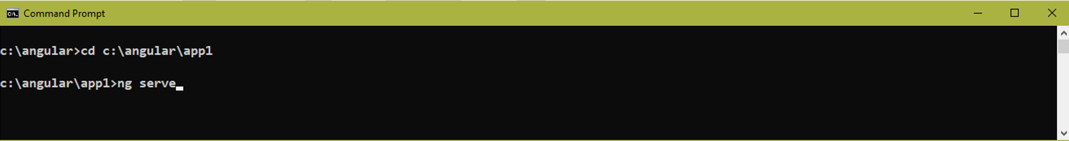
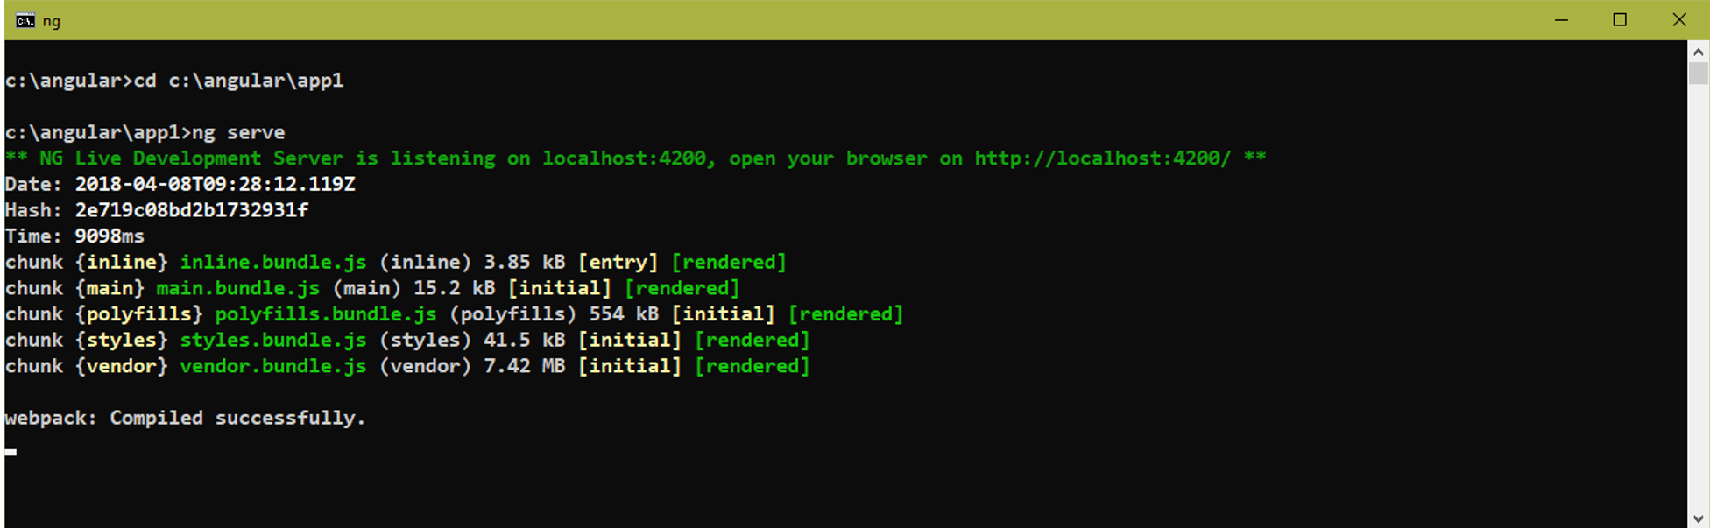
9) Compile the application
Open “Command Prompt” and run the following command:
cd c:\angular\app1\
ng serve

Slide 17
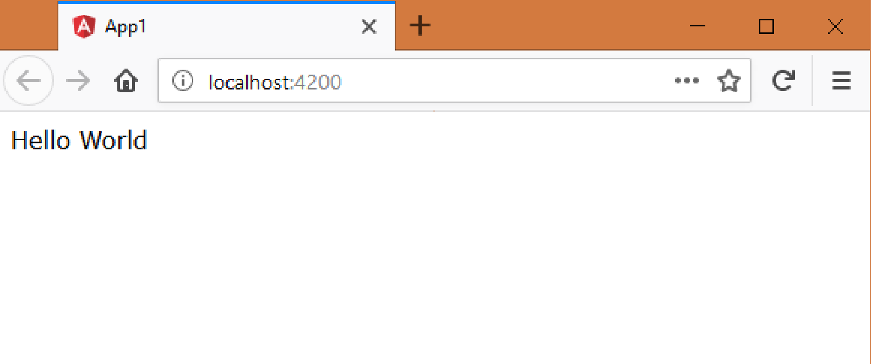
10) Run the application
Open the browser and enter the following URL:
http://localhost:4200

Slide 18
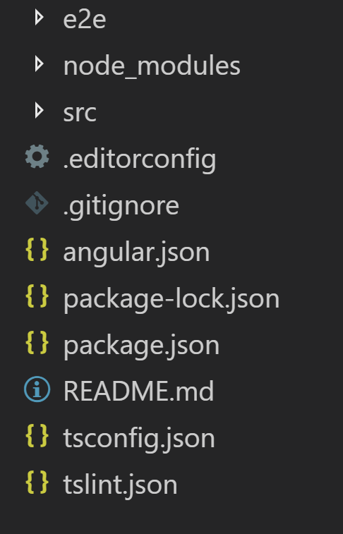
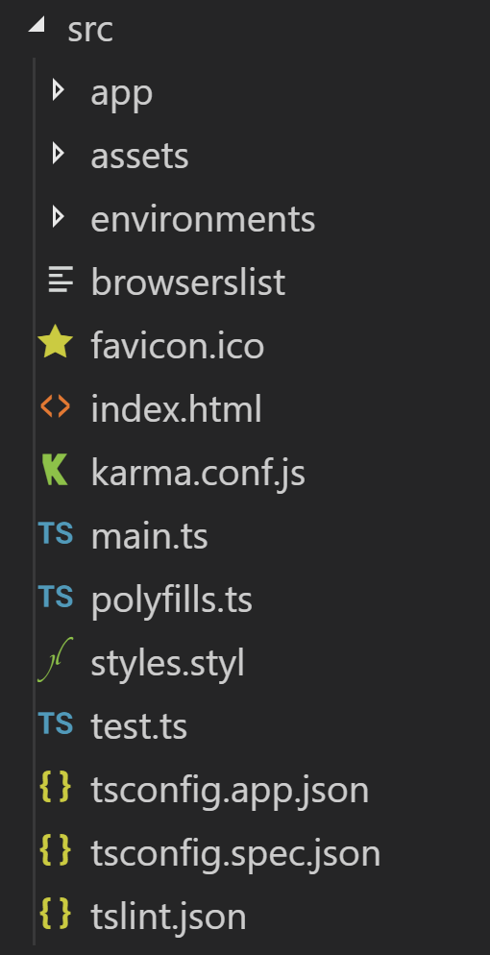
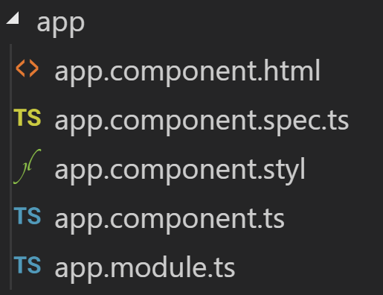
Folder Structure Of Angular

Slide 19
1) package.json
The “package.json” file represents the configuration settings / meta data of the application.
It specifies package name, version, dependencies etc.
It is a fixed filename.
It is must, without which the application is not accepted.
It is a JSON files, which means it contains key/value pairs. Every key and value must be within double quotes
(“ “) / single quotes (‘ ‘).
Properties of “package.json”
1.name
Represents name of the application.
It can be maximum of 214 characters.
Non-URL friendly characters such as /, :, @ etc., are not allowed.
Ex: “name”: “app1”
2.version
Represents version of the application. Ex: 1.0.0
It should have 3 numbers major version, minor version, subminor version.
Ex: “version”: “1.0.0”

Slide 20
3.license
Represents license of the application. Ex: MIT, ISC
MIT:
MIT stands for “Massachusetts Institute of Technology”.
MIT license allows to create private applications that can be used either privately within the organization and also can be shared with other known organizations.
Ex: “license”: “MIT”
ISC:
ISC stands for “Internet Systems Consortium”.
ISC license allows to create public applications that can be used anywhere.
Ex: “license”: “ISC”
4.scripts
Represents a set of commands that can run on the Command Prompt to run, test the applications using commands.
Ex:
“scripts”:
{
“start”: “ng serve”
}

Slide 21
5.Private
Represents whether the application should be used privately within the same organization or not.
If it is true, it can be used only within the same organization. Outside usage is not permitted.
Ex: “private”: true
6.Dependencies
Represents the list of packages that are to be installed to run the application. These packages will be installed in both developer machine and production server.
Ex: “dependencies”:
{
“@angular/core”: “^5.2.0”
}
7.devDependencies
Represents the list of packages that are to be installed to develop the application. These packages will be installed only in the developer machine; not in the production server.
Ex: “devDependencies”:
{
“@angular/cli”: “~1.7.4”
}

Slide 22
Packages of Angular
The angular 2+ framework is available as a collection of packages.
Each feature of the framework is represented as a package. For example, routing is available as a package called “@angular/router”.
We have to install (download) those packages in order to develop angular application.
The packages of angular 2+ are divided into two types:
I. Angular Packages:
These packages are part of angular 2+ framework.
II. Non-Angular Packages:
These packages are not part of angular 2+ framework; provided by third party companies, but needed / useful in angular applications.

Slide 23
Angular Packages
@angular/core
This package provides classes and interfaces that are related to decorators, component life cycle, dependency injection etc., that are needed in every angular 2+ application.
This is the mandatory package.
Examples of decorators provided by @angular/core package: @Component, @NgModule, @Input, @Injectable, @Inject etc.
Examples of component life cycle interfaces provided by @angular/core package: OnInit, DoCheck, AfterViewChecked, OnDestroy etc.
This package contains a module called “ApplicationModule”, which contains the set of pre-defined scripts that are needed to run the angular application.
@angular/common
This package provides common directives and pipes that are needed in most of the angular applications.
This is the mandatory package.
Ex of directives provided by @angular/common package: ngIf, ngFor, ngSwitch, ngClass etc.
Ex of pipes provided by @angular/common package: uppercase, lowercase, date, currency etc.
This package contains a module called “CommonModule”, which contains the above specified directives and pipes.

Slide 24
@angular/platform-browser
This package imports “ApplicationModule” from “@angular/core”, “CommonModule” from “@angular/common” and re-exports them as “BrowserModule”. Additionally, it provides some runtime services (such as “error handling, history handling” etc.), that are needed while running the application in the browser.
This is the mandatory package.
@angular/compiler
This package is used to compile the “template” into a “javascript code”. We never invoke the angular compiler directly; we will call it indirectly through either “@angular/platform-browser-dynamic” or “@angular/platform-browser”.
This is the mandatory package.
@angular/platform-browser-dynamic
An angular application can have any no. of modules. This package is used to bootstrap (start) executing a module, which execution should be started automatically at application startup. This is the mandatory package.

Slide 25
@angular/forms
This package is used for creating “two way data bindings” and “validations” in angular 2+ applications. This package works based on another package called “zone.js”.
This package has two modules: FormsModule and ReactiveFormsModule. This is the optional package.
@angular/router
This package is used to creating “routing” (page navigation) in angular 2+ applications.
This package has one module: RouterModule This is the optional package.
@angular/http
This package is used to send ajax requests to server and get ajax response from server. This package works based on another package called “rxjs”.
This package has one module: HttpClientModule This is the optional package.
@angular/animations
This package is used to create animations in angular 2+ applications. This package has one module: AnimationsModule
This is the optional package.

Slide 26
@angular/material
Used to use “angular material design” in angular applications.
This package has several modules: MatButtonMoudle, MatCheckboxModule, MatMenuModule etc.
This is the optional package.
@angular/cdk
Based on this package only, “angular material design” components are developed. So this package must be used while using “@angular/material” package.
This is the optional package.
@angular/cli
This package provides a set of commands to create new angular application and its code items such as components, pipes, directives, services etc.
This is the mandatory package.
This package must be installed globally, with “-g” option.

Slide 27
Non-Angular Packages
typescript
This package provides typescript compiler, which is used to compile “typescript files (.ts)” into “javascript files (.js)”.
This is the mandatory package.
This package must be installed globally, with “-g” option.
systemjs
This package is used to load both angular framework-related and application program-related “.js” files into the browser.
This is the mandatory package.
core-js
This package contains polyfills, which are needed to run angular 5 application in Internet Explorer 9+.
This is the mandatory package.
rxjs
This package “rxjs” (Reactive Extensions for JavaScript) provides necessary code for making ajax calls to server.
This is the mandatory package.

Slide 28
zone.js
This package identifies the events in the browser and informs the same to angular framework; so that it can perform “change detection”.
This is the mandatory package.
jasmine
This package is used to write test cases for unit testing of components. This is the mandatory package.
karma
This package is used to execute test cases. This is the mandatory package.
tslint
This package is used to check whether the typescript files are following set of rules or not. For example, you can check the maximum length of the line in the code. This is the mandatory package.

