Slide 1
Angular
Anil K

Slide 2
Life Cycle Hooks
Component has a life cycle, which is managed by Angular.
Angular creates it, renders it, creates and renders its children, checks it when its properties changed, and destroys it before removing it from the DOM.
Angular offers lifecycle hooks that provide visibility into these key life moments and the ability to act when they occur.
The life cycle events will execute automatically at different stages, while executing the component.

Slide 3
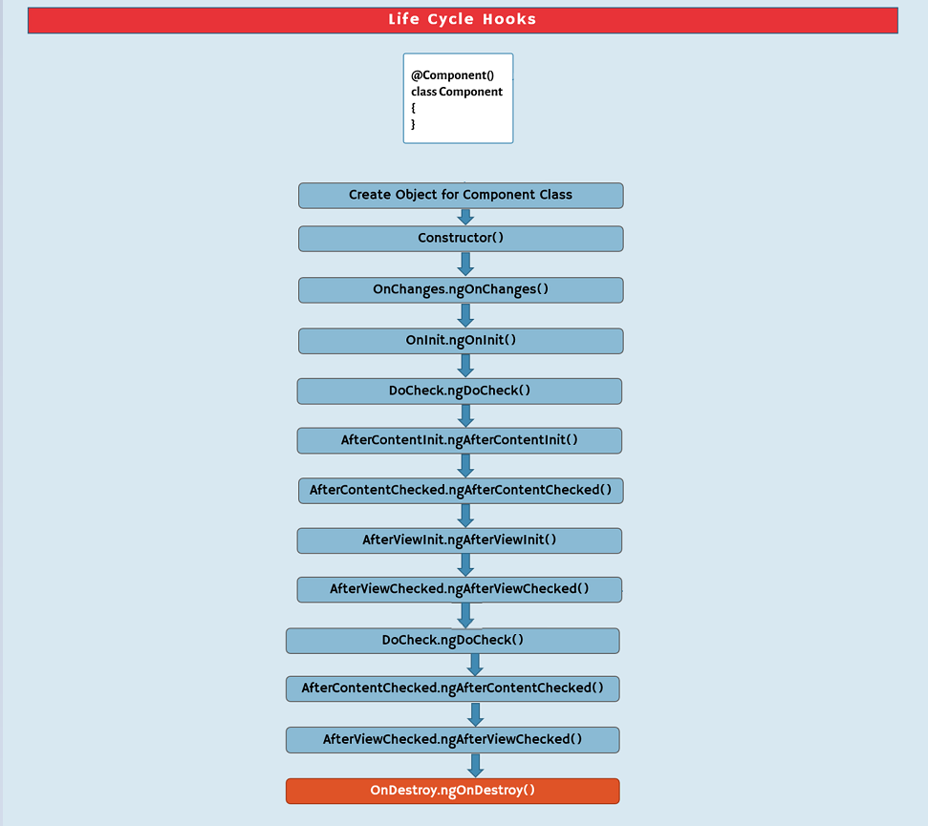

Slide 4
First run:
1. Component Object:
First, an object will be created for the component class. That means, the properties and methods of the component class, will be stored in the component object.
2. Constructor:
Next, the “constructor” of component class will be executed. Use the constructor, to set default values to any properties of the component, inject services into the component.
3. OnChanges.ngOnChanges:
Next, “ngOnChanges” method of “OnChanges” interface will be executed. This method executes when a new object is received with the new values of the input properties and just before a moment of assigning those new values into the respective input properties of the component. This method executes, only if the component has input properties.
4. OnInit.ngOnInit:
Next, “ngOnInit” method of “OnInit” interface will be executed. Use this method to call services to get data from database or any other data source.
5. DoCheck.ngDoCheck( ):
Next, “ngDoCheck” method of “DoCheck” interface will execute. This method executes when an event occurs, such as clicking, typing some key in the board etc. Use this method to identify whether the “change detection” process occurs or not.

Slide 5
6. AfterContentInit.ngAfterContentInit( ):
Next, “ngAfterContentInit” method of “AfterContentInit” interface will execute. This method executes after initializing the content of the component, which is passed while invoking the component. Use this method to set the properties of content children.
7. AfterContentChecked.ngAfterContentChecked( ):
Next, “ngAfterContentChecked” method of “AfterContentChecked” interface will execute. This method executes after “change detection” process of the content is completed. Use this method to check any properties of the content children, whether those are having specific values or not.
8. AfterViewInit.ngAfterViewInit( ):
Next, “ngAfterViewInit” method of “AfterViewInit” interface will execute. This method executes after initializing the view (template) of the component. Use this method to set the properties of view children.
9. AfterViewChecked.ngAfterViewChecked( ):
Next, “ngAfterViewChecked” method of “AfterViewChecked” interface will execute. This method executes after “change detection” process of view is completed. Use this method to check any properties of the view children, whether those are having specific values or not.

Slide 6
On an event occurs:
1. DoCheck.ngDoCheck( )
2. AfterContentChecked.ngAfterContentChecked( )
3. AfterViewChecked.ngAfterViewChecked( )
On deleting the component:
1. OnDestroy.ngOnDestroy( ): This method executes when the component is deleted from memory (when we close the web page in the browser).
Steps to handle event:
1. Import the interface:
import { interfacename } from “@angular/core”;
2. Implement the interface:
export class componentclassname implements interfacename { }
3. Create the method:
methodname() { //code here }

Slide 7
Life Cycle Hooks - Example
Creating Application
Open Command Prompt and enter the following commands:
cd c:\angular ng new my-app
cd c:\angular\my-app
ng g component company
c:\angular\my-app\src\app\app.component.html
<div>
<h4>App</h4>
<app-company [companyname]=" 'ABC Pvt Ltd' ">
<h5>one</h5>
<h5>two</h5>
<h5>three</h5>
</app-company>
</div>

Slide 8
c:\angular\my-app\src\app\app.module.ts
import { BrowserModule } from '@angular/platform-browser’;
import { NgModule } from '@angular/core’;
import { FormsModule } from "@angular/forms";
import { AppComponent } from './app.component’;
import { CompanyComponent } from './company/company.component';
@NgModule({
declarations: [ AppComponent, CompanyComponent ],
imports: [ BrowserModule, FormsModule ],
providers: [],
bootstrap: [AppComponent]
})
export class AppModule { }
c:\angular\my-app\src\app\app.component.ts
import { Component } from '@angular/core';
@Component({
selector: 'app-root’,
templateUrl: './app.component.html',
styleUrls: ['./app.component.css’]
})
export class AppComponent { }

Slide 9
c:\angular\my-app\src\app\company\company.component.ts
import { Component, Input, OnChanges, OnInit, DoCheck, AfterContentInit, AfterContentChecked, AfterViewInit, AfterViewChecked } from '@angular/core';
@Component({
selector: 'app-company',
templateUrl: './company.component.html',
styleUrls: ['./company.component.css’]
})
export class CompanyComponent implements OnChanges, OnInit, DoCheck, AfterContentInit, AfterContentChecked, AfterViewInit, AfterViewChecked {
@Input() companyname: string;
constructor() { console.log("constructor"); }
ngOnInit() { console.log("ngOnInit"); }
ngOnChanges() { console.log("ngOnChanges"); }
ngDoCheck() { console.log("ngDoCheck"); }
ngAfterContentInit() { console.log("ngAfterContentInit"); }
ngAfterContentChecked() { console.log("ngAfterContentChecked"); }
ngAfterViewInit() { console.log("ngAfterViewInit"); }
ngAfterViewChecked() { console.log("ngAfterViewChecked"); }
ngOnDestroy() { console.log("ngOnDestroy"); } }

Slide 10
c:\angular\my-app\src\app\company\company.component.html
<div>
<h5>Company</h5>
<input type="text" [(ngModel)]="companyname">
<ng-content></ng-content>
</div>
Executing the application:
Open Command Prompt and enter the following commands:
cd c:\angular\my-app ng serve
Open the browser and enter the following URL:
http://localhost:4200

Slide 11
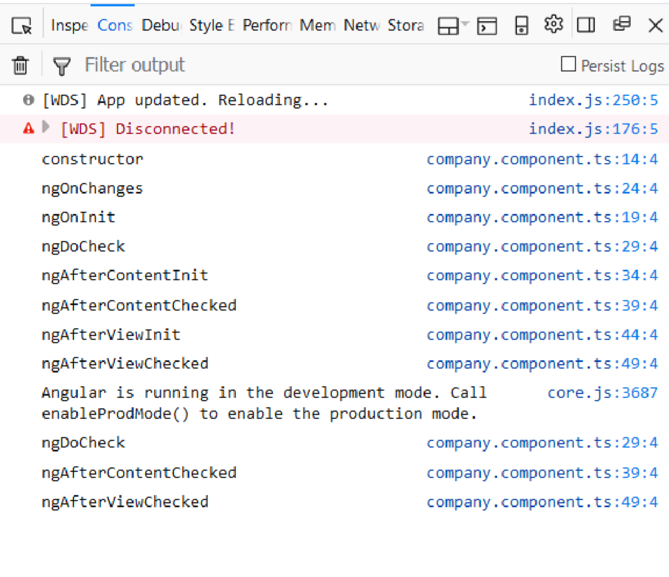
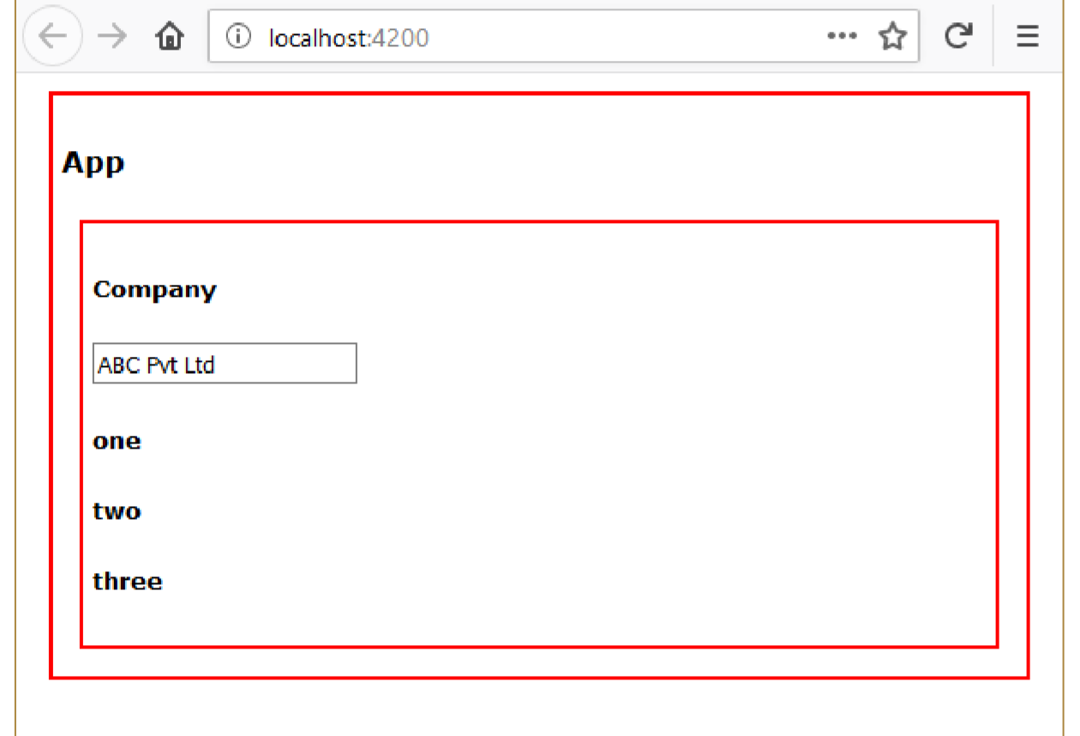

Slide 12
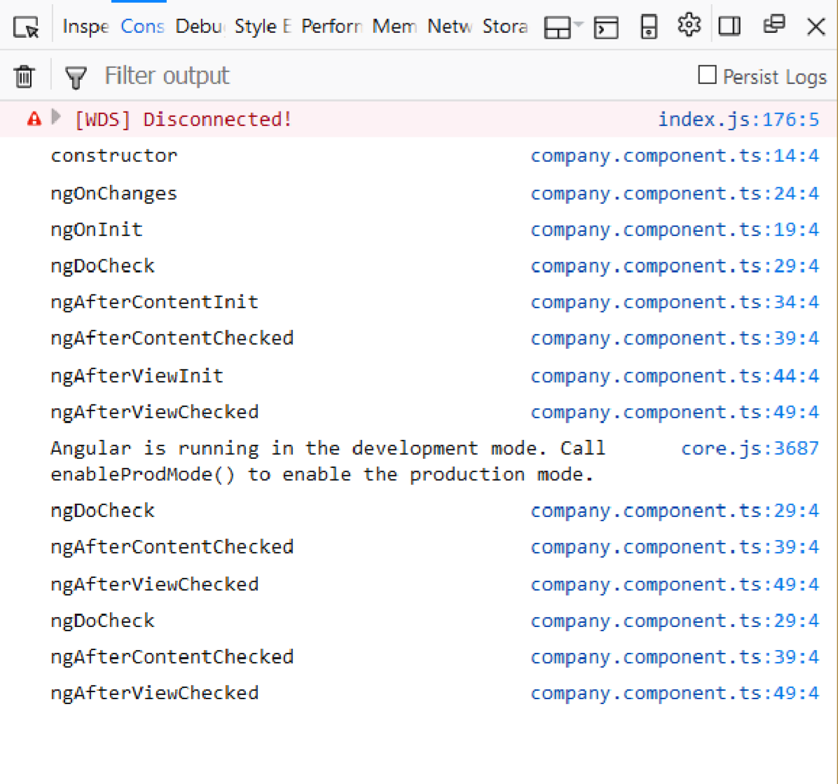
After typing some character in the textbox:

