Slide 1
Angular
Anil K

Slide 2
Custom Directives
Directive is a class, that can be invoked (called) through an attribute of a tag in the template.
Directive provides additional functionality for the html element.
For example, "ngIf" directive checks the condition, displays the element if the condition is TRUE; and removes the element if the condition is false.
The "ElementRef" class represents the element, in which the directive is invoked.
Directive can receive values from the element using @Input() decorator.
Directive can add events to the element by using @HostListener() decorator.
We can communicate between the component to the directive, using @ViewChild decorator in the component.

Slide 3
Steps for Working with Directives
Create directive:
@Directive( { selector: "[directiveattributename]" } )
class directiveclassname {
constructor(@Inject(ElementRef) referencename : ElementRef) { }
@Input() directiveproperty : datatype;
@HostListener("eventname") methodname( ) { }
}
Add directive to the module:
@NgModule( { …, declarations: [ …, directiveclassname] } )
class moduleclassname { }
Invoke directive from html tag:
<tag directiveattributename directiveproperty=" value "> </tag>

Slide 4
Custom Directives – Example
Creating Application
Open Command Prompt and enter the following commands:
cd c:\angular ng new app1
cd c:\angular\app1
ng g directive Sample
c:\angular\app1\src\app\app.module.ts
import { BrowserModule } from '@angular/platform-browser’;
import { NgModule } from '@angular/core’;
import { AppComponent } from './app.component’;
import { FormsModule } from "@angular/forms";
import { SampleDirective } from './sample.directive';
@NgModule({
declarations: [ AppComponent, SampleDirective ],
imports: [ BrowserModule, FormsModule ],
providers: [],
bootstrap: [AppComponent]
})
export class AppModule { }

Slide 5
c:\angular\app1\src\app\app.component.ts
import { Component } from '@angular/core';
@Component({
selector: ‘app-root’,
templateUrl: './app.component.html',
styleUrls: [‘./app.component.css’]
})
export class AppComponent { }
c:\angular\app1\src\app\app.component.html
<div>
<h4>Custom Directives</h4>
<img width="30px" appSample firstimage="assets/tick1.jpg" secondimage="assets/tick2.jpg">
</div>

Slide 6
c:\angular\app1\src\app\sample.directive.ts
import { Directive, Inject, ElementRef, Input, HostListener, OnChanges } from '@angular/core';
@Directive({ selector: '[appSample]' })
export class SampleDirective implements OnChanges {
constructor( @Inject(ElementRef) private element: ElementRef) {
this.element.nativeElement.style.border = "1px solid blue";
}
ngOnChanges() {
this.element.nativeElement.setAttribute("src", this.secondimage);
}
@Input() firstimage: string; @Input() secondimage: string;
@HostListener("mouseover") onMouseOver() {
this.element.nativeElement.setAttribute("src", this.firstimage);
}
@HostListener("mouseout") onMouseOut() {
this.element.nativeElement.setAttribute("src", this.secondimage);
}
}

Slide 7
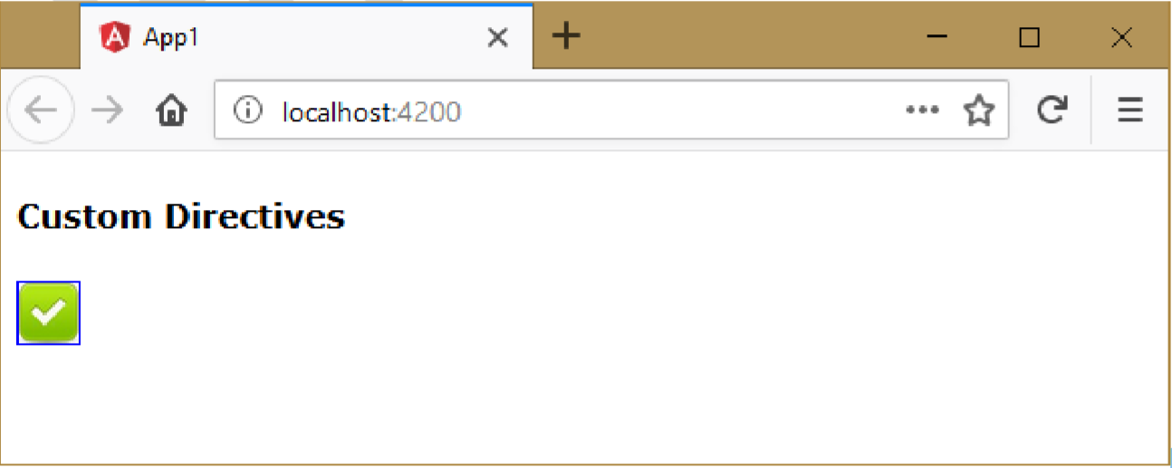
Executing the application:
Open Command Prompt and enter the following commands:
cd c:\angular\app1 ng serve
Open the browser and enter the following URL: http://localhost:4200

Slide 8

Pipes
Pipes transform the value into “user-expected format”.
Pipes are invoked in expressions (interpolation binding), through pipe ( | ) symbol.
Syntax: {{ property | pipe }}

Slide 9
List of Built-in Pipes in Angular 2+
1. uppercase
2. lowercase
3. slice
4. number
5. currency
6. percent
7. date
8. json
Pipes - Example
Creating Application
Open Command Prompt and enter the following commands:
cd c:\angular ng new app1
cd c:\angular\app1

Slide 10
c:\angular\app1\src\app\app.module.ts
import { BrowserModule } from '@angular/platform-browser';
import { NgModule } from '@angular/core';
import { AppComponent } from './app.component';
import { FormsModule } from "@angular/forms";
@NgModule({
declarations: [ AppComponent ],
imports: [ BrowserModule, FormsModule ],
providers: [],
bootstrap: [AppComponent]
})
export class AppModule { }

Slide 11
c:\angular\app1\src\app\app.component.ts
import { Component } from "@angular/core";
@Component({
selector: 'app-root',
templateUrl: './app.component.html',
styleUrls: ['./app.component.css’]
})
export class AppComponent {
city: string = “Edison";
salary: number = 752487500;
n: number = 0.72;
person: object = { firstname: "Adam", lastname: "Smith" };
dt: Date = new Date();
}

Slide 12
c:\angular\app1\src\app\app.component.html
<div>
<h4>Pipes</h4>
City: {{city}}<br>
Salary: {{salary}}<br>
n: {{n}}<br>
Current time: {{dt}}<br>
Person: {{person}}<br>
<hr>
Uppercase: {{city | uppercase}}<br>
Lowercase: {{city | lowercase}}<br>
Slice: {{city | slice: 2: 6}}<br>
number: {{salary | number}}<br>
number .2: {{salary | number: ".2"}}<br>
currency: {{salary | currency: "USD"}}<br>
INR: {{salary | currency: "INR"}}<br>
GBP: {{salary | currency: "GBP"}}<br>
EUR: {{salary | currency: "EUR"}}<br>
n (percent): {{n | percent}}<br>
json: {{person | json}}<br>

Slide 13
Short date: {{dt | date: "shortDate"}}<br>
Medium date: {{dt | date: "mediumDate"}}<br>
Long date: {{dt | date: "longDate"}}<br>
Full date: {{dt | date: "fullDate"}}<br>
Short time: {{dt | date: "shortTime"}}<br>
Long time: {{dt | date: "mediumTime"}}<br>
Short: {{dt | date: "short"}}<br>
Medium: {{dt | date: "medium"}}<br>
d/M/y: {{dt | date: "d/M/y"}}<br>
y-M-d: {{dt | date: "y-M-d"}}<br>
h:m:s: {{dt | date: "h:m:s"}}<br>
H:m: {{dt | date: "H:m"}}<br>
a: {{dt | date: "a"}}<br>
EEE: {{dt | date: "EEE"}}<br>
EEEE: {{dt | date: "EEEE"}}<br>
MMM: {{dt | date: "MMM"}}<br>
MMMM: {{dt | date: "MMMM"}}<br>
Z: {{dt | date: "Z"}}
</div>

Slide 14

Custom Pipes
Custom pipes are the user-defined pipes.
Custom pipe must be a class that has @Pipe( ) decorator and implements “PipeTransform” interface.
The “PipeTransform” interface has “transform” method, which must be implemented in your pipe class.
The “transform” method will be executed automatically, when the pipe is invoked in the expression (through pipe ( | ) symbol).
The “transform” method receive the input value as argument, do process, and return the result value, which will be displayed in the output.
Syntax to call pipe: {{ property | pipe }}

Slide 15
Syntax of Custom Pipe Class
import { Pipe, PipeTransform } from “@angular/core”;
@Pipe( { name: “namehere” } )
class custompipeclassname implements PipeTransform {
transform(value: datatype) : returndatatype {
//do something the value here
return (modified value);
}
}
Add Pipe to the module
@NgModule( { …, declarations: [ custompipeclassname ], … } )
class moduleclassname { }
Invoke the pipe in the template
{{componentproperty | pipename}}

Slide 16
Custom Pipes - Example
Creating Application
Open Command Prompt and enter the following commands:
cd c:\angular ng new app1
cd c:\angular\app1
ng g pipe Duration
c:\angular\app1\src\app\app.module.ts
import { BrowserModule } from '@angular/platform-browser’;
import { NgModule } from '@angular/core’;
import { AppComponent } from './app.component’;
import { FormsModule } from "@angular/forms";
import { DurationPipe } from './duration.pipe';
@NgModule({
declarations: [ AppComponent, DurationPipe ],
imports: [ BrowserModule, FormsModule ],
providers: [],
bootstrap: [AppComponent]
})
export class AppModule { }

Slide 17
c:\angular\app1\src\app\app.component.ts
import { Component } from "@angular/core";
@Component({
selector: 'app-root',
templateUrl: './app.component.html',
styleUrls: ['./app.component.css’]
})
export class AppComponent {
videoduration: number = 150;
}
c:\angular\app1\src\app\app.component.html
<div>
<h4>Custom Pipes</h4>
Video Duration: {{videoduration | duration: 'hoursandminutes' }}
</div>

Slide 18
c:\angular\app1\src\app\duration.pipe.ts
import { Pipe, PipeTransform } from '@angular/core';
@Pipe({
name: 'duration'
})
export class DurationPipe implements PipeTransform {
transform(value: number, format: string): string {
var s;
if (format == "hoursonly")
s = value / 60 + " hrs";
else if (format == "hoursandminutes")
s = Math.floor(value / 60) + " hrs " + ((value % 60 > 0) ? (" and " + value % 60) + " mins" : "");
else
s = value;
return s;
}
}

Slide 19
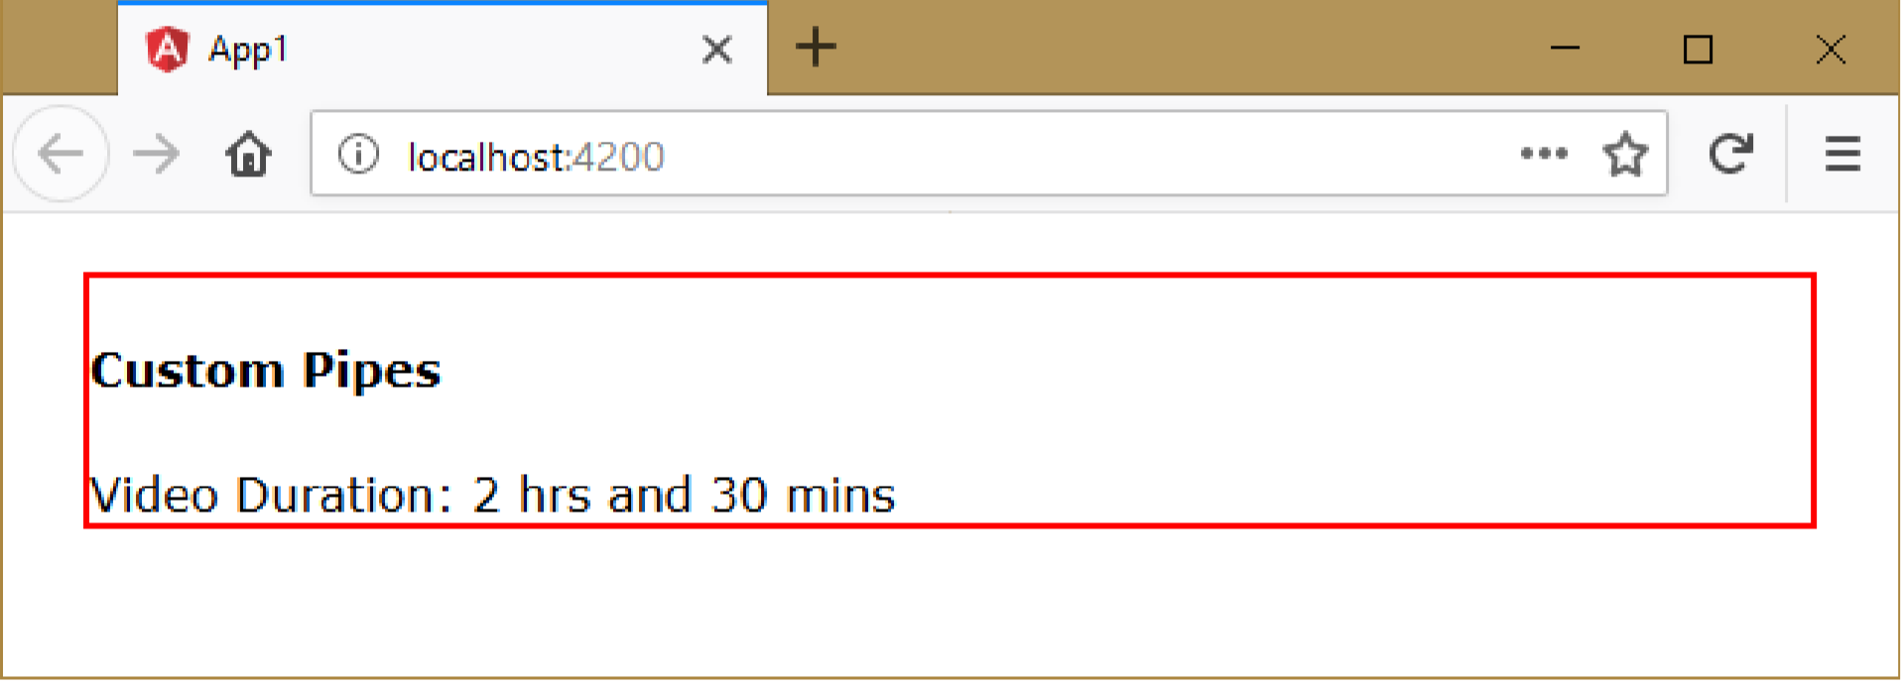
Executing the application:
Open Command Prompt and enter the following commands: cd c:\angular\app1 ng serve
Open the browser and enter the following URL: http://localhost:4200

