Slide 1
Angular
Anil K

Slide 2
AJAX
AJAX (Asynchronous JavaScript And Xml) is not a language, but it is a “concept”, which is used to “send a background request from browser to server” and also “get background response from server to browser”, without refreshing (reloading) the web page in the browser.
AJAX allows us to interact with the server and get some data from server, without refreshing the full web page.
Ex: Facebook like button, comments, IRCTC search trains.

Slide 3
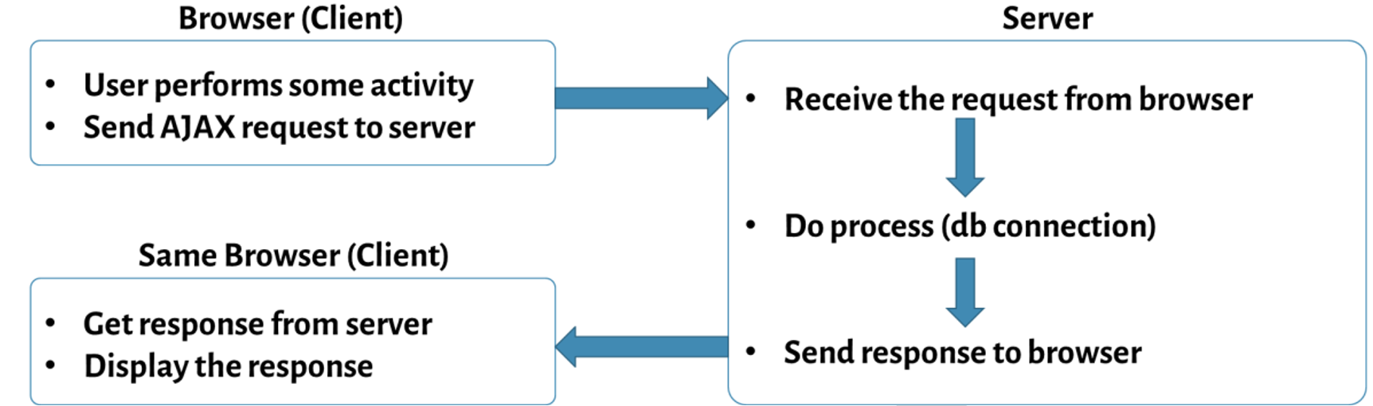
Execution Flow of AJAX

Slide 4
Advantages of AJAX
Executes faster
Less burden on browser (client) and server
Better user experience.
Types of AJAX Request
Get : Used to retrieve / search data from server
Post : Used to insert data to server.
Put : Used to update data on server.
Delete : Used to delete data from server
“@angular/common/http” package
The “@angular/common/http” package provides necessary services to send ajax request to server and get ajax response from server.

Slide 5
Steps for working with “@angular/common/http” package:
import “@angular/common” package in “package.json”: “dependencies”: { “@angular/common:”: “latest” }
Import “HttpClientModule” module:
import { HttpClientModule, HttpClient } from “@angular/common/http”;
Import “HttpClientModule” in “AppModule”:
@NgModule( { …, imports: [ …, HttpClientModule ] } )
class AppModule { }
Import “HttpClient” service:
import { HttpClient } from “@angular/common/http”;
Get “HttpClient” service in “AppComponent”:
constructor(@Inject(HttpClient) private http : HttpClient) { }
Send “get” request to server:
this.http.get<modelclassname>(“url”, { responseType: “json | text” }).subscribe(this.successcallback, this.errorcallback);
Send “post” request to server:
this.http.post(“url”, { data }, { responseType: “json | text” }).subscribe(this.successcallback, this.errorcallback);

Slide 6
Send “put” request to server:
this.http.put(“url”, { data }, { responseType: “json | text” }).subscribe(this.successcallback, this.errorcallback);
Send “delete” request to server:
this.http.delete(“url”, { responseType: “json | text” }).subscribe(this.successcallback, this.errorcallback);
Define “success” callback function:
successcallback = (response) => { //do something with response }
Define “error” callback function:
errorcallback = (error) => { //do something with error }

Slide 7
Creating Application
c:\angular\app1\src\app\app.module.ts
import { BrowserModule } from '@angular/platform-browser’;
import { NgModule } from '@angular/core’;
import { FormsModule } from "@angular/forms";
import { HttpClientModule } from "@angular/common/http";
import { AppComponent } from './app.component';
@NgModule({
declarations: [ AppComponent ],
imports: [ BrowserModule, FormsModule, HttpClientModule ],
providers: [],
bootstrap: [AppComponent]
})
export class AppModule { }

Slide 8
c:\angular\app1\src\app\app.component.ts
import { Component, Inject } from '@angular/core’;
import { HttpClient } from "@angular/common/http";
@Component({
selector: 'app-root',
templateUrl: './app.component.html',
styleUrls: ['./app.component.css’]
})
export class AppComponent {
message: string;
constructor(@Inject(HttpClient) private http: HttpClient) { }
onGetDataClick() {
this.http.get("/serviceUrl", {
responseType: "text"
}).subscribe(this.onAjaxSuccess, this.onAjaxError);
}
onAjaxSuccess = (response) => { this.message = response; }
onAjaxError = (error) => { alert(error); }
}

Slide 9
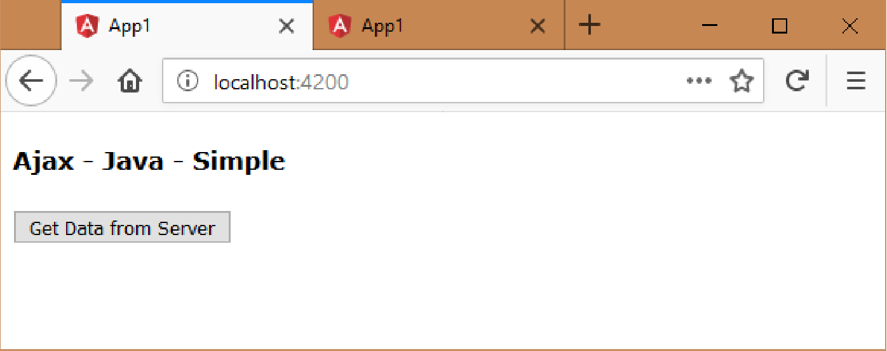
c:\angular\app1\src\app\app.component.html
<div>
<h4>Ajax - Java - Simple</h4>
<input type="button" value="Get Data from Server" (click)="onGetDataClick()">
<div>
{{message}}
</div>
</div>

Slide 10
Http Interceptor
Http Interceptor is a angular service, that adds one or more requests headers automatically for each ajax request sent from the application.
These are used to implement authentication.
Authentication is a process of checking whether the user is a valid user or not.
First, the server generates a random number, stores it at server and also sends it to the client as response. The client (browser) stores it in the localStorage. Next, the client sends the same random number to the server via HTTP header, by using Http Interceptor. Then the server verifies whether the received random number is matching with the stored random number. If matching, it is a valid user; otherwise invalid user. Thus authentication is performed.
Http Interceptors added as a provider in the module level; automatically executes for all ajax requests sent via HttpClient within the same module and its child modules.
Http Interceptor is a service class that implements HttpInterceptor interface. This interface enforces that the service class must contain a method called “intercept” with two parameters “request” or HttpRequest type and “next” of HttpHandler type and returns HttpEvent type.
The “intercept” method automatically executes before an AJAX request (Http Request) is sent to browser.
The “request” argument represents the current request. The “next” argument represents the next interceptor.
The “HttpEvent” represents each single process that happens before sending http request to server.
The “request.clone” method is used to copy the request into a new request object; so that we can add headers to the request.
The next.handle() method calls the next interceptor, if any.

Slide 11
Steps for Working with Http Interceptor
Create Service:
import { Injectable } from “@angular/core”;
import { HttpInterceptor, HttpRequest, HttpHandler, HttpEvent } from “@angular/common/http”;
import { Observable } from “rxjs/Observable”;
@Injectable( )
export class Serviceclassname implements HttpInterceptor {
intercept(request, HttpRequest<any>, next: HttpHandler):Observable<HttpEvent<any>> {
request = request.clone( { setHeaders: { “mykey”: “myvaluue” } } );
return next.handle(request);
}
}
Add Http Interceptor Service as provider in the component:
import { HTTP_INTERCEPTORS } from “@angular/common/http”;
@Component( { …, providers: [ { provide: HTTP_INTERCEPTORS, useClass: SampleInterceptorService, multi: true } ] } )
export class Moduleclassname { }

Slide 12
AJAX – Http Interceptors - Get - Example
Creating Application
Open Command Prompt and enter the following commands:
cd c:\angular
ng new app1
cd c:\angular\app1
ng g class Employee
ng g service Employees
ng g service SampleInterceptor

Slide 13
c: \angular\ app1\ src\ app\ employee.ts
export class Employee {
empid: number;
empname: string;
salary: number;
constructor(a, b, c) {
this.empid = a;
this.empname = b;
this.salary = c;
}
}

Slide 14
c: \angular\ app1\ src\ app\ employees.service.ts
import {Injectable,Inject} from '@angular/core';
import {Employee} from "./employee";
import {HttpClient} from "@angular/common/http";
@Injectable() export class EmployeesService {
constructor(@Inject(HttpClient) private http: HttpClient) {}
resolve: any;
reject: any;
getEmployees() {
this.http.get < Employee > ("/SampleServlet", {
responseType: "json"
}).subscribe(this.onAjaxSuccess, this.onAjaxError);
return new Promise(this.promiseCallback);
}
promiseCallback = (resolve, reject) => {
this.resolve = resolve;
this.reject = reject;
}
onAjaxSuccess = (response) => {
this.resolve(response);
}
onAjaxError = () => {
this.reject("Failed");
}
}

Slide 15
c: \angular\ app1\ src\ app\ sample - interceptor.service.ts
import {Injectable} from '@angular/core';
import {HttpInterceptor,HttpRequest,HttpHandler,HttpEvent} from "@angular/common/http";
import {Observable} from "rxjs/Observable";
@Injectable() export class SampleInterceptorService implements HttpInterceptor {
intercept(request: HttpRequest < any > , next: HttpHandler): Observable < HttpEvent < any >> {
request = request.clone({
setHeaders: {
"mykey": "myvalue"
}
});
return next.handle(request);
}
}

Slide 16
c: \angular\ app1\ src\ app\ app.module.ts
import {BrowserModule} from '@angular/platform-browser';
import { NgModule} from '@angular/core';
import { FormsModule} from "@angular/forms";
import { HttpClientModule} from "@angular/common/http";
import {AppComponent} from './app.component';
import {EmployeesService} from './employees.service';
import { HTTP_INTERCEPTORS} from "@angular/common/http";
import {SampleInterceptorService} from "./sample-interceptor.service";
@NgModule({
declarations: [AppComponent],
imports: [BrowserModule, FormsModule, HttpClientModule],
providers: [EmployeesService, {
provide: HTTP_INTERCEPTORS,
useClass: SampleInterceptorService,
multi: true
}],
bootstrap: [AppComponent]
}) export class AppModule {}

Slide 17
c: \angular\ app1\ src\ app\ app.component.ts
import {Component,Inject} from '@angular/core';
import {EmployeesService} from "./employees.service";
import {Employee} from "./employee";
@Component({
selector: 'app-root',
templateUrl: './app.component.html',
styleUrls: ['./app.component.css']
}) export class AppComponent {
employees: Employee[] = [];
constructor(@Inject(EmployeesService) private employeesService: EmployeesService) {}
onGetDataClick() {
this.employeesService.getEmployees().then(this.onPromiseSuccess, this.onPromiseError);
}
onPromiseSuccess = (response) => {
this.employees = response;
}
onPromiseError = () => {
alert("error");
}
}

Slide 18
c:\angular\app1\src\app\app.component.html
<div>
<h4>Ajax - Http Interceptors - Promise - Java - Get</h4>
<input type="button" value="Get Data" (click)="onGetDataClick()">
<table border="1">
<tr>
<th>Emp ID</th>
<th>Emp Name</th>
<th>Salary</th>
</tr>
<tr *ngFor="let employee of employees">
<td>{{employee.empid}}</td>
<td>{{employee.empname}}</td>
<td>{{employee.salary}}</td>
</tr>
</table>
</div>

Slide 19
AJAX – Java – Http Interceptors - Get - Example
Setting-up Environment for Java
Install Java from “https://java.com/en/download”.
Add “C:\Program Files\Java\jdk1.8.0_172\bin” as “Path” of system variables.
Add “JAVA_HOME” with “C:\Program Files\Java\jdk1.8.0_172” in system variables.
Download tomcat from “https://tomcat.apache.org/download-90.cgi”. Click on “zip” in “Core”. You will get a file called “apache-tomcat-9.0.7.zip”. Right click on “apache-tomcat-9.0.7.zip” and click on “Extract All”. Copy all contents of the extracted folder into “c:\tomcat” folder.
Open Command Prompt and enter the following commands: cd c:\tomcat\bin startup.bat

Slide 20
c: \tomcat\ webapps\ ROOT\ WEB - INF\ classes\ SampleServlet.java
import java.io.*;
import javax.servlet.*;
import javax.servlet.http.*;
public class SampleServlet extends HttpServlet {
public void doGet(HttpServletRequest request, HttpServletResponse response) throws ServletException, IOException {
PrintWriter out = response.getWriter();
if (request.getHeader("mykey").equals("myvalue")) {
out.println("[ { \"empid\": 1, \"empname\": \"Scott\", \"salary\": 4000 }, { \"empid\": 2, \"empname\": \"Allen\", \"salary\": 7500 }, { \"empid\": 3, \"empname\": \"Jones\", \"salary\": 9200 }, { \"empid\": 4, \"empname\": \"James\", \"salary\": 8400 }, { \"empid\": 5, \"empname\": \"Smith\", \"salary\": 5600 } ]");
} else {
out.println("[ { \"empid\": 0, \"empname\": \"no data\", \"salary\": 0 } ]");
}
}
}

Slide 21
c:\tomcat\webapps\ROOT\WEB-INF\web.xml
<?xml version="1.0" encoding="UTF-8"?> <web-app xmlns="http://xmlns.jcp.org/xml/ns/javaee" xmlns:xsi="http://www.w3.org/2001/XMLSchema-instance" xsi:schemaLocation="http://xmlns.jcp.org/xml/ns/javaee http://xmlns.jcp.org/xml/ns/javaee/web-app_4_0.xsd" version="4.0" metadata-complete="true">
<display-name>Welcome to Tomcat</display-name>
<description> Welcome to Tomcat </description>
<servlet>
<servlet-name>SampleServlet</servlet-name>
<servlet-class>SampleServlet</servlet-class>
</servlet>
<servlet-mapping>
<servlet-name>SampleServlet</servlet-name>
<url-pattern>/SampleServlet</url-pattern>
</servlet-mapping>
</web-app>

Slide 22
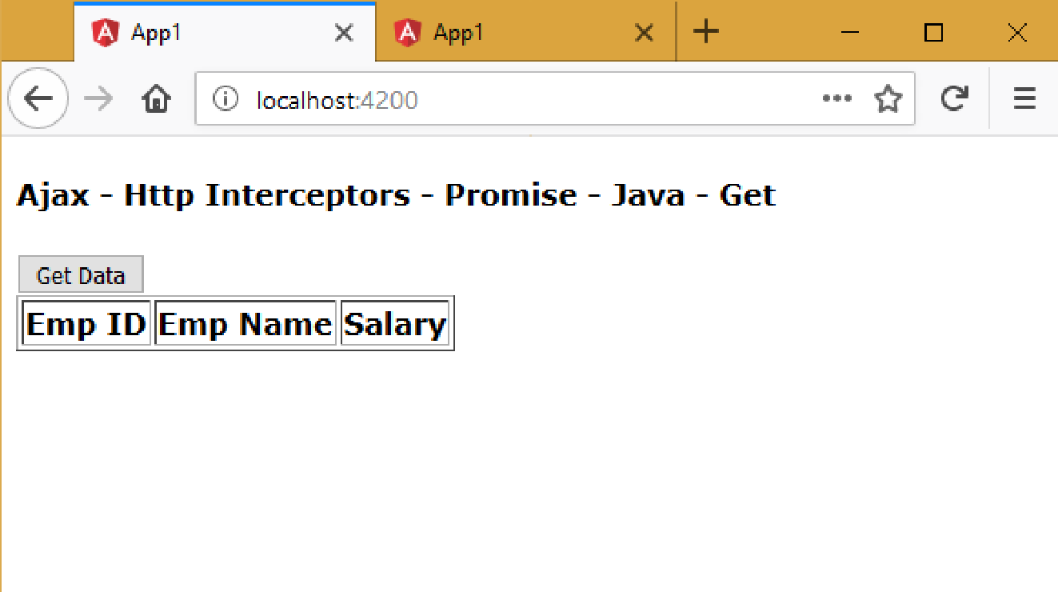
Executing the application:
Open Command Prompt and enter the following commands:
cd c:\tomcat\webapps\ROOT\WEB-INF\classes
javac -cp c:\tomcat\lib\servlet-api.jar SampleServlet.java
cd c:\angular\app1
ng build --prod
ng serve
Open the browser and enter the following URL: http://localhost:4200

Slide 23
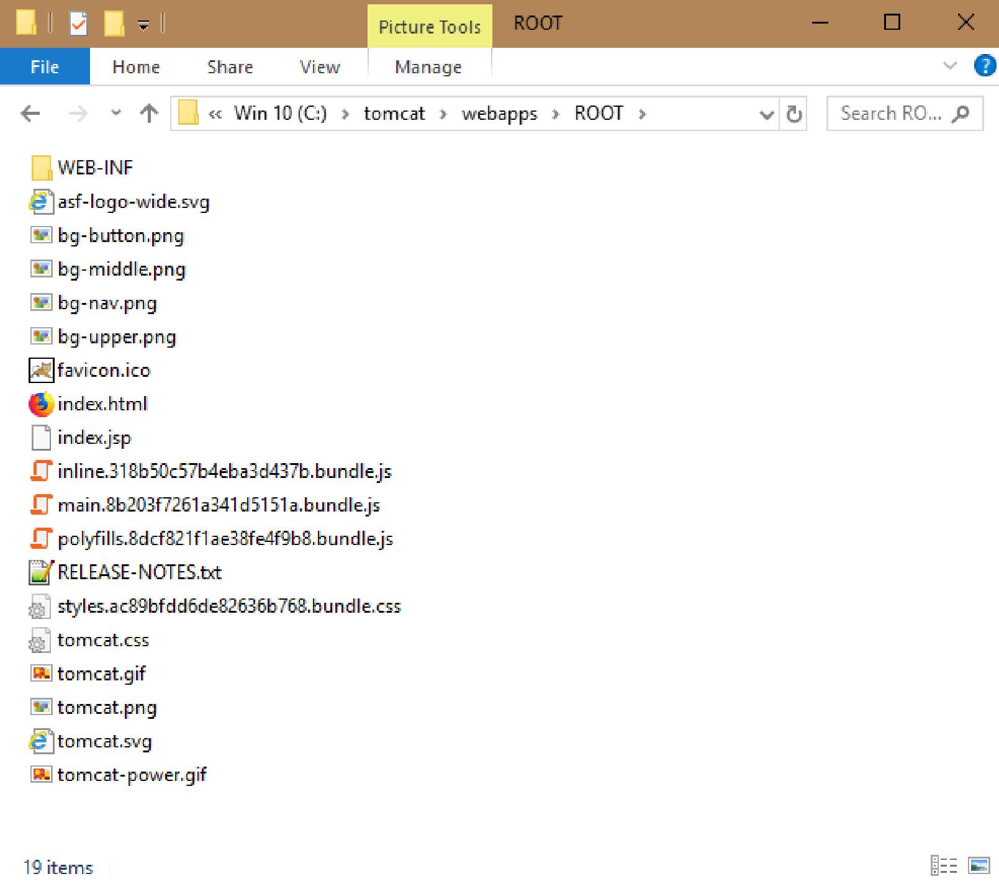
Copy all files from “c:\angular\app1\dist” folder to “c:\tomcat\webapps\ROOT”.

Slide 24
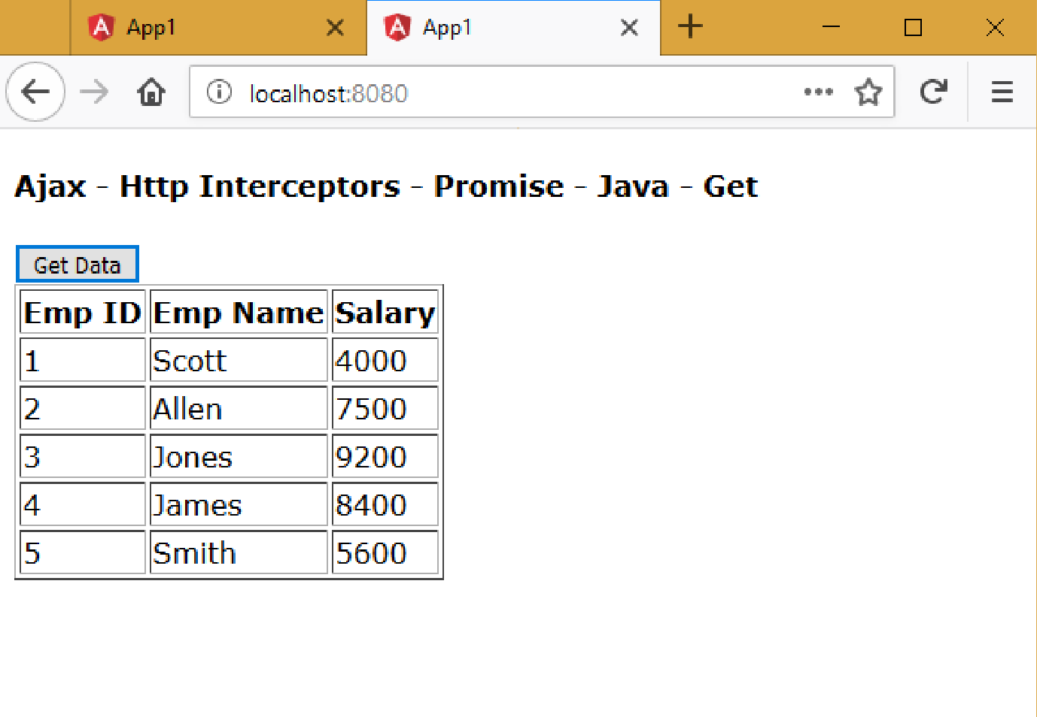
Open the browser and enter the following URL: http://localhost:8080/index.html

