Slide 1
TypeScript
Anil K

Slide 2
What is TypeScript
TypeScript is a programming language, which is developed based on JavaScript.
TypeScript is a superset of JavaScript, which adds data types, classes, interfaces and other features.
TypeScript = JavaScript + Data Types + Classes + Interfaces + Misc. Concepts (Arrow Functions + Multiline Strings + String Interpolation + Destructuring + Modules etc.)
TypeScript is built on the top of JavaScript. That means all the code of JavaScrpt works asit-is in TypeScript, but in TypeScript, we can additionally use data types, classes, interfaces etc., concepts.
TypeScript is developed by Microsoft Corporation in 2012.

Slide 3
Features of TypeScript
TypeScript is a general purpose programming language.
TypeScript is built in the top of JavaScript. It supports all the concepts of JavaScript.
TypeScript doesn't stick to client side programming / server side programming. TypeScript can be used in client side program development, using Angular framework. It can be used in server side program development, using NodeJS platform.
TypeScript requires to be used in modern code editors / IDE's, such as Visual Studio Code, Atom, Sublime Text, Web Storm, Eclipse etc.
Browser doesn’t support TypeScript directly. TypeScript code can’t be executed directly by the browser. So TypeScript code should be converted into JavaScript code, and we have to import JavaScript language file into the web page. Browser executes JavaScript. We use "TypeScript Compiler" (tsc) to compile / transpile "filename.ts (TypeScript file)" to "filename.js (JavaScript file)". We won't load TypeScript file into the browser; We will load & execute JavaScript file into the browser.

Slide 4
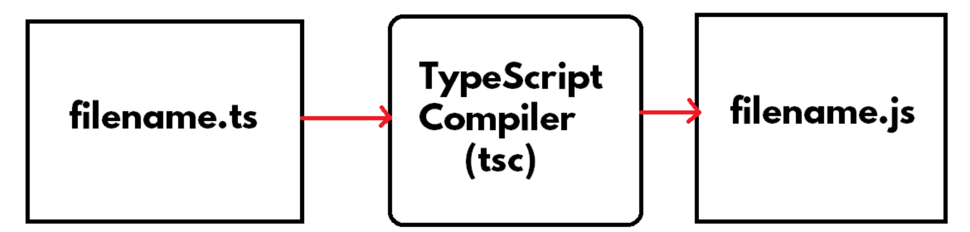

Slide 5
Advantages of TypeScript
Static Typing and Type Safety
Static Typing: Whenever we can fix a data type for the variable while declaration of variable, and we can’t change its data type throughout the program, then it is said to be “static typing”. Whenever we can’t fix a data type for the variable while declaration, and the data type will be automatically taken by the runtime engine automatically at the time of program execution, and we can assign any type of value into the variable, then it is said to be “dynamic typing”. C, C++, Java, C#.NET are examples of “static typing”. “JavaScript”, “Python” are examples of “dynamic typing”. TypeScript supports "Optional Static Typing". That means you can use both “dynamic typing” and “static typing” in TypeScript.
Type Safety: If we specify data type while declaring the variable and when we assign wrong type of value into the variable, the compiler shows errors.

Slide 6
Advantages of TypeScript
2.Identification of Errors
Typing mistakes and syntax errors are displayed as errors in the compilation time itself (rather than at runtime).
3.Classes and Interfaces
TypeScript supports classes and interfaces; so it providers rich programming experience much like other languages such as Java, C#.NET etc.
4.Intellisense
Automatic suggestions will be displayed while writing the code. For example, when we type “c” in the IDE, the list of matching names that start with “c” will be automatically displayed. This is available only in supporting code editors / IDE’s such as Visual Studio Code, WebStrom, Sublime Text etc.

Slide 7
Steps to prepare first example in TypeScript
Installing NodeJS
Installing TypeScript
Create Application Folder
Installing the Code Editor: Visual Studio Code
Create TypeScript Program
Compile the TypeScript Program
Execute the TypeScript Program

Slide 8
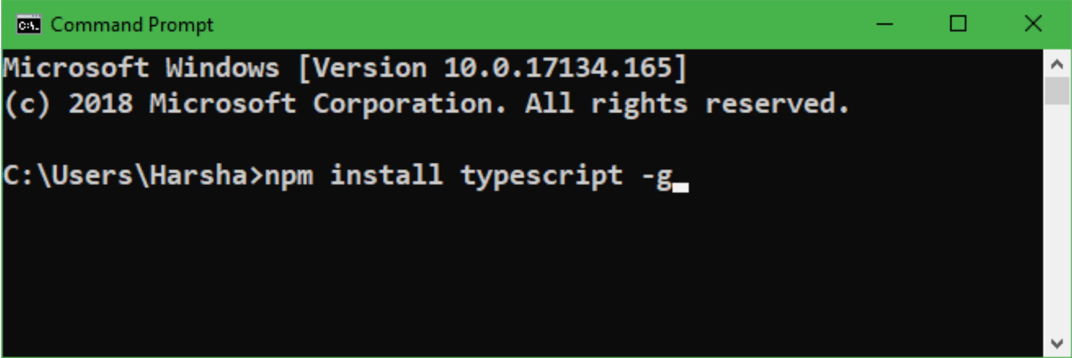
Installing TypeScript
Open “Command Prompt”.
Type npm install typescript -g in the Command prompt and press Enter.

Slide 9
Steps to prepare first example in TypeScript
Installing NodeJS
Installing TypeScript
Create Application Folder
Installing the Code Editor: Visual Studio Code
Create TypeScript Program
Compile the TypeScript Program
Execute the TypeScript Program

Slide 10
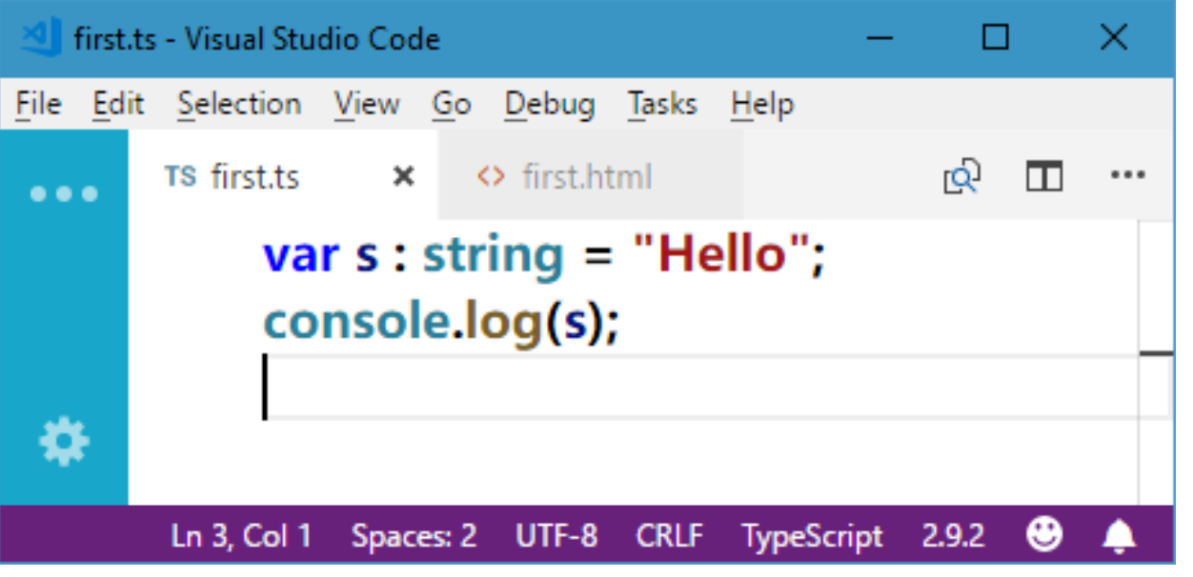
Go to “File” – “New File”.
Type the program as follows:
Go to “File” menu – “Save” (or) Press Ctrl+S.

Slide 11
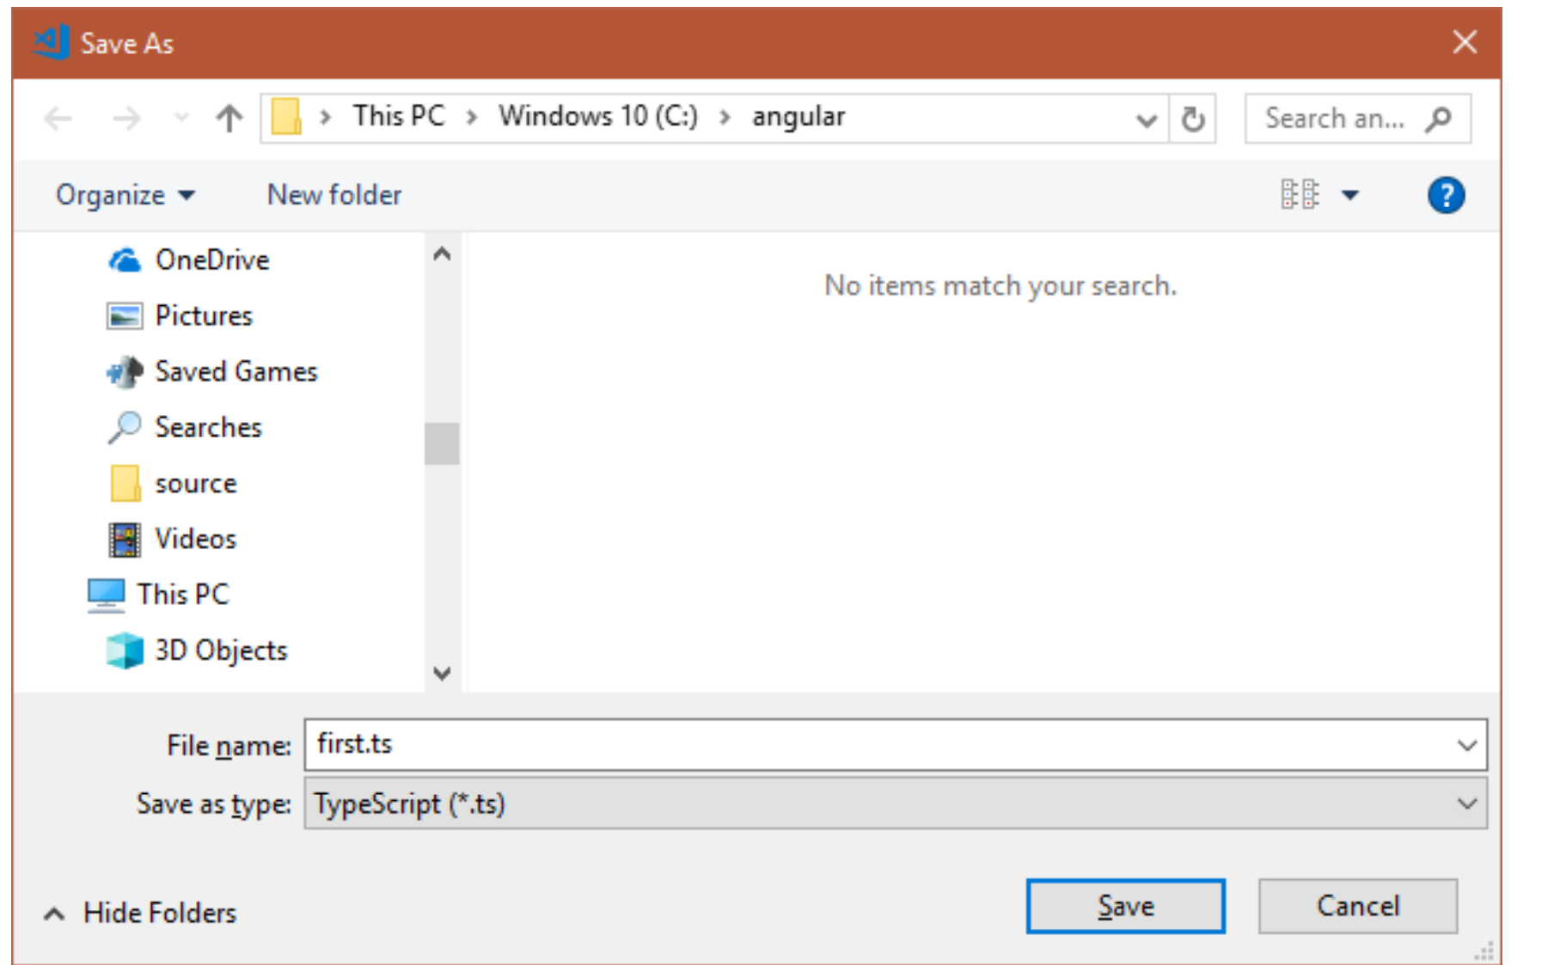
Select “c:\angular” folder and enter the filename as “first.ts”.
Click on “Save”.
Now the typescript file (c:\angular\first.ts) is ready.

Slide 12
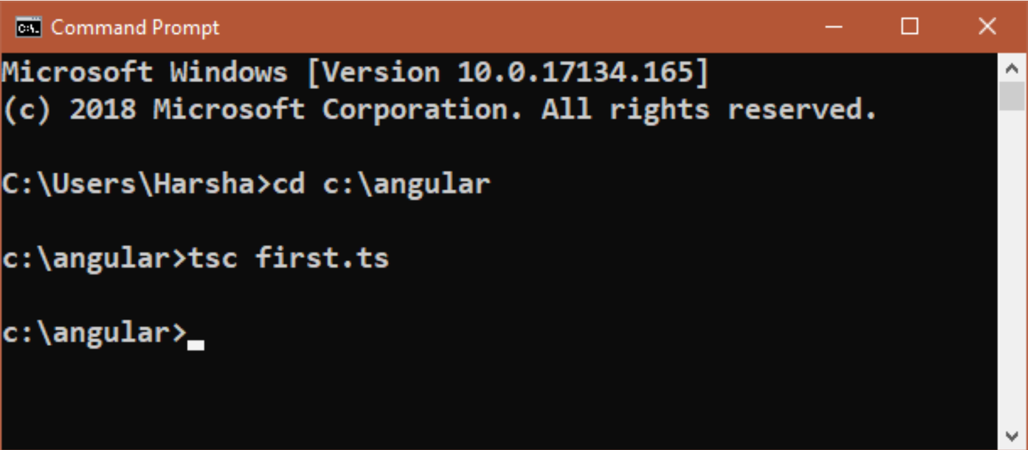
Compile the TypeScript Program
Open Command Prompt and enter the following commands:
cd c:\angular
tsc first.ts
Now the “typescript program” has been compiled into “javascript program”; So “first.js” file has been generated in “c:\angular” folder.

Slide 13
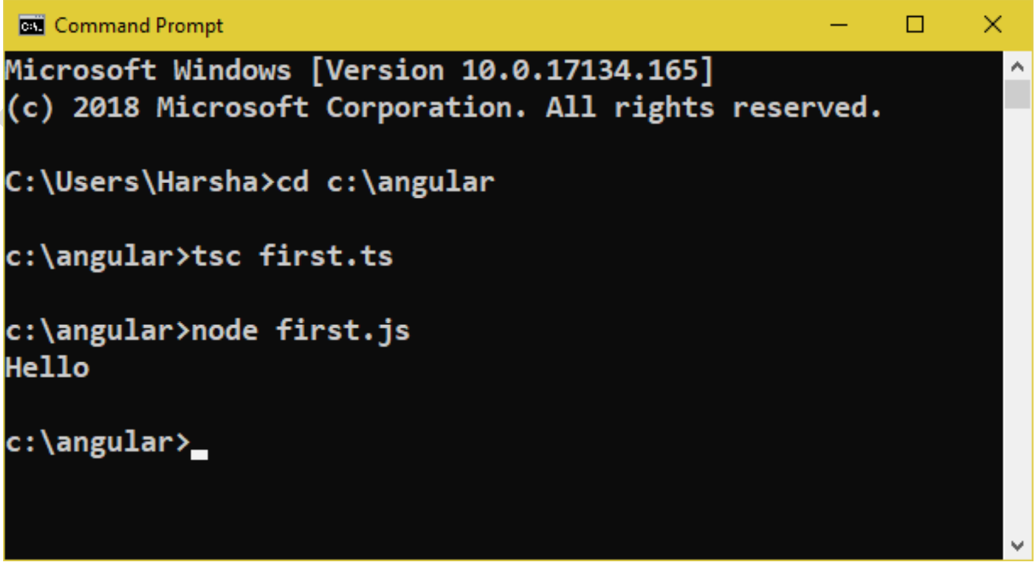
Execute the TypeScript Program
Enter the following commands in the same Command Prompt window:
node first.js
Output: Hello
Note: The "node" command (Provided by Node.js) executes the javascript file and executes its output in the Command Prompt itself.

