Slide 1
HTMl
By Anil K

Slide 2
HTML Forms
A HTML Form is simply an area which contains various form ﬁelds.
HTML Forms are used to collect the user information and send to a program which is running at server side for further processing.
HTML Form contains various form ﬁelds such as Text Box, Password Box, Radio button, SelectBox, text area and other input ﬁelds.
When a user enters / fills in the form data and click on the submit button, then the whole form data will be send to respective server for further processing.
In HTML, the Forms are represented with tag called <form>. This acts as the root tag for all the html form elements.
HTML Forms are divided into 3 categories such as,
1) HTML Form Elements
2) HTML Form Input Type
3) HTML Form Attributes

Slide 3
HTML Form Elements
HTML form elements are also called as HTML Form Tags. These HTML form elements are used to display various form ﬁelds on the webpage such as text box, password box, radio button, check box and text area.
Let's discuss some of the HTML form elements as below,
<labeI> Tag
The HTML <Iabel> tag is used to define a label information for any form ﬁeld.
<label for="username">UserName<label>
<input> Tag
The <input> tag is used to display almost all the input fields on the webpage such as text box ,password box , date selection and range selection.
For Text box,
<input type=“text” id="username">
For Password Box,
<input type=“password” id="password“>

Slide 4
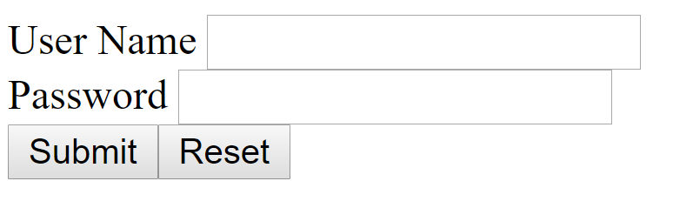
Let’s design a simple login form using the above tags,
<form>
<label for="username">User Name</label>
<input type="text" id="username">
<br>
<label for="password" >Password</label>
<input type="password" id="password">
<br>
<input type="submit"><input type="reset">
</form>

Slide 5
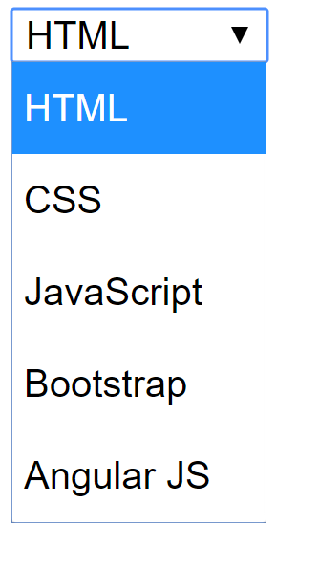
<select>, <option> Tags
The <select> Tag is used to display a select box on the webpage.
This is also called as a dropdown list. And each option inside of a select box is represented by <option> tag.
Let’s understand the select box with an example,
<select>
<option>HTML</option>
<option>CSS</option>
<option>JavaScript</option>
<option>Bootstrap</option>
<option>Angular JS</option>
</select>

Slide 6
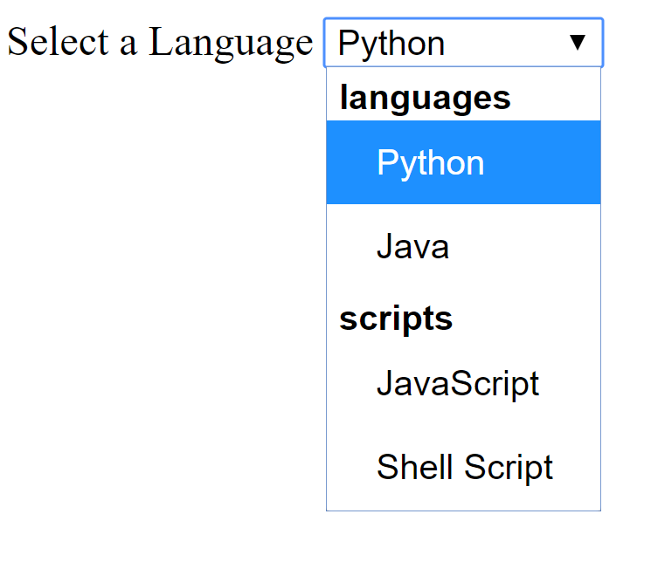
We can even group the options inside the select box using <optgroup> tag.
Let’s discuss the example of <optgroup> tag
<form>
<label>Select a Language</label>
<select>
<optgroup label="languages">
<option>Python</option>
<option>Java</option>
</optgroup>
<optgroup label="scripts">
<option>JavaScript</option>
<option>Shell Script</option>
</optgroup>
</select>
</form>

Slide 7
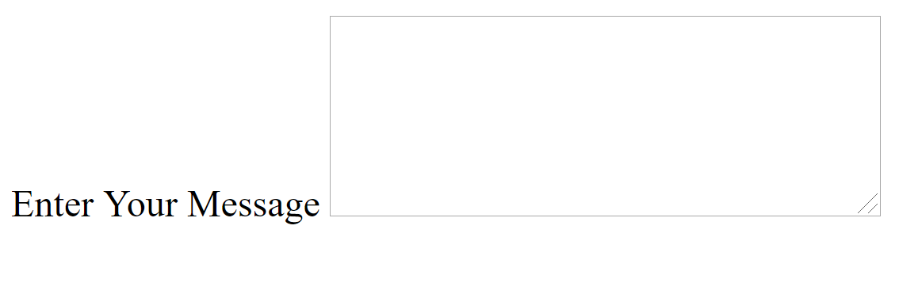
<textarea>tag
The HTML <textarea> tag is used to display a message box or comments box on the webpage.
This <textarea> tag contains two mandatory attributes such as rows, cols.
‘rows’ indicates the height of textarea and 'cols’ indicates the width of textarea box.
Let's discuss the example of Comments box using <textarea> tag as follows,
<form>
<label for="comments">Enter Your Message</label>
<textarea rows="5" cols="30" id="comments"></textarea>
</form>

Slide 8
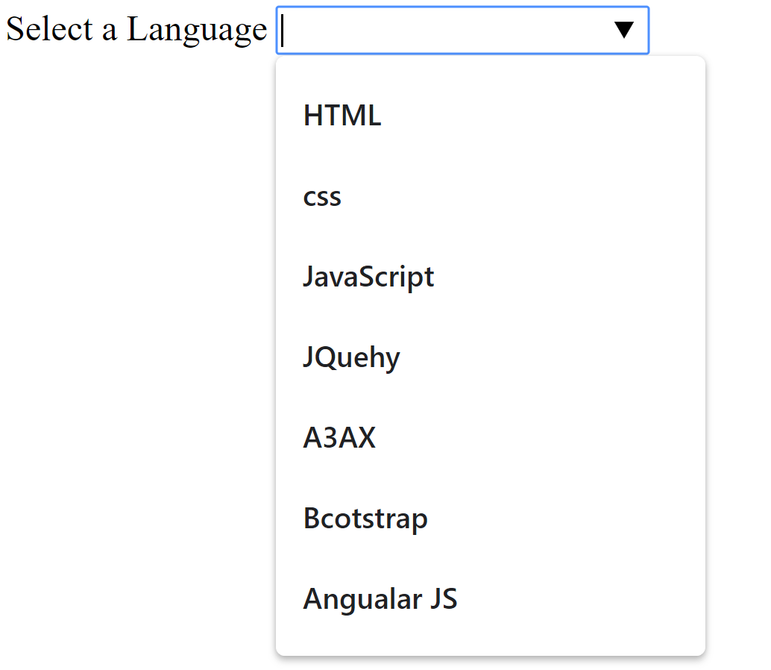
<datalist> tag
This tag is introduced in the HTMLS version.
The <datalist> element speciﬁes a list of pre-deﬁned options for an <input> element. Users will see a drop-down list of the pre-defined options as they input data.
The list attribute of the <input> element, must refer to the id attribute of the <datalist>element.
<form>
<label for="technologies">Select a Language</label>
<input list="technologies">
<datalist id="technologies">
<option>HTML</option>
<option>css</option>
<option>JavaScript</option>
<option>JQuehy</option>
<option>A3AX</option>
<option>Bcotstrap</option>
<option>Angualar JS</option>
</datalist>
</form>
Note: This <datalist> is the more reﬁned version of select box. Here we will get the options to be displayed based on the search query in datalist box.

Slide 9
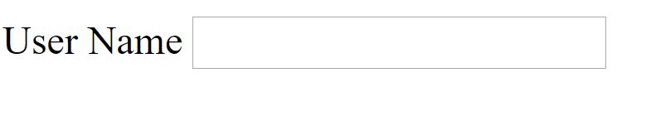
HTML Form Input Types
The HTML Form input types are used to display various input ﬁelds with only one tag called<input> .
In order to display various input fields we use only an <input> tag but the extra 'type' attribute value changes.
Depend on the 'type’ attribute value we will different input field.
type=“text”
This is used to display a text box on the webpage.
Example:
<form>
<label>User Name</label>
<input type="text">
</form>

Slide 10
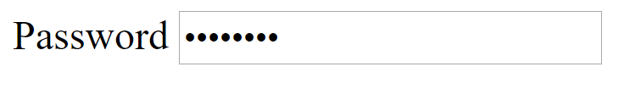
type="password"
This attribute is used to display a password box on the webpage.
Example:
type="submit"
This Attribute is used to display a submit button on the webpage.
Once a user enters the complete form data and clicks on the submit button then the entire form data will be sent the program which is running on the server.
type="reset"
This attribute is used to display a reset button on the webpage.
This button will reset the entire form. If any input ﬁeld is ﬁlled by the user will get cleared with reset button.
<form>
<label>Password</label>
<input type="password">
</form>

Slide 11
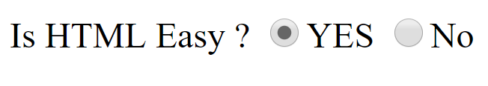
type="radio"
This attribute is used to display a radio button on the webpage.
The radio button is used to select only one input choice among many number of choices displayed.
Example:
<form>
<labe1>Is HTML Easy ?</label>
<input type="radio" name="easy" value="yes">YES
<input type="radio" name="easy" value="no">No
</form>
Note: Here the 'name' attribute Is mandatory, and the value of name attribute should be same for all the radio buttons.

Slide 12
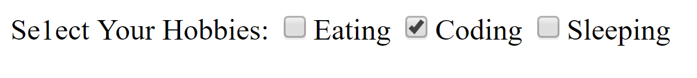
type="checkbox"
This attribute is used to display a checkbox on the webpage. This checkbox lets the user to select zero or more number of choices among the displayed check boxes.
Example:
<form>
<label>Se1ect Your Hobbies:</label>
<input type="checkbox" value="eating">Eating
<input type="checkbox" value="coding">Coding
<input type="checkbox" value="sleeping">Sleeping
</form>

Slide 13
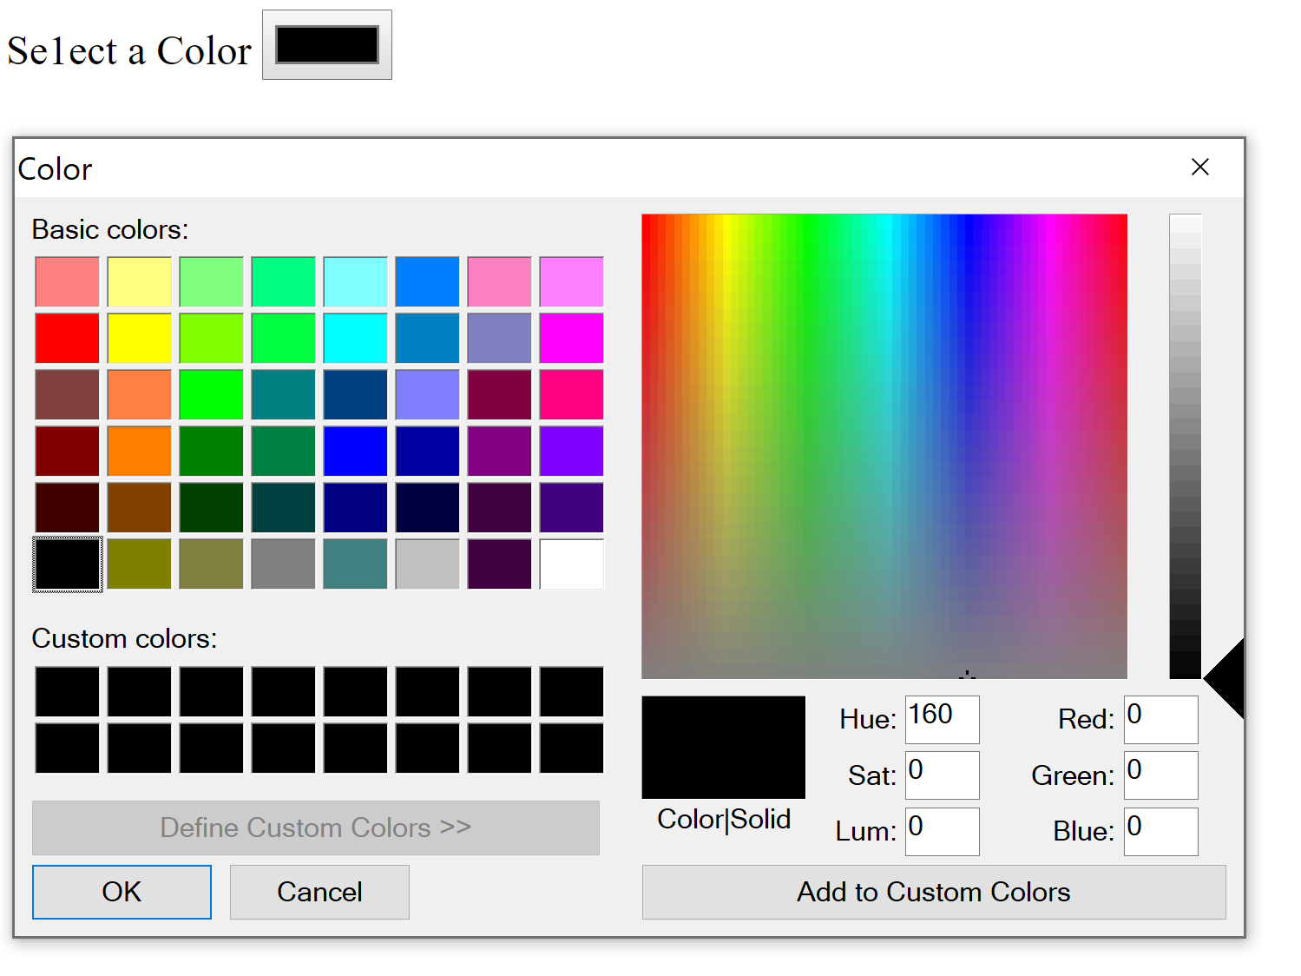
HTML 5 Input Types
The following are from HTML 5 version of Input Types,
type="color"
This is used for color selection among various colors on the webpage.
Example:
<form>
<label>Se1ect a Color</label>
<input type="color">
</form>

Slide 14
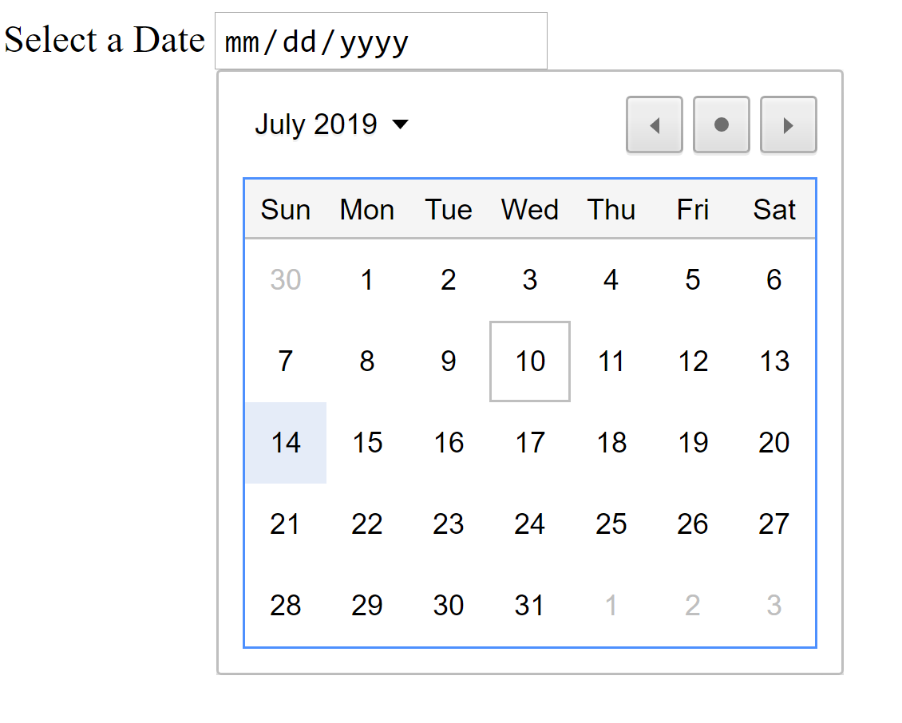
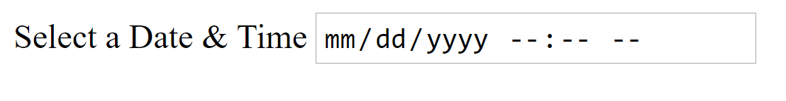
type="date"
This attribute is used for date selection. Here it will display a calendar to select a date.
Example:
type="datetime-local"
This attribute is used to select a date as well as time. This is date and time selection box
Example:
<form>
<label for="datetime" >Select a Date & Time</label>
<input type="datetime-local" id="datetime">
</form>
<form>
<label>Select a Date</label>
<input type="date">
</form>

Slide 15
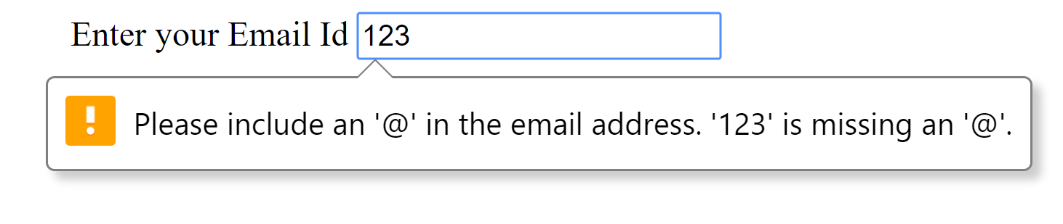
type= "email"
This is used to display an email box.
This seems like a normal text box but in the backend there is a email validation will be happened by HTML5.
It uses a pattern for default email validation using HTML5.
Example:
<form>
<label for="email" >Enter your Email Id</label>
<input type="email" id="email">
</form>

Slide 16
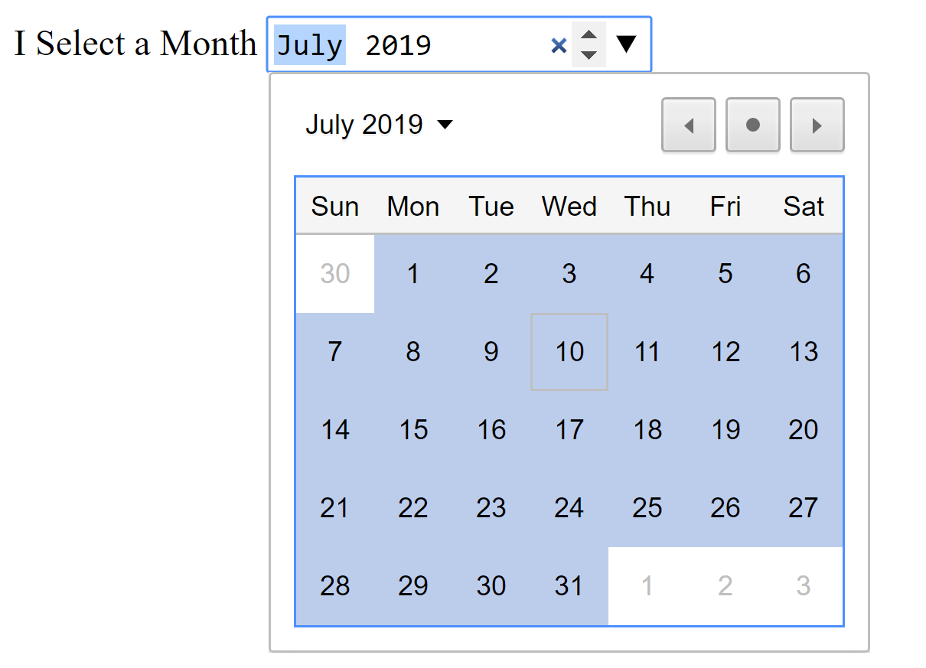
type="month"
This attribute is used for month selection. This will also display a calendar but here we can be able to select a specific month from that calendar.
Example:
<form>
<label For="month">Select a Month</label>
<input type="month" id="month">
</form>

Slide 17
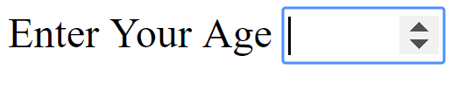
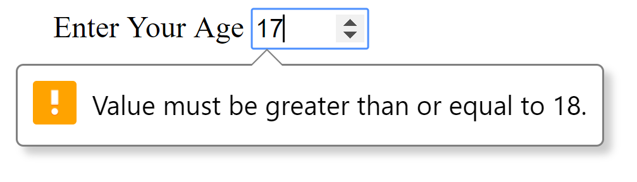
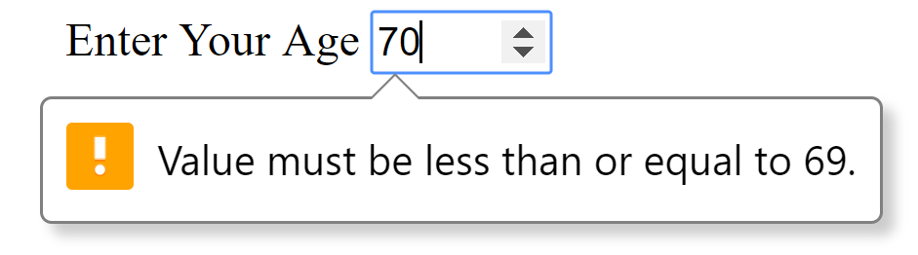
type="number"
This is used for number selection box. Here we can enter only numbers and we cannot be able to enter any other character other than number except 'e' (for exponential values).Here some default validation will be happened for number, we can specify minimum and maximum numbers validation.
Example:
<form>
<label>Enter Your Age</label>
<input type="number" min="18" max="69">
</form>

Slide 18
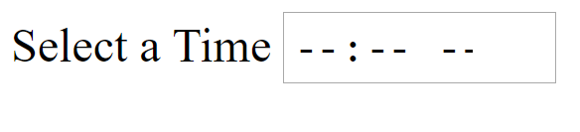
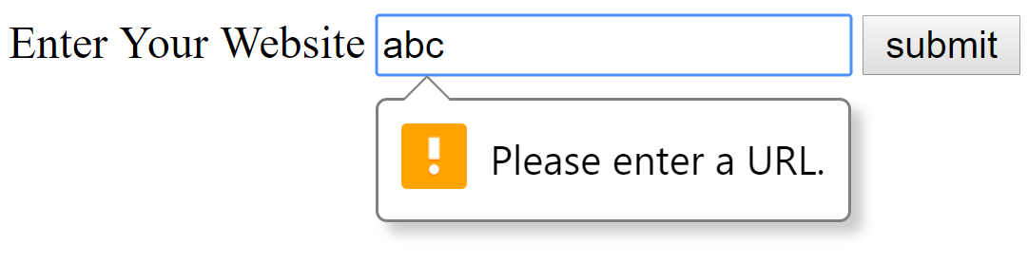
type="time"
This input type is used for time selection on the webpage. Here no clock will be displayed by default. We needs to enter the time manually.
Example:
<form>
<label for="time">Select a Time</label>
<input type="time" id="time">
</form>
type="url"
This input type is used for url validation. Here they use a default validation for url selection. It expects pattern of ’http://’.
Example:
<form>
<label for="url">Enter Your Website</label>
<input type="url" id="url">
<input type="submit" value="submit">
</form>

