Slide 1
HTMl
By Anil K

Slide 2
Introduction
HTML Stands for Hypertext markup language, this is one of the core language to develop any website among CSS and JavaScript. We can use the HTML for structuring of a webpage and it is a static programming language.
Any HTML document contains an extension of ‘.html’ or '.htm’ which can be run on any browser.
A HTML document contains full of HTML tags and these tags will be parsed by browser and the actual content will be displayed on the browser. Please note that, the HTML tags will not be displayed on the browser and only the content on between the tags Will be displayed on the browser.
Here browser is responsible to parse the HTML tags and display content on the webpage or browser.
HTML is a static programming language to display some static content on the webpage. The content can be a paragraph or headings or images without any styles.

Slide 3
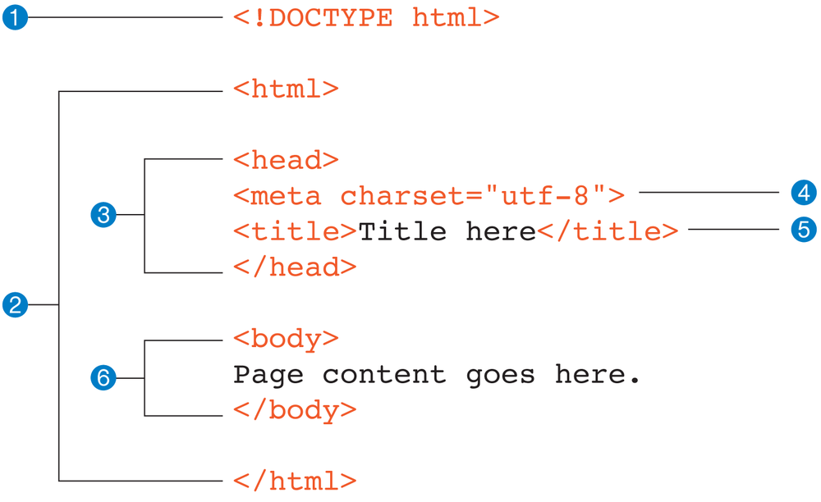
Structure of HTML Document

Slide 4
The complete HTML document is represented by the tag called <html> and it contains two parts as follows,
1) Head Section
2) Body Section
Head Section
The Head Section of a HTML document is represented with the tag called <head>.
Any textual content between <head> and </head> comes under head section.
‘<head> ...... </head>’
This section contains information like meta information and website's titIe and few CSS configurations information and few JavaScript Configuration.
Body Section
The Body section of HTML document is represented with the tag called <body>. Any textual content between <body> and </body> comes under body section. This is one of the important section to display any content on the webpage. Any websites visual area of content will comes under body section. We must write any visual content which we wants to show up on the webpage we must write those tags in body section only.

Slide 5
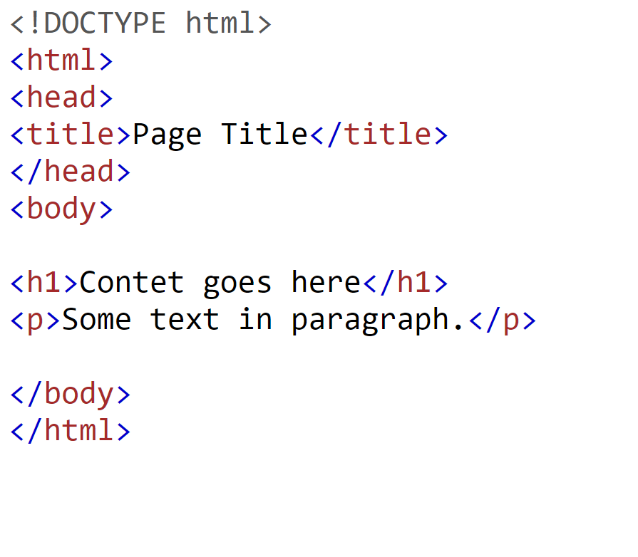
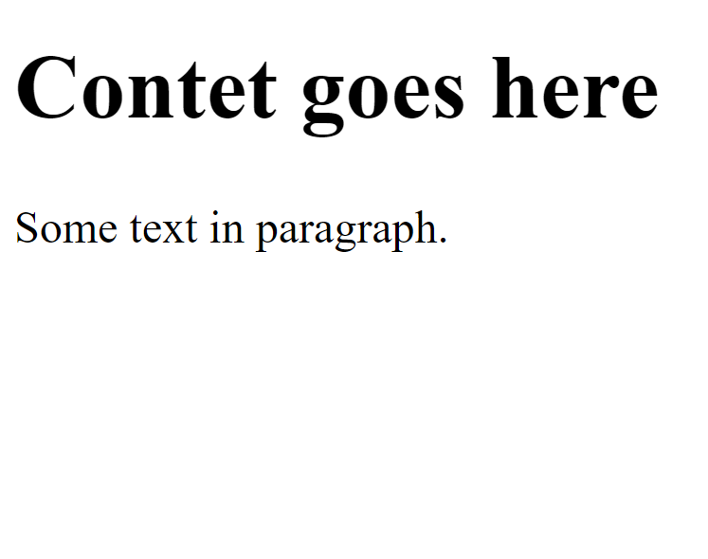
HTML First Application
The basic HTML Document structure looks as follows,

Slide 6
Rules for writing HTML Document
Each content which is displaying on the webpage should be written in between a html tag only.
All the html tags to be written in lowercase only.
Always add an end tag if required, means for some HTML tags / elements are not having a close / end tags.
We needs to add an end tag if it is required.
Example: <br> , <hr> , <img> tags will not have end tags.
Note: In HTML language HTML tag and HTML Elements are both one and the same.
Sometimes we may call it as HTML Tag and sometimes we may call it as HTML Element.

Slide 7
HTML Attributes
The HTML attributes provides an additional information to the HTML Tags, elements.
All the HTML Elements may have attributes but not all the html elements will have same attributes.
All HTML Attributes comes with key and value pairs.
All HTML Attributes should be added to the start tag only.
Example:
<input type="text" placeholder="Enter Your Name">
<img src="img/photo.jpg" width="300" height="200">
In the above example, the src, width, height are html attributes which adds an extra information to HTML elements.

Slide 8
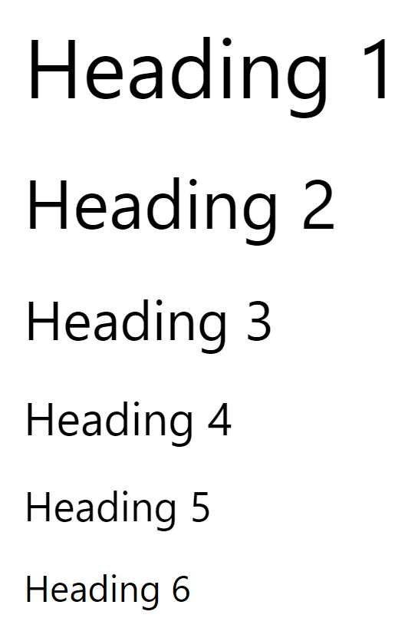
HTML Header Tags
We can display various headings on the webpage using the HTML Header tags. In HTML there are 6 types of header tags available such as,
<h1>Heading 1</h1>
<h2>Heading 2</h2>
<h3>Heading 3</h3>
<h4>Heading 4</h4>
<h5>Heading 5</h5>
<h6>Heading 6</h6>

Slide 9
HTML Paragraphs
We can display a paragraph in the webpage or browser using the HTML tag called <p> tag.
Any content to be displayed as a paragraph on the webpage we needs to provide this content between <p> and </p> tags.
Please note that the number of lines which are displayed on the webpage are not same as the number of lines which are written on the webpage.
Browser decides the number of lines to be displayed on the browser based on the width of the browser.
We cannot restricts the number of lines to be displayed on the webpage with the <p> tag. Note: Normally we never restrict the number of lines for any paragraph.
We can display the same number of lines written in the html document and-the number of lines displayed on the webpage using html tag called <pre> tag.

Slide 10
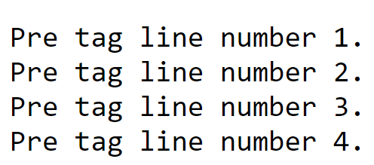
HTML <pre> Element
The HTML <pre> element defines preformatted text.
The text inside a <pre> element is displayed in a fixed-width font, and it preserves both spaces and line breaks:
Example :
<pre> Pre tag line number 1. Pre tag line number 2. Pre tag line number 3. Pre tag line number 4. </pre>

Slide 11
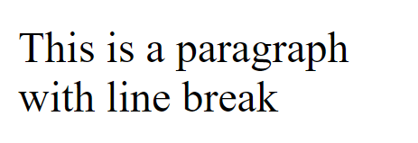
HTML Line Breaks
The HTML <br> element defines a single line break.
Use <br> if you want a line break (a new line) without starting a new paragraph:
Example :
<p>This is a paragraph<br>with line break</p>
The <br> tag is an empty tag, which means that it has no end tag.

Slide 12
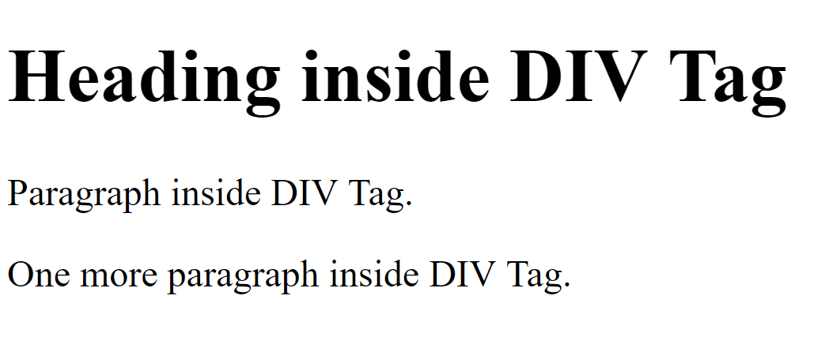
HTML DIV Tag
The HTML DIV tag deﬁnes a division or section in an HTML document.
We can divide an html document or the entire webpage into various sections or divisions using DIV tag.
The <div> tag is often used as container for other HTML Elements to style them with CSS.
Within the <div> tags, we can add any number of tags and display like a division or section of content on the webpage.
Please note by default no styles will be added for <div> tag. We may have to use CSS to apply custom styles.
Example :
<div>
<h1>Heading inside DIV Tag</h1>
<p>Paragraph inside DIV Tag.</p>
<p>One more paragraph inside DIV Tag.</p>
</div>

Slide 13
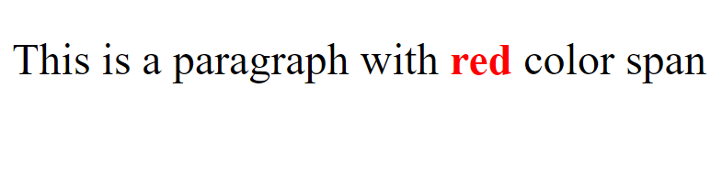
HTML Span Tag
The <span> tag is an example of inline element.
By using <span> tag we can apply some styles for a speciﬁc character or a word or a group of words inside a paragraph.
Just by adding a <span> tag, no styles will be applied by default. We can manage the styles by using CSS.
For example we have a content as follows:
<p>This is a paragraph with <span style="color:red;font-weight:bold">red</span> color span</p>

Slide 14
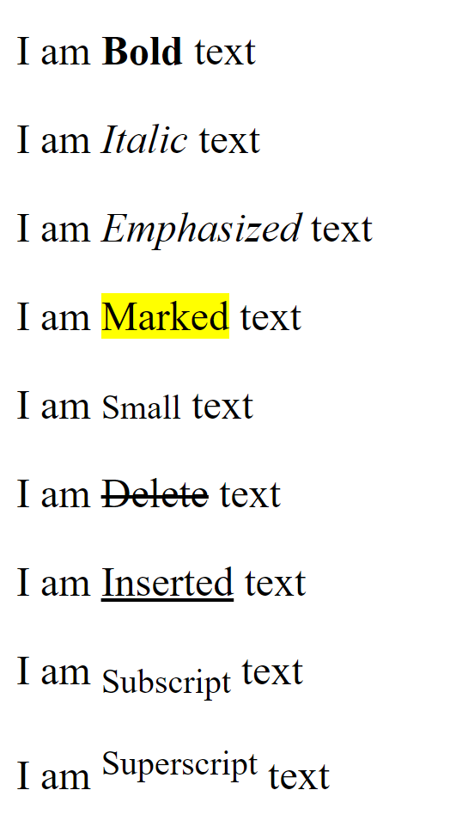
HTML Text Formatting
We can apply various text formatting styles to the HTML content using the following text formatting tags.
<b> — for Bold text
<i> — for Italic text
<em> — for Emphasized text
<mark> — for Marked text
<small> — for Small text
<del> — for Deleted text
<ins> — for Inserted text
<sub> — for Subscript text
<sup> — for Superscript text

Slide 15
<!--Bold Text-->
<div>
<p>I am <b>Bold</b> text</p>
</div>
<!--Italic Text-->
<div>
<p>I am <i>Italic</i> text</p>
</div>
<!--Emphasized Text-->
<div>
<p>I am <em>Emphasized</em> text</p>
</div>
<!--Marked Text-->
<div>
<p>I am <mark>Marked</mark> text</p>
</div>
<!--Small Text-->
<div>
<p>I am <small>Small</small> text</p>
</div>
<!--Delete Text-->
<div>
<p>I am <del>Delete</del> text</p>
</div>
<!--Inserted Text-->
<div>
<p>I am <ins>Inserted</ins> text</p>
</div>
<!--Subscript Text-->
<div>
<p>I am <sub>Subscript</sub> text</p>
</div>
<!--Superscript Text-->
<div>
<p>I am <sup>Superscript</sup> text</p>
</div>

Slide 16
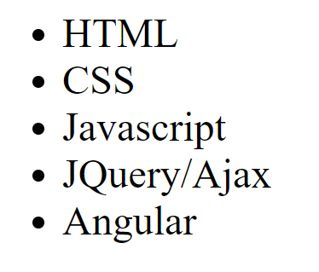
HTML List Tags
We can display any content in the list format using HTML List tags. In HTML there are two types of lists, they are ordered list and Un Ordered List.
UN Ordered List
In HTML the UN ordered list is represented by the tag called <ul> and each list item in unordered list is represented with the tag called <li>.
<ul>
<li>HTML</li>
<li>CSS</li>
<li>Javascript</li>
<li>JQuery/Ajax</li>
<li>Angular</li>
</ul>

Slide 17
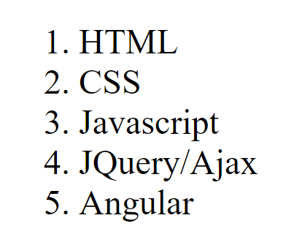
By default the list items will be displayed as 'dots', we can change this by using type attribute.
There are different types of UN ordered list types such as disc, circle, square, none.
We can change the type of unordered list is by using 'type' attribute, we needs to add this attribute to the start tag of <ul> tag only.
Ordered List
In HTML the ordered list is represented with the tag called <ol> and each list item of ordered list is represented with the tag called <li>.
By default the ordered list will displays each list item in 1,2,3,4 format. We can change this by using an attribute called ’type’.
There are ﬁve types of ordered lists available in HTML such as 1 , i , I , a and A.
Example:
<ol>
<li>HTML</li>
<li>CSS</li>
<li>Javascript</li>
<li>JQuery/Ajax</li>
<li>Angular</li>
</ol>

Slide 18

HTML Image Tag
We can display an image on the webpage by using a HTML tag called <img>.
The <img> tag contains the following attributes,
Src -> to specify the address of an image.
Example: <img src="img/facebook.jpg">
Alt -> The alt attribute is used to provide an alternate text for an image, if an image is not displayed on the webpage for some reason then the 'alt’ will be displayed. If the image is displayed then the alt attribute text will not be displayed.
<img src="img/facebook.jpg" width= "500" height= "300" alt="Facebook Image">
Width, height —> normally the image will be displayed of its own width and height, we can customize the width and height using width and height attributes.<img src=" img/facebook.jpg" width= "500" height= "300" >

Slide 19
HTML Tables
We can display any content in a table format on the webpage using a HTML tag called<table>. This Is the root tag for the entire table.
In HTML the entire table is represented with the tag called <table>
Each Table is having two sections such as head section and body section.
The Table's head section is represented with the tag called <thead> and the body section of HTML table is represented with the tag called <tbody>.
In HTML table’s head section, each cell is represented with the tag called <th> and in the body section each cell is represented with the tag called <td> and finally each row of a HTML table is represented with the tag called <tr>.
Note: For Each HTML table, defining <thead> and <tbody> is optional. Without these tags also we can be able to display a table. If we are planning to apply any styles related to head and body section of a table, for this we may use <thead> and <tbody> tags. For any HTML Table by default no borders will be displayed on the browser, we can display the borders using ‘border’ attribute or CSS.

Slide 20
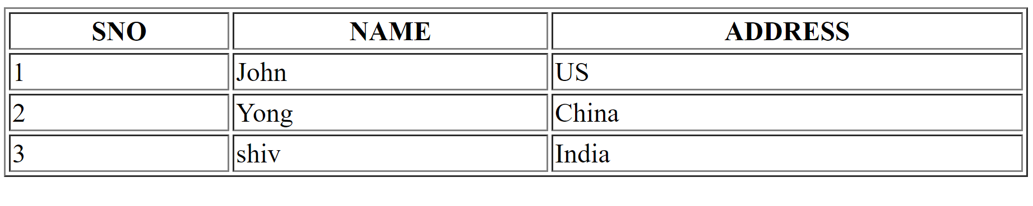
Let’s understand the HTML code to display the above table on the webpage.
<table border="1" width="100%">
<thead>
<tr>
<th>SNO</th>
<th>NAME</th>
<th>ADDRESS</th>
</tr>
</thead>
<tbody>
<tr>
<td>1</td>
<td>John</td>
<td>US</td>
</tr>
<tr>
<td>2</td>
<td>Yong</td>
<td>China</td>
</tr>
<tr>
<td>3</td>
<td>shiv</td>
<td>India</td>
</tr>
</tbody>
</table>

Slide 21
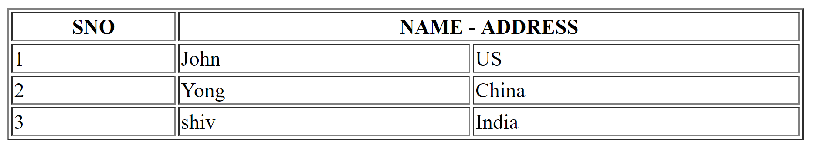
For every HTML table, we use two special attributes to combine two or more rows or columns.
Colspan
The HTML Colspan attribute used to combine two or more number of columns of a table. We normally use this for <th> elements.
Let’s understand the Colspan,
<table border="1" width="100%">
<thead>
<tr>
<th>SNO</th>
<th colspan="2">NAME - ADDRESS</th>
</tr>
</thead>
<tbody>
<tr>
<td>1</td>
<td>John</td>
<td>US</td>
</tr>
<tr>
<td>2</td>
<td>Yong</td>
<td>China</td>
</tr>
<tr>
<td>3</td>
<td>shiv</td>
<td>India</td>
</tr>
</tbody>
</table>

Slide 22
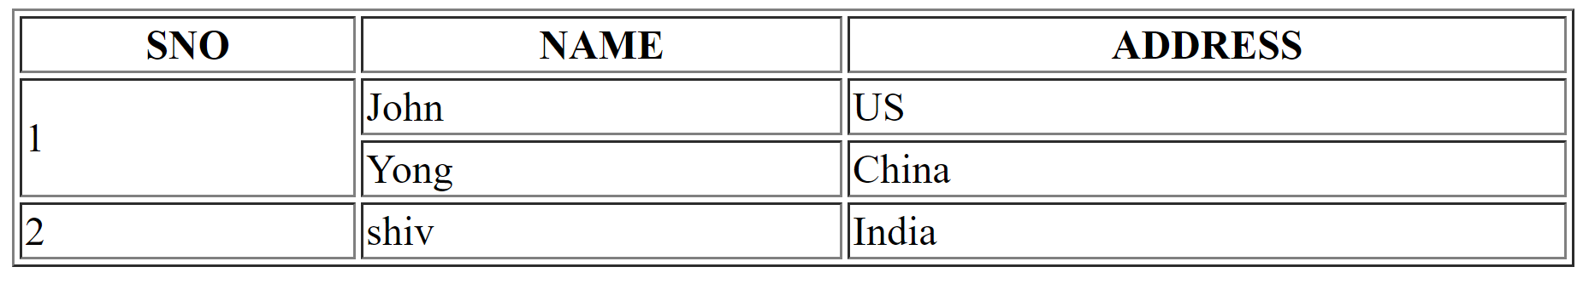
Rowspan
The Rowspan is used to combine two or more number of rows. We normally use this attribute with <td> tag.
Example:
<table border="1" width="100%">
<thead>
<tr>
<th>SNO</th>
<th>NAME</th>
<th>ADDRESS</th>
</tr>
</thead>
<tbody>
<tr>
<td rowspan="2">1</td>
<td>John</td>
<td>US</td>
</tr>
<tr>
<td>Yong</td>
<td>China</td>
</tr>
<tr>
<td>2</td>
<td>shiv</td>
<td>India</td>
</tr>
</tbody>
</table>

Slide 23

HTML Links
In HTML we can convert normal text into a clickable link or hyperlink or hypertext is by using<a> tag.
The hyperlinks are the clickable links and once we click on those links the control will jumps to the speciﬁed href location.
We identify the hyperlinks with respect to normal text, as for hyperlinks when we hover a mouse on them it automatically turns into a hand symbol.
Not only the text will be converted to hyperlinks, we can even convert an image also a hyperlink and once we click on the image the control will jump to the specified location in the href attribute.
Example:
<a href="https://www.google.co.in/">Google</a>

Slide 24
In the above example the word "Google” is converted as a hyperlink and once we click on this link then control jumps to google website.
We can even give the websites local links for the href attribute of <a> tag so that the control will jump to the local links of the webpage.
<a href="index.html">Home</a>
<a href="contact.html">Contact</a>
For HTML links there is an important attribute called ’target' and which specifies where to open the linked document.
The target attribute contains the following values,
_blank - Opens the linked document in a new window or tab
_self— Opens the linked document in the same window/tab as it was clicked (this is default)
_parent - Opens the linked document in the parent frame
_top - Opens the linked document in the full body of the window
<a href=https://www.google.co.in/ target="_blank" >Google</a>

Slide 25
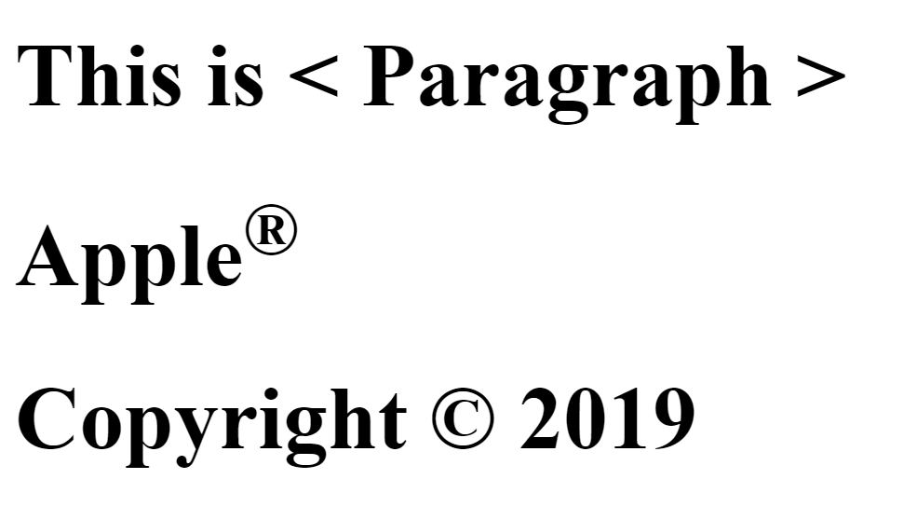
HTML Entities
The HTML Entities are used to display some of the reserved characters and few symbols on the webpage.
Syntax: &entity_name; or &#entity_name;
Symbol | Entity Name
Copyright symbol | &copy;
Reg Trademark | &reg;
Dollar Symbol | $#36;
Example:
<h1>This is &lt; Paragraph &gt;</h1>
<h1>Apple<sup>&reg;</sup></h1>
<h1>Copyright &copy; 2019</h1>

Slide 26
HTML Iframes
HTML Iframes are used to display a webpage within another webpage.
Using an Iframe a webpage is loaded within then frame of another webpage.
Syntax:
<iframe src="URL"></iframe>
Each iFrame is having its own width and height, we can specify our own height and width for an iframe.
Example:
<iframe width="560" height="315" src="https://www.youtube.com/embed/7jbO8ToJTko" ></iframe>
Note: We normally use Iframe tag to display a YouTube video on our own webpage.

Slide 27

How to display a YouTube video on our own web page:
Go to YouTube Select a video to display on the webpage.
Click on ’share’ link
Click on 'Embed’ link
Select the Embed Option
Copy the <iframe> tag completely and paste it in the HTML Document.
Open that HTML Document on the browser, the selected YouTube video will be played on our own webpage.
Example:
<iframe width="560" height="315" src="https://www.youtube.com/embed/7jbO8ToJTko" frameborder="0" allow="accelerometer; autoplay; encrypted-media; gyroscope; picture-in-picture" allowfullscreen></iframe>

