Slide 1
Angular
Anil K

Slide 2
Routing
The “Routing” concept is used to create page navigation in angular 2+ applications.
“Routing” includes the process of mapping between the “route (url)” and corresponding component. Ex:
http://localhost:4200/home ➔ HomeComponent
http://localhost:4200/about ➔ AboutComponent
The “@angular/router” package provides essential API to create routing.
Angular 2+ supports two types of routing.
1. Hash-less routing Ex: /home
2. Hash routing Ex: #/home

Slide 3
Steps for working with Routing
Import “@angular/router” package in “package.json” file:
“dependencies”: {
“@angular/router”: “latest”
}
Set the base location of the application on server:
<base href=”/”>
Import “Router” from “@angular/router” package:
Import { Routes } from “@angular/router”;
Create routes:
var variable1 : Routes = [
{ path: “path here”, component: ComponentClassName },
{ path: “path here”, component: ComponentClassName },
….
];

Slide 4
Import “RouterModule” from “@angular/router” package:
Import { RoutesModule} from “@angular/router”;
Combine “your routes” and “RouterModule”:
var variable2 = RouterModule.forRoot(variable1, { useHash: true/false } );
Import both “routes” and “RouterModule” in “AppModule”:
@NgModule( { …, imports: [ …, variable2 ] } )
class AppModule( ) { }
Create hyperlink to route:
<a routerLink=”/path”>Link text</a>
Create placeholder to display route content:
<router-outlet> </router-outlet>

Slide 5
Routing - Example
Creating Application
Open Command Prompt and enter the following commands:
cd c:\angular
ng new app1
cd c:\angular\app1
ng g component Home
ng g component About
ng g component Contact

Slide 6
c:\angular\app1\src\app\app.module.ts
import { BrowserModule } from '@angular/platform-browser’;
import { NgModule } from '@angular/core’;
import { AppComponent } from './app.component’;
import { FormsModule } from "@angular/forms";
import { Routes, RouterModule } from "@angular/router";
import { HomeComponent } from './home/home.component’;
import { AboutComponent } from './about/about.component’;
import { ContactComponent } from './contact/contact.component';
var myroutes: Routes = [
{ path: "", component: HomeComponent },
{ path: "home", component: HomeComponent },
{ path: "about", component: AboutComponent },
{ path: "contact", component: ContactComponent }
];
var myroutes2 = RouterModule.forRoot(myroutes);

Slide 7
@NgModule({
declarations: [ AppComponent, HomeComponent, AboutComponent, ContactComponent ],
imports: [ BrowserModule, FormsModule, myroutes2 ],
providers: [],
bootstrap: [AppComponent]
})
export class AppModule { }
c:\angular\app1\src\app\app.component.ts
import { Component } from "@angular/core";
@Component({
selector: 'app-root',
templateUrl: './app.component.html',
styleUrls: ['./app.component.css’]
})
export class AppComponent { }

Slide 8
c:\angular\app1\src\app\app.component.html
<div class="class1">
<h4>Routing</h4>
<a routerLink="home">Home</a>
<a routerLink="about">About</a>
<a routerLink="contact">Contact</a>
<div id="container">
<router-outlet> </router-outlet>
</div>
</div>

Slide 9
c:\angular\app1\src\app\home\home.component.ts
import { Component, OnInit } from '@angular/core';
@Component({
selector: 'app-home',
templateUrl: './home.component.html',
styleUrls: ['./home.component.css'] })
export class HomeComponent implements OnInit {
constructor() { }
ngOnInit() { }
}
c:\angular\app1\src\app\home\home.component.html
<div class="class1">
<h5>Home</h5>
</div>

Slide 10
c:\angular\app1\src\app\about\about.component.ts
import { Component, OnInit } from '@angular/core';
@Component({
selector: 'app-about',
templateUrl: './about.component.html’,
styleUrls: ['./about.component.css’]
})
export class AboutComponent implements OnInit {
constructor() { }
ngOnInit() { }
}
c:\angular\app1\src\app\about\about.component.html
<div class="class1">
<h5>About</h5>
</div>

Slide 11
c:\angular\app1\src\app\contact\contact.component.ts
import { Component, OnInit } from '@angular/core';
@Component({
selector: 'app-contact',
templateUrl: './contact.component.html',
styleUrls: ['./contact.component.css’]
})
export class ContactComponent implements OnInit {
constructor() { }
ngOnInit() { }
}
c:\angular\app1\src\app\contact\contact.component.html
<div class="class1">
<h5>Contact</h5>
</div>

Slide 12
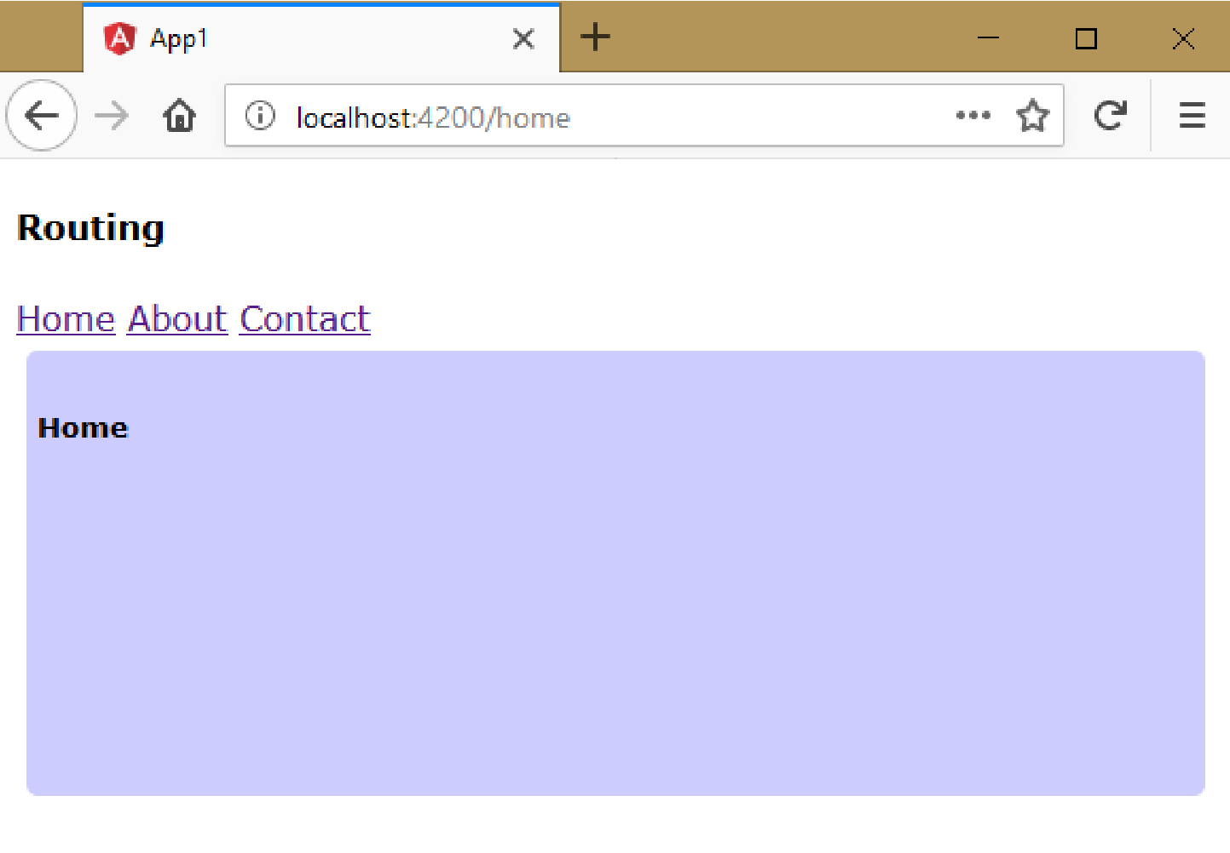
Executing the application:
Open Command Prompt and enter the following commands:
cd c:\angular\app1 ng serve
Open the browser and enter the following URL: http://localhost:4200

Slide 13
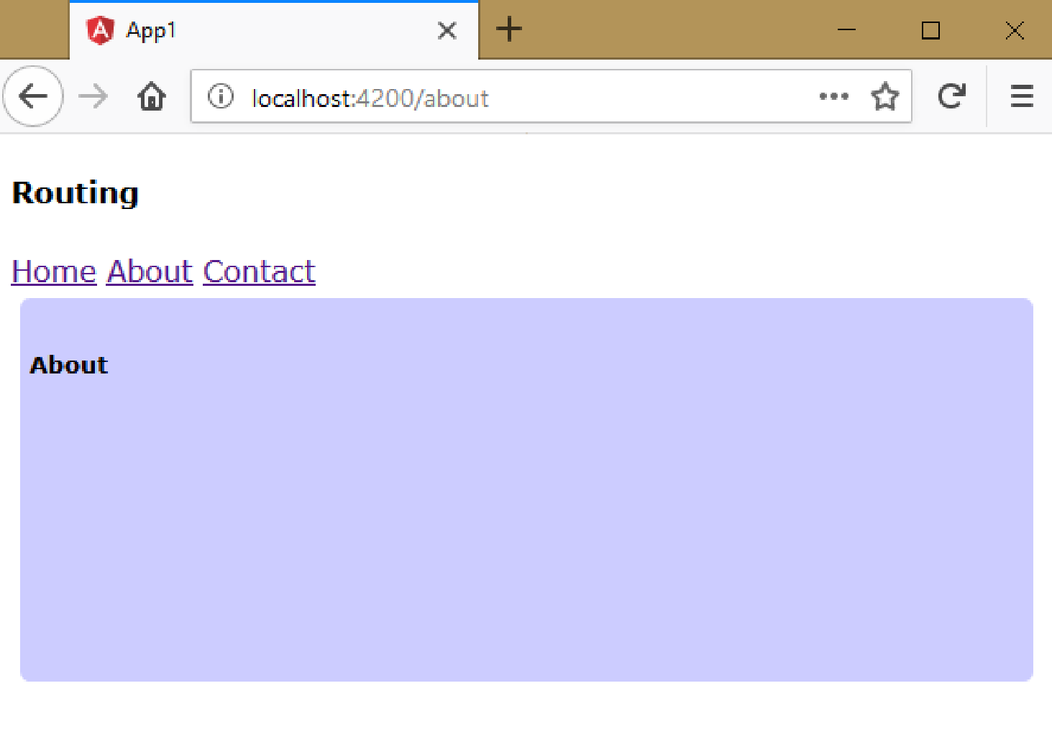
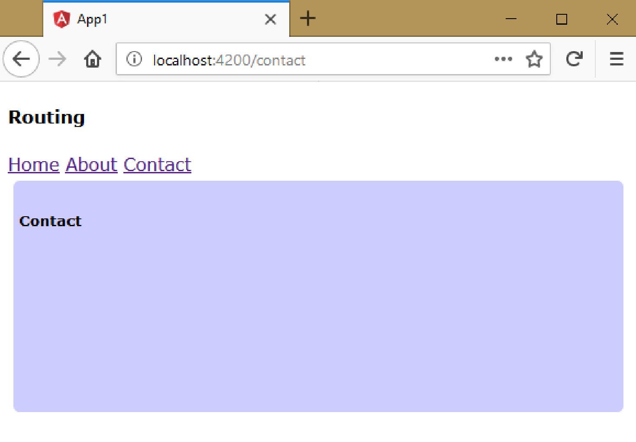

Slide 14
Route Parameters
You can pass parameters to the route.
Route parameter is represented as “:parametername” syntax.
You can get the value of the parameter in the component using “ActivatedRoute” service.
Steps for Working with Route Parameters
Create parameter in the route:
{ path: "pathname/:parametername", component: ComponentClassname }
Import the "ActivatedRoute" service:
import { ActivatedRoute } from "@angular/router";
Get an object of "ActivatedRoute" service:
constructor(@Inject(ActivatedRoute) private route : ActivatedRoute) { }
Get the value of parameter:
this.route.snapshot.params["parametername"]
(or) Get the value of parameter with updates:
this.route.params.subscribe(params => { params["parametername"] });

Slide 15
Route Parameters - Example
Creating Application
Open Command Prompt and enter the following commands:
cd c:\angular ng new app1
cd c:\angular\app1 ng g component Home
ng g component About
ng g component Contact
ng g component Products
ng g class Product
ng g service Products

Slide 16
c:\angular\app1\src\product.ts
export class Product {
productId: number;
productName: string;
cost: number;
brand: string;
constructor(productId: number, productName: string, cost: number, brand: string) {
this.productId = productId;
this.productName = productName;
this.cost = cost;
this.brand = brand;
}
}

Slide 17
c:\angular\app1\src\products.service.ts
import { Injectable } from '@angular/core’;
import { Product } from "./product";
@Injectable() export class ProductsService {
products: Product[] = [];
constructor() {
this.products = [
new Product(101, "Samsumg S8", 40000, "Samsung"),
new Product(101, "Samsumg S9", 62000, "Samsung"),
new Product(101, "iPhone 8", 60000, "Apple"),
new Product(101, "iPhone 10", 98000, "Apple"),
new Product(101, "Pixel 2", 53000, "Google"),
new Product(101, "Pixel 3", 95000, "Google"),
];
}
}

Slide 18
getProductsByBrand(brandName: string): Product[] {
var selectedProducts : Product[] = [];
for (var i = 0; i < this.products.length; i++) {
if (this.products[i].brand == brandName) {
selectedProducts.push(this.products[i]);
}
}
return selectedProducts;
}

Slide 19
c:\angular\app1\src\app\app.module.ts
import { BrowserModule } from '@angular/platform-browser’;
import { NgModule } from '@angular/core’;
import { AppComponent } from './app.component’;
import { FormsModule } from "@angular/forms";
import { Routes, RouterModule } from "@angular/router";
import { HomeComponent } from './home/home.component’;
import { AboutComponent } from './about/about.component’;
import { ContactComponent } from './contact/contact.component’;
import { ProductsComponent } from './products/products.component’;
import { ProductsService } from './products.service';
var myroutes: Routes = [
{ path: "", component: HomeComponent },
{ path: "home", component: HomeComponent },
{ path: "about", component: AboutComponent },
{ path: "contact", component: ContactComponent },
{ path: "products/:brandname", component: ProductsComponent }
];
var myroutes2 = RouterModule.forRoot(myroutes);

Slide 20
@NgModule({
declarations: [ AppComponent, HomeComponent, AboutComponent, ContactComponent, ProductsComponent ],
imports: [ BrowserModule, FormsModule, myroutes2 ],
providers: [ ProductsService ],
bootstrap: [AppComponent] })
export class AppModule { }
c:\angular\app1\src\app\app.component.ts
import { Component } from "@angular/core";
@Component({
selector: 'app-root',
templateUrl: './app.component.html',
styleUrls: ['./app.component.css’]
})
export class AppComponent { }

Slide 21
c:\angular\app1\src\app\app.component.html
<div class="class1">
<h4>Routing</h4>
<a routerLink="home">Home</a>
<a routerLink="about">About</a>
<a routerLink="contact">Contact</a>
<a routerLink="products/Samsung">Samsung</a>
<a routerLink="products/Apple">Apple</a>
<a routerLink="products/Google">Google</a>
<div id="container">
<router-outlet> </router-outlet>
</div>
</div>

Slide 22
c:\angular\app1\src\app\products\products.component.ts
import { Component, OnInit, Inject } from '@angular/core’;
import { Product } from '../product’;
import { ProductsService } from "../products.service";
import { ActivatedRoute } from "@angular/router";
@Component({
selector: 'app-products',
templateUrl: './products.component.html',
styleUrls: ['./products.component.css’]
})
export class ProductsComponent implements OnInit {
brand: string;
matchingproducts: Product[] = [];
constructor(@Inject(ProductsService) private prodService : ProductsService, @Inject(ActivatedRoute) private route: ActivatedRoute) { }

Slide 23
ngOnInit() {
this.route.params.subscribe(params => {
var selectedBrand = params["brandname"];
this.brand = selectedBrand;
this.matchingproducts = this.prodService.getProductsByBrand(selectedBrand);
});
}
}

Slide 24
c:\angular\app1\src\app\products\products.component.html
<div>
<h2>Products</h2>
<h3>{{brand}}</h3>
<table border="1">
<tr>
<th>Product ID</th>
<th>Product Name</th>
<th>Cost</th>
<th>Brand</th>
</tr>
<tr *ngFor="let product of matchingproducts">
<td>{{product.productId}}</td>
<td>{{product.productName}}</td>
<td>{{product.cost}}</td>
<td>{{product.brand}}</td>
</tr>
</table>
<a routerLink="/home">Back to Home</a>
</div>

Slide 25
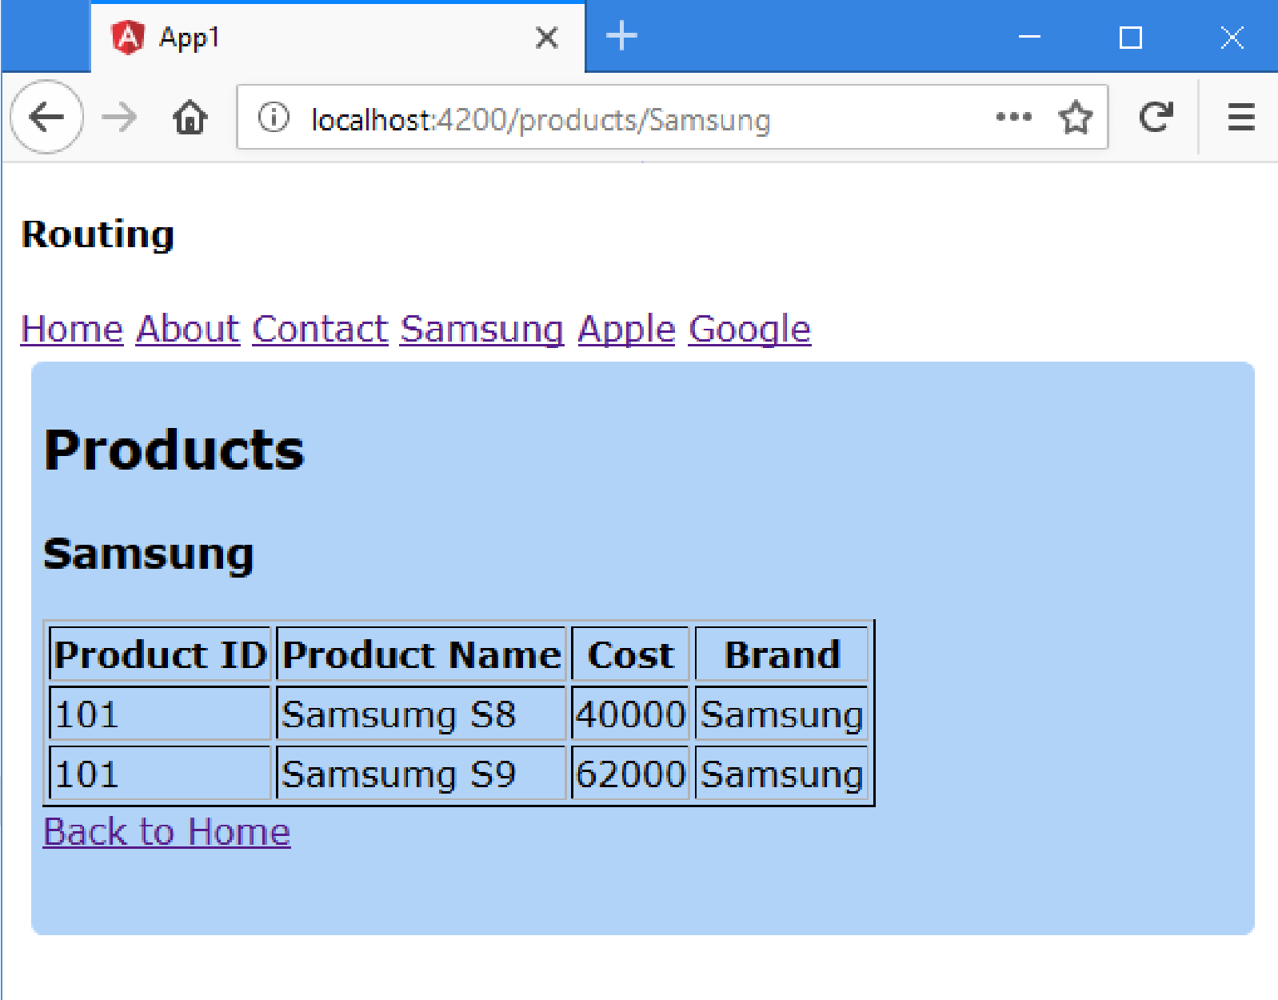

Slide 26
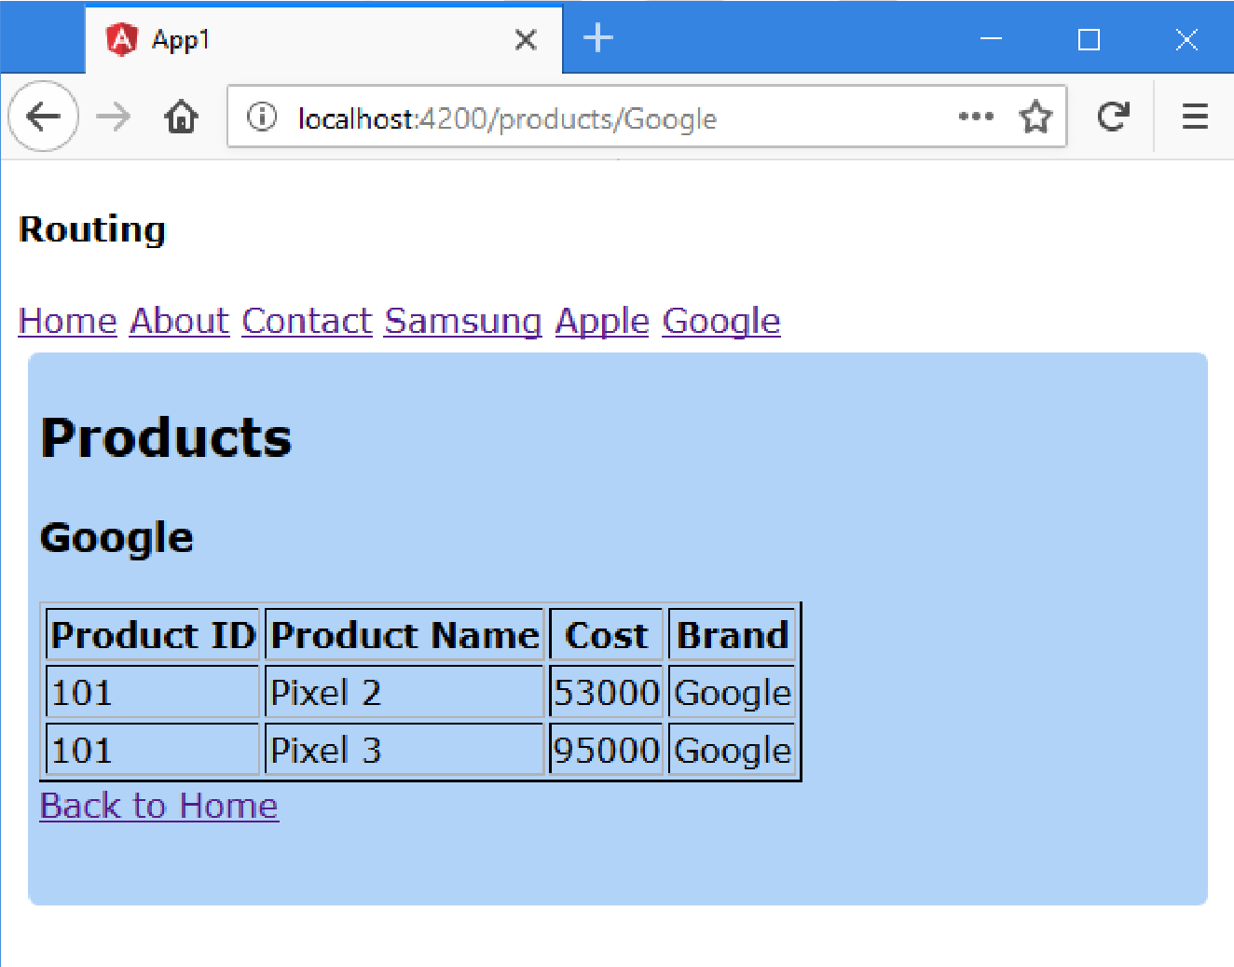
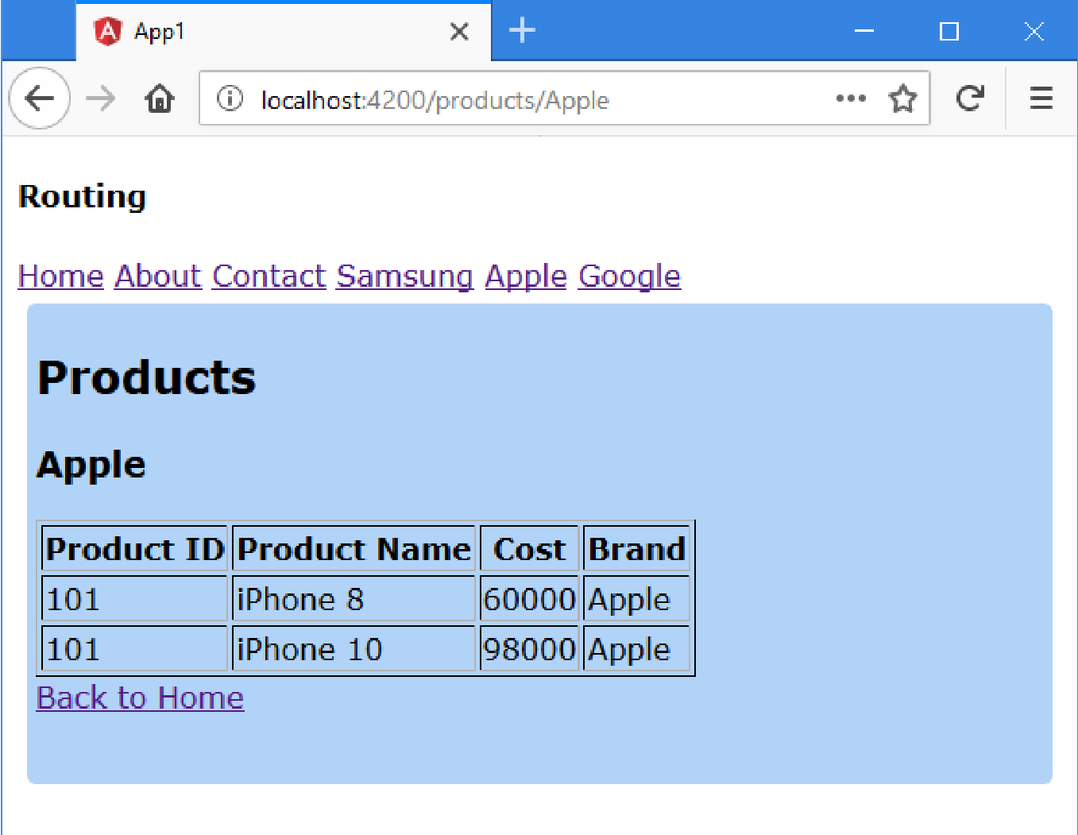

Slide 27
Child Routes
Route can have child routes up to unlimited no. of nested levels.
Ex: "Funds Transfer" menu has "Transfer", "Add Payee", "Activate Payee" etc.
Steps for Working with Child Routes
Create Child Routes:
{
path: "parentpath ", component: ComponentClassname,
children: [
{ path: "childpath ", component: ComponentClassname },
{ path: "childpath ", component: ComponentClassname },
…
]
}
Create hyperlink for the child route:
<a href="/parentpath/childpath">Link text</a>
Create router outlet for child routes (in the parent route component's template):
<router-outlet> </router-outlet>

Slide 28
Child Routes – Example
Creating Application
Open Command Prompt and enter the following commands:
cd c:\angular
ng new app1
cd c:\angular\app1
ng g component OnlineShopping
ng g component Appliances
ng g component Electronics
ng g component Fashion
ng g component Furniture
ng g component Lighting
ng g component Mobiles
ng g component Laptops
ng g component Men
ng g component Women
ng g component Furniture

Slide 29
c:\angular\app1\src\app\app.module.ts
import { BrowserModule } from '@angular/platform-browser’;
import { NgModule } from '@angular/core’;
import { AppComponent } from './app.component’;
import { FormsModule } from "@angular/forms";
import { Routes, RouterModule } from "@angular/router";
import { AppliancesComponent } from './appliances/appliances.component’;
import { ElectronicsComponent } from './electronics/electronics.component’;
import { FashionComponent } from './fashion/fashion.component’;
import { FurnitureComponent } from './furniture/furniture.component’;
import { LaptopsComponent } from './laptops/laptops.component’;
import { LightingComponent } from './lighting/lighting.component’;
import { MenComponent } from './men/men.component’;
import { MobilesComponent } from './mobiles/mobiles.component’;
import { OnlineShoppingComponent } from './online-shopping/online-shopping.component’;
import { WomenComponent } from './women/women.component';

Slide 30
var myroutes: Routes = [
{ path: "", component: OnlineShoppingComponent },
{ path: "electronics", component: ElectronicsComponent,
children: [{ path: "mobiles", component: MobilesComponent },
{ path: "laptops", component: LaptopsComponent }]
},
{ path: "appliances", component: AppliancesComponent,
children: [{ path: "lighting", component: LightingComponent },
{ path: "furniture", component: FurnitureComponent }]
},
{ path: "fashion", component: FashionComponent,
children: [ { path: "men", component: MenComponent },
{ path: "women", component: WomenComponent }]
}
];
var myroutes2 = RouterModule.forRoot(myroutes);

Slide 31
@NgModule({
declarations: [ AppComponent, AppliancesComponent, ElectronicsComponent, FashionComponent, FurnitureComponent, LaptopsComponent, LightingComponent, MenComponent, MobilesComponent, OnlineShoppingComponent, WomenComponent ],
imports: [ BrowserModule, FormsModule, myroutes2 ],
providers: [ ],
bootstrap: [AppComponent]
})
export class AppModule { }

Slide 32
c:\angular\app1\src\app\app.component.ts
import { Component } from "@angular/core";
@Component({
selector: 'app-root',
templateUrl: './app.component.html',
styleUrls: ['./app.component.css’]
})
export class AppComponent { }
c:\angular\app1\src\app\app.component.html
<div class="class1">
<h4>Child Routes</h4>
<div id="container">
<router-outlet> </router-outlet>
</div>
</div>

Slide 33
c:\angular\app1\src\app\online-shopping\online-shopping.component.ts
import { Component, OnInit } from '@angular/core';
@Component({
selector: 'app-online-shopping',
templateUrl: './online-shopping.component.html',
styleUrls: ['./online-shopping.component.css’]
}) export class OnlineShoppingComponent implements OnInit {
constructor() { }
ngOnInit() { }
}
c:\angular\app1\src\app\online-shopping\online-shopping.component.html
<div>
<h4>Online Shopping</h4>
<a routerLink="electronics">Electronics</a><br>
<a routerLink="appliances">Appliances</a><br>
<a routerLink="fashion">Fashion</a><br>
</div>

Slide 34
c:\angular\app1\src\app\appliances\appliances.component.ts
import { Component, OnInit } from '@angular/core';
@Component({
selector: 'app-appliances',
templateUrl: './appliances.component.html',
styleUrls: ['./appliances.component.css’]
})
export class AppliancesComponent implements OnInit {
constructor() { }
ngOnInit() { }
}
c:\angular\app1\src\app\appliances\appliances.component.html
<div>
<h4>Appliances</h4>
<a routerLink="lighting">Lighting</a><br>
<a routerLink="furniture">Furniture</a><br>
<a routerLink="/">Home</a><br>
<div class="container2">
<router-outlet> </router-outlet>
</div>
</div>

Slide 35
c:\angular\app1\src\app\electronics\electronics.component.ts
import { Component, OnInit } from '@angular/core';
@Component({
selector: 'app-electronics',
templateUrl: './electronics.component.html',
styleUrls: ['./electronics.component.css’]
})
export class ElectronicsComponent implements OnInit {
constructor() { }
ngOnInit() { }
}
c:\angular\app1\src\app\electronics\electronics.component.html
<div>
<h4>Electronics</h4>
<a routerLink="mobiles">Mobiles</a><br>
<a routerLink="laptops">Laptops</a><br>
<a routerLink="/">Home</a><br>
<div class="container2">
<router-outlet> </router-outlet>
</div>
</div>

Slide 36
c:\angular\app1\src\app\fashion\fashion.component.ts
import { Component, OnInit } from '@angular/core';
@Component({
selector: 'app-fashion',
templateUrl: './fashion.component.html',
styleUrls: ['./fashion.component.css’]
})
export class FashionComponent implements OnInit {
constructor() { }
ngOnInit() { }
}
c:\angular\app1\src\app\fashion\fashion.component.html
<div>
<h4>Fashion</h4>
<a routerLink="men">Men</a><br>
<a routerLink="women">Women</a><br>
<a routerLink="/">Home</a><br>
<div class="container2">
<router-outlet> </router-outlet>
</div>
</div>

Slide 37
c:\angular\app1\src\app\furniture\furniture.component.ts
import { Component, OnInit } from '@angular/core';
@Component({
selector: 'app-furniture',
templateUrl: './furniture.component.html',
styleUrls: ['./furniture.component.css’]
})
export class FurnitureComponent implements OnInit {
constructor() { }
ngOnInit() { }
}
c:\angular\app1\src\app\furniture\furniture.component.html
<div>
<h5>Furniture</h5>
</div>

Slide 38
c:\angular\app1\src\app\lighting\lighting.component.ts
import { Component, OnInit } from '@angular/core';
@Component({
selector: 'app-lighting',
templateUrl: './lighting.component.html',
styleUrls: ['./lighting.component.css’]
})
export class LightingComponent implements OnInit {
constructor() { }
ngOnInit() { }
}
c:\angular\app1\src\app\lighting\lighting.component.html
<div>
<h5>Lighting</h5>
</div>

Slide 39
c:\angular\app1\src\app\mobiles\mobiles.component.ts
import { Component, OnInit } from '@angular/core';
@Component({
selector: 'app-mobiles',
templateUrl: './mobiles.component.html',
styleUrls: ['./mobiles.component.css’]
})
export class MobilesComponent implements OnInit {
constructor() { }
ngOnInit() { }
}
c:\angular\app1\src\app\mobiles\mobiles.component.html
<div>
<h5>Mobiles</h5>
</div>

Slide 40
c:\angular\app1\src\app\laptops\laptops.component.ts
import { Component, OnInit } from '@angular/core';
@Component({
selector: 'app-laptops',
templateUrl: './laptops.component.html',
styleUrls: ['./laptops.component.css’]
})
export class LaptopsComponent implements OnInit {
constructor() { }
ngOnInit() { }
}
c:\angular\app1\src\app\laptops\laptops.component.html
<div>
<h5>Laptops</h5>
</div>

Slide 41
c:\angular\app1\src\app\men\men.component.ts
import { Component, OnInit } from '@angular/core';
@Component({
selector: 'app-men',
templateUrl: './men.component.html',
styleUrls: ['./men.component.css’]
})
export class MenComponent implements OnInit {
constructor() { }
ngOnInit() { }
}
c:\angular\app1\src\app\men\men.component.html
<div>
<h5>Men</h5>
</div>

Slide 42
c:\angular\app1\src\app\women\women.component.ts
import { Component, OnInit } from '@angular/core';
@Component({
selector: 'app-women',
templateUrl: './women.component.html',
styleUrls: ['./women.component.css’]
})
export class WomenComponent implements OnInit {
constructor() { }
ngOnInit() { }
}
c:\angular\app1\src\app\women\women.component.html
<div>
<h5>Women</h5>
</div>

Slide 43
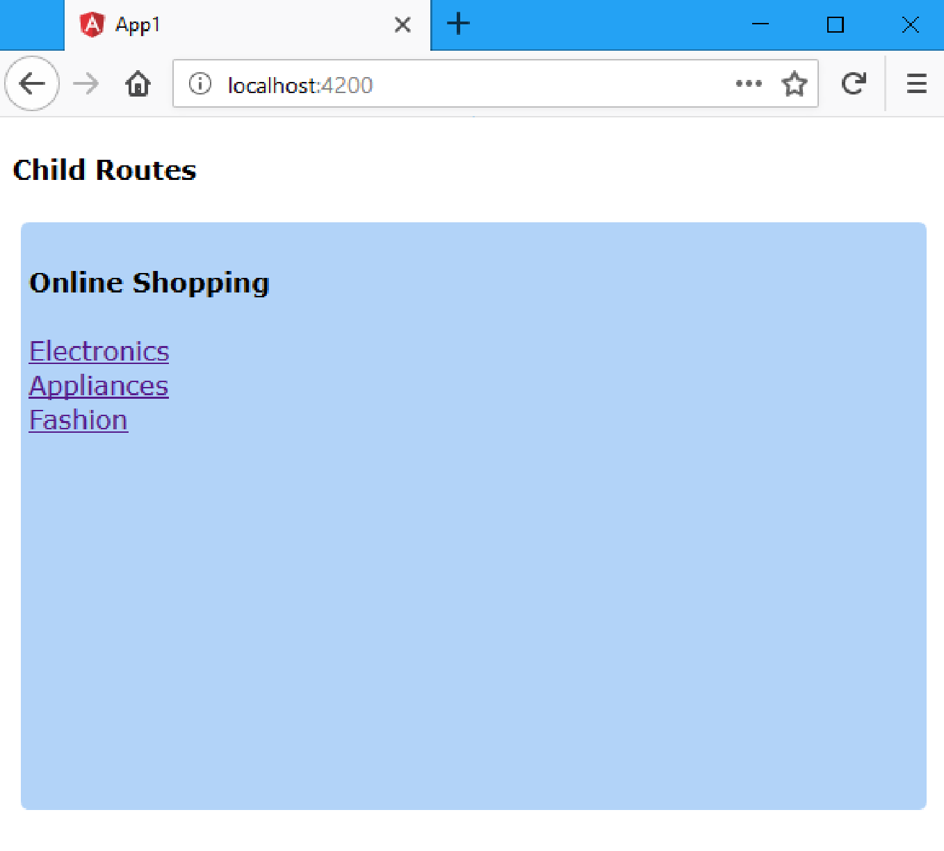

Slide 44
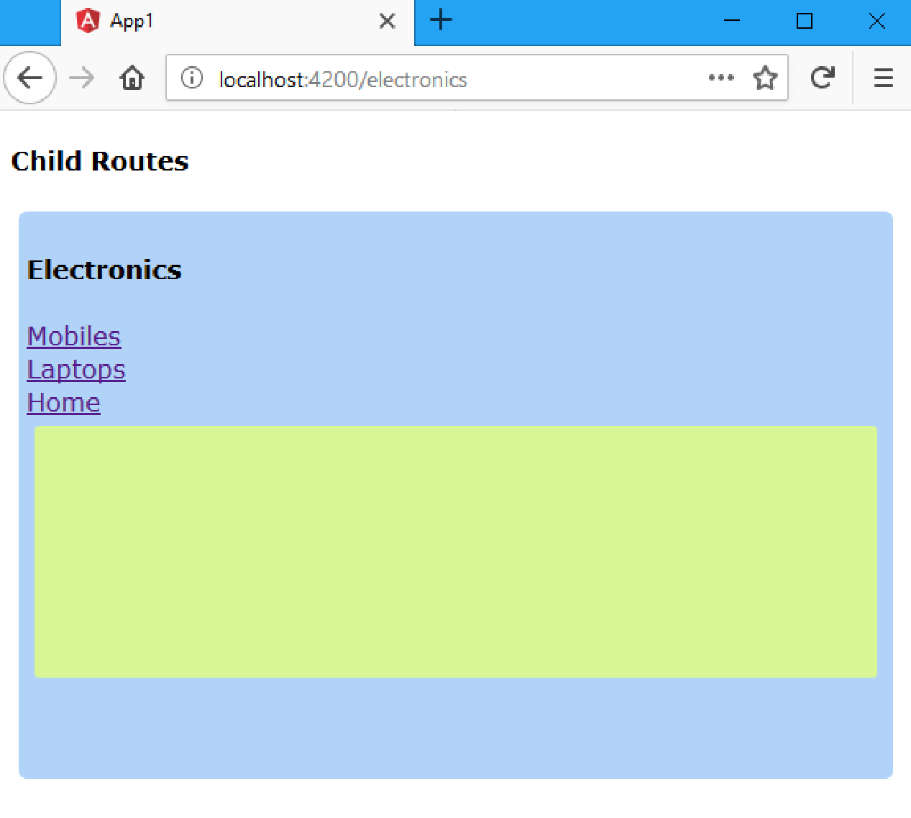

Slide 45
