Slide 1
Angular
Anil K

Slide 2
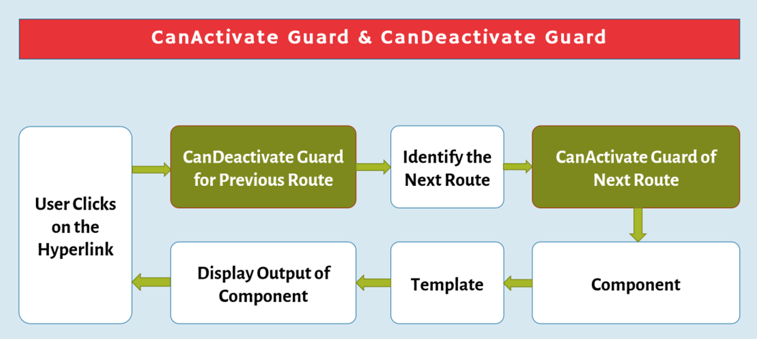
Guards
The Guard is a service that executes at the specified situation while angular is navigating from one route to another route.
Angular mainly supports two types of Guards:
CanActivate: Executes before entering into a route.
CanDeactivate: Executes before leaving a route.

Slide 3
CanActivate
The "CanActivate" Guard executes before entering into a route.
Process: User clicks on the hyperlink → Identify the route → CanActivate Guard → Navigate to the Route → Corresponding component.
This guard can be created by implementing "CanActivate" interface.
The "CanActivate" interface has a method called "canActivate". This method must return a boolean value, which indicates whether the route can be navigated or not. If we return "true", the route will be navigated; if we return "false", the route navigation will be stopped.
It can receive an argument of "ActivatedRouteSnapshot" type, which represents the current state of the route.

Slide 4
Steps for Working with CanActivate
Import "CanActivate" interface from "@angular/router" package:
import { CanActivate, ActivatedRouteSnapshot } from "@angular/router";
Create a Service that implements "CanActivate" interface:
class Serviceclassname implements CanActivate {
canActivate(route: ActivatedRouteSnapshot): Boolean
{ return true / false; }
}
Add service to the module:
@NgModule( { …, providers: [ Serviceclassname ] } )
class moduleclassname { }
Add guard to the route:
{ path: "path here", component: ComponentClassname, canActivate: [ Serviceclassname ] }

Slide 5
CanActivate - Example
Creating Application
Open Command Prompt and enter the following commands:
cd c:\angular
ng new app1
cd c:\angular\app1
ng g component OnlineShopping
ng g component Appliances
ng g component Electronics
ng g component Fashion
ng g component Furniture
ng g component Lighting
ng g component Mobiles
ng g component Laptops
ng g component Men
ng g component Women
ng g component Furniture
ng g component Login
ng g service LoginStatus

Slide 6
c:\angular\app1\src\app\app.module.ts
import { BrowserModule } from '@angular/platform-browser’;
import { NgModule } from '@angular/core’;
import { AppComponent } from './app.component’;
import { FormsModule } from "@angular/forms";
import { Routes, RouterModule } from "@angular/router";
import { AppliancesComponent } from './appliances/appliances.component’;
import { ElectronicsComponent } from './electronics/electronics.component’;
import { FashionComponent } from './fashion/fashion.component’;
import { FurnitureComponent } from './furniture/furniture.component’;
import { LaptopsComponent } from './laptops/laptops.component’;
import { LightingComponent } from './lighting/lighting.component’;
import { MenComponent } from './men/men.component’;
import { MobilesComponent } from './mobiles/mobiles.component’;
import { OnlineShoppingComponent } from './online-shopping/online-shopping.component’;
import { WomenComponent } from './women/women.component’;
import { LoginComponent } from './login/login.component’;
import { LoginStatusService } from "./login-status.service";
import { LoginAuthService } from './login-auth.service';

Slide 7
var myroutes: Routes = [
{ path: "", component: OnlineShoppingComponent },
{ path: "electronics", component: ElectronicsComponent, canActivate: [LoginAuthService],
children: [
{ path: "mobiles", component: MobilesComponent },
{ path: "laptops", component: LaptopsComponent } ]
},
{ path: "appliances", component: AppliancesComponent,
children: [
{ path: "lighting", component: LightingComponent },
{ path: "furniture", component: FurnitureComponent } ]
},
{ path: "fashion", component: FashionComponent,
children: [
{ path: "men", component: MenComponent },
{ path: "women", component: WomenComponent } ]
} ];
var myroutes2 = RouterModule.forRoot(myroutes);

Slide 8
@NgModule({
declarations: [
AppComponent,
AppliancesComponent,
ElectronicsComponent,
FashionComponent,
FurnitureComponent,
LaptopsComponent,
LightingComponent,
MenComponent,
MobilesComponent,
OnlineShoppingComponent,
WomenComponent,
LoginComponent
],
imports: [ BrowserModule, FormsModule, myroutes2 ],
providers: [ LoginStatusService, LoginAuthService ],
bootstrap: [AppComponent]
})
export class AppModule { }

Slide 9
c:\angular\app1\src\app\login-status.service.ts
import { Injectable } from '@angular/core';
@Injectable() export class LoginStatusService {
isLoggedIn: boolean = false;
}
c:\angular\app1\src\app\login-auth.service.ts
import { Injectable, Inject } from '@angular/core’;
import { LoginStatusService } from "./login-status.service";
import { Router, ActivatedRouteSnapshot } from "@angular/router";
@Injectable() export class LoginAuthService {
constructor( @Inject(LoginStatusService) private loginStatusService: LoginStatusService, @Inject(Router) private router: Router) { }
canActivate(route: ActivatedRouteSnapshot): boolean {
if (this.loginStatusService.isLoggedIn == false) {
alert("You must login to access electronics page");
this.router.navigateByUrl("/");
}
return this.loginStatusService.isLoggedIn;
}
}

Slide 10
c:\angular\app1\src\app\login\login.component.ts
import { Component, Inject } from '@angular/core’;
import { LoginStatusService } from "../login-status.service";
@Component({
selector: 'app-login',
templateUrl: './login.component.html',
styleUrls: ['./login.component.css’]
})
export class LoginComponent {
username: string = "";
password: string = "";
msg: string = "";
loginStatus: boolean;
constructor( @Inject(LoginStatusService) private loginStatusService: LoginStatusService) {
this.loginStatus = this.loginStatusService.isLoggedIn;
}

Slide 11
CheckLogin(txt1) {
if (this.username == "admin" && this.password == "manager") {
this.msg = "Successful login";
this.loginStatusService.isLoggedIn = true;
this.loginStatus = true;
} else {
this.msg = "Invalid login";
this.loginStatusService.isLoggedIn = false;
this.loginStatus = false;
txt1.focus();
}
}
Logout() {
this.loginStatusService.isLoggedIn = false;
this.loginStatus = false;
}
}

Slide 12
c:\angular\app1\src\app\login\login.component.html
<div>
<div *ngIf="!loginStatus">
<form>
<h5>Login</h5>
Username: <input type="text" [(ngModel)]="username" name="username“ #t1><br>
Password: <input type="password" [(ngModel)]="password" name="password"><br>
<input type="submit" value="Login" (click)="CheckLogin(t1)"><br>
{{msg}}
</form>
</div>
<div *ngIf="loginStatus">
<form>
<input type="submit" value="Logout" (click)="Logout()"><br>
</form>
</div>
</div>

Slide 13
c:\angular\app1\src\app\app.component.ts
import { Component } from "@angular/core";
@Component({
selector: 'app-root',
templateUrl: './app.component.html',
styleUrls: ['./app.component.css’]
})
export class AppComponent { }
c:\angular\app1\src\app\app.component.html
<div class="class1">
<h4>canActivate</h4>
<div id="container">
<router-outlet> </router-outlet>
</div>

Slide 14
c:\angular\app1\src\app\online-shopping\online-shopping.component.ts
import { Component, OnInit } from '@angular/core';
@Component({
selector: 'app-online-shopping',
templateUrl: './online-shopping.component.html',
styleUrls: ['./online-shopping.component.css’]
})
export class OnlineShoppingComponent implements OnInit {
constructor() { }
ngOnInit() { }
}
c:\angular\app1\src\app\online-shopping\online-shopping.component.html
<div>
<h4>Online Shopping</h4>
<a routerLink="electronics">Electronics</a><br>
<a routerLink="appliances">Appliances</a><br>
<a routerLink="fashion">Fashion</a><br>
<app-login></app-login>
</div>

Slide 15
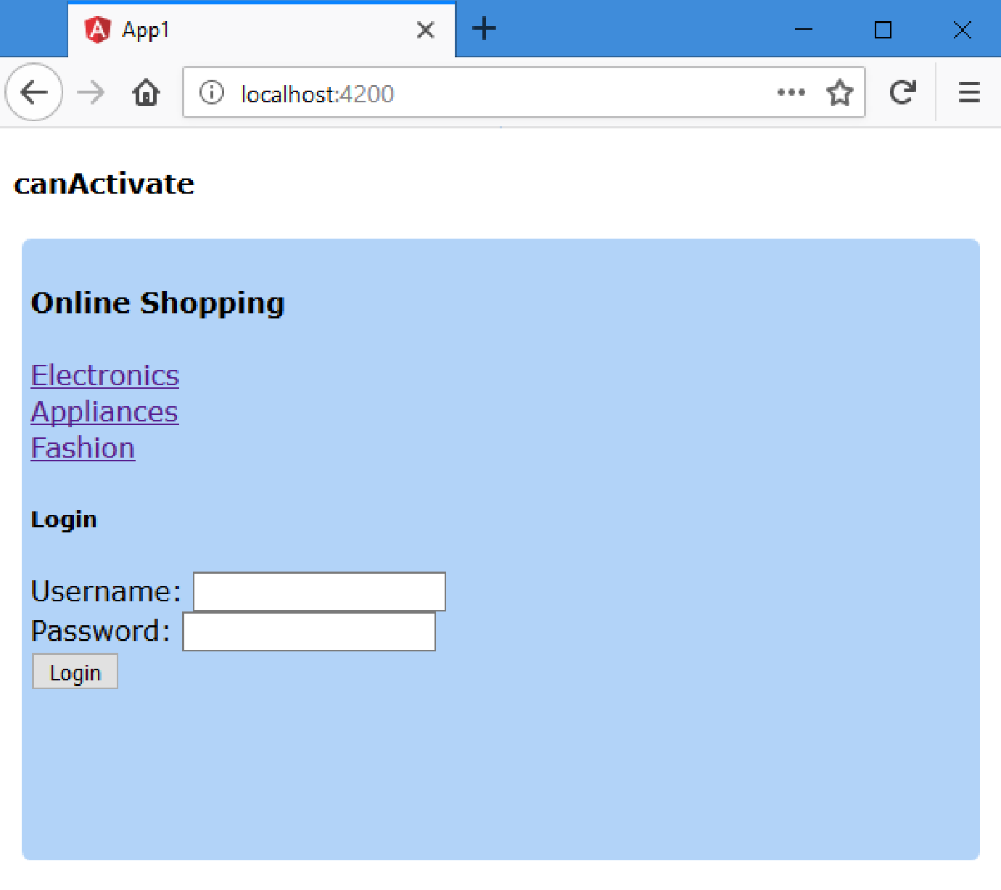

Slide 16
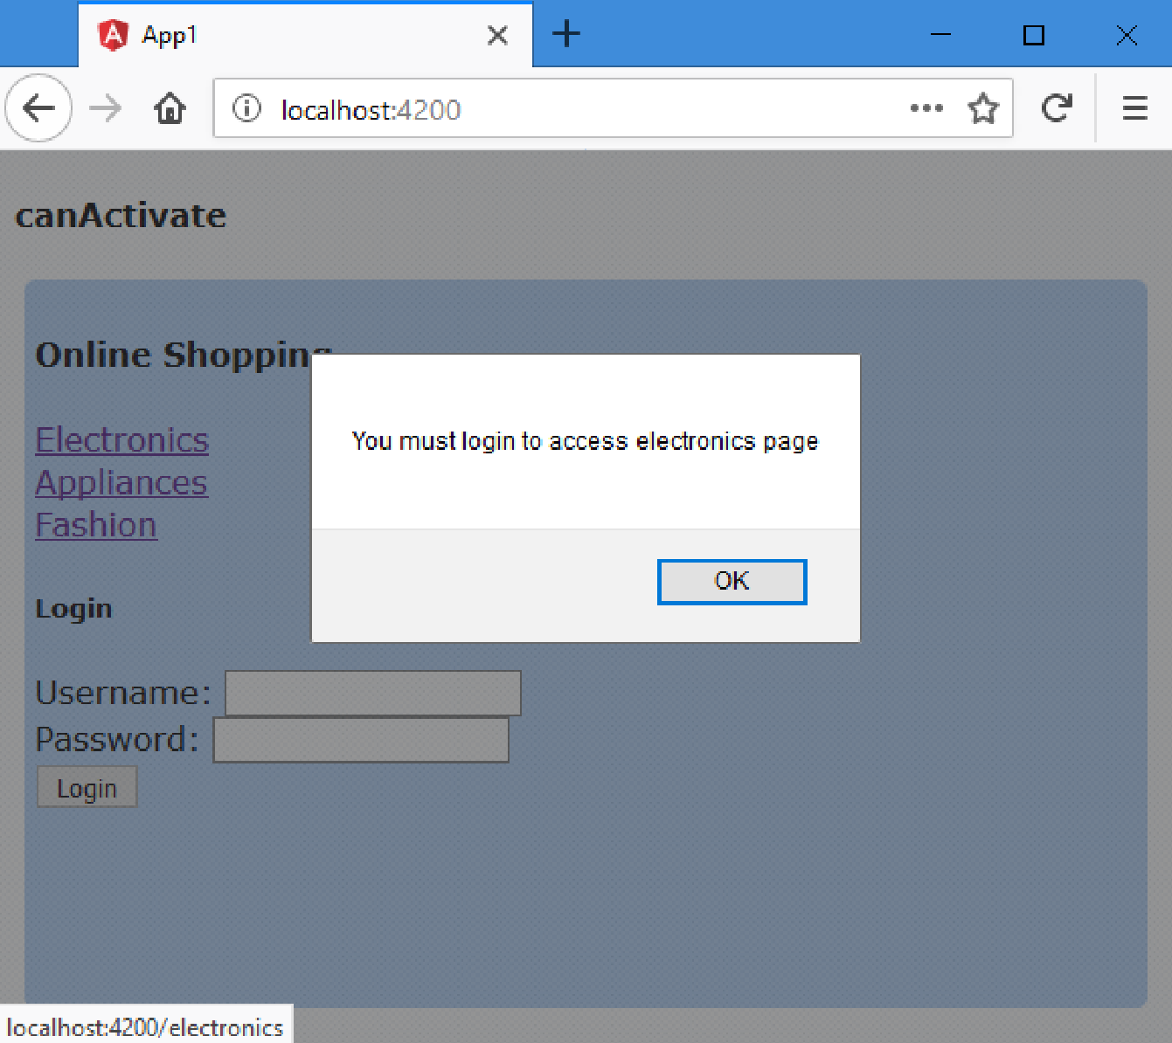

Slide 17
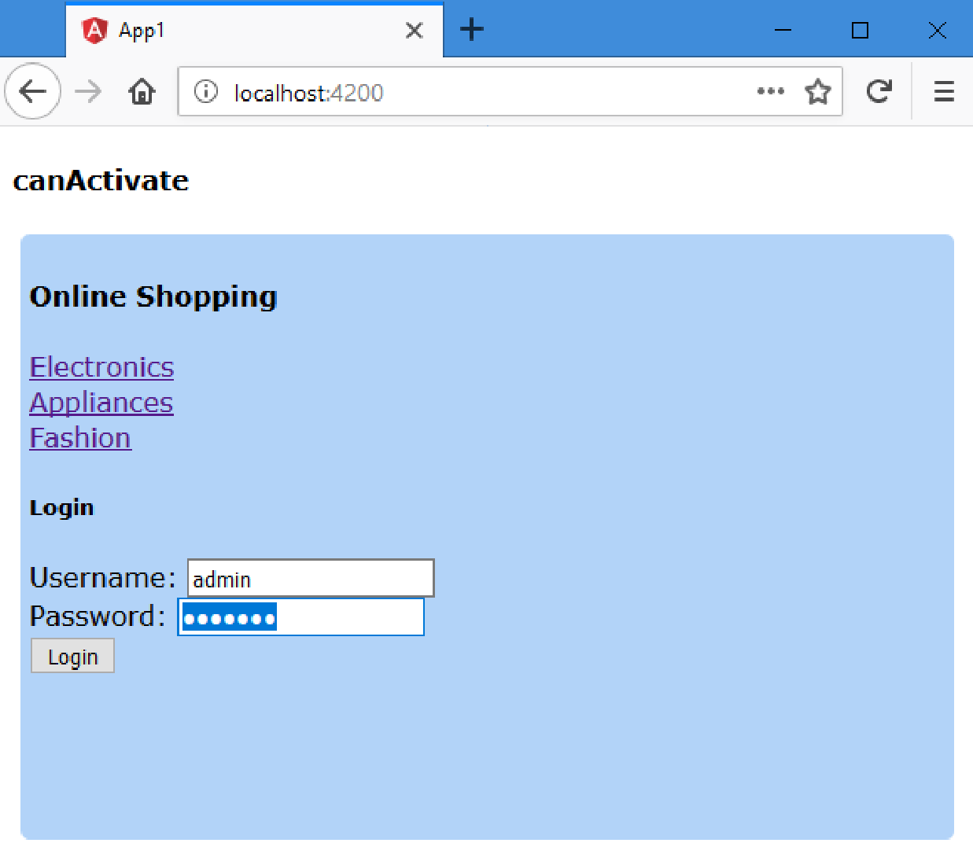

Slide 18
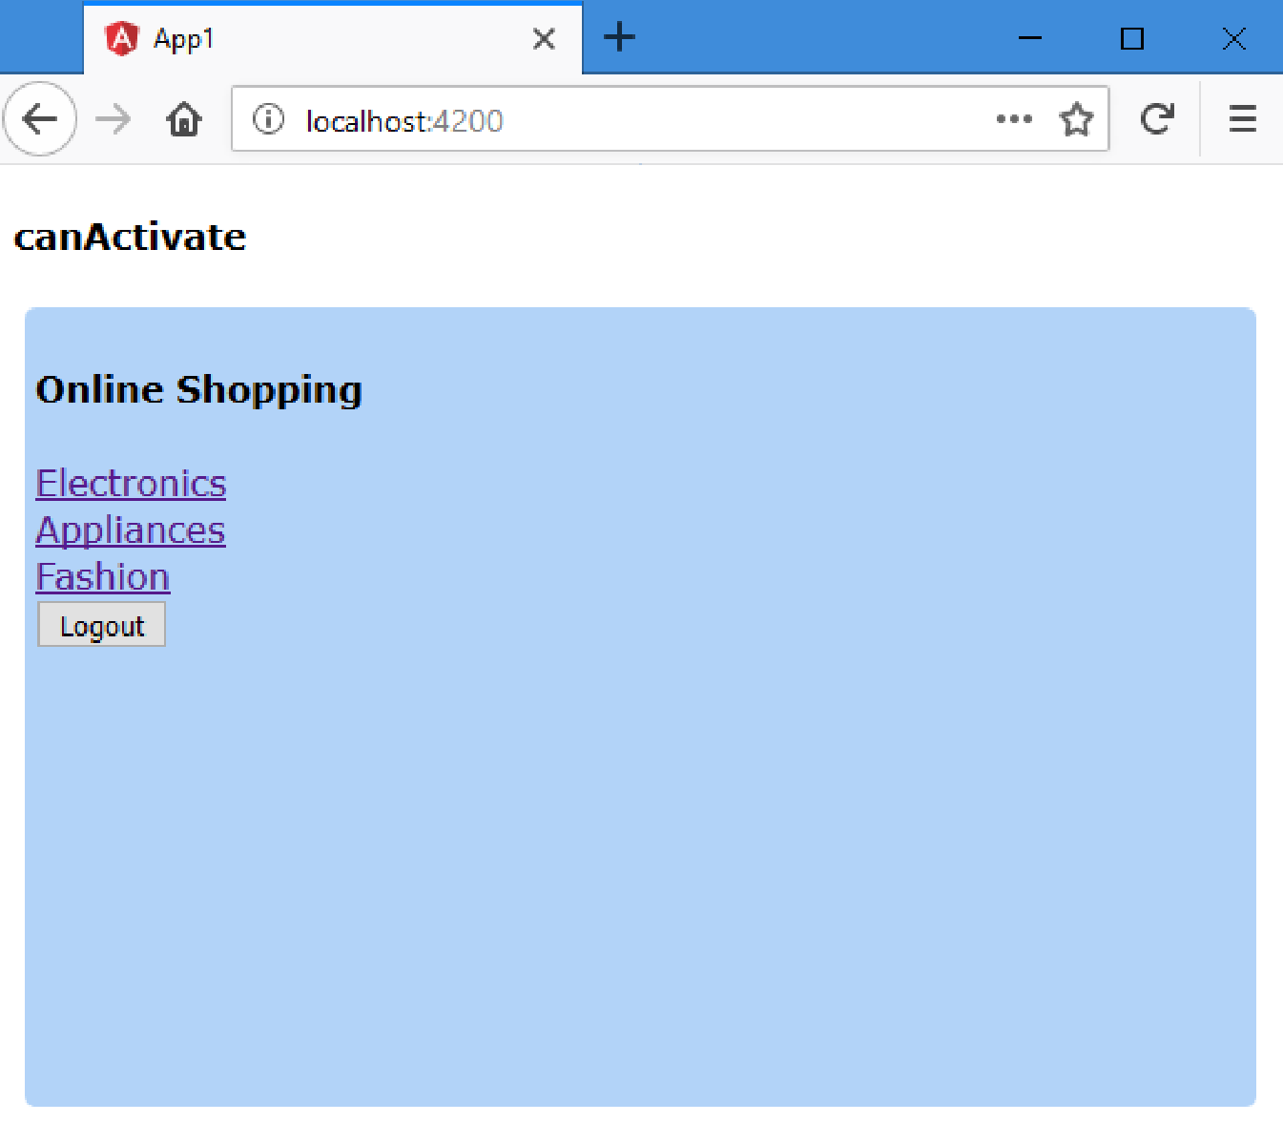

Slide 19
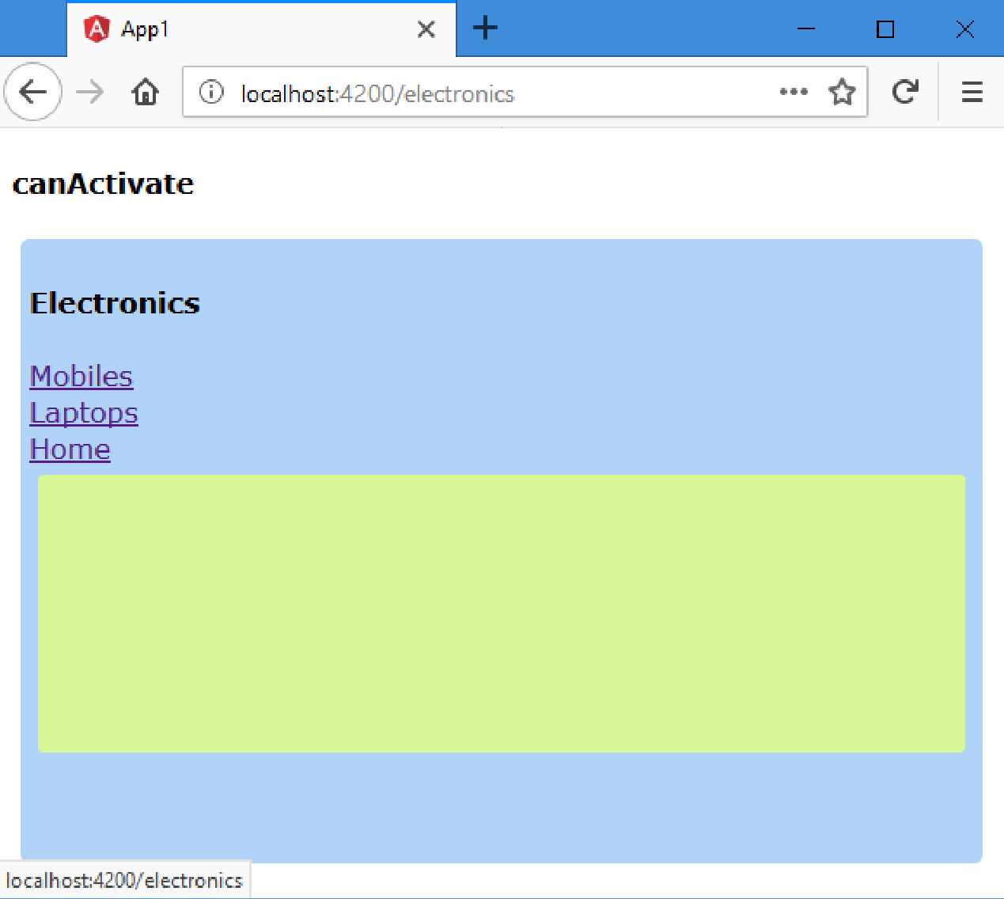

Slide 20
CanDeactivate
The "CanDeactivate" Guard executes before leaving from a route.
This guard can be created by implementing "CanDeactivate" interface.
The "CanDeactivate" interface has a method called "canDeactivate". This method must return a boolean value, which indicates whether the route can be leave or not. If we return "true", the route will be left; if we return "false", the route navigation will be stopped.
It can receive an argument of an user-defined interface type, which represents the current component.

Slide 21
Steps for Working with CanDeactive
Import "CanDeactivate" interface from "@angular/router" package:
import { CanDeactivate } from "@angular/router";
Create the interface for CanDeactive Guard:
interface interfacename { canNavigate: boolean; }
Create a Service that implements "CanDeactivate" interface:
class Serviceclassname implements CanDeactivate<interfacename> {
canDeactivate(component: interfacename): boolean {
return true / false;
}
}
Add service to the module:
@NgModule( { …, providers: [ Serviceclassname ] } )
class moduleclassname { }
Add guard to the route: { path: "path here", component:
ComponentClassname, canDeactivate: [ Serviceclassname ] }

Slide 22
CanDeactivate - Example
Creating Application
Open Command Prompt and enter the following commands:
cd c:\angular
ng new app1
cd c:\angular\app1
ng g component Home
ng g component About
ng g component Contact
//ng g class CanComponentDeactivate
ng g interface CanComponentDeactivate
ng g service CanDeactiveGuard

Slide 23
c:\angular\app1\src\app\can-component-deactivate.ts
export interface CanComponentDeactivate {
canNavigate: boolean;
}
c:\angular\app1\src\app\can-deactivate-guard.service.ts
import { Injectable } from '@angular/core’;
import { CanDeactivate } from "@angular/router";
import { CanComponentDeactivate } from "./can-component-deactivate";
@Injectable() export class CanDeactivateGuardService implements CanDeactivate<CanComponentDeactivate> {
canDeactivate(component: CanComponentDeactivate) {
if (component.canNavigate == true) { return true; }
else {
if (confirm("Do you want to discard changes?")) { return true; }
else { return false; }
}
}
}

Slide 24
c:\angular\app1\src\app\app.module.ts
import { BrowserModule } from '@angular/platform-browser’;
import { NgModule } from '@angular/core’;
import { AppComponent } from './app.component’;
import { FormsModule } from "@angular/forms";
import { Routes, RouterModule } from "@angular/router";
import { HomeComponent } from './home/home.component’;
import { AboutComponent } from './about/about.component’;
import { ContactComponent } from './contact/contact.component’;
import { CanDeactivateGuardService } from "./can-deactivate-guard.service";
var myroutes: Routes = [
{ path: "", component: HomeComponent },
{ path: "home", component: HomeComponent, canDeactivate: [CanDeactivateGuardService] },
{ path: "about", component: AboutComponent },
{ path: "contact", component: ContactComponent }
];
var myroutes2 = RouterModule.forRoot(myroutes);

Slide 25
@NgModule({
declarations: [ AppComponent, HomeComponent, AboutComponent, ContactComponent ],
imports: [ BrowserModule, FormsModule, myroutes2 ],
providers: [CanDeactivateGuardService ],
bootstrap: [AppComponent]
})
export class AppModule { }
c:\angular\app1\src\app\app.component.ts
import { Component } from "@angular/core";
@Component({
selector: 'app-root',
templateUrl: './app.component.html',
styleUrls: ['./app.component.css’]
})
export class AppComponent { }

Slide 26
c:\angular\app1\src\app\app.component.html
<div class="class1">
<h4>CanDeactivate</h4>
<a routerLink="home">Home</a>
<a routerLink="about">About</a>
<a routerLink="contact">Contact</a>
<div id="container">
<router-outlet> </router-outlet>
</div>
</div>

Slide 27
c:\angular\app1\src\app\home\home.component.ts
import { Component } from '@angular/core';
@Component({
selector: 'app-home',
templateUrl: './home.component.html',
styleUrls: ['./home.component.css’]
})
export class HomeComponent {
firstname: string = null;
lastname: string = null;
canNavigate: boolean = true;
onFirstNameChange() { this.canNavigate = false; }
onLastNameChange() { this.canNavigate = false; }
onSave() { this.canNavigate = true; alert("Saved"); }
}
c:\angular\app1\src\app\home\home.component.html
<div class="class1">
<h5>Home</h5>
Firstname: <input type="text" (change)="onFirstNameChange()"><br>
Lastname: <input type="text" (change)="onLastNameChange()"><br>
<input type="submit" value="Save" (click)="onSave()">
</div>

Slide 28
c:\angular\app1\src\app\about\about.component.ts
import { Component, OnInit } from '@angular/core';
@Component({
selector: 'app-about',
templateUrl: './about.component.html',
styleUrls: ['./about.component.css’]
})
export class AboutComponent implements OnInit {
constructor() { }
ngOnInit() { }
}
c:\angular\app1\src\app\about\about.component.html
<div class="class1">
<h5>About</h5>
</div>

Slide 29
c:\angular\app1\src\app\contact\contact.component.ts
import { Component, OnInit } from '@angular/core';
@Component({
selector: 'app-contact',
templateUrl: './contact.component.html',
styleUrls: ['./contact.component.css’]
})
export class ContactComponent implements OnInit {
constructor() { }
ngOnInit() { }
}
c:\angular\app1\src\app\contact\contact.component.html
<div class="class1">
<h5>Contact</h5>
</div>

Slide 30
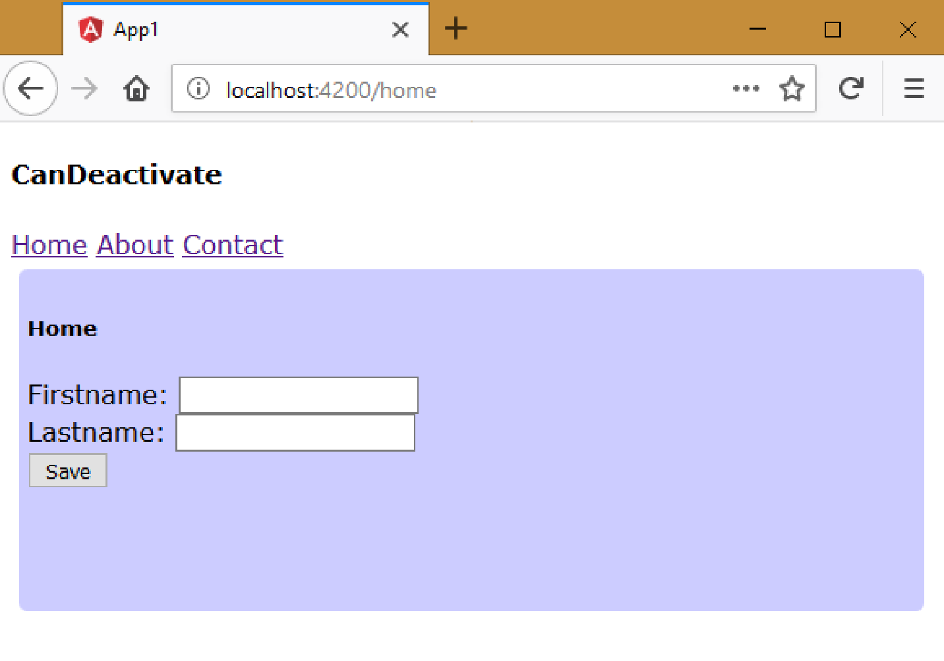

Slide 31
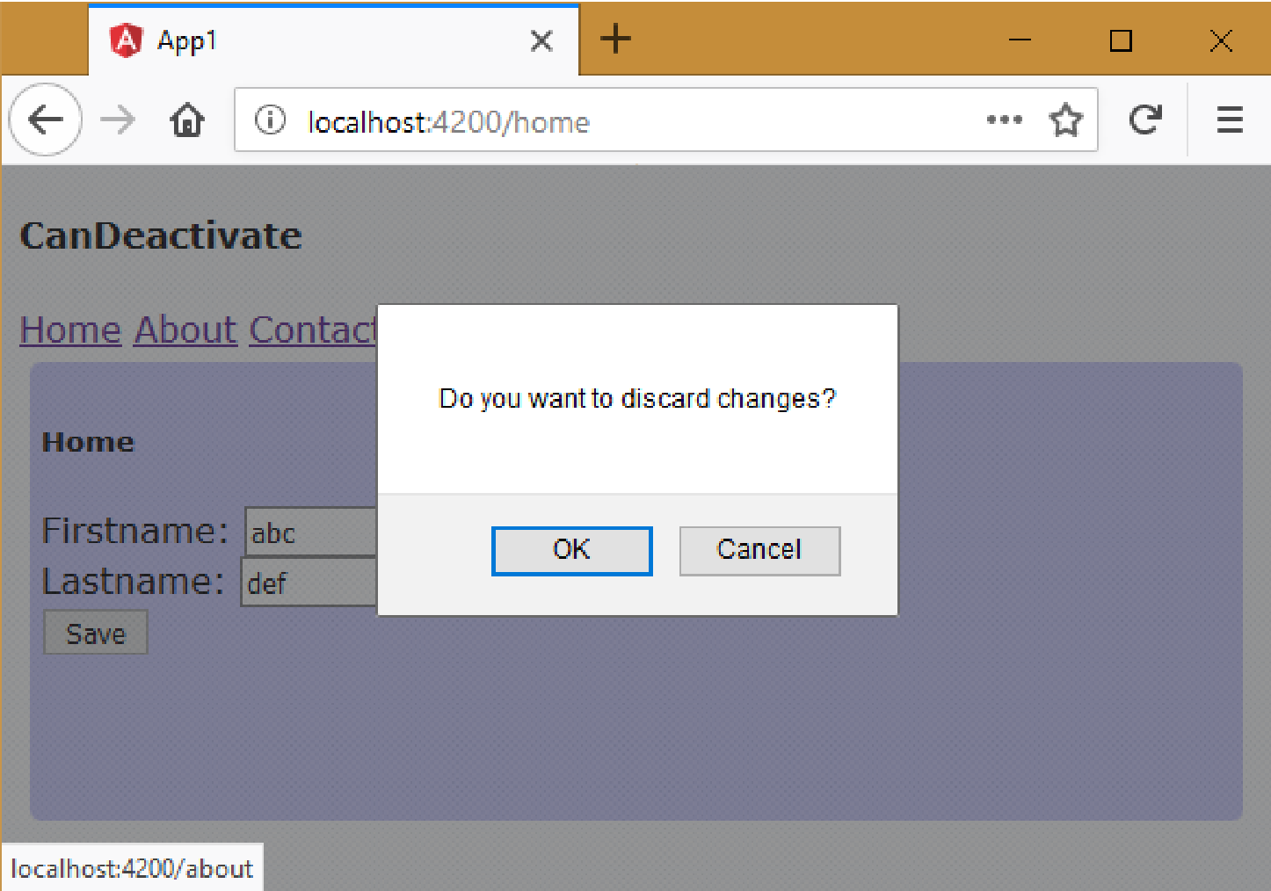

Slide 32
