Slide 1
Angular
Anil K

Slide 2
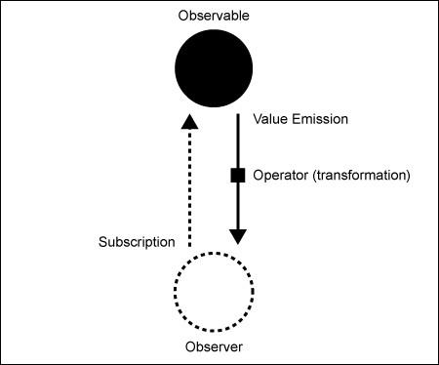
RxJS
Observable and Observer
Observable is a data source (User events, Http requests, Custom data source), which emits data packets to the observer.
Observer is an object that subscribes to the observable and listens to the data packets that are sent by observables.
Data Flow
“Observable” emits (sends) data to observer. Everytime it emits data, the corresponding callback function automatically executes in observer.

Slide 3
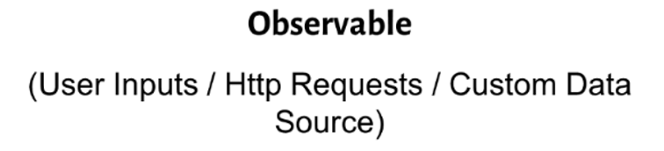
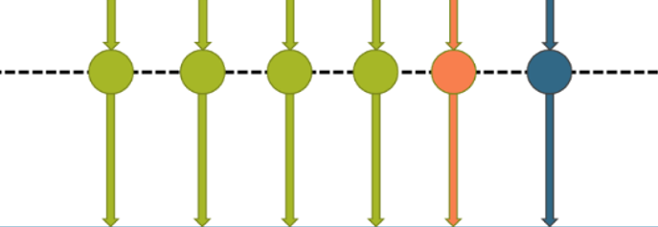
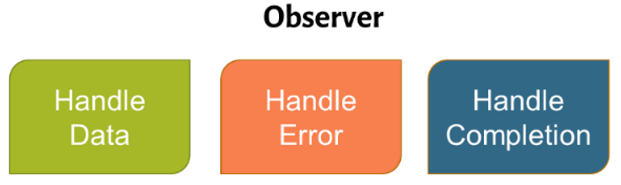
Types of Callback functions in Observer:
HandleData Callback: It executes when next data packet has been emitted by the observable.
HandleError Callback: It executes when error emitted by the observable. If this is invoked, the observable stream ends; that means, no other callback functions are invoked further.
HandleCompletion Callback: It executes when observable indicates stream completion. If this is invoked, the observable stream ends; that means, no other callback functions are invoked further.

Slide 4
Creating Observable
Import “Observable”:
import { Observable } from “rxjs/Observable”;
Import RxJS Operators:
import “rxjs/rx”;
Creating Observable:
1. Observable.interval( )
2. Observable.range( )
3. Observable.from( )
4. Observable.fromEvent( )
5. Observable.create( )
6. Subject

Slide 5
Creating Observer
Observablevariable.subscribe( () => { … }, () => { … }, () => { …} )
Note: The three callback functions are respectively “data callback”, “error callback” and “completion callback”. The data callback executes when the observable emits (passes) some data to the observer. The error callback executes when the observable emits (passes) some error; but all further callbacks will be stopped in this case. The completion callback executes when the observable emits (passes) completion to observer; so further callbacks will be stopped in this case also.

Slide 6
Observable.interval
It emits (passes) a number (0 to unlimited) to the observer, for every completion of specified no. of milli seconds.
It is the easy way to create observable. For every specified no. of milli seconds, it invokes the observer. The observer receives a new value.

Slide 7
Creating Observable.interval
Observable.interval(milli seconds);
Observable.Interval - Example
Creating Application
Open Command Prompt and enter the following commands:
cd c:\angular
ng new app1
cd c:\angular\app1
ng g component Home
ng g component About
ng g component Contact

Slide 8
c:\angular\app1\src\app\app.module.ts
import { BrowserModule } from '@angular/platform-browser’;
import { NgModule } from '@angular/core’;
import { AppComponent } from './app.component’;
import { FormsModule } from "@angular/forms";
import { Routes, RouterModule } from "@angular/router";
import { HomeComponent } from './home/home.component’;
import { AboutComponent } from './about/about.component’;
import { ContactComponent } from './contact/contact.component';
var myroutes: Routes = [
{ path: "", component: HomeComponent },
{ path: "home", component: HomeComponent },
{ path: "about", component: AboutComponent },
{ path: "contact", component: ContactComponent }
];
var myroutes2 = RouterModule.forRoot(myroutes);
@NgModule({
declarations: [ AppComponent, HomeComponent, AboutComponent, ContactComponent ],
imports: [ BrowserModule, FormsModule, myroutes2 ],
providers: [],
bootstrap: [AppComponent]
})
export class AppModule { }

Slide 9
c:\angular\app1\src\app\app.component.ts
import { Component } from "@angular/core";
import { FormGroup, FormControl, Validators } from "@angular/forms";
@Component({
selector: 'app-root',
templateUrl: './app.component.html',
styleUrls: ['./app.component.css’]
})
export class AppComponent { }
c:\angular\app1\src\app\app.component.html
<div class="class1">
<h4>Routing</h4>
<a routerLink="home">Home</a>
<a routerLink="about">About</a>
<a routerLink="contact">Contact</a>
<div id="container">
<router-outlet> </router-outlet>
</div>
</div>

Slide 10
c:\angular\app1\src\app\home\home.component.ts
import { Component, OnInit, OnDestroy } from '@angular/core’;
import { Observable } from "rxjs/Observable";
import "rxjs/Rx";
import { Subscription } from "rxjs/Subscription";
@Component({
selector: 'app-home',
templateUrl: './home.component.html',
styleUrls: ['./home.component.css’]
})

Slide 11
export class HomeComponent implements OnInit, OnDestroy {
subscription = new Subscription();
ngOnInit() {
var mynumbers = interval(1000);
this.subscription = mynumbers.subscribe(
(n) => { console.log(n); },
(error) => { console.log(error); },
() => { console.log("Completed"); }
);
}
ngOnDestroy() { this.subscription.unsubscribe(); }
}
c:\angular\app1\src\app\home\home.component.html
<div class="class1">
<h5>Home</h5>
</div>

Slide 12
c:\angular\app1\src\app\about\about.component.ts
import { Component, OnInit } from '@angular/core';
@Component({
selector: 'app-about',
templateUrl: './about.component.html',
styleUrls: ['./about.component.css’]
})
export class AboutComponent implements OnInit {
constructor() { }
ngOnInit() { }
}
c:\angular\app1\src\app\about\about.component.html
<div class="class1">
<h5>About</h5>
</div>

Slide 13
c:\angular\app1\src\app\contact\contact.component.ts
import { Component, OnInit } from '@angular/core';
@Component({
selector: 'app-contact',
templateUrl: './contact.component.html',
styleUrls: ['./contact.component.css’]
})
export class ContactComponent implements OnInit {
constructor() { }
ngOnInit() { }
}
c:\angular\app1\src\app\contact\contact.component.html
<div class="class1">
<h5>Contact</h5>
</div>

Slide 14
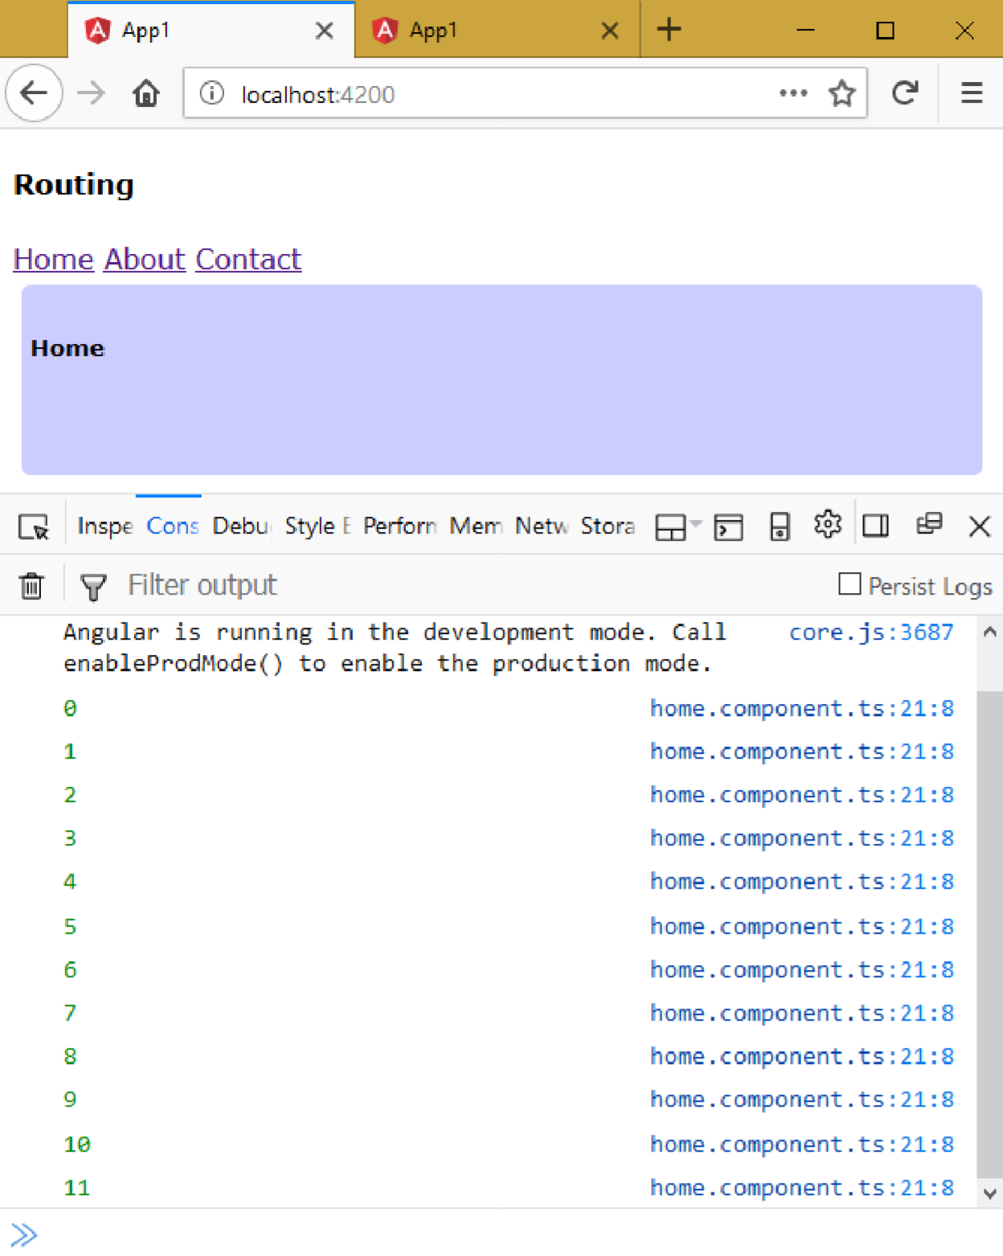
Executing the application: • Open Command Prompt and enter the following commands: cd c:\angular\app1 ng serve • Open the browser and enter the following URL: http://localhost:4200

Slide 15
Observable.range
It emits (passes) a number (beginning with start number, incremented by one, upto the specified count of numbers) to the observer.

Slide 16
Creating Observable.range
Observable.range(start, count);
Observable.range - Example
Creating Application
Open Command Prompt and enter the following commands:
cd c:\angular
ng new app1
cd c:\angular\app1
ng g component Home
ng g component About
ng g component Contact

Slide 17
c: \angular\ app1\ src\ app\ app.module.ts
import {BrowserModule} from '@angular/platform-browser';
import {NgModule} from '@angular/core';
import {AppComponent} from './app.component';
import {FormsModule} from "@angular/forms";
import {Routes,RouterModule} from "@angular/router";
import {HomeComponent} from './home/home.component';
import {AboutComponent} from './about/about.component';
import {ContactComponent} from './contact/contact.component';
var myroutes: Routes = [ {path: "", component: HomeComponent},
{ path: "home", component: HomeComponent},
{ path: "about", component: AboutComponent},
{ path: "contact", component: ContactComponent}];
var myroutes2 = RouterModule.forRoot(myroutes);
@NgModule({
declarations: [AppComponent, HomeComponent, AboutComponent, ContactComponent],
imports: [BrowserModule, FormsModule, myroutes2],
providers: [],
bootstrap: [AppComponent]
}) export class AppModule {}

Slide 18
c: \angular\ app1\ src\ app\ app.component.ts
import {Component} from "@angular/core";
import {FormGroup,FormControl,Validators} from "@angular/forms";
@Component({
selector: 'app-root',
templateUrl: './app.component.html',
styleUrls: ['./app.component.css']
}) export class AppComponent {}
c:\angular\app1\src\app\app.component.html
<div class="class1">
<h4>Routing</h4> <a routerLink="home">Home</a>
<a routerLink="about">About</a> <a routerLink="contact">Contact</a>
<div id="container">
<router-outlet> </router-outlet>
</div>
</div>

Slide 19
c:\angular\app1\src\app\home\home.component.ts
import { Component, OnInit, OnDestroy } from '@angular/core’;
import { Observable, Subscription , range } from "rxjs";
@Component({
selector: 'app-home',
templateUrl: './home.component.html',
styleUrls: ['./home.component.css’]
})
export class HomeComponent implements OnInit, OnDestroy {
Subscription = Subscription();
ngOnInit() {
var mynumbers = range(11, 20);
this.subscription = mynumbers.subscribe(
(n) => { console.log(n); },
(error) => { console.log(error); },
() => { console.log("Completed"); }
);
}
ngOnDestroy() { this.subscription.unsubscribe(); }
}

Slide 20
c:\angular\app1\src\app\home\home.component.html
<div class="class1">
<h5>Home</h5>
</div>
c:\angular\app1\src\app\about\about.component.ts
import { Component, OnInit } from '@angular/core';
@Component({
selector: 'app-about',
templateUrl: './about.component.html',
styleUrls: ['./about.component.css’]
})
export class AboutComponent implements OnInit {
constructor() { }
ngOnInit() { }
}
c:\angular\app1\src\app\about\about.component.html
<div class="class1">
<h5>About</h5>
</div>

Slide 21
c:\angular\app1\src\app\contact\contact.component.ts
import { Component, OnInit } from '@angular/core';
@Component({
selector: 'app-contact',
templateUrl: './contact.component.html',
styleUrls: ['./contact.component.css’]
})
export class ContactComponent implements OnInit {
constructor() { }
ngOnInit() { }
}
c:\angular\app1\src\app\contact\contact.component.html
<div class="class1">
<h5>Contact</h5>
</div>

Slide 22
Executing the application:
Open Command Prompt and enter the following commands:
cd c:\angular\app1 ng serve
Open the browser and enter the following URL:
http://localhost:4200

Slide 23
Observable.from
It emits (passes) each element of an array one-by-one, from first to last element, to the observer.

Slide 24
Creating Observable.from
Observable.from(array);
Observable.from - Example
Creating Application
Open Command Prompt and enter the following commands:
cd c:\angular
ng new app1
cd c:\angular\app1
ng g component Home
ng g component About
ng g component Contact

Slide 25
c:\angular\app1\src\app\app.module.ts
import { BrowserModule } from '@angular/platform-browser’;
import { NgModule } from '@angular/core’;
import { AppComponent } from './app.component’;
import { FormsModule } from "@angular/forms";
import { Routes, RouterModule } from "@angular/router";
import { HomeComponent } from './home/home.component’;
import { AboutComponent } from './about/about.component’;
import { ContactComponent } from './contact/contact.component';
var myroutes: Routes = [ { path: "", component: HomeComponent },
{ path: "home", component: HomeComponent },
{ path: "about", component: AboutComponent },
{ path: "contact", component: ContactComponent } ];
var myroutes2 = RouterModule.forRoot(myroutes);
@NgModule({
declarations: [ AppComponent, HomeComponent, AboutComponent, ContactComponent ],
imports: [ BrowserModule, FormsModule, myroutes2 ],
providers: [],
bootstrap: [AppComponent]
})
export class AppModule { }

Slide 26
c:\angular\app1\src\app\app.component.ts
import { Component } from "@angular/core";
import { FormGroup, FormControl, Validators } from "@angular/forms";
@Component({
selector: 'app-root',
templateUrl: './app.component.html',
styleUrls: ['./app.component.css’]
})
export class AppComponent { }
c:\angular\app1\src\app\app.component.html
<div class="class1">
<h4>Routing</h4>
<a routerLink="home">Home</a>
<a routerLink="about">About</a>
<a routerLink="contact">Contact</a>
<div id="container">
<router-outlet> </router-outlet>
</div>
</div>

Slide 27
c: \angular\ app1\ src\ app\ home\ home.component.ts
import {Component,OnInit, OnDestroy} from '@angular/core';
import {Observable, Subscription , from} from "rxjs";
@Component({
selector: 'app-home',
templateUrl: './home.component.html',
styleUrls: ['./home.component.css']
})
export class HomeComponent implements OnInit, OnDestroy {
subscription = new Subscription();

Slide 28
ngOnInit() {
var myarray = [10, 20, 30, 40, 50];
var mynumbers = from(myarray);
this.subscription = mynumbers.subscribe((n) => {
console.log(n);
}, (error) => {
console.log(error);
}, () => {
console.log("Completed");
});
}
ngOnDestroy() {
this.subscription.unsubscribe();
}
}
c:\angular\app1\src\app\home\home.component.html
<div class="class1">
<h5>Home</h5>
</div>

Slide 29
c: \angular\ app1\ src\ app\ about\ about.component.ts
import {Component,OnInit} from '@angular/core’;
@Component({
selector: 'app-about',
templateUrl: './about.component.html',
styleUrls: ['./about.component.css']
}) export class AboutComponent implements OnInit {
constructor() {}
ngOnInit() {}
}
c:\angular\app1\src\app\about\about.component.html
<div class="class1">
<h5>About</h5>
</div>

Slide 30
c: \angular\ app1\ src\ app\ contact\ contact.component.ts
import {Component,OnInit} from '@angular/core’;
@Component({
selector: 'app-contact',
templateUrl: './contact.component.html',
styleUrls: ['./contact.component.css']
}) export class ContactComponent implements OnInit {
constructor() {}
ngOnInit() {}
}
c:\angular\app1\src\app\contact\contact.component.html
<div class="class1">
<h5>Contact</h5>
</div>

Slide 31
Executing the application:
Open Command Prompt and enter the following commands:
cd c:\angular\app1 ng serve
Open the browser and enter the following URL: http://localhost:4200

Slide 32
Observable.fromEvent
It emits (passes) “event arguments” to the observer, everytime the event is raised.

Slide 33
Creating Observable.fromEvent Observable.fromEvent(document.getElementById(“element”), “event”);
Observable.fromEvent - Example
Creating Application
Open Command Prompt and enter the following commands:
cd c:\angular
ng new app1
cd c:\angular\app1
ng g component Home
ng g component About
ng g component Contact

Slide 34
c: \angular\ app1\ src\ app\ app.module.ts
import {BrowserModule} from '@angular/platform-browser';
import {NgModule} from '@angular/core';
import {AppComponent} from './app.component';
import {FormsModule} from "@angular/forms";
import {Routes, RouterModule} from "@angular/router";
import {HomeComponent} from './home/home.component';
import {AboutComponent} from './about/about.component';
import {ContactComponent} from './contact/contact.component';
var myroutes: Routes = [{path: "", component: HomeComponent},
{ path: "home",component: HomeComponent},
{path: "about",component: AboutComponent},
{path: "contact",component: ContactComponent}];
var myroutes2 = RouterModule.forRoot(myroutes);
@NgModule({
declarations: [AppComponent, HomeComponent, AboutComponent, ContactComponent],
imports: [BrowserModule, FormsModule, myroutes2],
providers: [],
bootstrap: [AppComponent]
}) export class AppModule {}

Slide 35
c: \angular\ app1\ src\ app\ app.component.ts
import {Component} from "@angular/core";
@Component({
selector: 'app-root',
templateUrl: './app.component.html',
styleUrls: ['./app.component.css']
}) export class AppComponent {}
c:\angular\app1\src\app\app.component.html
<div class="class1">
<h4>Routing</h4>
<a routerLink="home">Home</a>
<a routerLink="about">About</a>
<a routerLink="contact">Contact</a>
<div id="container">
<router-outlet> </router-outlet>
</div>
</div>

Slide 36
c: \angular\ app1\ src\ app\ home\ home.component.ts
import {Component, OnInit, OnDestroy} from '@angular/core';
import {Observable,Subscription, fromEvent} from "rxjs";
@Component({
selector: 'app-home',
templateUrl: './home.component.html',
styleUrls: ['./home.component.css']
})
export class HomeComponent implements OnInit, OnDestroy {
subscription = new Subscription();
ngOnInit() {
var txtEle = document.getElementById("txt1");
var txtClick = fromEvent(txtEle!, "keyup");
this.subscription = txtClick.subscribe((n) => {
console.log(n);
}, (error) => {
console.log(error);
}, () => {
console.log("Completed");
});
}
ngOnDestroy() {
this.subscription.unsubscribe();
}
}

Slide 37
c:\angular\app1\src\app\home\home.component.html
<div class="class1">
<h5>Home</h5>
<input type="text" id="txt1">
</div>
c: \angular\ app1\ src\ app\ about\ about.component.ts
import {Component,OnInit} from '@angular/core';
@Component({
selector: 'app-about',
templateUrl: './about.component.html',
styleUrls: ['./about.component.css']
}) export class AboutComponent implements OnInit {
constructor() {}
ngOnInit() {}
}
c:\angular\app1\src\app\about\about.component.html
<div class="class1">
<h5>About</h5>
</div>

Slide 38
c: \angular\ app1\ src\ app\ contact\ contact.component.ts
import {Component,OnInit} from '@angular/core';
@Component({
selector: 'app-contact',
templateUrl: './contact.component.html',
styleUrls: ['./contact.component.css']
}) export class ContactComponent implements OnInit {
constructor() {}
ngOnInit() {}
}
c:\angular\app1\src\app\contact\contact.component.html
<div class="class1">
<h5>Contact</h5>
</div>

Slide 39
Executing the application:
Open Command Prompt and enter the following commands:
cd c:\angular\app1
ng serve
Open the browser and enter the following URL:
http://localhost:4200

Slide 40
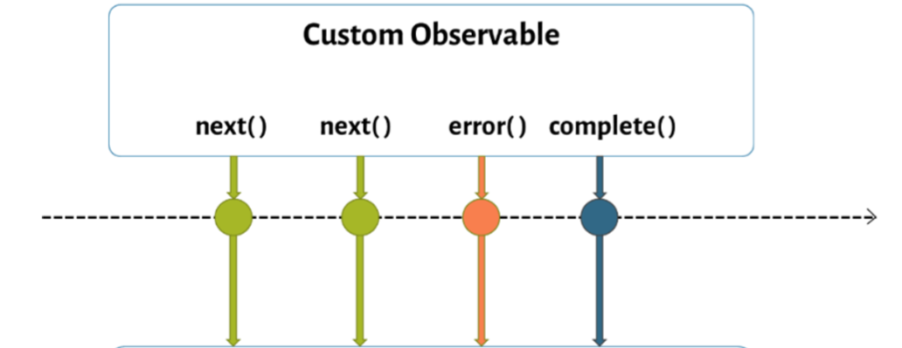

Custom Observables
It emits (passes) “event arguments” to the observer, everytime the event is raised.

Slide 41
Creating Custom Observables
import { Observer } from "rxjs/Observer";
Observable.create( (observer : Observer) => {
observer.next(data); //passes data to "handle data" function
observer.error(data); //passes data to "handle error" function
observer.complete(); //finishes the observable and calls "handle completion" function
});

Slide 42
Custom Observables - Example
Creating Application
Open Command Prompt and enter the following commands:
cd c:\angular
ng new app1
cd c:\angular\app1
ng g component Home
ng g component About
ng g component Contact

Slide 43
c: \angular\ app1\ src\ app\ app.module.ts
import {BrowserModule} from '@angular/platform-browser';
import {NgModule} from '@angular/core';
import {AppComponent} from './app.component';
import {FormsModule} from "@angular/forms";
import {Routes,RouterModule} from "@angular/router";
import { HomeComponent} from './home/home.component';
import { AboutComponent} from './about/about.component';
import { ContactComponent} from './contact/contact.component';
var myroutes: Routes = [{ path: "", component: HomeComponent},
{ path: "home", component: HomeComponent},
{ path: "about", component: AboutComponent},
{ path: "contact", component: ContactComponent}];
var myroutes2 = RouterModule.forRoot(myroutes);
@NgModule({
declarations: [AppComponent, HomeComponent, AboutComponent, ContactComponent],
imports: [BrowserModule, FormsModule, myroutes2],
providers: [],
bootstrap: [AppComponent]
}) export class AppModule {}

Slide 44
c: \angular\ app1\ src\ app\ app.component.ts
import {Component} from "@angular/core";
@Component({
selector: 'app-root',
templateUrl: './app.component.html',
styleUrls: ['./app.component.css']
}) export class AppComponent {}
c:\angular\app1\src\app\app.component.html <div class="class1">
<h4>Routing</h4> <a routerLink="home">Home</a> <a routerLink="about">About</a> <a routerLink="contact">Contact</a>
<div id="container">
<router-outlet> </router-outlet>
</div>
</div>

Slide 45
c: \angular\ app1\ src\ app\ home\ home.component.ts
import { Component, OnInit, OnDestroy } from '@angular/core';
import { Observable, Subscription, Observer } from "rxjs";
@Component({
selector: 'app-home',
templateUrl: './home.component.html',
styleUrls: ['./home.component.css']
})
export class HomeComponent implements OnInit, OnDestroy {
subscription = new Subscription();
ngOnInit() {
var myObservable = new Observable((observer: Observer<string>) => {
setTimeout(() => {
observer.next("first data package");
}, 2000);
setTimeout(() => {
observer.next("second data package");
}, 5000);
setTimeout(() => {
observer.next("third data package");
}, 8000);

Slide 46
//setTimeout(() => { observer.error("error message"); }, 10000);
//setTimeout(() => { observer.complete(); }, 10000);
//setTimeout(() => { observer.next("fourth data package"); }, 12000);
});
this.subscription = myObservable.subscribe(
(n) => {
console.log(n);
}, (error) => {
console.log(error);
}, () => {
console.log("Completed");
});
}
ngOnDestroy() {
this.subscription.unsubscribe();
}
}
c:\angular\app1\src\app\home\home.component.html
<div class="class1">
<h5>Home</h5>
</div>

Slide 47
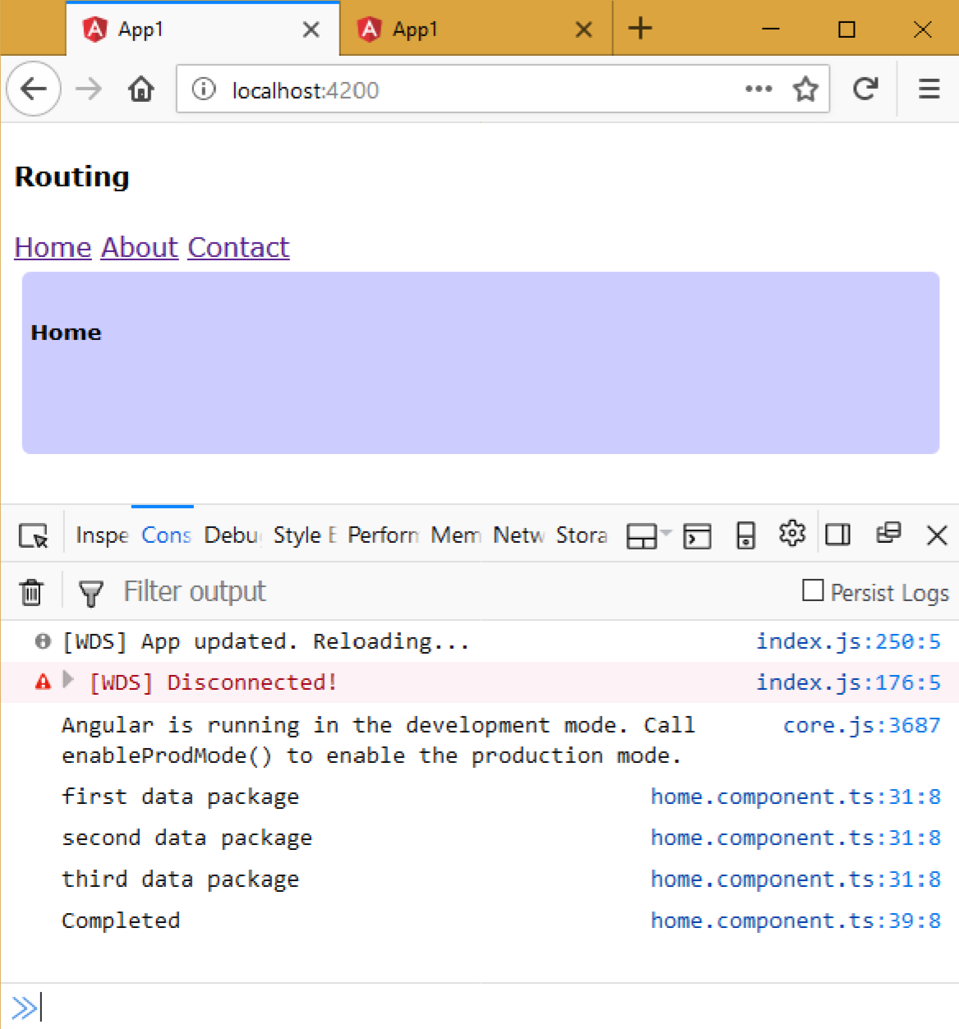
Executing the application:
Open Command Prompt and enter the following commands:
cd c:\angular\app1
ng serve
Open the browser and enter the following URL:
http://localhost:4200

