Slide 1
Angular
Anil K

Slide 2
What is Component?
The component class represents certain section of the web page. For example, “login form” is represented as a “Login Component”.
The component class includes “properties” (to store data), “methods” (event handler methods to manipulate data).
Every “angular 2+ application” contains at-least one component, which is called as “app component”. You can create any no. of components in the project.
The component is invoked (called) through a custom tag (user-defined tag). For example, “login component” is invoked through <app-login></app-login> tag. The custom tag is also called as “selector”.
The component class should have a decorator called “@Component()”, to define that the class is a component class.
Syntax to create Component:
import { Component } from “@angular/core”;
@Component( meta data )
class classname
{
property: datatype = value;
method( arguments ) : returntype
{
}
}

Slide 3
Meta Data Properties of Component:
1.selector:
Represents the selector (tag) to invoke the component.
2.template:
Represents the template content of the component.
3.templateUrl:
Represents the html file that has to be rendered when the component is invoked.
4.styleUrls:
Represents the list of style sheets (css files) that have to be loaded for the component.
5.providers:
Represents the list of services to be imported into the component.
6.animations:
Represents the list of animations to be performed in the component.

Slide 4
What is Module?
Module is a part of the project.
Module is a collection of components, directives and pipes that are related to one specific task of the project.
Ex: “Net banking” project contains modules like “Savings account module”, “Credit cards module” etc.
Every angular application should contain at least one module, which is called as “root module” or “app module”. The “app component” will be a part of the “app module”. Modules can share its components and pipes to other modules.
Module is a class, with “@NgModule” decorator.
Syntax to create Module:
import { NgModule } from “@angular/core”;
@NgModule( meta data )
class classname
{
}

Slide 5
Meta Data Properties of Module:
declarations
Represents the list of components and pipes that are members of the current module.
imports
Represents the list of modules that you want to import into the current module.
You must import “BrowserModule” into the browser, which can be imported from “@angular/platform-browser”.
The “BrowserModule” imports “ApplicationModule” from “@angular/core”, “CommonModule” from “@angular/common” and re-exports them.
The “BrowserModule” must be imported only in the “app module (root module)”; we need not import it in other child modules.
Other modules to import: FormsModule, ReactiveFormsModule,
BrowserAnimationsModule, HttpClientModule, RouterModule etc.
exports
Represents the list of components or pipes that are to be exported to other modules.
bootstrap
Represents the component that is to be displayed in the web page. Only “app module” has to bootstrap “app component”. Other modules should not bootstrap any component.
providers
Represents list of services to be imported into the module.

Slide 6
Syntax to bootstrap (start) the module into the browser:
import { platformBrowserDynamic } from “@angular/platform-browser-dynamic”; platformBrowserDynamic( ).bootstrapModule( moduleclassname );

Slide 7
Data Binding
The “data binding” is the relation between “component” and the “template”.
When the value of “component” is changed, the “template” will be changed automatically. When the value of “template” is changed, the “component” will be changed automatically.
Data binding is four types:
A) Interpolation Binding
B) Property Binding
C) Event Binding
D) Two-Way Binding

Slide 8
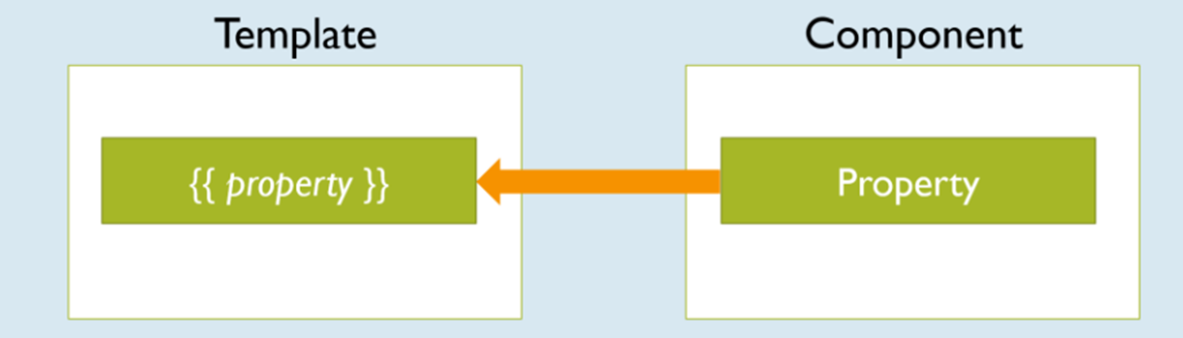
Interpolation Binding
Syntax: {{property}}
It displays the value of the property in the template.
When the value of the property is changed, the same value will be automatically updated in the template.

Slide 9
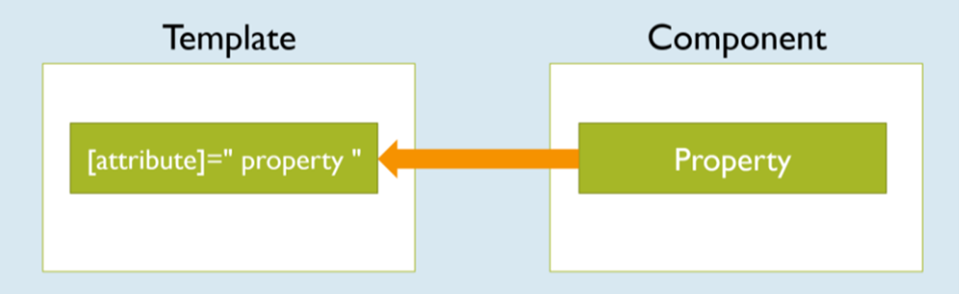
Property Binding
Syntax: <tag [attribute]=” property ”> </tag>
“Property binding” is used to send data from component to template and assign the same into an attribute of the tag.
When the value of the property is changed, the same value will be automatically updated in the template.

Slide 10
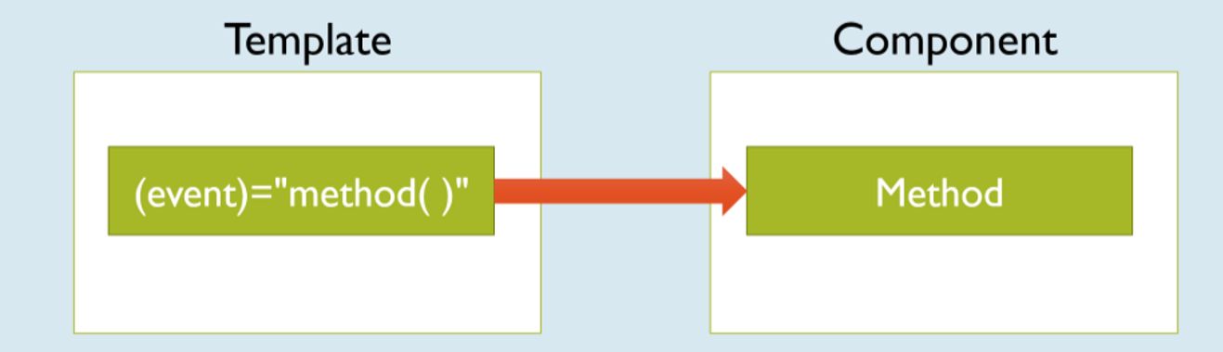
Event Binding
Syntax: <tag (event)=”method( )”> </tag>
It is used to pass event notifications from template to component.

Slide 11
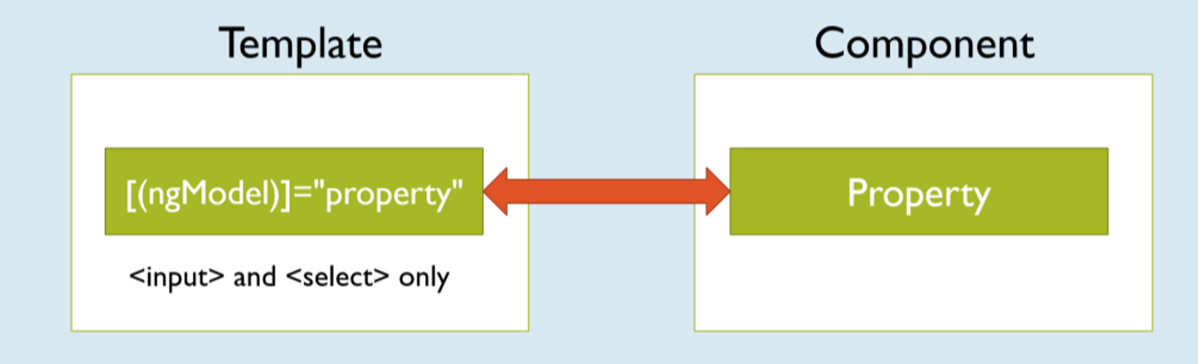
Two-Way Binding
Syntax: <tag [(ngModel)]=”property”> </tag>
“Two Way Binding” (a.k.a Two-Way Data Binding) is a combination of both “property binding” and “event binding”.
When you change the value of “property”, the same will be automatically updated in the “html element”.
When you change the value of “html element”, the same will be automatically updated in the “property”.
The “ngModel” is a pre-defined directive, which is used to create two-way binding.
Two-Way Binding is applicable only for <input> and <select> tags.
“FormsModule” must be imported in order to use two-way binding.

Slide 12
Data Bindings – Example
Creating Application
Open Command Prompt and enter the following commands:
cd c:\angular
ng new app1
c: \angular\ app1\ src\ app\ app.module.ts
import {BrowserModule} from '@angular/platform-browser';
import {NgModule} from '@angular/core';
import {AppComponent} from './app.component';
import {FormsModule} from "@angular/forms";
@NgModule({
declarations: [AppComponent],
imports: [BrowserModule, FormsModule],
providers: [],
bootstrap: [AppComponent]
}) export class AppModule {}

Slide 13
c: \angular\ app1\ src\ app\ app.component.ts
import {Component} from '@angular/core';
@Component({
selector: 'app-root',
templateUrl: './app.component.html',
styleUrls: ['./app.component.css']
}) export class AppComponent {
firstname: string = "Adam";
lastname: string = "Smith";
age: number = 20;
receivenewsletters: boolean = true;
gender: string = "Male";
country: string = "India";
address: string = "http://www.facebook.com";
ChangeData() {
this.firstname = "John";
this.lastname = "Resig";
this.age = 30;
this.receivenewsletters = false;
this.gender = "Female";
this.country = "USA";
}
}

Slide 14
c:\angular\app1\src\app\app.component.html
<div>
<h4>Data Bindings</h4>
Firstname: {{firstname}}<br>
Lastname: {{lastname}}<br>
Age: {{age}}<br>
Receive News Letters: {{receivenewsletters}}<br>
Gender: {{gender}}<br>
Country: {{country}}
<hr>
<a [href]="address">Click here</a>
<hr>
Firstname: <input type="text" [(ngModel)]="firstname"><br>
Lastname: <input type="text" [(ngModel)]="lastname"><br>
Age: <input type="text" [(ngModel)]="age"><br>
Receive News Letters: <input type="checkbox" [(ngModel)]="receivenewsletters"><br>
Gender: <input type="radio" [(ngModel)]="gender" value="Male">Male <input type="radio" [(ngModel)]="gender" value="Female">Female<br>
Country: <select [(ngModel)]="country">
<option>India</option>
<option>UK</option>
<option>USA</option>
</select><br>
<input type="button" value="Change Data" (click)="ChangeData()">
</div>

Slide 15
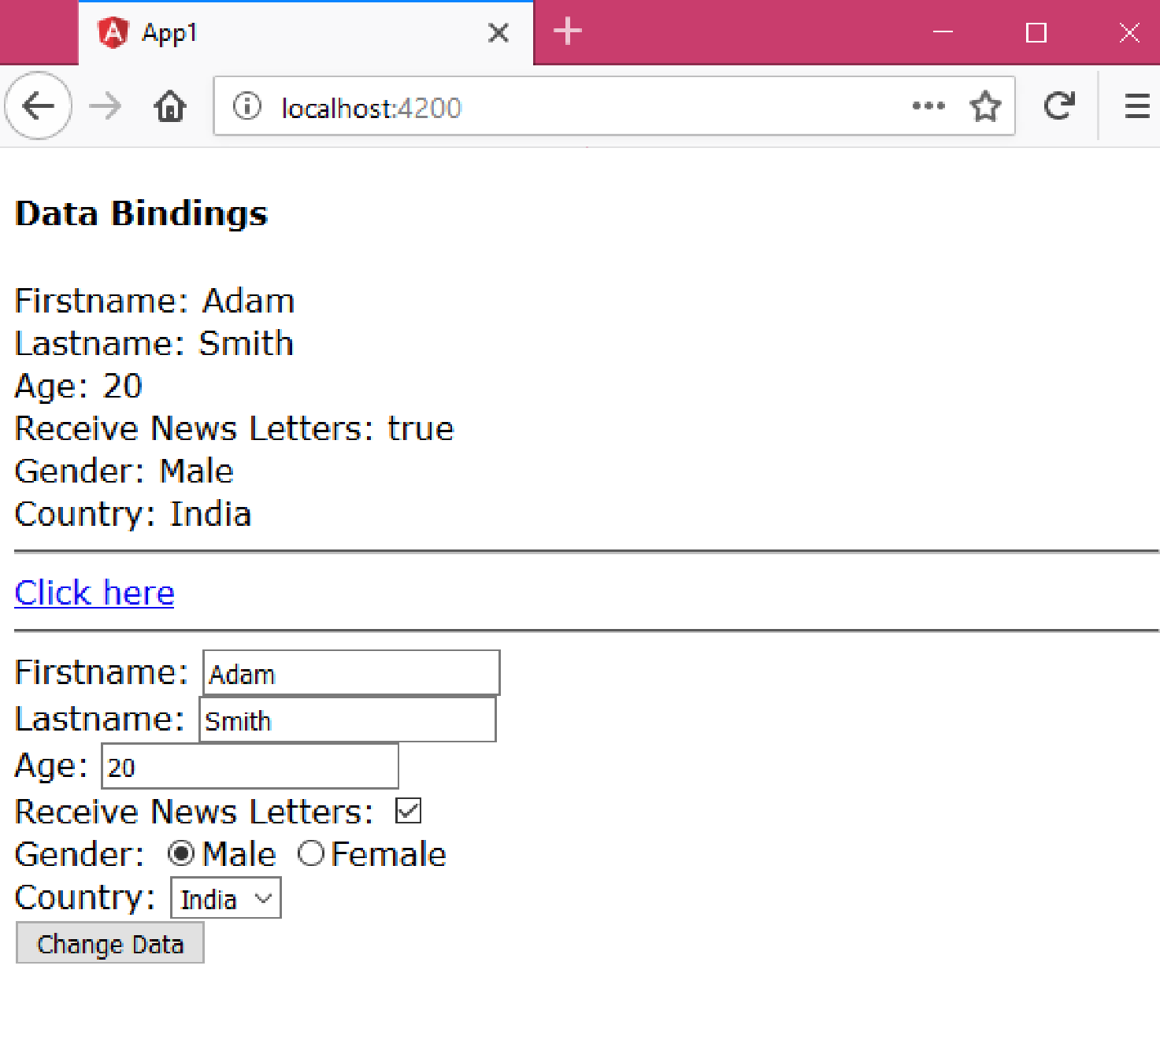
Executing the application:
Open Command Prompt and enter the following commands:
cd c:\angular\app1
ng serve
Open the browser and enter the following URL:
http://localhost:4200

Slide 16
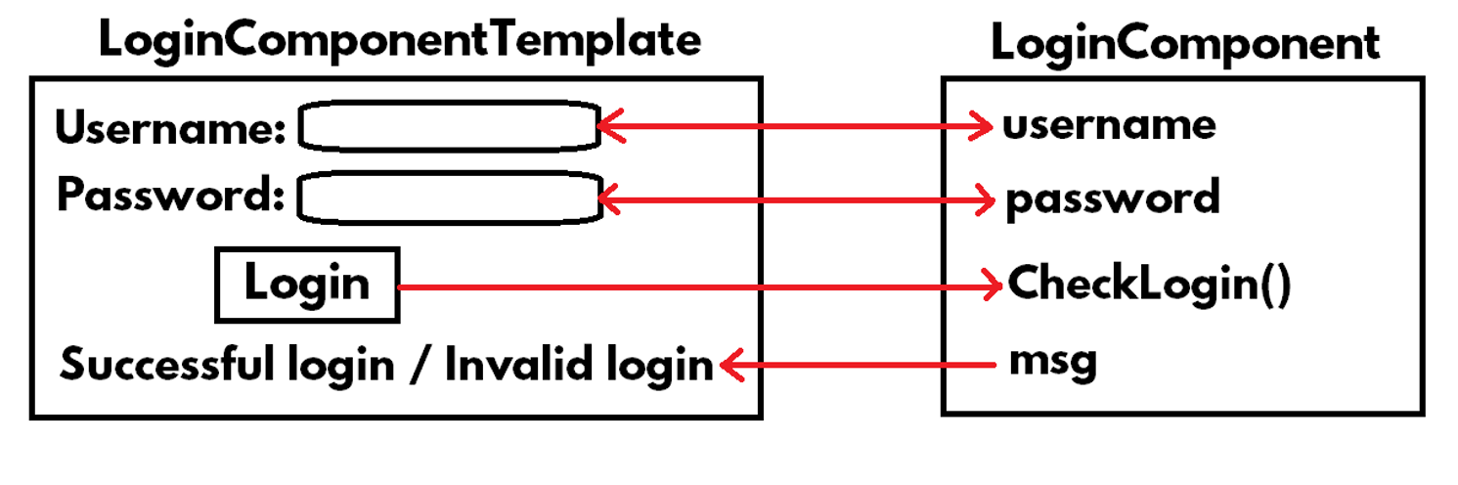
Login – Example
Creating Application
Open Command Prompt and enter the following commands:
cd c:\angular ng
new app1

Slide 17
c:\angular\app1\src\app\app.module.ts
import { BrowserModule } from '@angular/platform-browser';
import { NgModule } from '@angular/core';
import { AppComponent } from './app.component';
import { FormsModule } from "@angular/forms";
@NgModule({
declarations: [ AppComponent ],
imports: [
BrowserModule,
FormsModule
],
providers: [],
bootstrap: [AppComponent]
})
export class AppModule { }

Slide 18
c: \angular\ app1\ src\ app\ app.component.ts
import {Component} from "@angular/core";
@Component({
selector: 'app-root',
templateUrl: './app.component.html',
styleUrls: ['./app.component.css']
})
export class AppComponent {
username: string = "";
password: string = "";
msg: string = "";
CheckLogin(txt1) {
if (this.username == "admin" && this.password == "manager") {
this.msg = "Successful login";
} else {
this.msg = "Invalid login";
txt1.focus();
}
}
}

Slide 19
c:\angular\app1\src\app\app.component.html
<div>
<form>
<h4>Login</h4>
Username: <input type="text" [(ngModel)]="username" name="username" #t1><br>
Password: <input type="password" [(ngModel)]="password" name="password"><br>
<input type="submit" value="Login" (click)="CheckLogin(t1)"><br>
{{msg}}
</form>
</div>

Slide 20
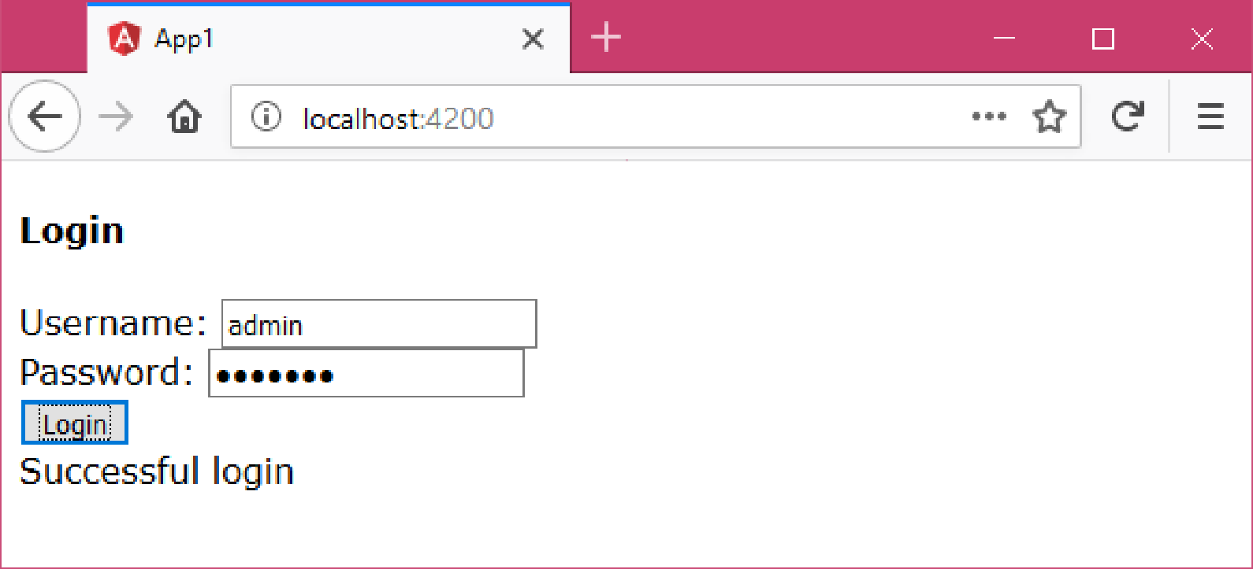
Executing the application:
Open Command Prompt and enter the following commands:
cd c:\angular\app1
ng serve
Open the browser and enter the following URL:
http://localhost:4200

