Slide 1
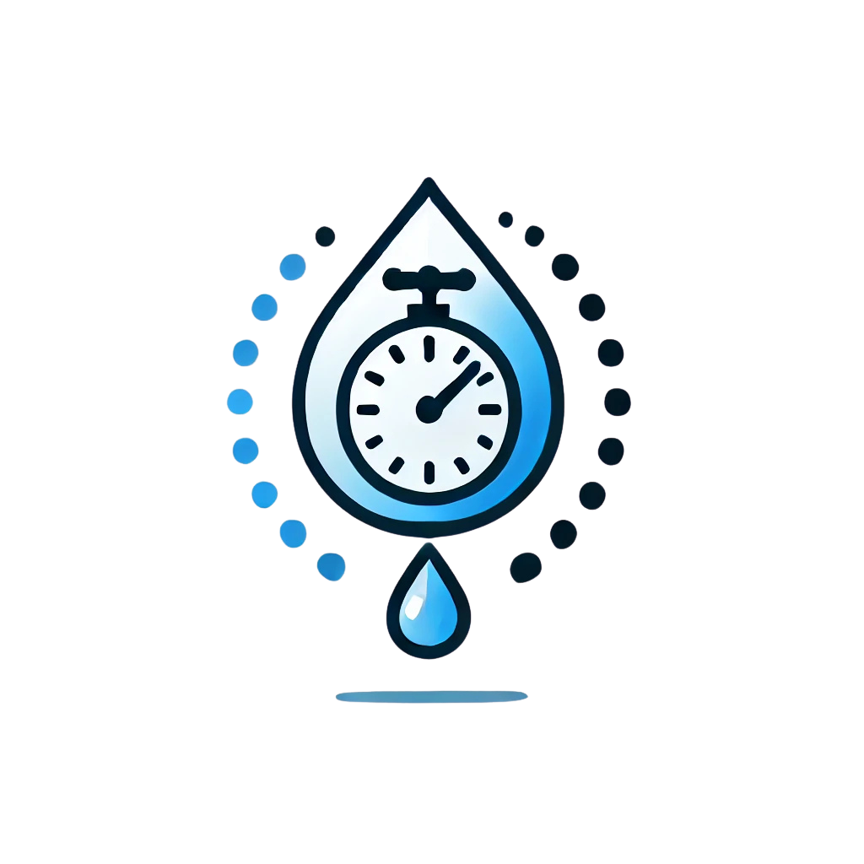
TapTrack
End Water Wastage
One Second At A Time

Slide 2

The Problem: Water Waste
Running Tap
Global Impact
Household Costs
Wastes up to 6 liters per minute
Water scarcity affects over 2 billion people
Increased water bills due to wastage

Slide 3
The Solution: Introducing TapTrack
1
Attachable Timer
2
Tracks Usage
3
Simple and Effective
Easily attaches to any standard tap
Monitors water flow to reduce waste
Promotes water conservation effortlessly

Slide 4



How TapTrack Works
Sensor Detection
Detects when tap is turned on using a motion sensor.
Time-Based Alerts
Notifies users after set time by using an LCD screen and a buzzer
Customisable
Can change timer to suit your everyday unique needs
Can also make customisable message to remind you to stop wasting water.

Slide 5



Benefits of TapTrack
Saves Water
Eco-Friendly
Better Habits
Reduces water bills efficiently
Easy to use for everyone
Encourages conservation practices

Slide 6
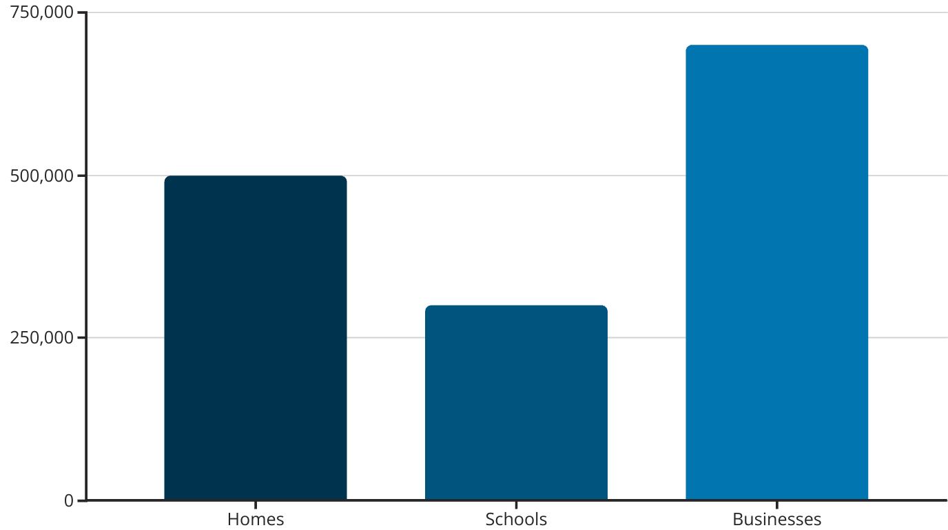
Market and Impact
Amout (Number)
TapTrack can significantly reduce water waste in homes, schools, and businesses, creating a substantial environmental impact.

Slide 7
Join the Movement!
Every drop matters - take action today!
Remember:
You Can End Water Wastage One Second At A Time
With TapTrack

