Slide 1
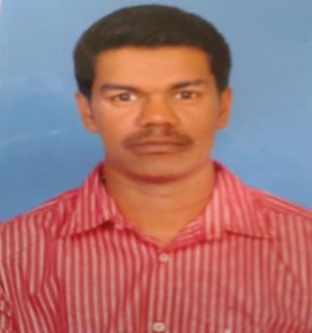
A.MOHAMMED FAZIL
E-mail:fazilinu@gmail.com Contact no. : 9788403885
Permanent Address
No.99, Kanagaraja Ganapathy st, Ponnamapet,
Salem District, Tamilnadu 636001.
Objective
To be potential resource to the organization where I can utilize all my skills and knowledge to help in growth of organization and further enhance my growth profile.
Educational Qualifications
S.NO
Course
B.E
(Automobile Engineering)
H.S.C
Institution
Year of passing
Percentage of marks/CGPA
1
Karpaga Vinayaga College of Engineering and Technology
The Little Flower Higher Secondary School, Salem.
Jothi Matriculation Higher Secondary School, Salem.
2015
7.6
2
2011
66.50%
3
S.S.L.C
2009
80%
Software Skills
Auto Cad
Pro-E
Solid Works
Ansys
Area of Interest
Ignition System
Production
Steering Column Assembly

Slide 2
Technical Activities
INPLANT TRAINING
INDUSTRIAL VISIT
: Lanson Toyota, Pallikaranai (10 days)
: Delphi TVS, Thiruvallur.
One day National level workshop attended in Saveetha University, Chennai
Two day’s national level workshop attended in Karpaga Vinayaga College of Engg & Tech, Chennai.
Project
“Title: Location Variation Control in Steering Column Assembly by Jig Improvement.
Our Project work is done in Hyundai Mobis Private India limited.
Description: we designed a new jig for the steering column, In old jig it looks with various drawbacks in its designs such as ignition lock issue, shaking condition, clamp deflection, column pipe damage, movement of steering column, lack of supporting clamp, defect in motor supporting stage and attachment for steering column etc., In order to overcome all those drawbacks, we all came up with an idea in concluding all these problems. It provided a rigid and clamping type jig to avoid ignition lock gap issue.
Extra Curricular Activities
I was participated in Anna university zonal Hockey match.
I was participated in inter college cricket, Hockey, Handball, Table Tennis & Tennis matches.
Hobbies
Reading News Papers
Playing Cricket
Watching News
Playing Hockey

Slide 3
Achievements
Got Prizes in intramural Hockey, Table Tennis, Tennis & Handball matches
Got Prize in Intramural Athlete event.
Strengths
Work effectively in a team or individually.
Punctuality and Time Management.
Personal Details
Father name
Date of birth
Marital status
Religion
Community
Gender
Languages known
: A. Abdul Rasheeth
: 08 April 1994
: Single
: Muslim
: BC
: Male
: English, Tamil, Hindi (Read, Write & Speak).
References
Mr. Rajesh M.E., (Ph.D.),
Associate Professor,
Department of Automobile Engineering, Karpaga vinayaga college of Engineering and Technology,
Chennai-603308.
Mobile No: 9094059459.
Declaration
I hereby declare that the above information is true to the best of my knowledge and belief. And I also assure that there might not be any discrepancies.
Place: Chennai
Yours Sincerely
Date:
A. Mohammed fazil

