Slide 1
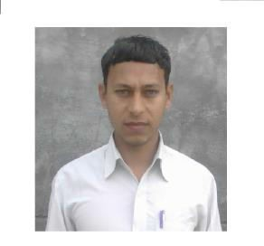
Resume
ANIL KUMAR
Village Post Tehsil
– Paigambarpur
-- Satawara
-- Debai
Pin Code -202392
Distt. Mob. Email
-- Bulandsahar (U.P.)
-- 08954537801
-- rishvaanil@gmail.com
CAREER OBJECTIVE:
I believe in sincerity, perfectionism and above all positive thinking, I value the job, which would give me an opportunity to apply my knowledge and provide me with an environment that stimulates learning.
PROFESSIONAL QUALIFICATION:
Bachelor of Technology in Mechanical Engineering with 60% marks (2014) from Uttar Pradesh Technical University, Lucknow
ACADEMIC QUALIFICATION:
High School (10th) from U.P Board, year 2006 with 62% marks.
Intermediate (12th) from U.P Board, year 2010 with 60% marks.
PROJECT TITLE:
Project: Analysis of automatic transmission
TECHNICAL SKILLS:
Auto CAD
Summer training :
Machines: Lathes, Drill, Press, Grinder, Milling, Planing, Heat treatment. CNC Machines
EXPERIENCE:
Fresher
PERSONAL INFORMATION:
Father’s Name
Mother’s Name
Date of Birth
Nationality
Religion
Sex
Marital Status
:
:
:
:
:
:
:
Mr. Uday vir singh Mrs. Shri Devi 15/05/1989
Indian Hindu Male married
DECLARATION:
I hereby declare that above mentioned information is correct and true to the best of my knowledge
Dated
(Anil Kumar)

