Slide 1
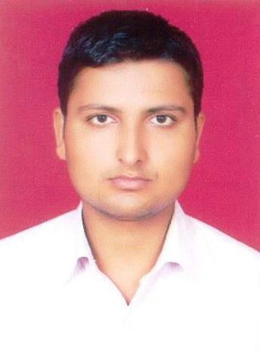
RESUME
RAJAN KUMAR MISHRA
Contact: +91 7503301204;
Email: rajanm937@gmail.com
OBJECTIVE:
I want to be a part of your professional successful team as a team member where I can leverage my potentials and contribute my qualification & skills towards the optimization of the organization goals.
TRAINING AND PROJECT
Training:-
Vocational Summer training in BHEL Heavy Equipment Repair Plant Varanasi From 25/06/2013 to 26/07/2013
Project- “Hexalagged All Terrain Multipurpose Robotic Concept Car”
EDUCATIONAL ATTAINMENT
Professional:-
69.74% in B.Tech Mechanical Engineering from U.P.T.U. Lucknow in session 2010-2014.
Academic:-
CLASS | YEAR | PERCENTAGE | BOARD/UNIVERSITY | DIVISION
Xth | 2006 | 65.67 | UP Board | Ist
XIIth | 2008 | 58.8 | UP Board | IInd

Slide 2
Technical Skills
[Auto CAD]
Fundamental Knowledge in Computer.
ABOUT ME
Good at human relations, good decision maker, ability to hard work , good team player. Self motivated enthusiastic to learn, posses effective and outstanding communication skills.
I have positive thinking against the problem solving and good interpersonal skills. Willingness to take up the challenging works.
HOBBIES
Net surfing, reading ,travelling
Cricket
PERSONAL DATA
NAME | Rajan Kumar Mishra
FATHER’S NAME | Mr. Pramod Kumar Mishra
PERMANENT ADDRESS | Vill&Post-Sikanderpur Bahraich (U.P.) 271824
NATIONALITY | INDIAN
SEX | Male
Date of Birth | 5th july 1991
MARITAL STATUS | Single
LANGUAGES KNOWN | Hindi, English
I hereby declare that above information is best of my knowledge.
Date:10/02/2015
(Rajan Kumar Mishra)

