Slide 1
DIVYANSHU BAJPAI
Correspondence address: Santi kunj moh-dubey post- Bisalpur distt - pilibhit (U.P)
Pin-262201
bajpai.divyanshu11@gmail.com
+ 91-9456861550
Objective
To get a job in a reputed organization as a mechanical engineer, where I can utilize my technical skills through self-motivation and hard work.
Academic Qualification
Graduation :
B.Tech in mechanical Engineering from UPTU (Lucknow) with 69.63%
Passed with 78.2% from U.P. Board of Education. Passed with 70.33% from U.P. Board of Education
Intermediate :
Matriculation :
Industrial Summer Training
Completed 1 month industrial training in Electric Loco Shed, Ghaziabad
1 Month [June 16, 2014- July 12, 2014]
During training, I have learned team coordination and time management.
Project
Fabrication of solar cooker working on dual energy source (solar and electric) and its performance analysis
Project Description: in this project, I will use solar energy, electric heating and concept of thermal engineering and design a solar cooker after that enhance its performance.
Technical and personal skills
Thermal science
Strong analytical and mathematical skills
Knowledge of manufacturing science
Knowledge of theory of machine
Team work
Disciplined and loyal

Slide 2
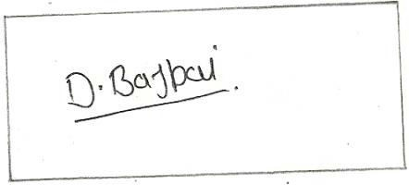
Good imagination power
Strengths
Good communication skills.(written and spoken )
Having patience
Sound sense of humor.
Curious and receptive to new learning.
Positive approach
Leadership quality
Hobbies/ Interest
Video gaming
Watching fiction movies
Extra-curricular Activities
Participated in VARIOUS SEMINARS in our college.
Industrial visit at NPCIL, NARORA(U.P.)
Get 1st prize for (as a topper) in my inter college.
Get 1st prize in one minute competition at my school level.
Participated in MECH FAIR in my college
Personal Details
Date of Birth | 8th may-1993
Blessed under | Mr. Anil Kishore bajpai & Mrs. Sushma bajpai
Permanent Address | Santi kunj moh-dubey bisalpur(pilibhit) , U.P.
Contact Number
E-mail Address
Gender
Language known
+91-9456861550
bajpai.divynshu11@gmail.com Male
Hindi and English
Dated- 19 May 2015

